Slide 1
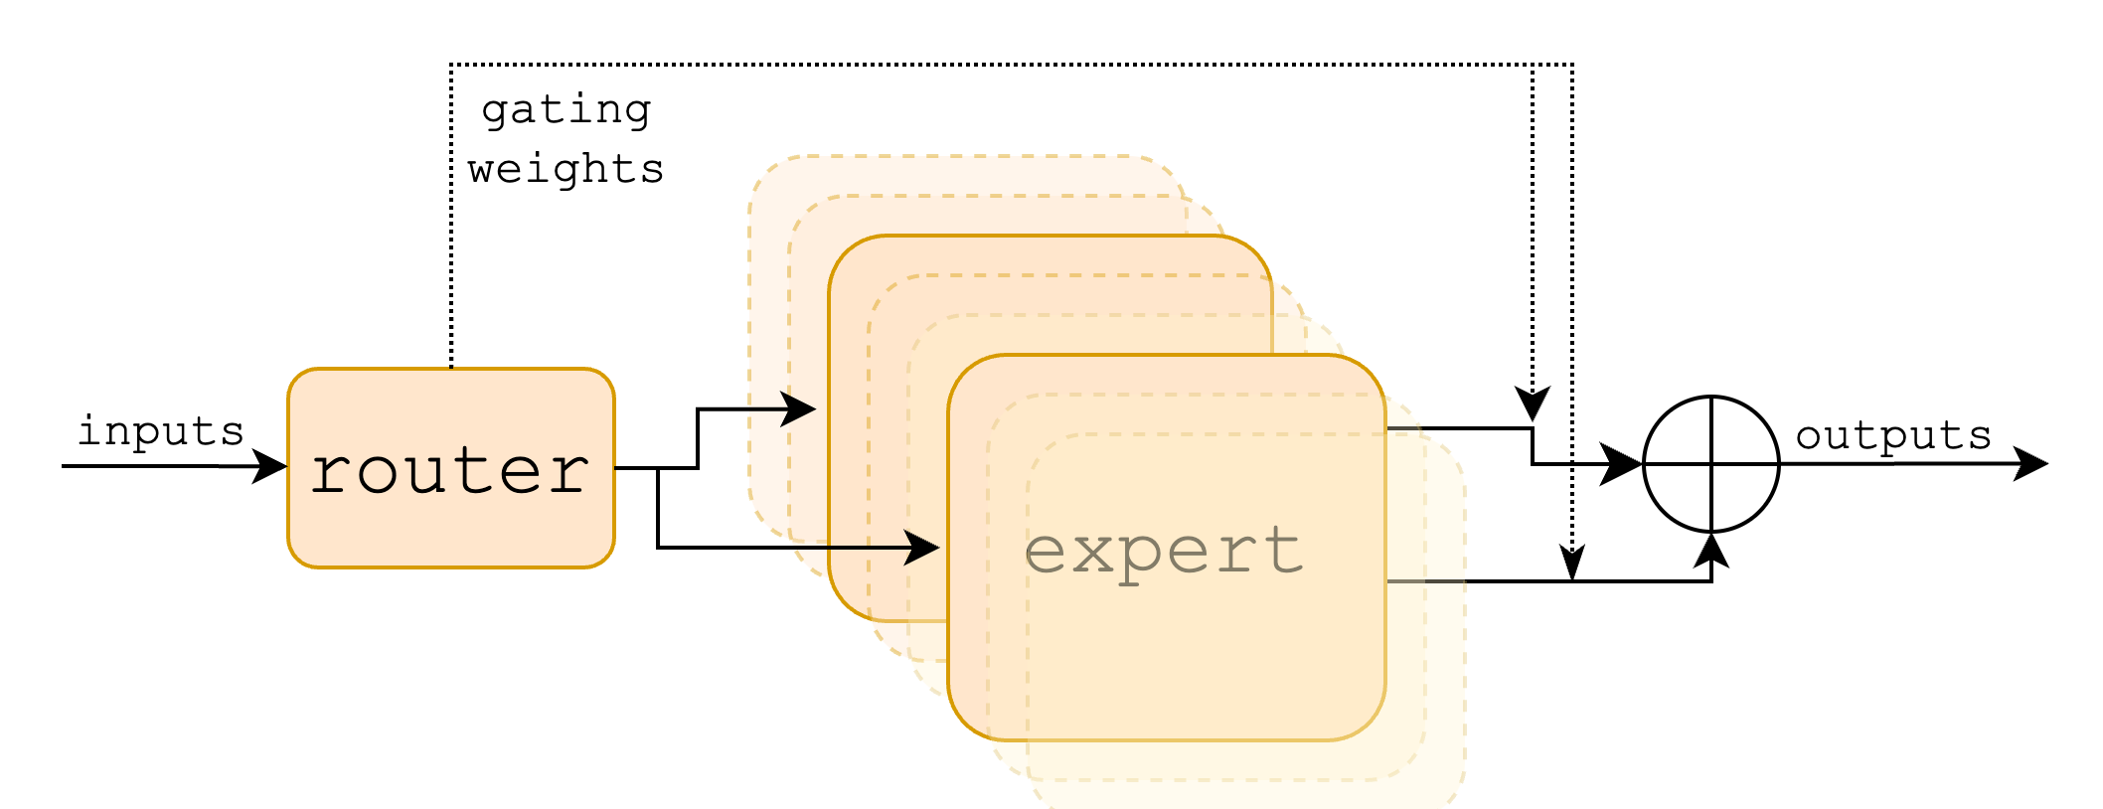
Mixtral of Experts
Mian Zhong, Zihao Zhao

Slide 2
Notes
Blackboard on explaining what is Mixtrue of experts?
Table 1 -4 and Figure 2-3 are not very interesting for discussion, just MoE is better at all tasks
Table 5: expert repetition (maybe include this)
Figure 5: long range task
Figure 8 to show routing analysis is good

Slide 3
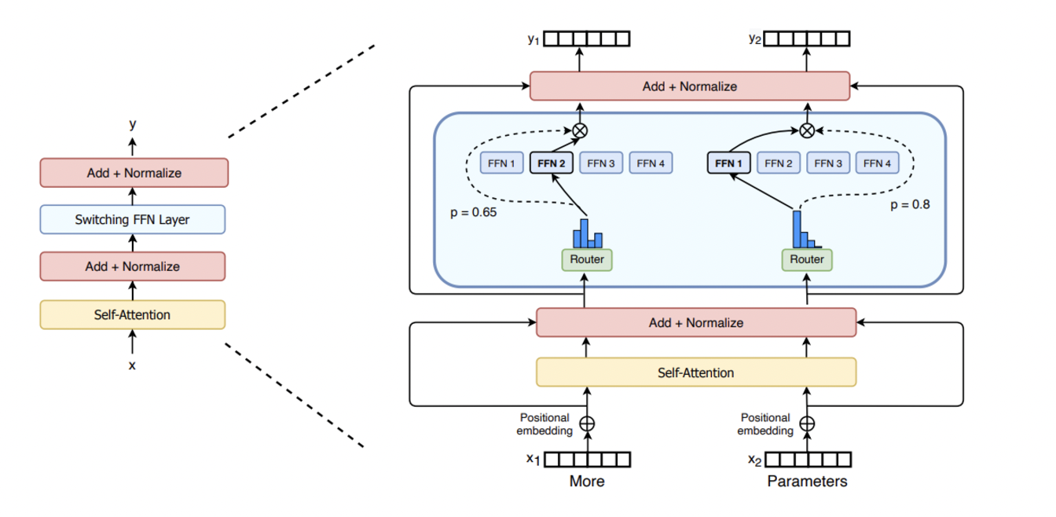
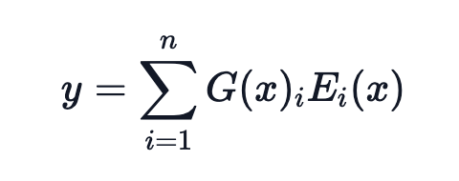
What is Sparse Mixture of Experts (MoE)?
Every FFN layer of the transformer model is replaced with an MoE layer.
MoE layers have a certain number of “experts”, where each expert is a neural network (FFN).
The router determines which tokens are sent to which expert.

Slide 4
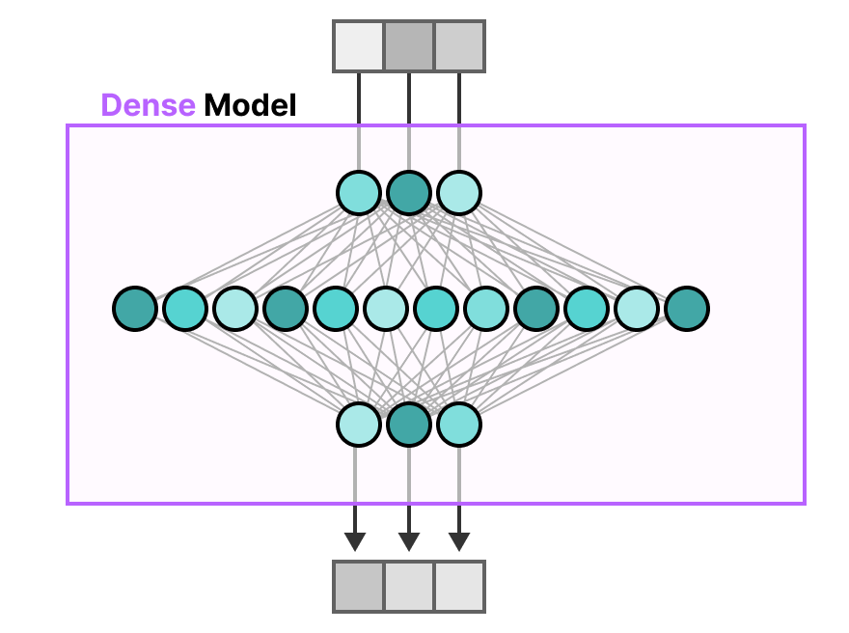
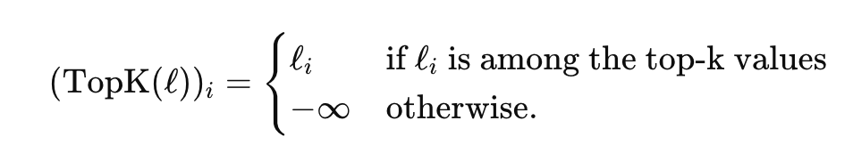
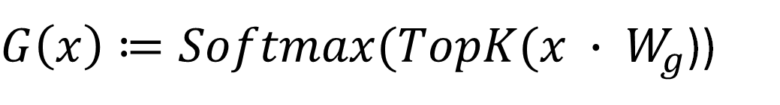
What is Sparsity?
While in dense models all the parameters are used for all the inputs, sparsity allows us to only run some parts of the whole system.
Wg: learned parameter matrix
$G\left(x\right)≔Softmax(TopK(x ∙ W_{g}$))

Slide 5
Expert initialization
(1) All experts are initialized identically using a common initialization scheme
(2) Train each expert independently on its assigned data or task
(3) Sparse Upcycling Initialization:
Start with a dense model pre-trained on a general task.
"Split" the dense model's parameters into multiple experts, assigning a subset of the dense model's parameters to each expert.
Fine-tune the sparse MoE model on the downstream task.

Slide 6
Advantages of MoE
Efficient Training: Only the active experts (e.g., Top-k) contribute to each computation, saving memory and computation time.
Lower computational cost during training and inference
Different experts can specialize in handling specific patterns, tasks, or domains in the data. This improves the model's ability to generalize and perform well across a wide variety of inputs.

Slide 7
Limitations of MoE
All parameters need to be loaded in RAM, so memory requirements are high. For example, given a MoE like Mixtral 8x7B, we’ll need to have enough VRAM to hold a dense 47B parameter model.
Some experts might be over-utilized while others remain under-utilized, leading to inefficient use of resources.

Slide 8
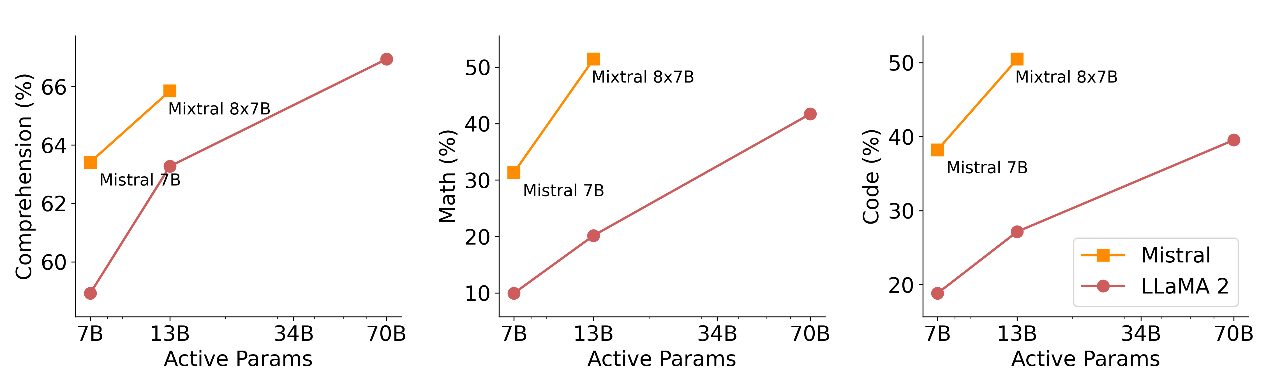
Mixtral of Experts (Mistral.AI)
Long context window: 32k tokens
> Llama 2 70B with 6x faster inference
Math/Code Generation 👍 Multilingual (upsampling pre-train) 👍 Less bias 👍

Slide 9
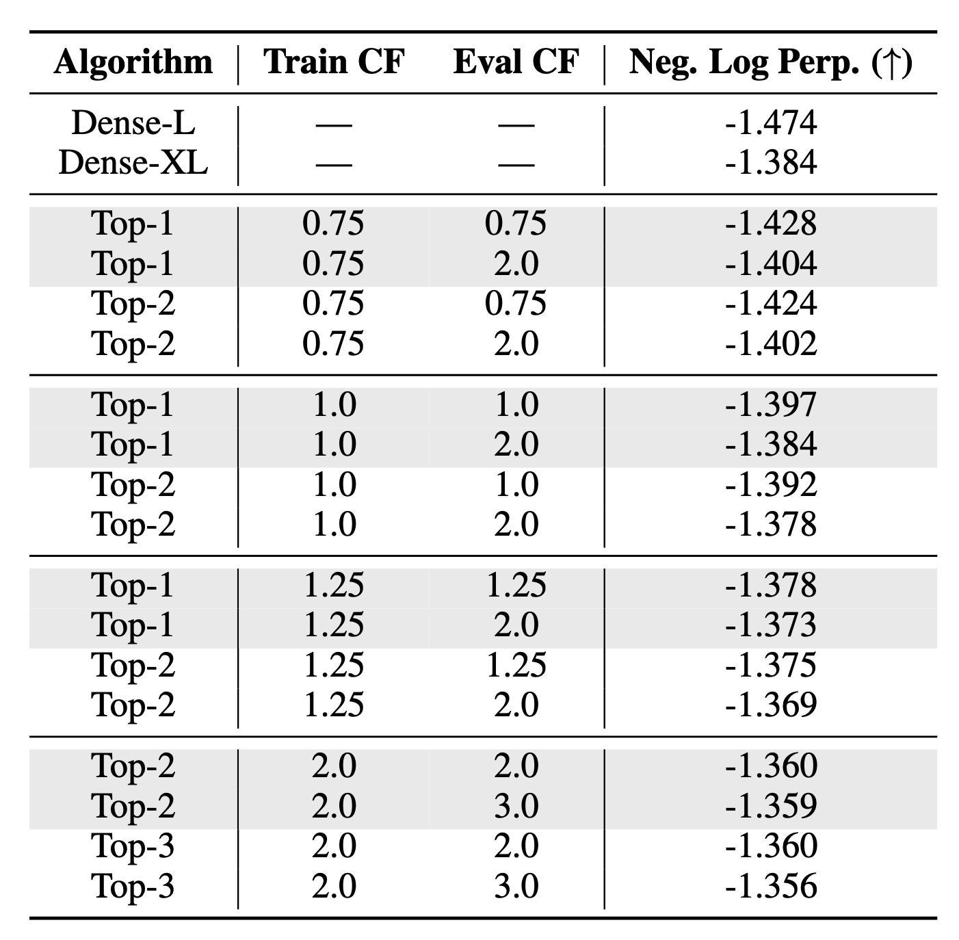
Design Choice
More experts, same computation, more memory transfer
Why Top-2 routing?
Capacity Factor: expand/contract “tokens per expert”
Likely the best hardware-software optimization for Mixtral
Notes:
So Mixtral model achieved SOTA by then. Now we want to bring up some results other than accuracy to hopefully spark some discussion later
First, how is the architecture design choice made? The Mixtral paper did not include details, and we referred to the additional reading: Designing Stable and Transferable Sparse Expert Models
How many experts do we need? Empirically > 256 experts result in a little gain of performance
Why top-2 routing?
We need to introduce capacity factor which is an coefficient to control how many tokens per expert

Slide 10
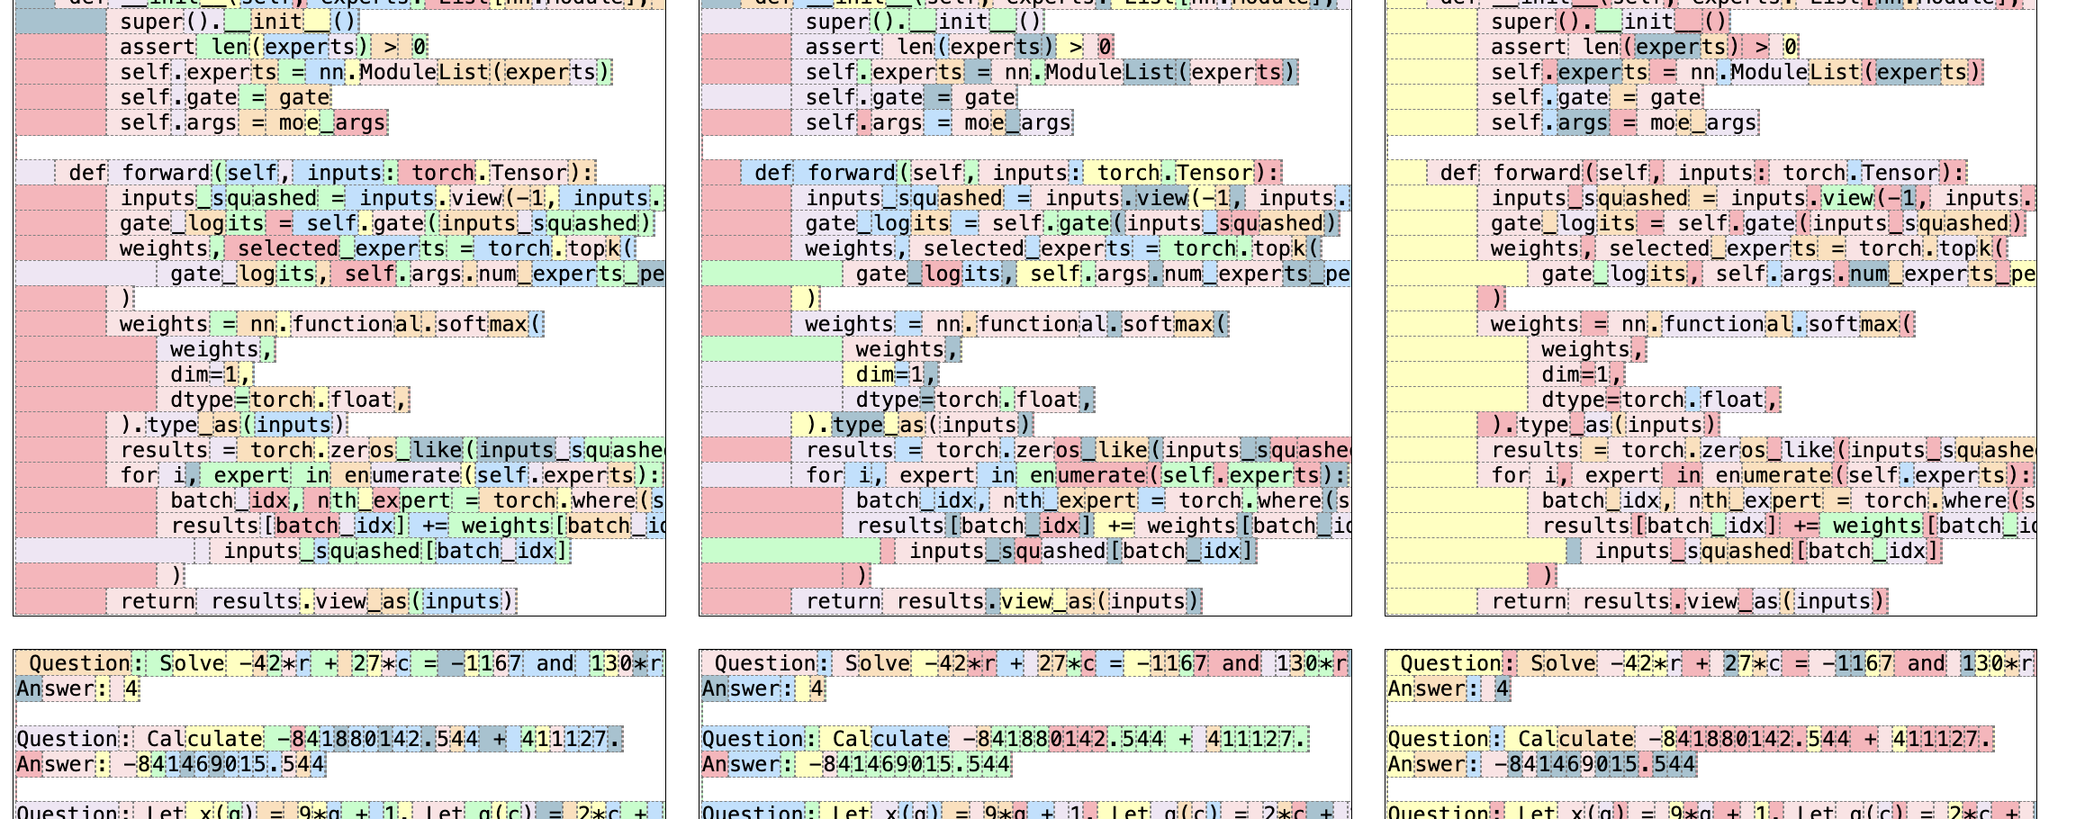
What are experts specialized in? 😮 Syntax, not domains.
Notes:
Another question we might be interested about the experts is, what are the experts specialized in?
During training, the authors hypothesized that the selection of experts is based on domains, like math, biology or coding…

Slide 11
More on experts specialization
Encoder-decoder model ST-MoE pretrained on C4
More obvious at encoder
An expert on mask tokens
Far less noticeable in the decoder
Multilingual experts are not by languages
Routers pass indiscriminately -> all experts are encouraged to handle all languages
Notes:
Again, this is some observations from the design paper.

Slide 12
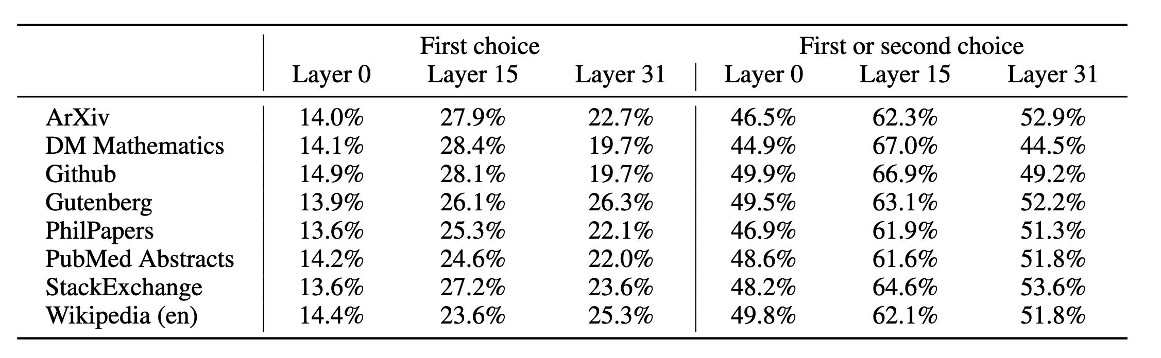
Repeated Experts
The proportion of two consecutive tokens get the same expert
Notes:
Lastly, we want to

Slide 13
Repeated Experts

