Slide 1
Does inference-time reasoning lead to more creative problem-solving?
How Alignment Shrinks the Generative Horizon
Roll the dice & look before you leap: Going beyond the creative limits of next-token prediction
Tom and Matt
Notes:
Tip: If you want to update this template with your division or center logo, navigate to View > Slide Master and edit the template from there.

Slide 2

How Alignment Shrinks the Generative Horizon
https://arxiv.org/abs/2506.17871

Slide 3
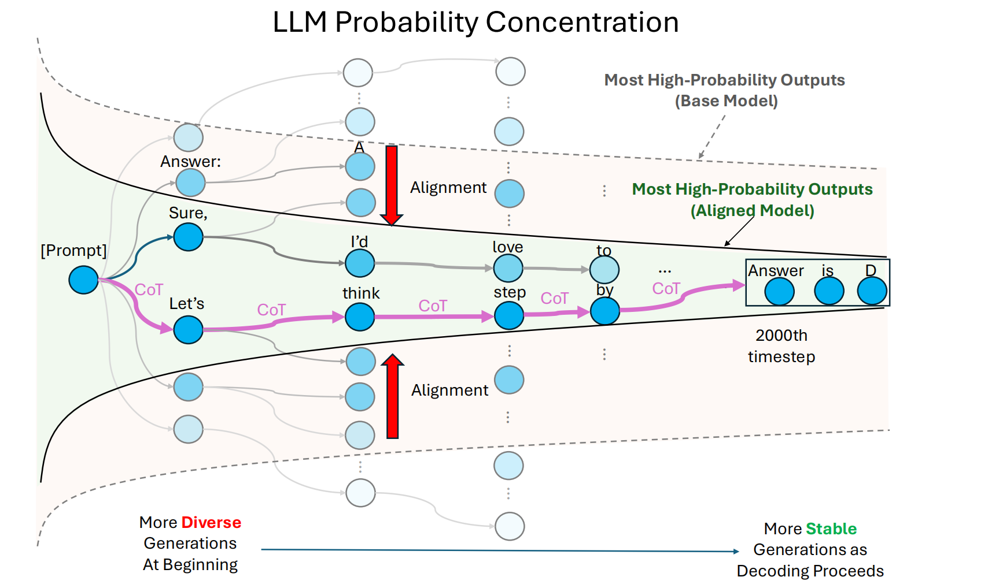
Big Picture
Notes:
Alignment as p[runing, callback

Slide 4
Some quick Math to set the stage

Slide 5
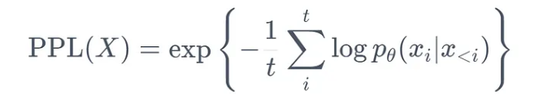
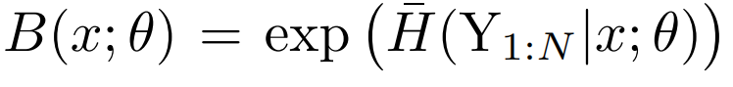


Branching Factor
Measuring the output diversity of the model.
Avg Conditional entropy:
Prefix-level Entropy: (expected entropy of the last token
Token-level Entropy:
Questions: What’s the different with perplexity? When are they (approx.) equal?

Slide 6
How to estimate BF?
Short outputs? Long outputs?

Slide 7
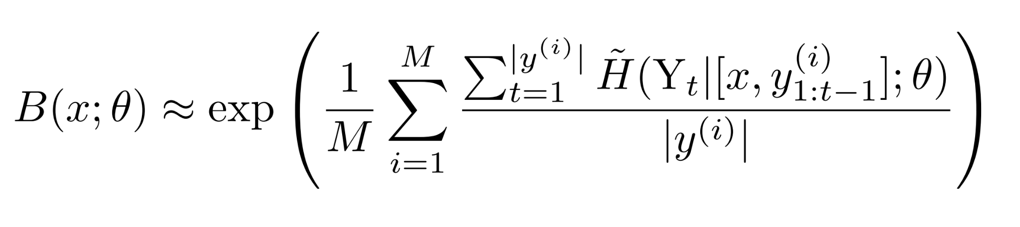
Branching Factor - Estimation
Short outputs: MC sampling
For short outputs, where it’s tractable to sample sufficiently many sequences to closely estimate the conditional entropy at each position, we can estimate the BF by computing the conditional entropy at each position and then aggregating as:
Entropy
Per token
Sentence length
M samples

Slide 8
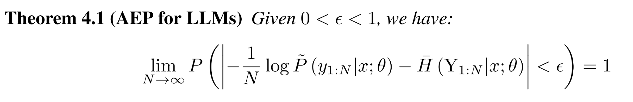
Branching Factor - Estimation
What about long output - (Weak) Law of large number to the rescue.
When LLMs generate sufficiently long outputs, the average log-probability of each output sequence will be roughly the same, and can approximate average output entropy well, following the Asymptotic Equipartition Property (AEP)
Avg Conditional entropy are sum of small values:
Per token entropy
Concentration Argument, convergent i.p
Want a.s. Conv aka strong LLN? => Need i.i.d. or stationary ergodic Condition, which LLM don’t give
LLM Sequence Probability (per token)

Slide 9
Experiments & Results

Slide 10
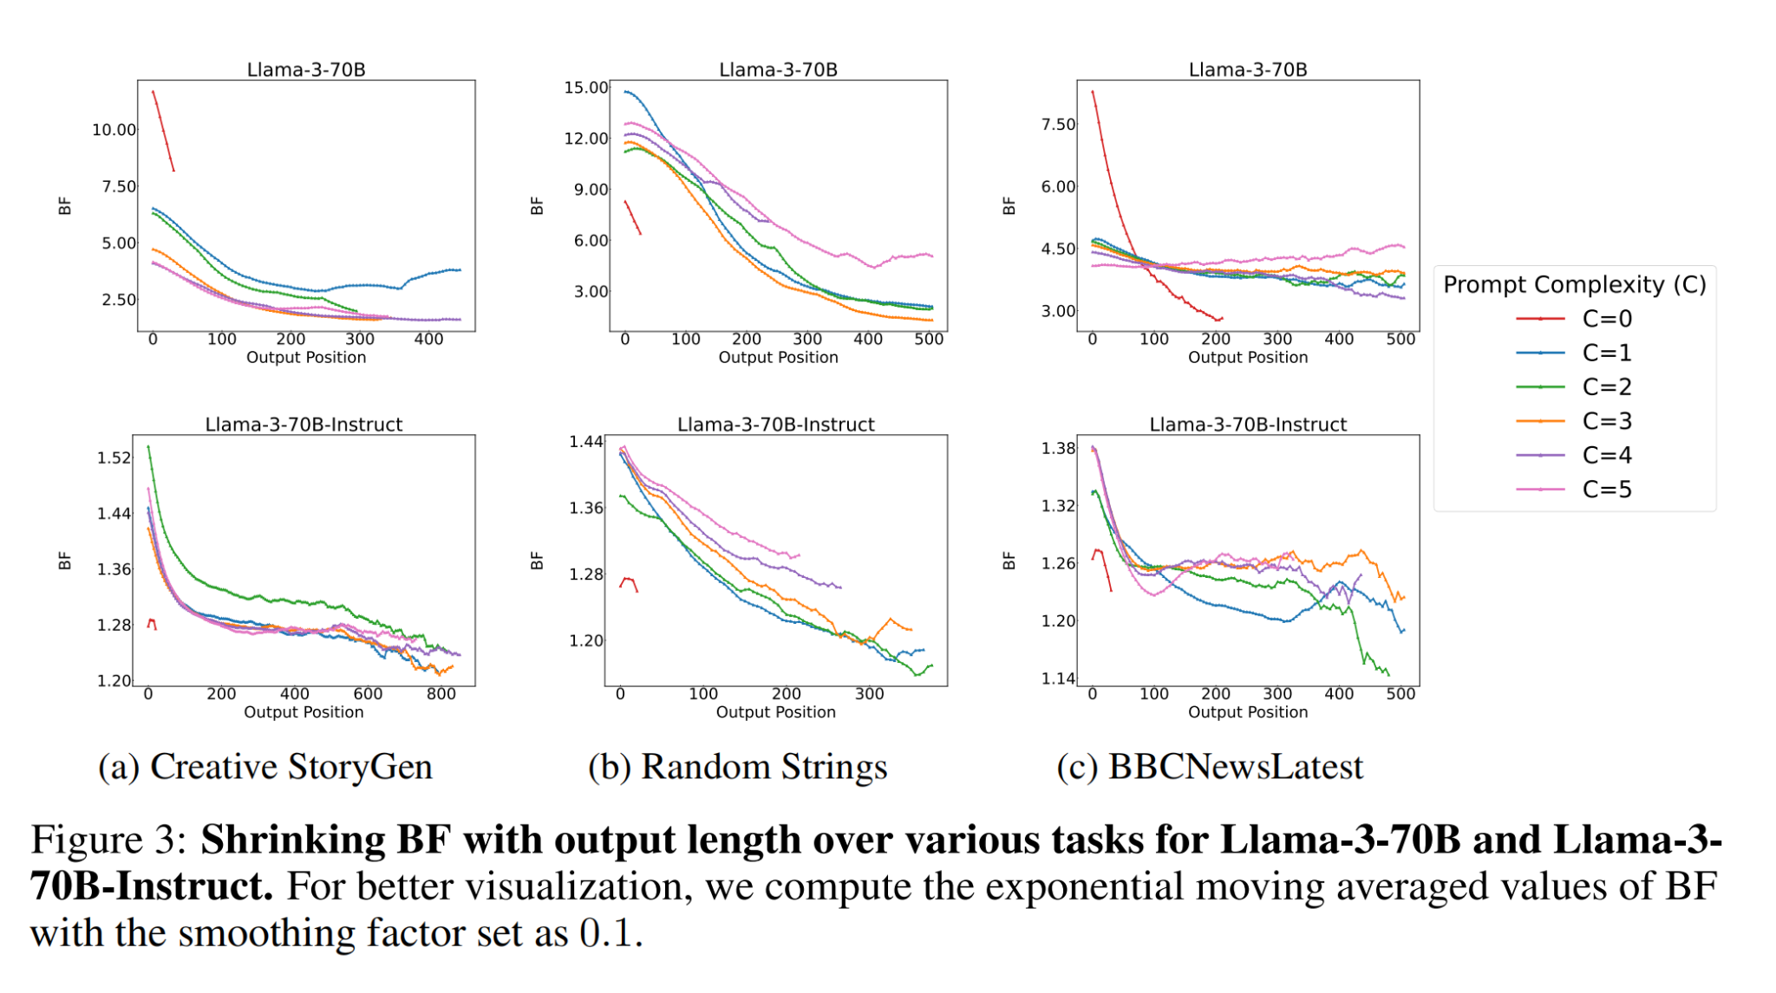
BF decrease over decoding time
C = more info/ more constraints
CoT: Push decision to later stage, where BF is low. Complexity has different effect on BF => Cognitive Overload
Notes:
Connect cognitive overload, C

Slide 11
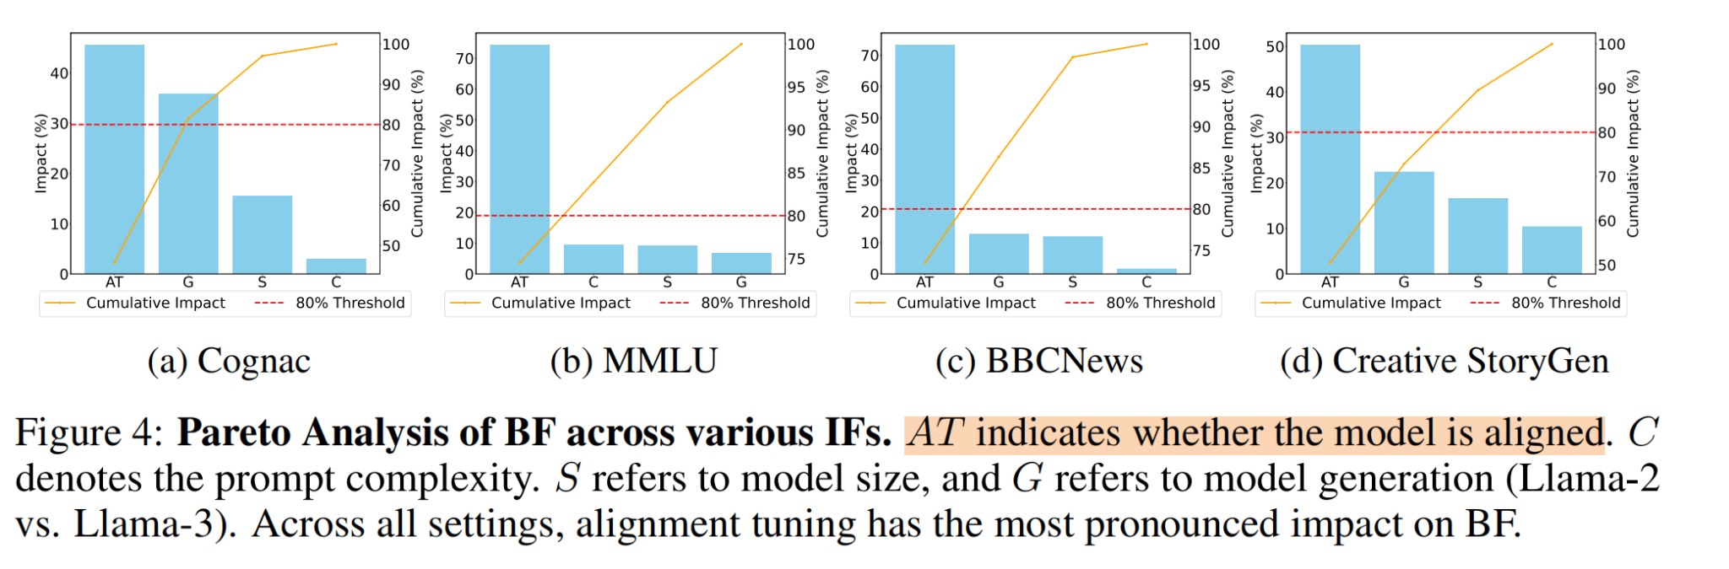
Which Factor affect BF the most
Y-axis measures sensitivity of that factor on BF.
alignment tuning is the most influential factor affecting BF
For task with richer inputs, prompt complexity C and model size M also important.

Slide 12
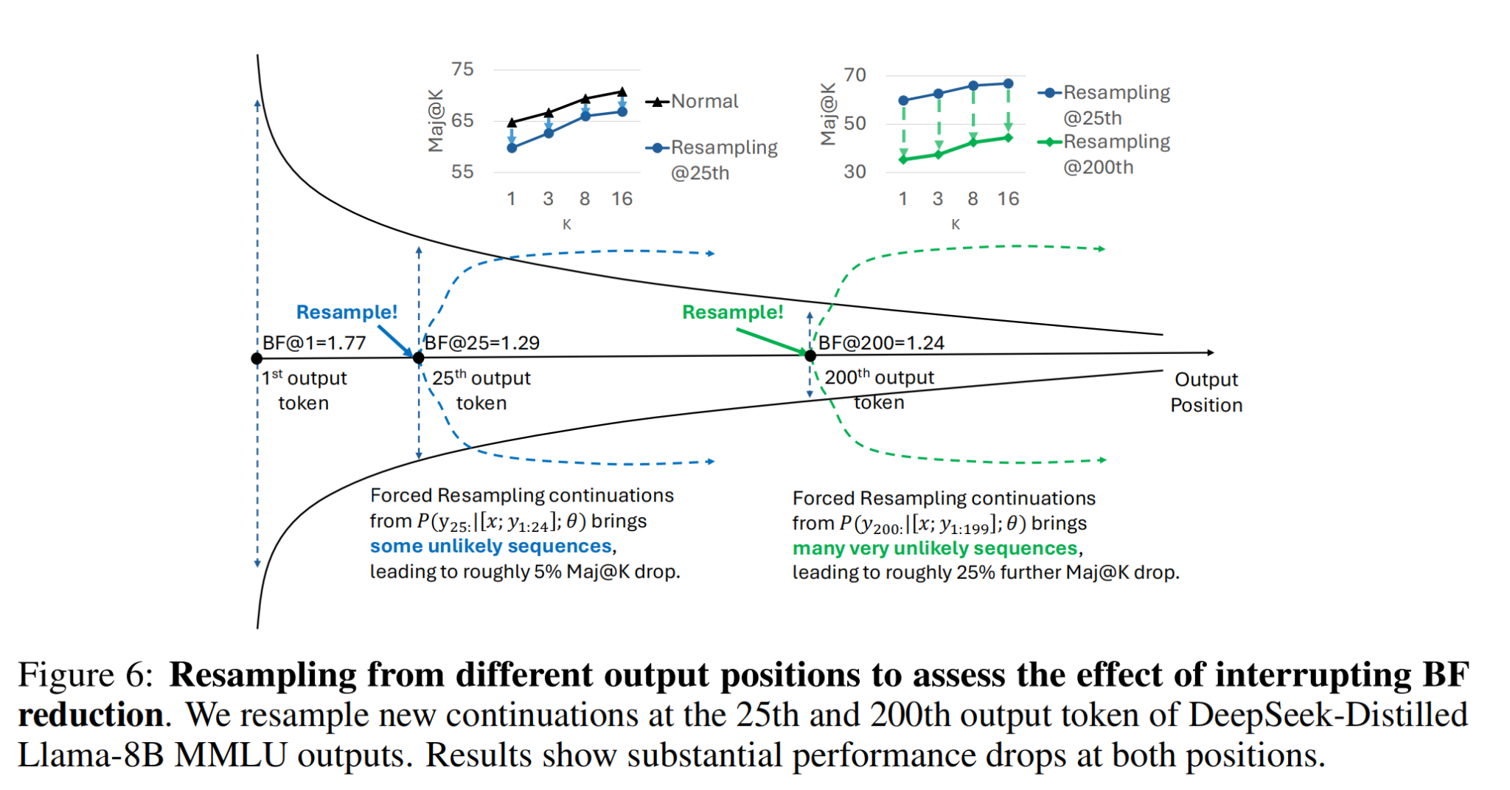
Resampling
Insight: Parallel sampling should be applied early, while BF remains high, to ensure meaningful diversity and avoid quality degradation.

Slide 13
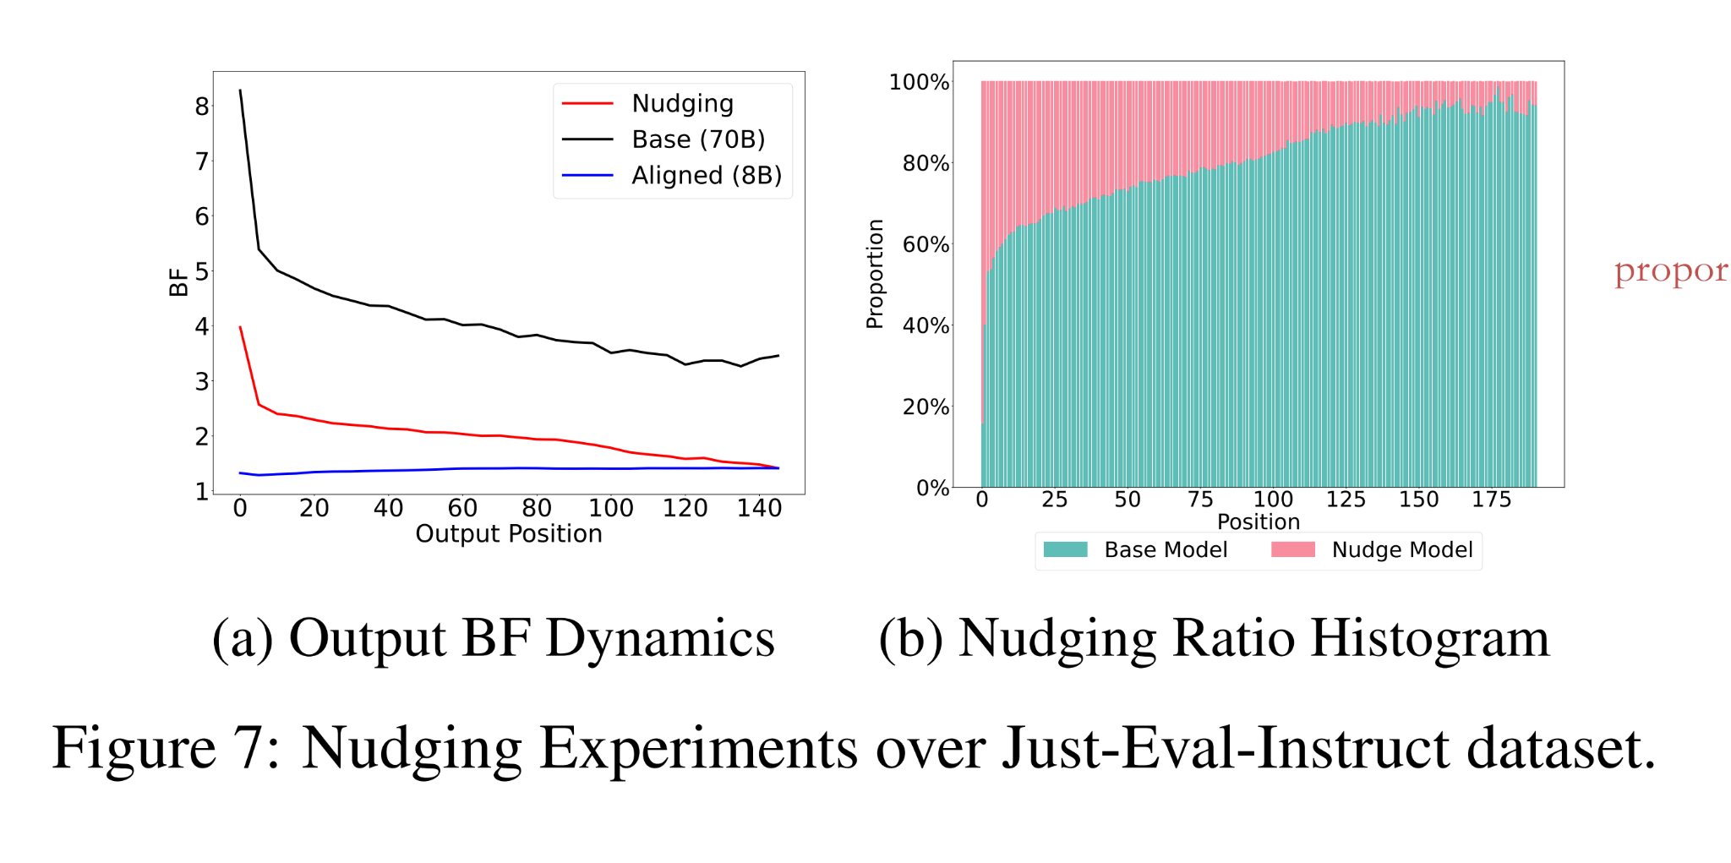
Nudging Experiment
Does base model already has the low BF, “aligned-like” paths?
Start with base model decoding, but whenever the base model’s top-1 probability is “low,” they temporarily switch to an aligned model (Llama-3-8B-Instruct) to emit a single token.
The left graph show nudging actually decrease BF => the prefix generated by the nudging model is of low probability.
Right graph show nudging happens more in earlier decoding. Base model locks in if the prefix is “nudged” (See how low BF is at position >100, while only 20% token is nudged)
Notes:
connect

Slide 14
Summary
Let’s pop out and think about what we learned!
Aligned models exhibit BF values nearly an order of magnitude lower than their base counterparts, with BF declining further during generation.
Alignment training as pruning, one major effect is stability (less creative - hold on to this…)
Helps explain Aligned model’s reduced output diversity, low sampling variance, and insensitivity to decoding strategies
Aligned CoT models due to their especially low BF, produce more stable outputs. Mid-generation resampling yields degraded performance by forcing unlikely continuations, especially for resampling later in the output.
Nudging experiments further support that alignment narrows generation by steering it toward stylistic tokens that activate low-entropy subspaces already present in the base model.
Questions: Which components of alignment tuning/ pretraining drive these effects?

Slide 15
Roll the dice & look before you leap: Going beyond the creative limits of next-token prediction
Authors: Vaishnavh Nagarajan, Chen Henry Wu, Charles Ding, Aditi Raghunathan

Slide 16
Problem Statement
Current LLM Limitations in Creative Tasks
Large Language Models (LLMs) struggle with creative generation that requires novelty, diversity, and originality beyond mere correctness.
Examples include generating challenging math problems, designing new proteins, or drawing surprising analogies.
Root cause: Standard training misaligns with the global planning required for creative outputs.

Slide 17
Key Challenges
Why Creativity is Hard for Current LLMs
Creativity is difficult to quantify objectively while maintaining coherence and avoiding training-data memorization.
Next-Token Prediction (NTP) optimizes for local likelihood but not global structure.
Output‑level randomness (temperature) can hurt coherence and cause “cognitive overload”

Slide 18
Innovation
Controlled Evaluation: Design minimal, algorithmic tasks to quantify creativity objectively
Training Alternatives: Teacherless Multi-token and diffusion methods to capture global structure beyond NTP
Input-level Randomness: Seed-conditioning with random prefixes to elicit diverse, coherent plans even with greedy decoding

Slide 19
Creativity Framework
Combinational Creativity: Creating novel connections from existing stored knowledge
Example: wordplay, analogies, and humor
Exploratory Creativity: Constructing new structures within given constraints
Example: design puzzle, word problems, and new proteins
Notes:
What kind of shoes do spies wear? Sneakers.

Slide 20
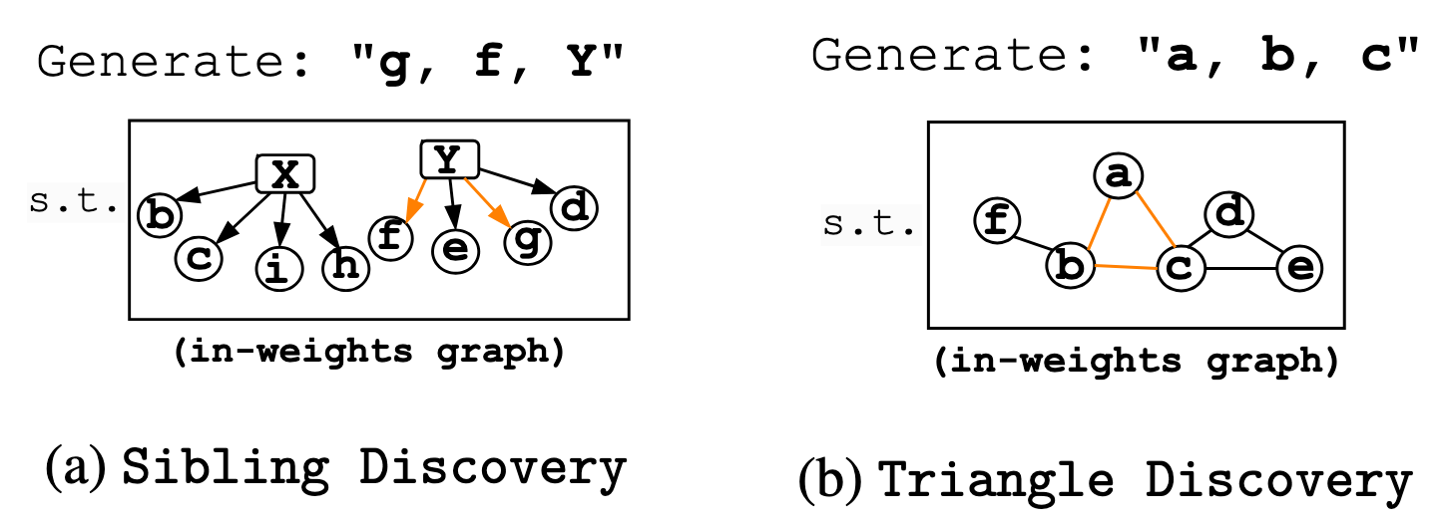
Combinational Creativity
Sibling Discovery:
Goal: Find coherent triplet (child1, child2, parent) where both children connect to the same parent in a bipartite graph
Challenge: Model must implicitly select parent first, then find siblings, but present parent last (adversarial to NTP)
Triangle Discovery:
Goal: Generate 3 nodes forming a triangle in an undirected graph
Challenge: Coordinate three edges simultaneously from memory

Slide 21
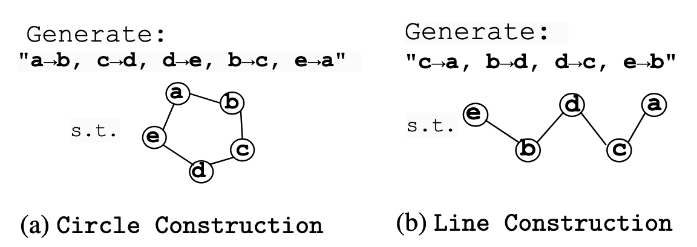
Exploratory Creativity
Circle Construction:
Goal: Generate a list of connections (an "adjacency list") between distinct nodes that, when followed, form a complete, closed loop or cycle.
Line Construction:
Goal: Similar to Circle Construction, but the generated connections must instead form a single, open path from a start node to an end node.
Creativity & Challenge: The model must produce novel and diverse arrangements of connections while ensuring global coherence (the entire structure is a valid circle or line).
Notes:
This is difficult because there's no fixed order or "privileged token" to guide the generation step-by-step.

Slide 22
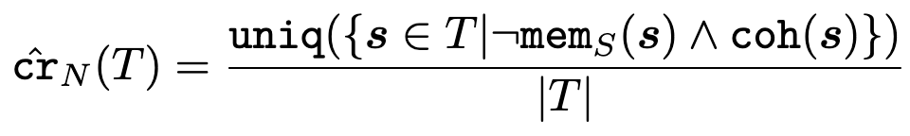
Evaluation Metric
Creativity Score = proportion of generated samples that are:
Original: not in training set
Coherent: valid under task rules
Unique: not duplicates in generation set

Slide 23
Next-Token Prediction Failures
Short-Sighted Focus: NTP's sequential "next-token" approach is too local and struggles with the overall planning and "leap of thought" required for creative tasks.
Hidden Structure Problem: NTP fails to infer deeper, non-obvious patterns where underlying thought process isn't immediately visible in the token sequence.
“Clever Hans” Cheat: NTP can exploit local shortcuts (e.g., immediately inferring a parent from siblings) rather than learning a true, global latent plan.
Data-Hungry Learning: Without a global plan, NTP resorts to learning complex, less efficient conditional distributions, requiring significantly more training data for creative tasks.
Notes:
Infer parent v.s. Pick parent first and output at last. Learn one combined v.s. Multiple seperate

Slide 24
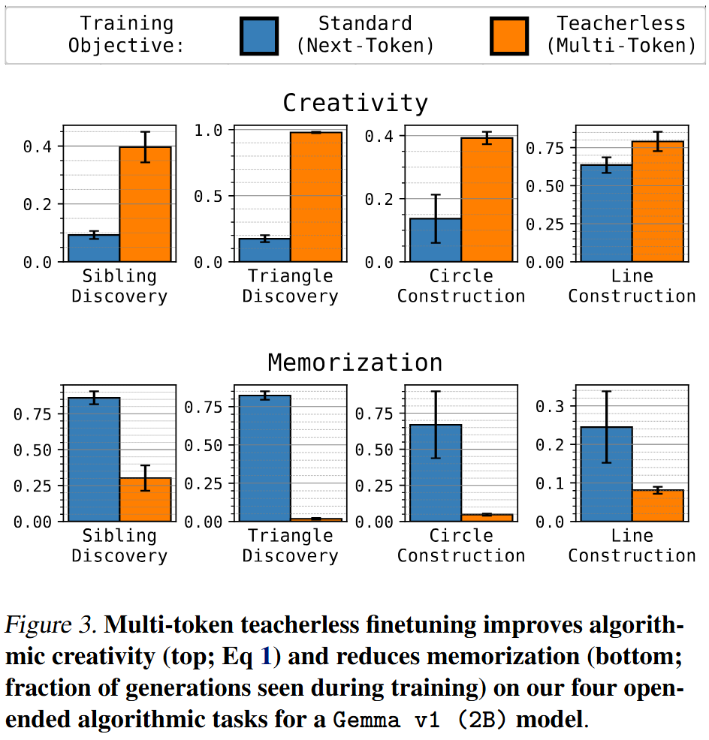
Alternative Training Paradigms
Teacherless Multi-token Training
Method: Trains the model to predict all output tokens simultaneously, given only the initial prompt and dummy placeholders instead of sequential "teacher-forced" tokens. (Inference can still be autoregressive.)
Advantage: Learns global to local mapping, closer to human planning process
Results (Gemma 2B):
Leads to significantly higher algorithmic creativity and notably lower memorization of training data across diverse tasks on large transformer.

Slide 25
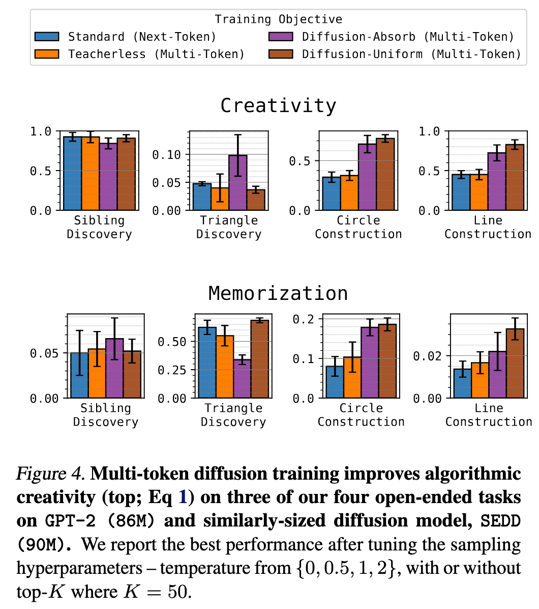
Alternative Training Paradigms
Diffusion Models
Method: Iteratively refines a corrupted input (denoising from a random state) to generate a coherent output.
Advantage: Naturally suitable for satisfying global constraints by refining the entire sequence, a good fit for creative tasks.
Results (GPT-2 v.s. SEDD):
Diffusion models show better algorithmic creativity than (NTP) Transformers on most tasks, especially exploratory tasks.
Diffusion provides the more reliable boost than teacherless training for smaller model.

Slide 26
Alternative Randomness
Seed-Conditioning
Traditional temperature sampling (output randomness) might cause "cognitive overload" by forcing the model to process multiple "thoughts" to create a diverse output distribution.
Introduce "seed-conditioning" by adding an arbitrary, random prefix to the input during both training and inference.
This input-level noise helps the model focus on developing one particular thought per seed, resulting in diverse but coherent outputs. It also works as a structured way to introduce prompt variations.

Slide 27
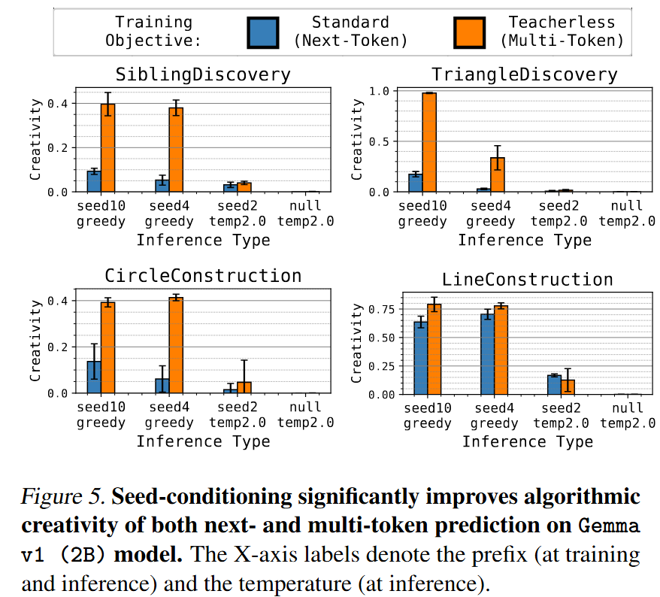
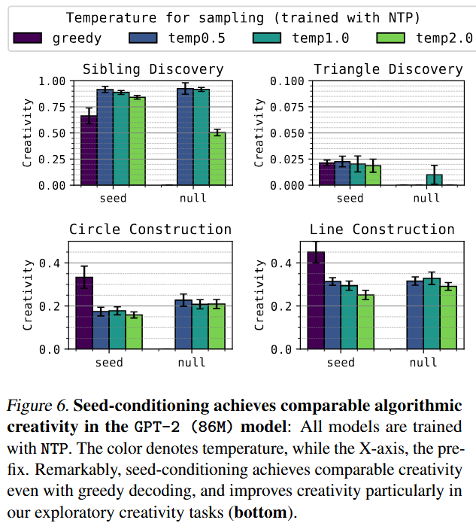
Alternative Randomness
Seed-Conditioning
Boosts algorithmic creativity in Transformers, even with greedy decoding.
Often matches or surpasses the creativity achieved by conventional temperature sampling.
Longer seed lengths generally lead to even higher algorithmic creativity.

Slide 28
Summary
NTP’s Creative Bottleneck: Standard next-token prediction limits creativity in open-ended tasks. It fails to capture global latent plans and leads to memorization.
Multi-Token Paradigm Boosts Creativity: Teacherless multi-token objectives and diffusion models achieve higher algorithmic creativity, with substantially less memorization, especially in larger models.
Seed-Conditioning Over Output Sampling: Injecting noisiness at the input via random prefixes is more effective for diversity. It competes with or outperforms output-temperature sampling, even with greedy decoding.
Limitations: 1. Tasks are simplified abstractions 2. Multi-token training is harder to optimize 3. Full understanding and generalization of seed-conditioning to real data need further research.

Slide 29
Questions
Can CoT help global planning?
Which components of alignment tuning/finetuning drive BF down? Why BF decrease over output generation?
What is the role of temperature at inference?
What is rationale behind the “random prefix”?

Slide 30
Thank You!
Notes:
Tip: There’s no need to include WWW or HTTPS in front of your URL.

