Slide 1
Infini-gram: Scaling n-gram Language Models to a Trillion Tokens
The return of n-grams

Slide 2

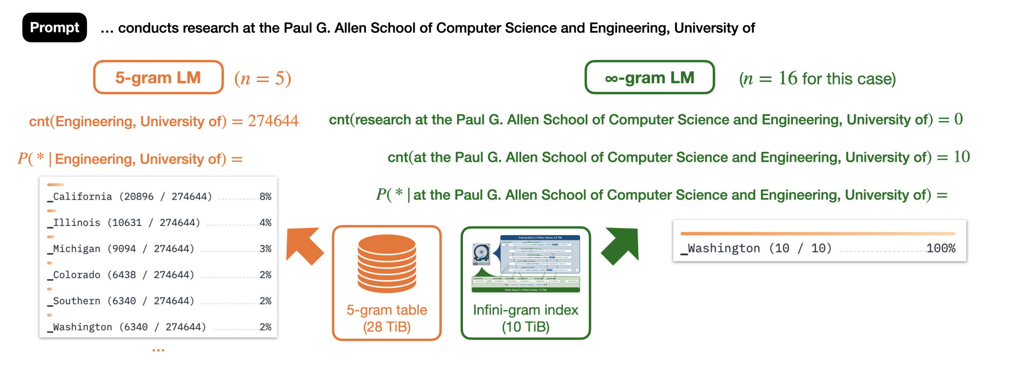
To Infinity and Beyond!
Infinitely long n-grams with backoff

Slide 3
Outline
Infini-gram and Suffix Array: definition and implementation
What is Infini-gram
What is Suffix Array? How can we derive Infini-grams from index?
Results
Comparing next-token prediction to real (human) text
Comparing to model-generated text
Interpolation with neural models

Slide 4
N-gram
Sequence of n adjacent symbols in order
1 gram: a, b, c, d
2gram: ab, cd, ee, po
3gram: abc, pow, ivo, ovq

Slide 5
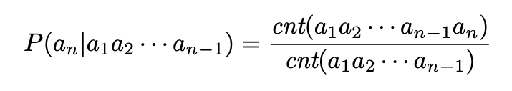
N-Gram Probability
Probability of the next token given (n-1) context
Bigram: p(a | b)
Trigram Example: p(a | po)
N-Gram Probability is used interchangeably with N-Gram
Choose the right definition according to context
In general, n-gram probability is calculated using

Slide 6
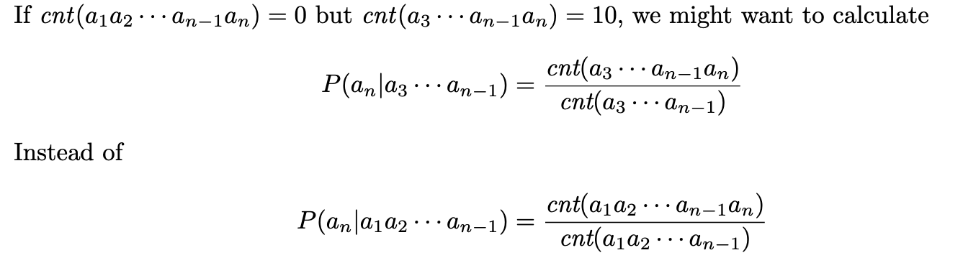
Backoff
Sometimes n-gram sequence is rare or unseen in training data
In this case, using less context might be helpful

Slide 7
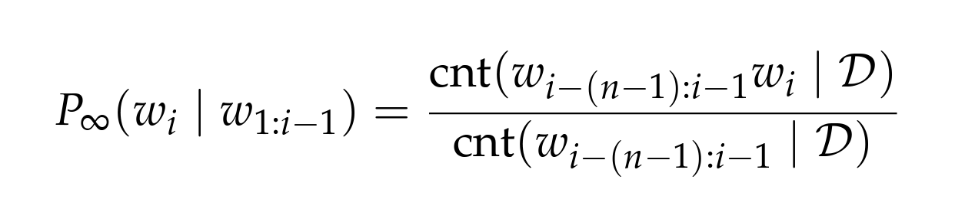


∞-Gram: definition
N-grams that are extrapolated to infinity.
Backoff when the denominator is zero
An infini-gram is sparse when for some $w_{i}$
An effective n of an infini-gram is equal to one plus the length of the prompt’s longest suffix that appears in the training data.
Given a string, n of the longest n-gram that appeared in the corpus.

Slide 8
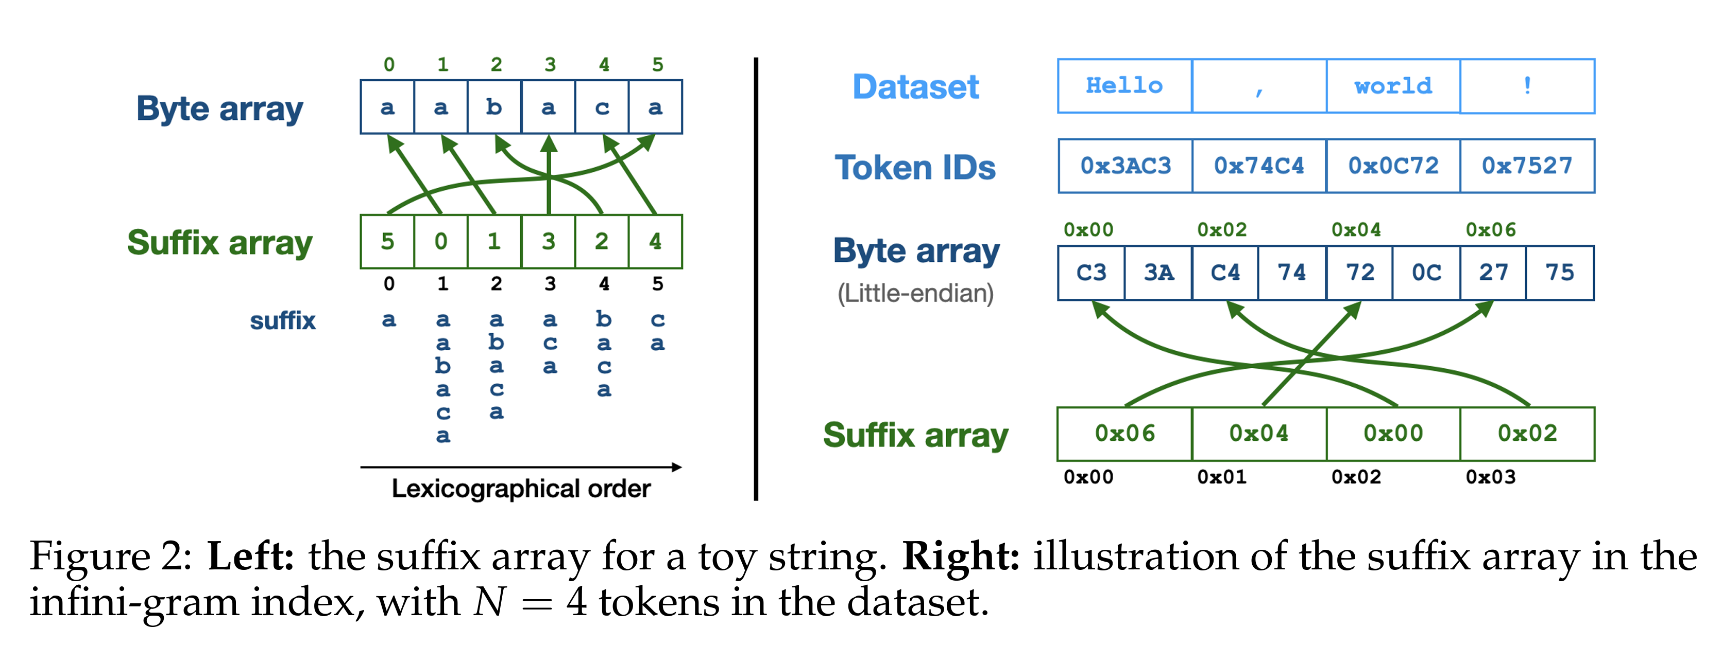
Suffix Array
A sorted list of all suffix start indices in a string

Slide 9
Suffix Array
Suffixes of “APPLE”
APPLE
PPLE
PLE
LE
E

Slide 10
Suffix Array
Suffixes of “APPLE”
APPLE
PPLE
PLE
LE
E
Alphabetical ordering
Ordered Suffixes of “APPLE”
APPLE
E
LE
PLE
PPLE

Slide 11
Suffix Array
Suffixes of “APPLE”
APPLE
PPLE
PLE
LE
E
Alphabetical ordering
Ordered Suffixes of “APPLE” (index)
APPLE [0]
E [4]
LE [3]
PLE [2]
PPLE [1]
Suffix Array: [0,4,3,2,1]
Can use binary search to find suffixes (infini-grams)

Slide 12
N-Gram Search
Ordered Suffixes of “APPLE” (index)
APPLE [0]
E [4]
LE [3]
PLE [2]
PPLE [1]
w = APPLE. w[j]: suffix after jth index
i = [0, 4, 3, 2, 1]
Want to find bigram that starts with P.

Slide 13
N-Gram Search
Ordered Suffixes of “APPLE” (index)
APPLE [0]
E [4]
LE [3]
PLE [2]
PPLE [1]
w = APPLE. w[j]: suffix after jth index i = [0, 4, 3, 2, 1]
Want to find bigram that starts with P.
Check w[i[2]] = w[3] = LE

Slide 14
N-Gram Search
Ordered Suffixes of “APPLE” (index)
APPLE [0]
E [4]
LE [3]
PLE [2]
PPLE [1]
w = APPLE. w[j] suffix after jth index
i = [0, 4, 3, 2, 1]
Want to find bigram that starts with P.
Check w[i[2]] -> w[3] = LE
LE < P, check w[i[4]]

Slide 15
N-Gram Search
Ordered Suffixes of “APPLE” (index)
APPLE [0]
E [4]
LE [3]
PLE [2]
PPLE [1]
w = APPLE. w[j] suffix after jth index
i = [0, 4, 3, 2, 1]
Want to find bigram that starts with P.
Check w[i[2]] -> w[3] = LE
LE < P, check w[i[4]]
w[I[4]] = w[1] = PPLE
PPLE > P and is the last index, search for start index if bigram that starts with p

Slide 16
N-Gram Search
Ordered Suffixes of “APPLE” (index)
APPLE [0]
E [4]
LE [3]
PLE [2]
PPLE [1]
w = APPLE. w[j] suffix after jth index
i = [0, 4, 3, 2, 1]
Want to find bigram that starts with P.
Check w[i[2]] -> w[3] = LE
LE < P, check w[i[4]]
w[I[4]] = w[1] = PPLE
PPLE > P and is the last index, search for start index if bigram that starts with p
w[i[3]] = w[2] = PLE
Thus there are two bigrams that start with P. Namly PP and PL

Slide 17

Infini-grams
… … …
index:
Want to find $p\left(B \right|MA)$
$p\left(B \right|MA)= \frac{cnt(MAB)}{cnt(MA)}$ = $\frac{c −b}{d −a}$
Values of $a,b,c,d$ can be found by binary search
AAA . . | AAB . . | A BB . .
MA . . | MAB . . | MAB . .
MAB . . | MAC . . | MAD . .
MAZ . . | MBB . . | MBC . .
a
b
c
d

Slide 18
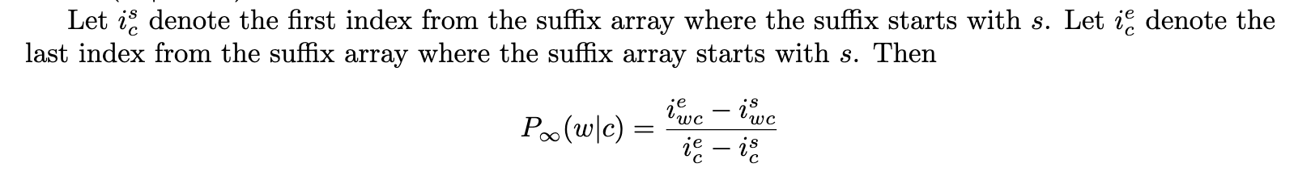
Indices can be found by binary search

Slide 19
Suffix Array is Efficient
Space efficient in O(N). ... (N: size of the corpus)
O(N log(N)) But in reality O(N)
Search Efficient in O(log(N))
Next word prediction with prob > .5 is fast
Check the .25, .5, .75 index of the n-gram
∞-grams agree with text if the next word prediction from suffix array has probability greater than .5 and matches text.

Slide 20
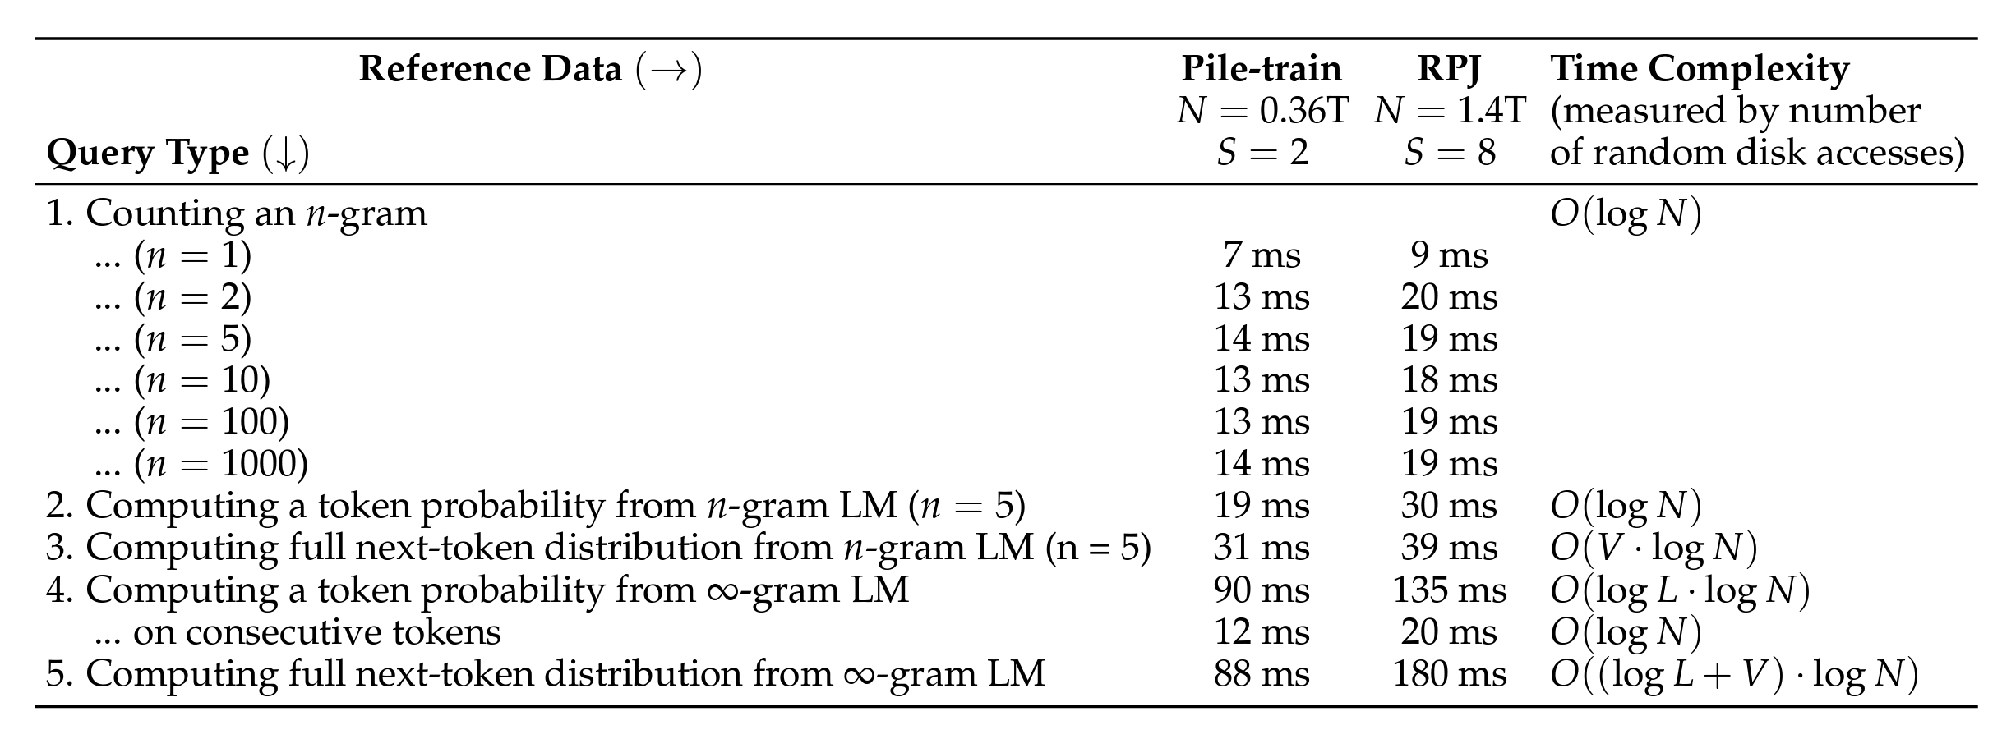
Suffix Array is (not) Efficient
Full next-token distribution calculation is slow
O(V logN) (V is size of vocab, N is size of corpus)
argmax (most possible next word prediction) is slow

Slide 21
Demo
https://huggingface.co/spaces/liujch1998/infini-gram

Slide 22
Train / Test Data
Train (Reference):
Pile-train (380B tokens)
RedPajama (1.4T tokens) for some experiments
Test:
Pile-val
Pile-test

Slide 23
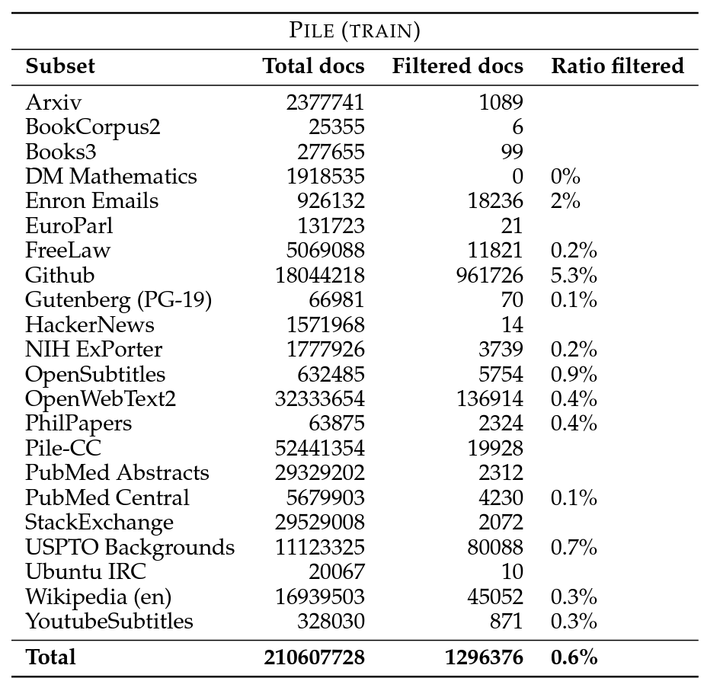
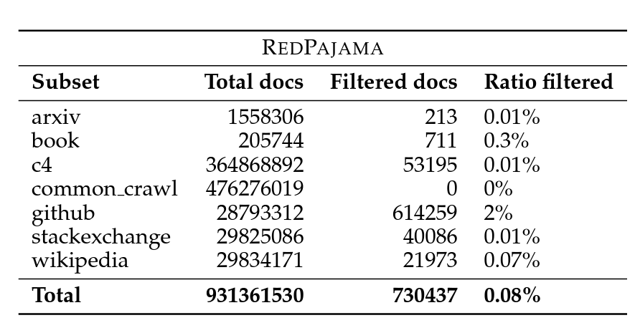
Decontamination of the Training Data
Filtering out repeated documents in training and test data
Important, because ∞-grams memorizes sparse sequences
Document-wise filter
80% 13-gram overlap

Slide 24
Results

Slide 25
Comparing with Human-Written Text: Setup
Next-token prediction
Measure token-wise agreement between the predicted token and human-written text
A prediction is deemed in-agreement if p > 0.5
Why agreement? Why not perplexity?
Because getting probabilities for every possible token is slow…
If the prediction is sparse and wrong, then perplexity = ∞
The cat sat on the ____
I have a pet ____
mat
desk
bed
⋮
(p=0.6)
(p=0.2)
(p=0.05)
⋮
✅
dog
cat
snake
⋮
(p=0.3)
(p=0.25)
(p=0.05)
⋮
❌

Slide 26
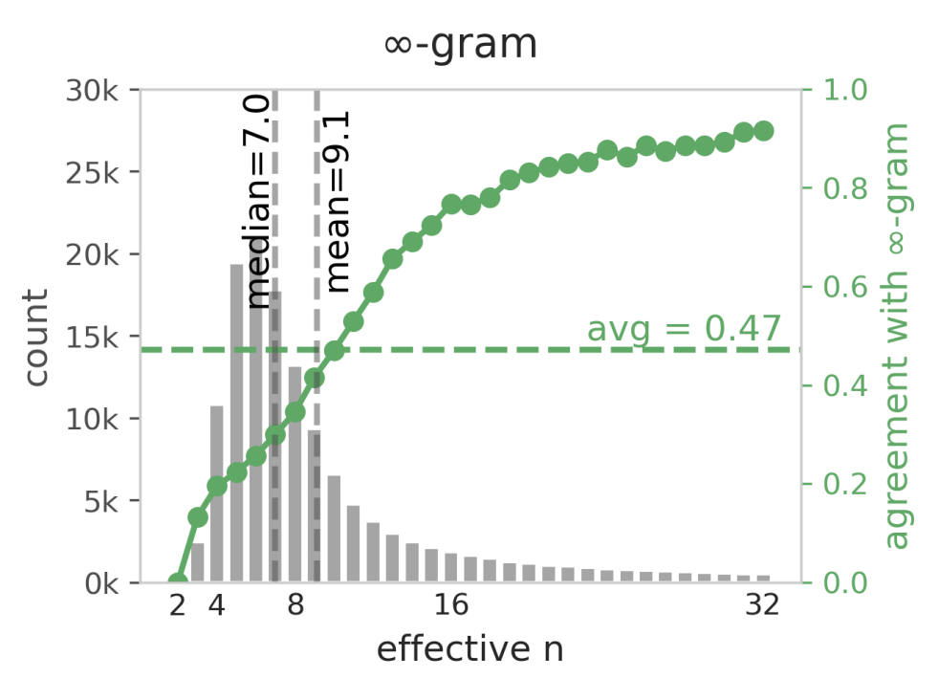
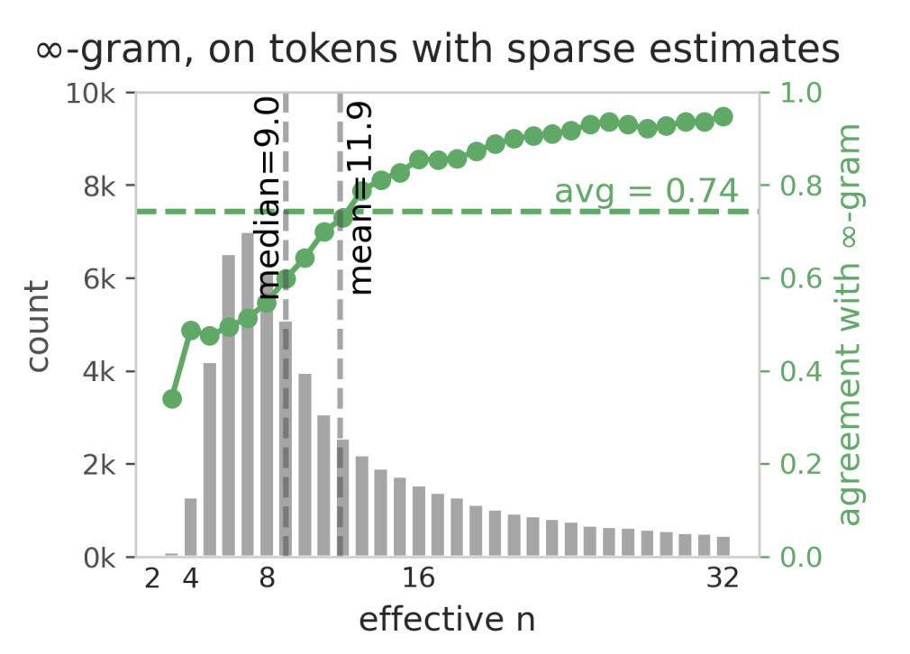
Human-Written Text: Results
47% overall agreement rate
Larger effective n = higher agreement
Effective n: the actual length of context (+1) being used in a prediction
75% agreement for n = 16
Sparse = higher agreement
75% overall sparse agreement

Slide 27
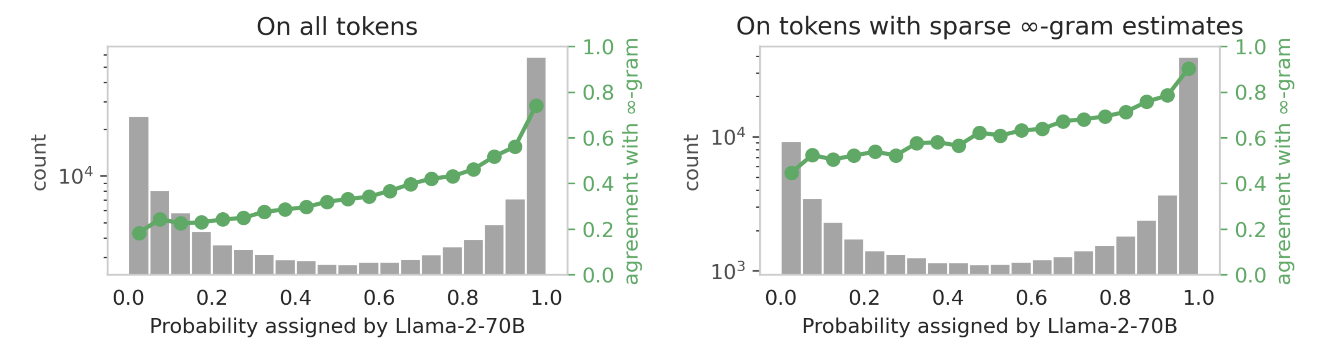
Human-Written Text: against neural LMs
“∞-grams shines where neural LMs fail”
N-gram performance is nontrivial even for tokens in which Llama performs very poorly
Notes:
For the grey part of the figures, The x-axis is the predicted probability assigned by Llama-2 70B for any given word, and the y axis is the number of all words per probability bin in the Llama prediction. The green curve shows the agreement level between the infinigram model and the real text per bin (given by the y axis on the right of the graphs). For a significant portion of real tokens, Llama 2 assigned very low probabilities; and infini-gram shows non-trivial agreement levels even for these tokens.

Slide 28
Comparing with Machine-Generated Text: Setup
Generate a sequence with a model, then test for agreement with ∞-grams next-token prediction

Slide 29
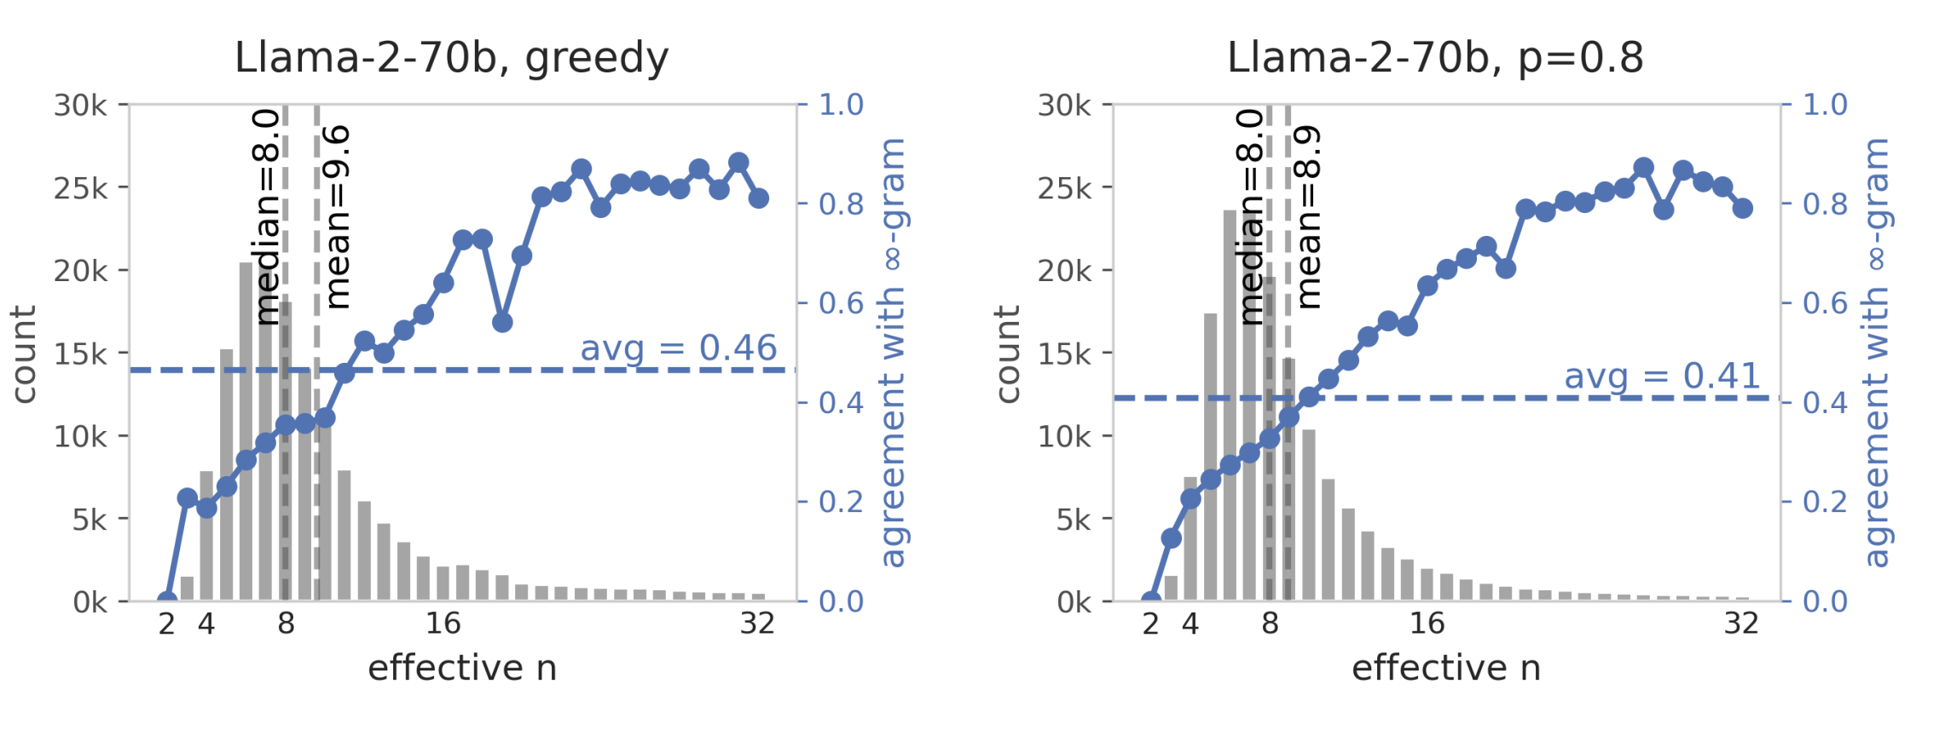
Machine-Generated Text: Results
Impact of decoding methods
Greedy: most agreement
Nucleus (top-p): most similar distribution to ∞-grams vs. human-written text
(Human)

Slide 30
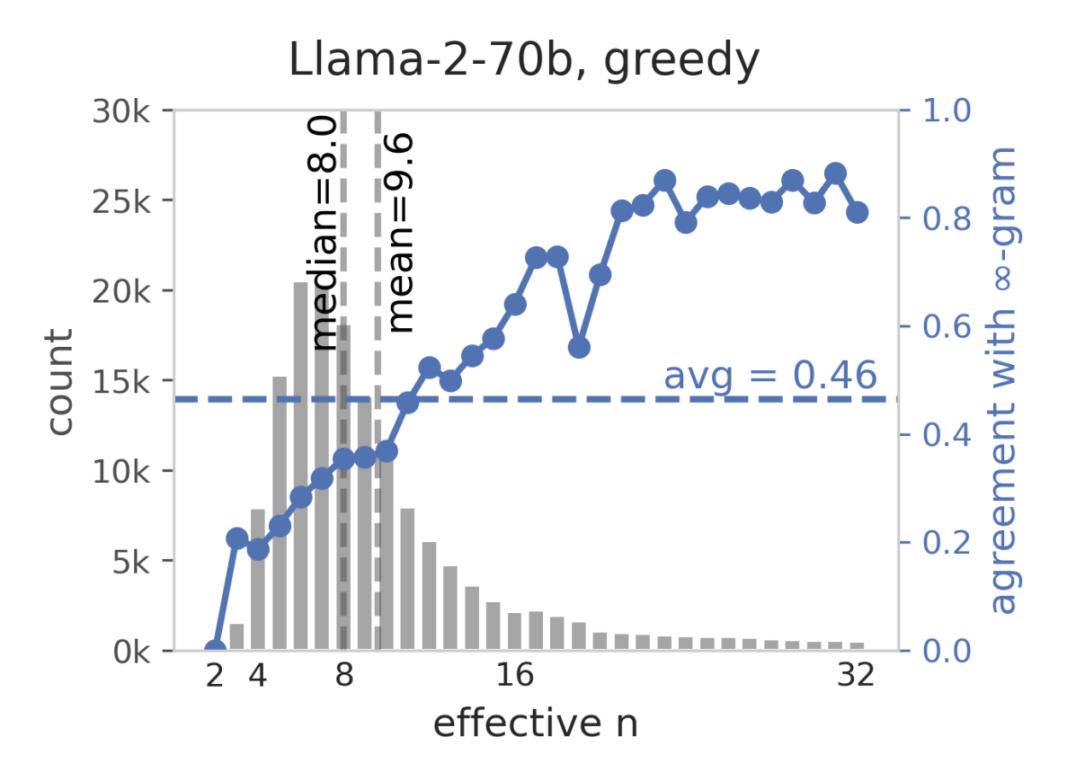
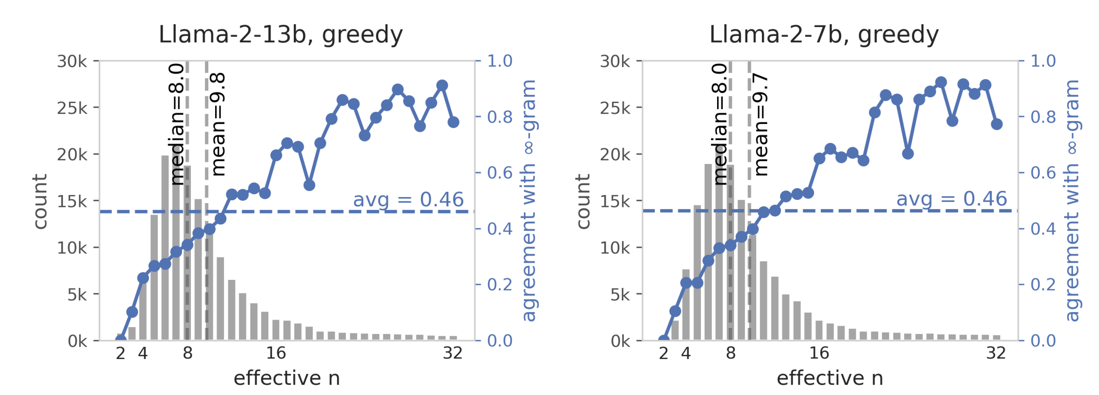
Machine-Generated Text: Results
Impact of model size
Claim: increasing model size increases agreement level and slightly increases effective-n
What does effective-n mean?
Higher effective-n = the generator is more likely to copy verbatim from the training data (if the training and reference data overlap)

Slide 31
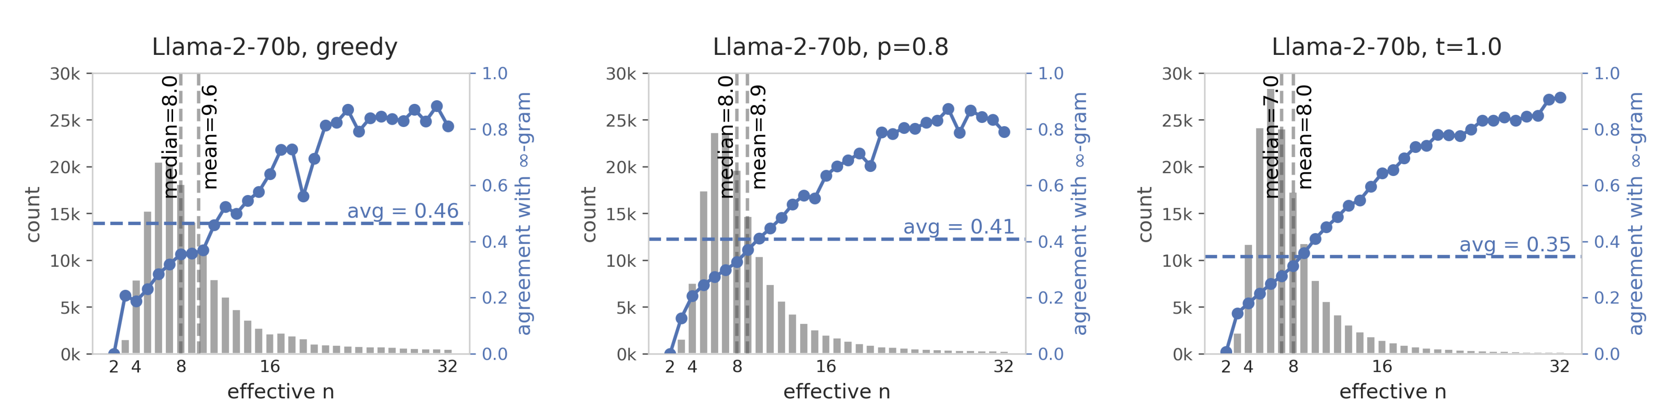
Machine-Generated Text: Results
Curious phenomenon:
For greedy decoding, agreement level fluctuates as effective-n increases
Not for nucleus or temperature sampling
Suspected reason: have something to do with positional embeddings

Slide 32

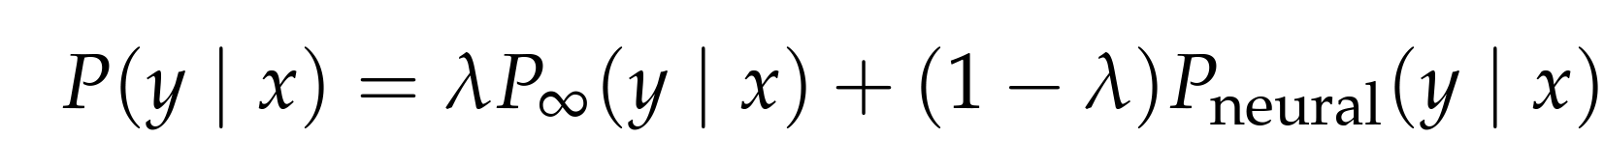
Can this help LLMs?
Interpolate the probability of the infini-grams and neural network
Different lambda values for sparse infinigrams
Lambda values optimized on Pile-val
1
1
if P∞(y_{i}|x) = 1 (sparse)
2
2
if 0 < P∞(y_{i}|x) < 1 (non-sparse)

Slide 33
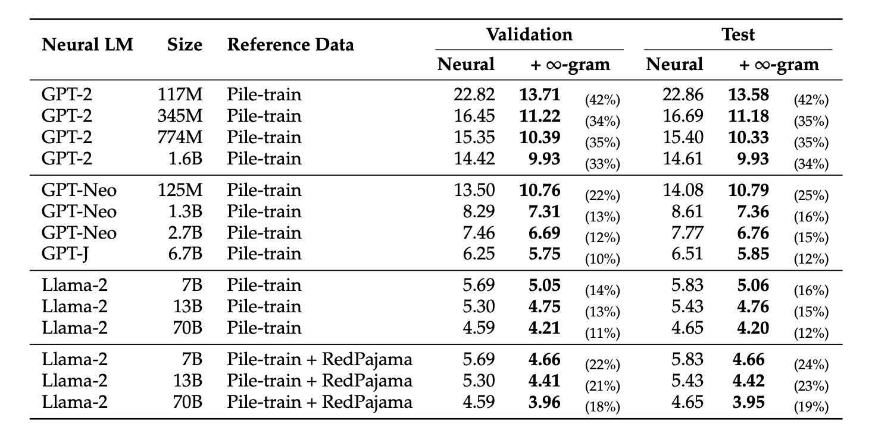

Interpolating with neural LMs: Results
Significant improvements on perplexity
11% to 42%

Slide 34

Interpolating with neural LMs: Results
Smaller LMs = more improvement (for models in the same family)
Does not hold across families, some models are already trained on Pile

Slide 35



Interpolating with neural LMs: Results
More reference context helps

Slide 36
Text generation
Might harm generation, because the infinigram model may predict completely irrelevant tokens and make the model digress.
Notes:
As the paper suggests, We do think that this is

Slide 37
Questions
Isn’t this just memorization?
(Isn’t neural LMs also just memorization of probabilistic distributions of a language?)
Loss on infinigrams alone?
We can use backoff + smoothing to estimate perplexity.

