Slide 1
Reconstructing the pressure field around an undulating body using physics-informed neural networks: a tutorial
Michael Calicchia

Slide 2
MATLAB GUI (PINN_Input.mlapp)
Michael Calicchia

Slide 3
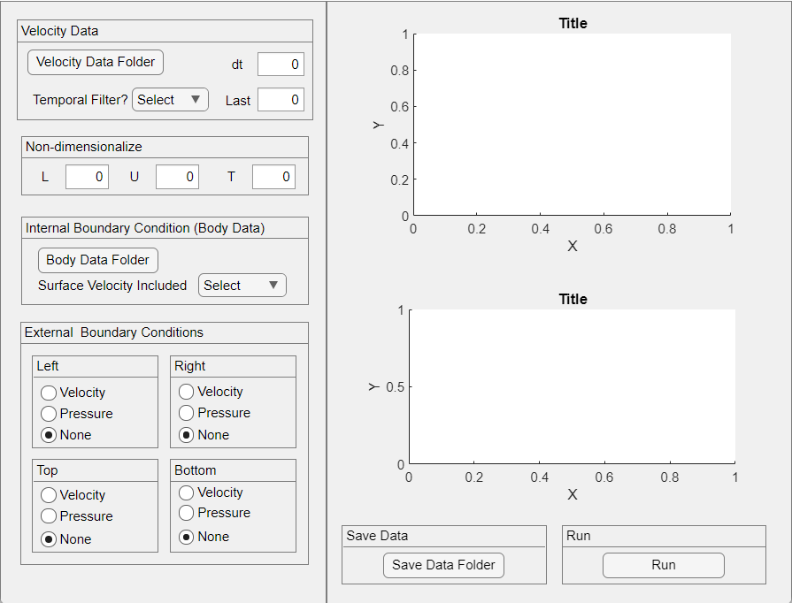
Use MATLAB GUI to generate inputs into PINN

Slide 4
Input Files to GUI
Velocity Data Naming convention: 2Dvel_00001.dat
x, y, u, v
Body Data Naming convention: body_00001.dat
x, y, u, v
Note:
Coordinates of the body should consist of all points above the midline (right side) followed by all points below the midline (left side). There should be an equal number of points on the left and right side of the body.

Slide 5
Option to apply a temporal filter to smooth velocity field
Yes – applies filter
No – doesn’t
Press to be prompted to select folder that contains time series of velocity fields
Specify the time step between frames
Specify the number of files that need to be read
Characteristic length (L), velocity (U), and T (t) used to non-dimensionalize the spatio-temporal coordinates and corresponding velocity field
*units should be consistent with the units of the x,y,u,v, dt

Slide 6
Specify if velocity at body coordinates are specified.
If no, velocity will be interpolated from nearest velocity vector
Press to be prompted to select folder that contains the body coordinates
Specify the boundary condition, if any, to be applied on the external boundaries:
Velocity – prescribes the known velocity from the velocity field data
Pressure – prescribes zero pressure on the selected boundary

Slide 7
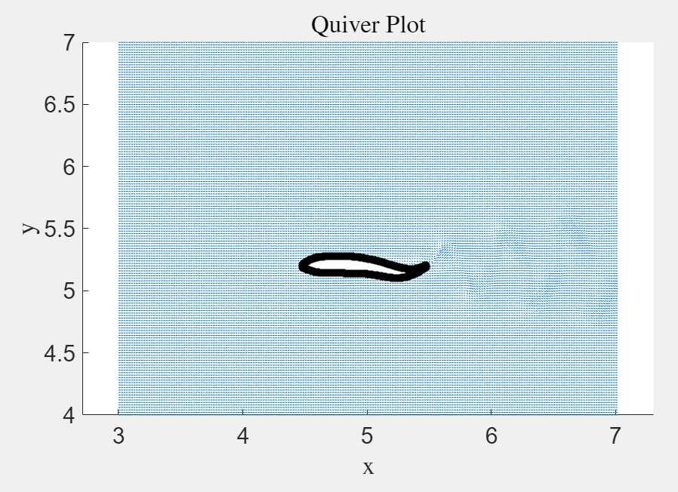
Figure 1 will loop through the velocity fields with the body of the object included. Please make sure the inside of the body is free of any velocity vectors

Slide 8
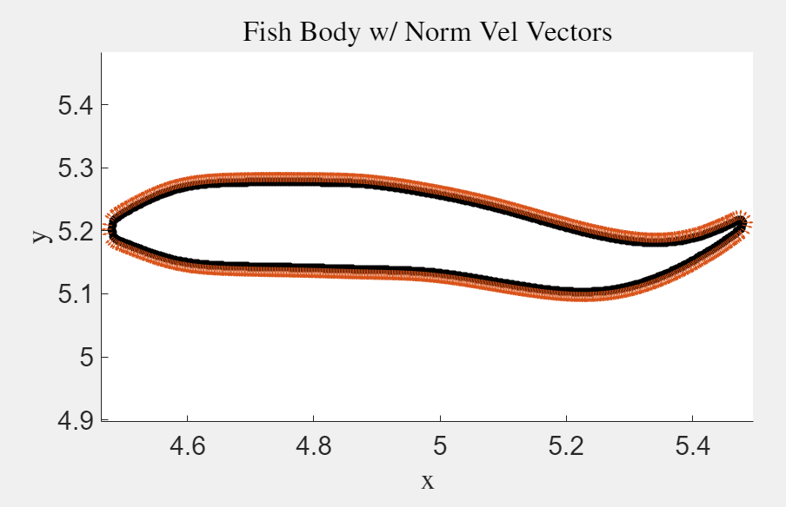
Figure 2 will loop through the motion of the body and show the vectors normal to the body. Please make sure the vectors point away from the body.

Slide 9
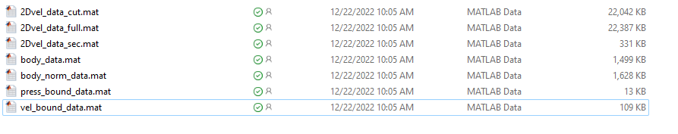
Press save to select the folder where the output matfiles will be saved
After responding to all previous prompts, press run to generate matfiles and plots
Example of the generated matfiles
Matfiles are arranged such that each column is a new time step

Slide 10
GUI Output
Contains velocity data excluding region around body
Contains velocity data from entire domain
Contains only around the body
Contains coordinates of the body
Contains info to enforce body kinematics
Contains info to enforce a pressure boundary condition
Contains info to enforce velocity boundary conditions
Matfiles are arranged such that each column is a new time step
Velocity field is separated into different regions to enable more passes through the velocity data closest to the body to improve accuracy in this region

Slide 11
Installation of necessary environment to run on GPU
Michael Calicchia

Slide 12

Creating an Environment
Download Anaconda: https://www.anaconda.com/products/individual-d
I used anaconda because it allows me to easily control the version of python

Slide 13
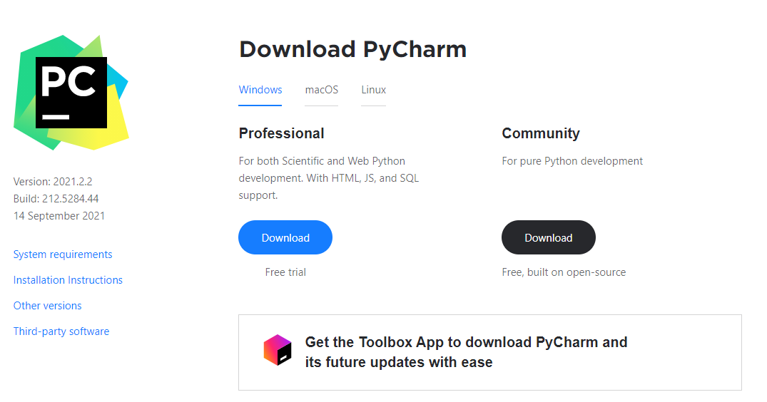
Creating an Environment
Download PyCharm (or any other Editor): https://www.jetbrains.com/pycharm/

Slide 14
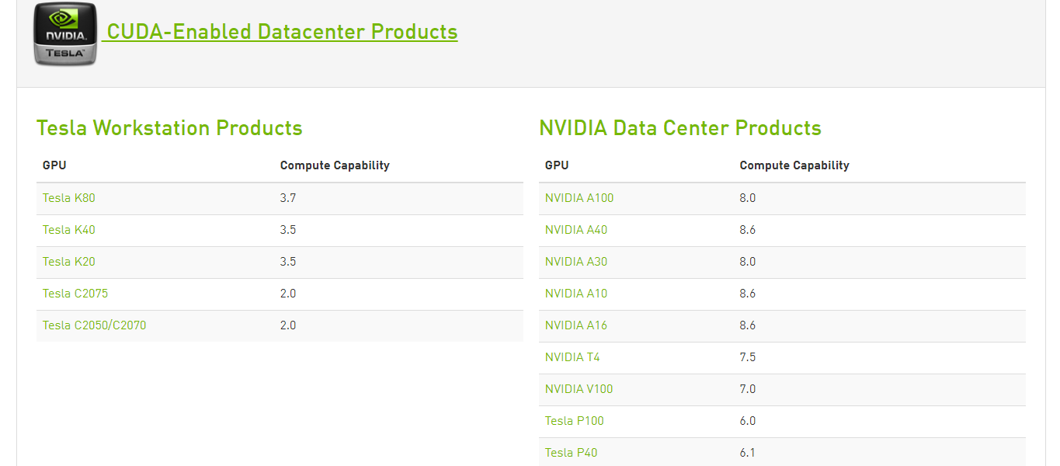
Creating an Environment
If you want to run the code on a GPU, first check that you have a CUDA enabled GPU and download the appropriate drivers: https://developer.nvidia.com/cuda-gpus

Slide 15
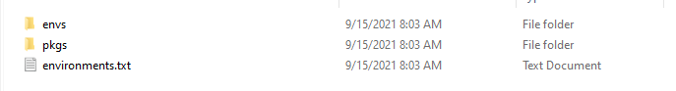
Creating an Environment
Open Anaconda (you’ll see the Anaconda prompt)
Change directory if needed
First create an environment for Python 3.9
Type: conda create --name [environment name] python=3.9
When prompted type “y” for yes
Type conda activate [environment name]

Slide 16
Creating an Environment
Next create an environment for Tensorflow 2.x (latest version of tensorflow that the code is currently compatible with)
To obtain the GPU version type:
conda create --name [environment name] tensorflow-gpu
To obtain the CPU version type:
conda create --name [environment name] tensorflow

Slide 17
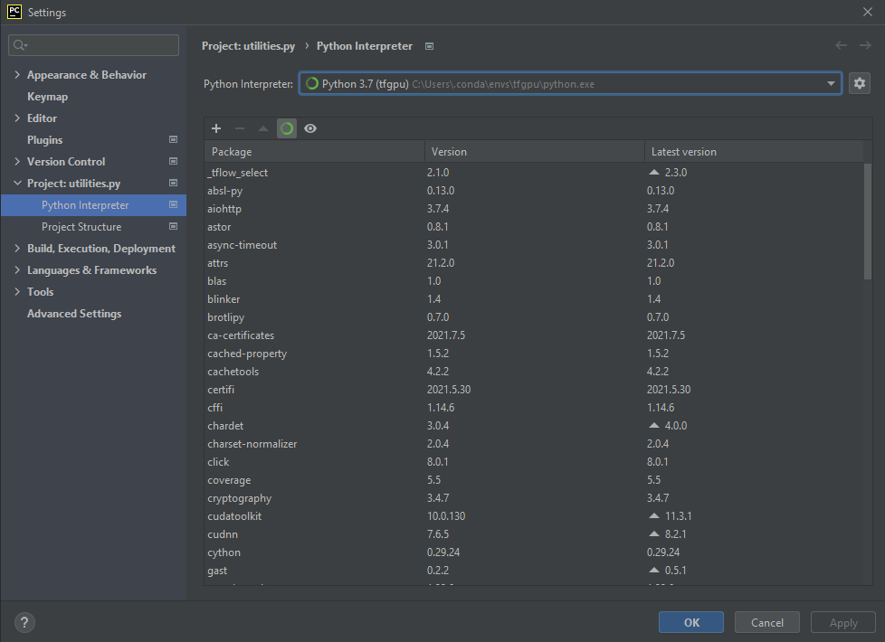
Change Interpreter in PyCharm
Open PyCharm and go to file -> settings
Press then click add

Slide 18
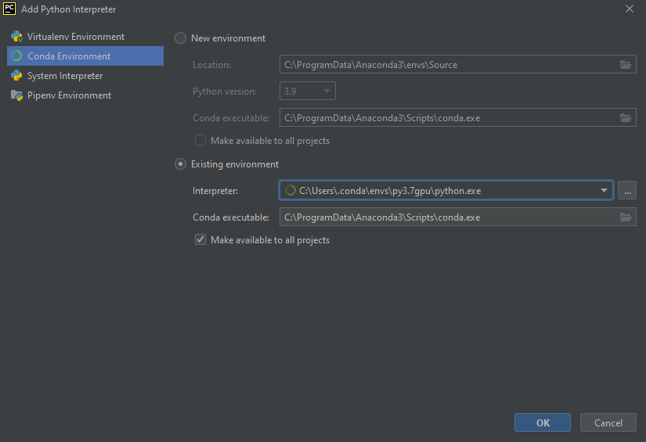
Change Interpreter in PyCharm

Slide 19
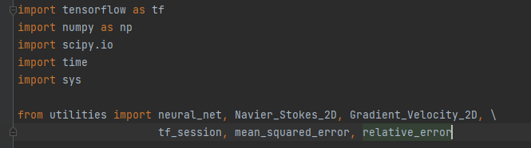
Check Packages are Installed
After creating the proper environment and installing the required packages, you're ready to run the code

Slide 20
Create Tensorflow Environment
After logging in type ml anaconda (loads anaconda module that is already pre-installed)
Type conda create –name [env name] tensorflow-gpu
Note that tensforflow-gpu environment has already been created. It is called tf_gpu.
Note: These instructions are the rockfish computing cluster at JHU

Slide 21
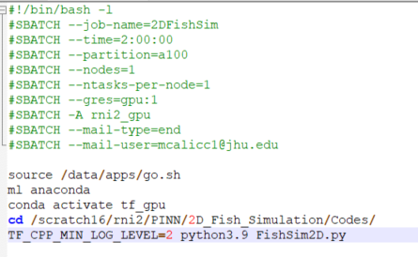
Creating the Batch File
There is probably a better way of doing this but I created my batch file in Notepad++. (Using the regular windows notepad will provide an error when you try to read the script on Rockfish)
In Notepad++, go to edit, EOL conversion, Unix (LF), then press save
Give a name to your job
Time you're allotting for this job, make sure this is enough time for your code to run
Partition where GPUs are located
Number of nodes you’re requesting (There are 10 GPU nodes)
Max is 48
There are 4 GPUs on each node
Account name where hours are charged (must be included)
Include to receive an email when job in finished
Provide your email address
Not sure if this is needed or not
Needed to activate the tensorflow environment for running the PINN
Change directory to code location
List the code you want to run

Slide 22
PINN_2D_UndulatingBodies
Michael Calicchia

Slide 23
PINN Code
Two main files:
PINN_2D_UndulatingBodies.py
utilities.py
5-7 input files (depends on enforced BC)
2Dvel_data_full.mat
2Dvel_data_cut.mat
2Dvel_data_sec.mat
body_data.mat
body_norm_data.mat
press_bound_data.mat
vel_bound_data.mat
Detailed comments are included in the code explaining what each section is doing. If you have any additional questions, please feel free to reach out to me at mcalicc1@jhu.edu

Slide 24
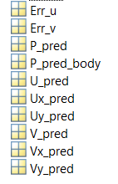
PINN Output
Contains error in u component of velocity field
Contains error in v component of velocity field
Contains predicted pressure
Contains predicted surface pressure
Contains predicted u velocity component
Contains predicted du/dx
Contains predicted du/dy
Contains predicted v velocity
Contains predicted dv/dx
Contains predicted dv/dy
Derivatives of velocity fields can be used to compute 2D divergence field and vorticity field

