Slide 1
A Microkernel Virtual Machine:
Building Security with Clear Interfaces
Xiaoqi Lu Scott Smith
The Johns Hopkins University

Slide 2
Dimensions of Code-based Security
Inter-Application Security
  Non-interference between independent applications
Intra-Application Security
  The Principle of Least Privilege within a single application
System Service Security
  Protect system resources from being misused by applications
This talk
Notes:
Code-based security means code from difference sources can be given different permissions. We think that there are three dimensions of code-based security:
1.Independent applications running in the same Virtual Machine should not interfere each other’s computation. Projects like Isolates, Multi-tasking Virtual Machine and JKernel fall into this dimension .
2.The different components of a large application may not all need the full set of privileges given the application as a whole. For instance, an application has a component doing mathematic computation doesn’t need to have the network privilege.
3. focus of our research is on this dimension.

Slide 3
Secure System Services in Java
Security Policy
App Domain
classloader
Permissions
App.class
Libraries
SecurityManager
System Domain
checkPermssion()
doPrivileged()
File IO
Net IO
AWT
•••
Notes:
The primary use of the Java access control mechanism in practice is to limit access by application to system resources. So, we first review how Java secures system resources
Codebase, Permissions, Policy file, SecurityManager
Application domain vs. system domain
Java libraries sit in the system domain and unanimously have system privileges
An application domain can access system resources only if it has proper permissions. Security Manager is responsible for enforcing this.
There are two important security related methods in Java: checkPermssion and doPrivileged. A call to checkPermssion triggers the SecurityManager to perform security inspection. The doPrivileged method temporarily increases caller’s security level.
The security inspection algorithm performed by the Java Security Manager is called runtime stack inspection

Slide 4
How Java Stack Inspection Works
Codebase | Permission
App | Read
Library | All Permissions
Fail
App.main()
App.main()
Library.foo1()
Library.foo1()
Succeed
Library.foo2()
doPrivileged()
checkPermssion (write)
Library.foo2()
…
checkPermssion (write)
…
Notes:
It traverses the call stack to check if every call frame has the required permissions.
When checkPermssion on write is invoked, the stack inspection traverses the stack to make sure all frames on the stack have the required write permission. And, it will fail when it hits the application frame because the application has only read permission.
In this case, foo1 uses its own write permission to invoke foo2 on behalf of the application who does not have the write permission itself.
The ultimate goal of stack inspection is to make sure that a class cannot gain additional permissions by calling or being called by a more privileged class

Slide 5
Drawbacks of Java Security
Object references can break the boundary of the system domain
No clear compile-time security interface
Stack inspection conflicts with compiler optimizations
Notes:
There are several shortcomings of Java’s security architecture.
1, object references can be freely passed across component boundary, which can possibly open backdoor channels. An over-simplified example is that a reference to an open file might be accidentally leaked to an application who doesn’t have the permission to open the file
2.The security interface is set up by code snippet in the form of checkPermission() and doPrivileged(), which are scattered throughout library code. It is difficult for application developers to get a handle on the accurate security architecture on which they will run their application.
3. Stack inspection relies on the order of the call stack. However, compiler optimizations usually involve changes to the call stack, which may in turn change the security semantics of the whole system

Slide 6
The Microkernel Virtual Machine
Put a clear, inviolable interface between system domain and application space
Minimize the size of core system domain
  Microkernel architecture, the μKVM
Notes:
To secure system services in a more elegant way, we propose a microkernel based solution
1. With such an interface, we efficiently remove the need for runtime stack inspection and avoid the pitfalls the Java has.
2. As we know, the smaller the trust computing base is, the easier to secure it.

Slide 7

Secure System Services in theμKVM
Security Policy
App Domain
classloader
Permissions
App.class
Library
SecurityManager
System Domain
File IO
Net IO
AWT
Notes:
This diagram illustrates our methodology clearly
We want to separate the application domain and the system domain using a concrete solid interface so that the security manager only needs to protect such an interface.
Meanwhile, we want to shrink system domain to include only the core privileged code.

Slide 8

Architectural Elements of theμKVM
read
write
seek
OSVersion
FileIO
Kernel
Virtual Machine
Operating System
Notes:
The kernel is a special component. It manages system resources and exposes uniform interfaces via which user applications can interact with the kernel. The kernel is the only component in our system that runs in privileged mode.
Connectors are bi-directional, they import plugins and export plugouts. A connection is required before plugin/plugout can be used..
Services are for standard client/service style invocations.

Slide 9


Declarative Connector Interfaces
FileIO
FileIO
Application or
Library
Kernel
Virtual Machine
Operating System
Notes:
For an application or a library that wants to use the kernel’s FileIO connector, it needs to declare a matching connector as shown in the diagram

Slide 10


A Runtime Connection
FileIO
Application or
Library
Kernel
Virtual Machine
Operating System
Notes:
At runtime, the application or library requests a connection on the FileIO connector from the kernel. If the application/library has the proper permission, the kernel would grant the access by establish the connection. A connection is maintained until any of the two parties disconnect the connection explicitly.
Connections on matching connectors are peer-to-peer persistent links constructed by mutual agreement between the two parties involved.
Connectors can express persistent communication protocols such as socket connection, while services are used to one-time requests. Therefore we have two different types of interfaces in the microkernel VM

Slide 11
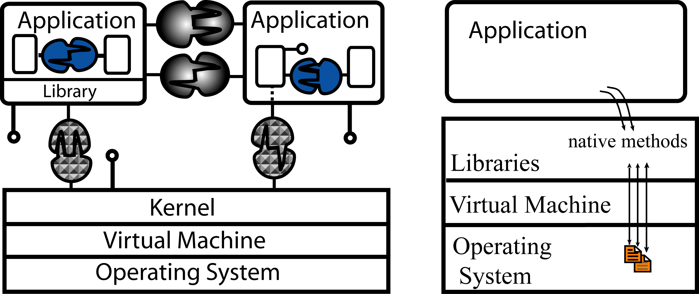
μKVM vs. J2SDK
Library
Notes:
We put runtime views of microkernel VM and J2SDK together to illustrated their differences,
Libraries do not have privileges, they are executed in user mode
Libraries interact with the kernel on connector/services interface, same as user applications do. The two applications in the left diagram interact with the kernel through libraries and directly respectively
The kernel-application interface is solid and clear. All access checks can be performed on this interface.
In this picture, we also show, connector/service interfaces can be also used for securing inter-application and intra-application communication. More details can be found in our paper.

Slide 12
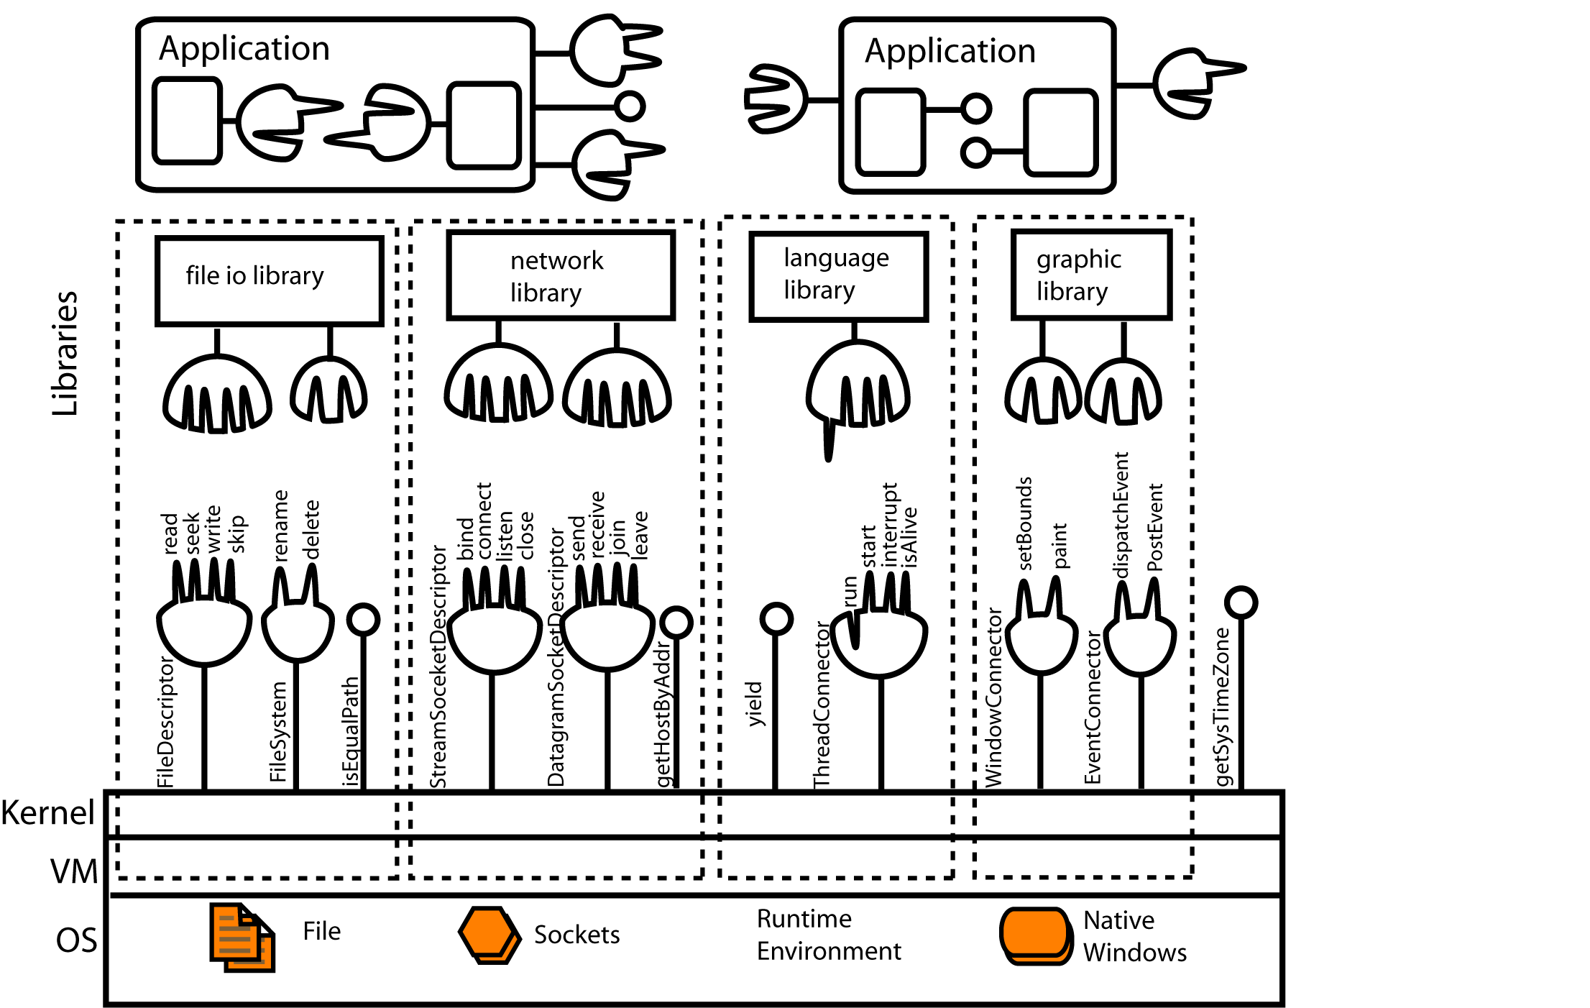
TheμKVM Architecture
Notes:
Now, let’s see the whole picture of the microkernel VM architecture. There are four types of system resources that are crucial to a language runtime,: the file system, network, runtime environment and graphical user interface. They need to be protected from unauthorized use
They are two important parts of the microkernel VM, the first part includes the kernel and the interface provided by the kernel. As we said before, security checks are performed on this interface.
The other important part is the system libraries. System libraries don’t have any permissions by themselves, they inherit permissions from applications who use them.

Slide 13
TheμKVM Implementation
Implemented in Java by mapping theμKVM kernel, connector and service interfaces to java classes
Modified Sun J2SDK, including JVM and libraries
Library APIs stay unchanged except package names
  java.io.* becomes library.io.*
Prototype implementation
  includes: file I/O, network, threads, GUI core
The kernel interface consists of 7 connectors, 14 services

Slide 14
Secure System Services in theμKVM
Security Policy
App Domain
classloader
Permissions
App.class
Library
SecurityManager
System Domain
File IO
Net IO
AWT
Notes:
The key to secure system services in the microkernel VM is to make the kernel-application interface the only channel for accessing system services. This means we need to eliminate all possible back channels.

Slide 15
Eliminating Backdoors
Kernel has no public static fields
Connectors/services are the only channels to access kernel functions
  Only primitive types or immutable objects can be transferred across the interface
  Data are passing by copy only
Exceptions
Native code disallowed in application space
Notes:
First of all, the kernel does not have any public fields, from where object references internal to the kernel can escape.
The only way that data can be exchanged is via connector and services. Furthermore, data across the kernel-application interface have to be primitive date such as String, integer or immutable data types that the kernel provides for public use. Those data are passing by copy so that exchanging them does not introduce any reference sharing between the kernel and applications
This sounds like a very restrictive rules. But in the real world, typically there are only a few, low-level channels of data in and out of an application. The implementation of the microkernel VM has proved the feasibility such a system. And data passing on such a interfaces meet the restrictions I just mentioned. Because this interface is so small, it is a fairly easy job to enforce those rules as well
Exceptions may traverse domains: a kernel exception may be propagated to applications. So we only allow exception to carry string messages
Native code is a back door through which an application can bypass the language runtime. So it is not allowed in application space. This does not mean our model is less flexible than the J2SDK: when a secure runtime is required, the Java SecurityManager also must disallow arbitrary native code

Slide 16

Inviolate Interface around System Services
Security Policy
classloader
App Domain
Permissions
Library
App.class
SecurityManager
System Domain
File IO
Net IO
AWT
Notes:
Security Enforcement in theμKVM
Reuse the Java framework: codebase, polices, permission etc.
Security checks are installed on the kernel-application interface
Change how the policy is enforced–immediate caller’s permission is checked:
before a service can be invoked
when a connection is requested

Slide 17
Functionality Benchmark
Mauve suite
 | J2SDK |  |  | μKVM
 | Fail | Pass | Total | Fail | Pass | Total
File IO | 9 | 648 | 657 | 9 | 648 | 657
Network | 9 | 365 | 374 | 8 | 378 | 384
Thread | 0 | 85 | 85 | 0 | 85 | 85
Total | 18 | 1098 | 1116 | 17 | 1109 | 1126
– Numbers in the table are the number of tests
Notes:
We have conduced a series of benchmarks on our microkernel implementation and compare the results with J2SDK
For functionality test, we used mauve test suites, the result show that our implementation meets the functionality specifications of both the mauve suite and the J2SDK
The difference in the total number of tests performed on the J2SDK and the µKVM prototype results from tests grouping: one test failure may cause skipping of the rest of tests in the same group. All the failed tests on our packages and those on peer Java packages are either the same or simply different on exception types. For example, writing to a closed socket in Java throws an IOException, while the µKVM throws a null pointer exception because the connection associated with that socket has been disconnected and becomes null.

Slide 18
Performance with Security
Security Manager is on in these benchmarks
  Stack inspection for J2SDK
  Security checks on the μKVM kernel interface
File Open Operation
File Num | File Open Time (ms) |  |  | Memory (kbyte)
 | J2SDK | μKVM | Diff(%) | J2SDK | μKVM | Diff(%)
500 | 934 | 686 | -26.66 | 2968 | 2969 | 0.01
1000 | 1502 | 1244 | -18.51 | 3450 | 3394 | -1.63
Diff = (μKVM – J2SDK) /J2SDK * 100%
Notes:
In the second group of benchmarks, we tested performances of our microkernel VM and J2SDK with security enabled. This means turning on the stack inspection for Java and performing security checks on the microkernel VM kernel-application interface.
The table shows the time and memory consumption of the two platforms in file opening operation. As we can see, when 500 files are opened at the same time, the microkernel VM runs about 27% faster than J2SDK

Slide 19
Performance without Security
File Operations: open, read and write
Network: transfer time for 1M data
  -1.01% ~ 3.37%, packet size = 64~16384 bytes
  -1.01% ~ 2.84%, packet size = 1024 bytes
File Num | File Open Time (ms) |  |  | Memory (kbyte)
 | J2SDK | μKVM | Diff(%) | J2SDK | μKVM | Diff(%)
500 | 395 | 407 | 2.98 | 2386 | 2458 | 3.03
1000 | 847 | 875 | 3.33 | 2408 | 2497 | 3.69
Notes:
When security is not a concern of an application, our microkernel VM does not have much overhead either. To demonstrate this, we performed some efficiency benchmark without enabling security. Efficiency benchmarks include file open, read/write operations, and network data transmissions. The table shows the benchmark result of file open operation. Our microkernel VM slows down at most 3.4% in the case of 1000 files are opened at the same time
We haven’t applied any optimization to our implementation yet, We can further improve our performance by, for example, implementation the kernel in native code

Slide 20
Related Work
Cell Project [Rinat et al. ’00] [Liu et al. ’04]
Secure System Domain
  J2SDK and CLR
  JOS, a JKernel extension
  MARCO [Pistoia et al. ’05]
  Operating Systems: KaffeOS [Back et al. ’99&’00 ], JX [Golm et al. ’02]
Capability-based Systems
  E language [Miller]
Notes:
The microkernel VM model is developed from our previous project, Cell project. More details about the Cell project can be found those papers.
J2SDK and similarly Microsoft Common Language Runtime have the code based security system as we discussed in the early part of this talk
JOS is an extension of JKernel, it puts the Java File IO library in a separate domain, so all accesses to it can be monitored. However, they have only done this on the File Operation. And because they simply put the whole File IO in a separate domain without separating the real privileged one and non-privileged one, which makes the cross domain communication costly
MARCO is a static inter-procedural analysis. it detects implicit leaks of authority. It is a useful tool brings the Java J2SDK closer to our model
KaffeOS and JX are micro-kernel based operating systems, so they focus on problems specific to operating system.

