Slide 1
RFC 9675 DTNMA
DTNMA AMM
RFC 7950
YANGv1.1
DTNMA ADM-YANG
RFC 3986
URI
DTNMA ARI
RFC 9171
BPv7
RFC 8949
CBOR
DTNMA AMP
RFC 9172
BPSec
Icons include document links

Slide 2
General Case
Orchestrator
Manager
Manager
…
Agent
Agent
Agent
Managed Device
Managed Device
Managed Device

Slide 3
Manager
Agent
Managed Device

Slide 4
Manager
Agent
Agent
Agent
Managed Device
Managed Device
Managed Device

Slide 5
Manager
Agent
Agent
Agent
Managed Device

Slide 6
Manager
Manager
…
Agent
Managed Device

Slide 7
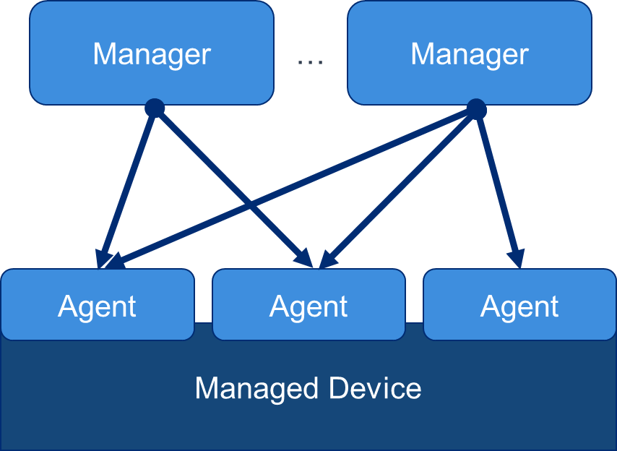
Manager
Manager
…
Agent
Agent
Agent
Managed Device

Slide 8
Agent
Agent
Agent
Data Model
Data Model
Data Model
Managed Device
Agent
Data Model
Data Model
Data Model
Managed Device

Slide 9
Manager
Manager
Agent
Agent
Agent
Agent
Data Model
Data Model
Data Model
Data Model
Data Model
Data Model
Managed Device
Managed Device

Slide 10
Orchestrator
Logic
Manager
Agent
Autonomy Rules
Data Model
Managed Device

