Slide 1



BRIDGE-AI Kenya - Smart Mushroom Farming
Building Resilient Development with Generative AI in Agriculture

Slide 2
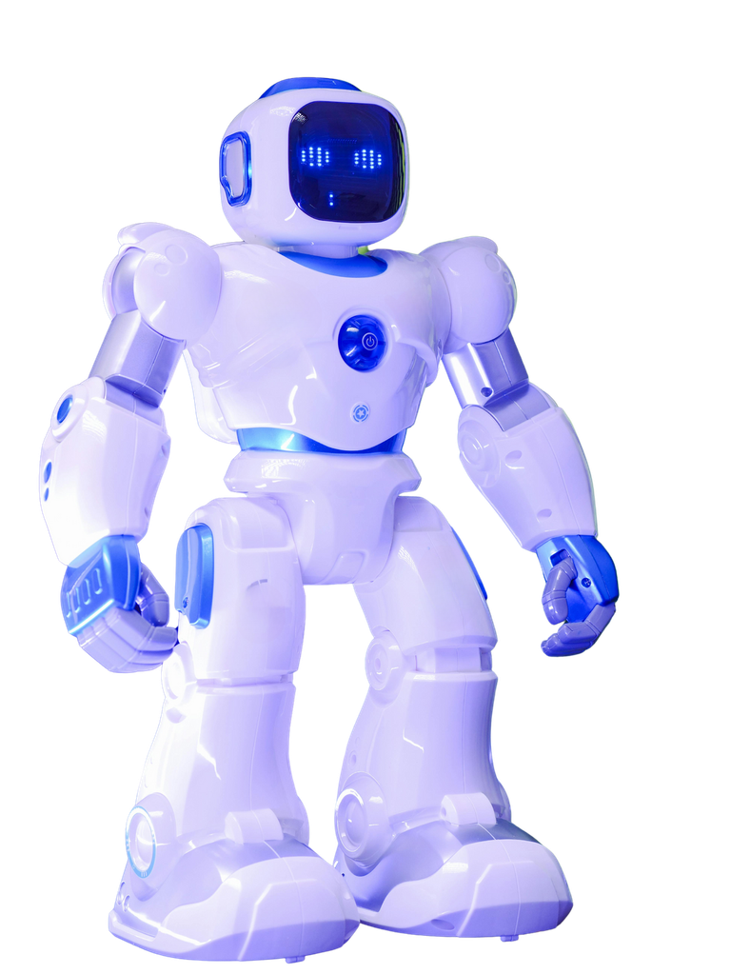


About
BRIDGE-AI is a Horizon Europe Research and Innovation Action that integrates Generative AI-based solutions into agricultural optimization and digital skills acquisition across Kenya, Tunisia, and Nigeria. The Smart Mushroom Project at JKUAT, launched in April 2025, represents Kenya's flagship case study, combining IoT sensors, AI-powered monitoring, and biotechnology to create a scalable smart farming model for smallholder farmers. This initiative aims to improve rural livelihoods by enhancing mushroom cultivation through precision agriculture, while simultaneously building digital capacity among local communities.

Slide 3
Mission
Mission & Vision
To empower smallholder farmers with climate-smart, tech-enabled mushroom cultivation techniques that improve food security, protect forests, and create sustainable livelihoods.
Vision
A digitally skilled Africa where GenAI and smart agriculture drive rural resilience, economic empowerment, and environmental conservation.
Serviceable Available Market (SAM)

Slide 4
BRIDGE-AI Kenya: Our Pillars of Impact
Building Resilient Development with Generative AI in Agriculture
Pillar 1: Smart Technology Integration
IoT sensors, AI-powered climate control, and smartphone-based remote monitoring for precision mushroom farming.
Pillar 2: Spawn Production & Distribution
Climate-resilient spawn production and nationwide distribution to empower smallholder farmers with quality inputs.
Pillar 3: Training & Capacity Building
Digital skills acquisition, entrepreneurship training, and hands-on workshops for youth, women, and local communities.
Pillar 4: Research & Innovation
Applied research in partnership with universities, sensor testing, data analytics, and sustainable farming innovations.
Pillar 5: Environmental Conservation
Reducing deforestation through climate-smart alternatives, forest preservation, and promoting sustainable agricultural practices.

Slide 5

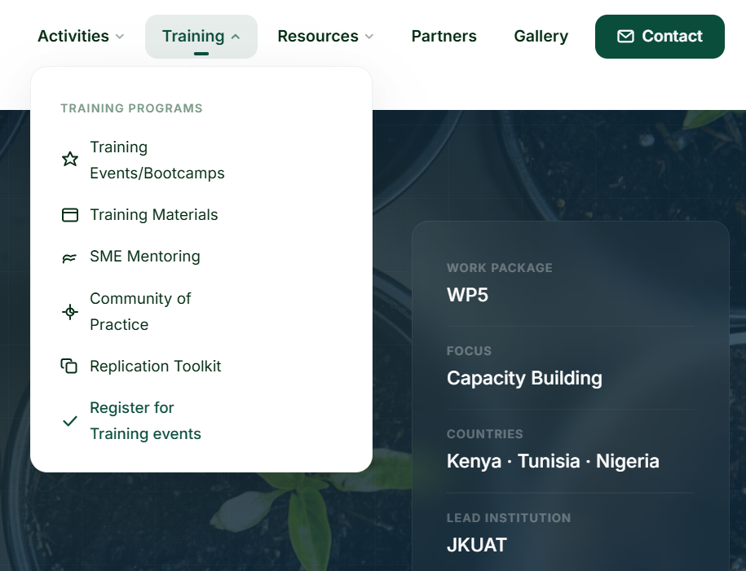
BRIDGE-AI Platform
Digital Tools for Farmers
BRIDGE-AI Website - Central hub showcasing project information, research updates, training resources, and partner collaborations.
Farmers Dashboard - Real-time mobile/desktop interface for farmers to monitor mushroom house conditions (temperature, humidity, CO₂, light) remotely via smartphone.
Key Features – Automated alerts, yield tracking, crop health insights, and AI-powered recommendations for optimal harvest timing.

Slide 6
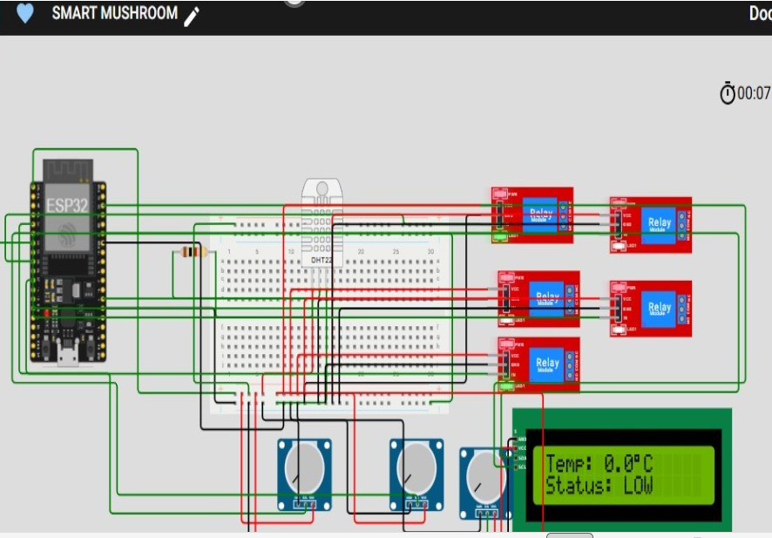
IoT-Powered Smart Mushroom Farming
Sensors + AI = Precision Agriculture
Sensors Deployed - Temperature, humidity, CO₂, light intensity, and soil moisture sensors installed in mushroom houses for real-time data collection.
AI Monitoring - Data analyzed by AI algorithms to automatically regulate climate conditions, detect anomalies, and predict optimal harvest windows.
Impact - Increased yield, reduced crop loss, minimized manual intervention, and actionable insights delivered directly to farmers' phones.

Slide 7
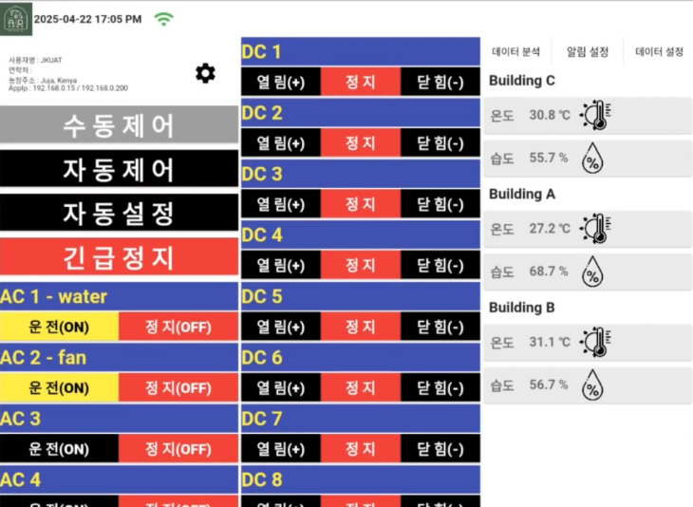
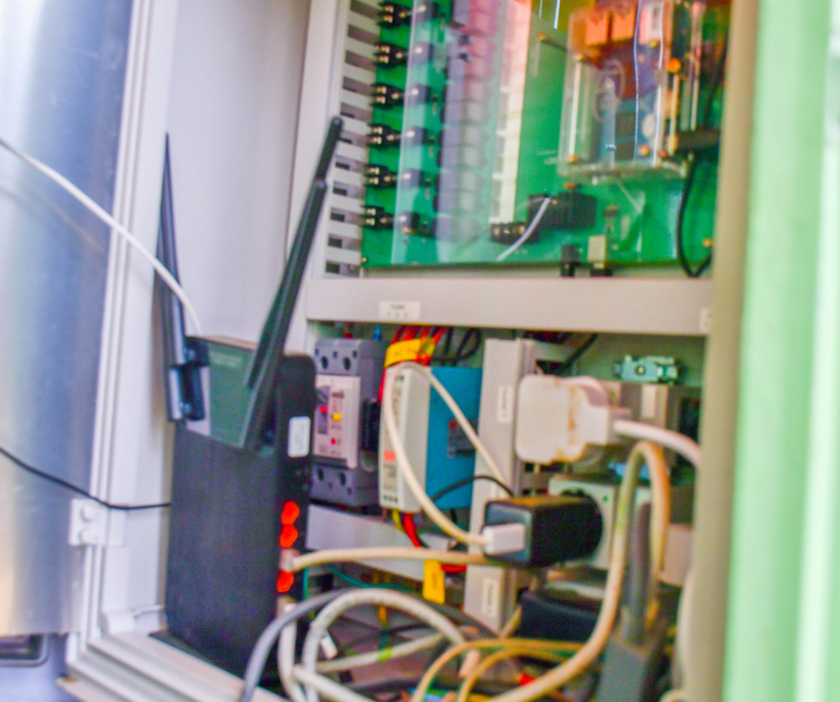
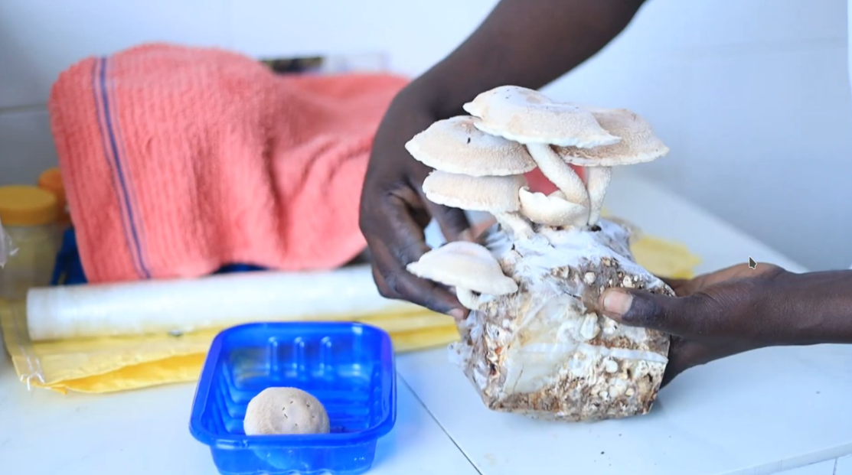
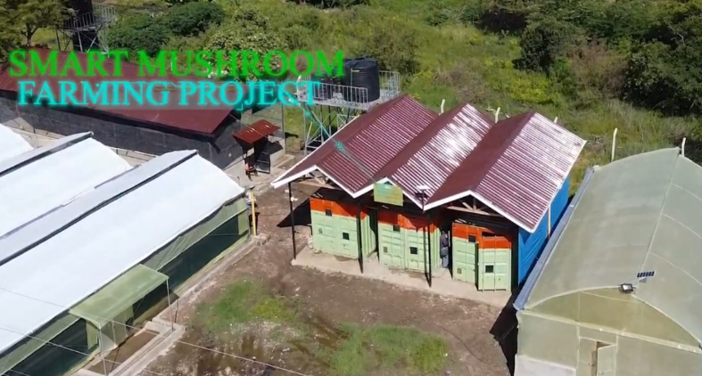
Project Launches
Smart Mushroom Project Launch

Slide 8
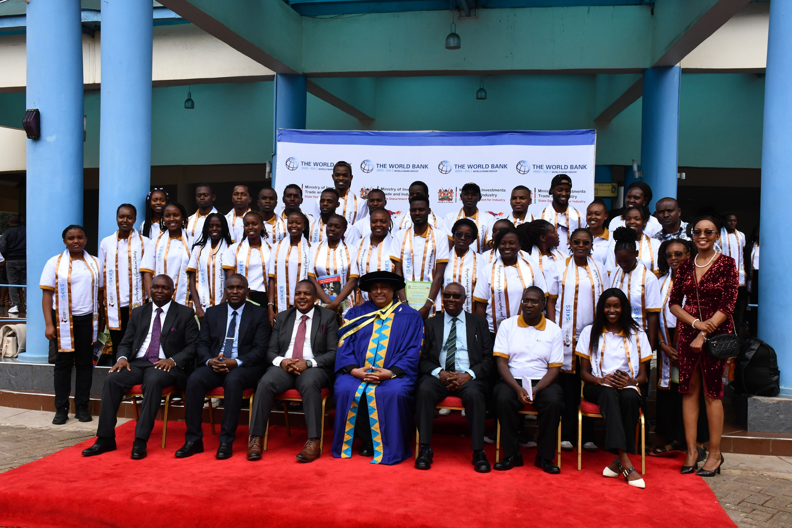
SKIES-KIEP Rapid Tech Skills
Our Trainings
JHUB Africa’s KIEP-SKIES Rapid Tech Skills training at JKUAT equipS participants with skills in Digital Literacy, Tech Entrepreneurship, Software Development, Data Science, Digital Marketing, and Cybersecurity. The program aims to empower individuals for success in the digital economy. Trainees gain hands-on experience and practical knowledge in these high-demand fields. It is funded by World Bank and implemented through the Ministry of Investments, Trade & Industry and E4Impact Entrepreneurship Centre, Kenya.
ZOHO Young Creators Program
JHUB Africa, in partnership with ZOHO, hosted a low-code application development training at JKUAT for 28 students. This initiative supports the skilling agenda, empowering young people with valuable tech skills to enhance their career opportunities.
Digital Skills for Innovators, Startups & MSMEs
JHUB, in partnership with gDIH Kenya, is training 120 MSMEs, startups, and innovators on agriculture-based digital technologies to boost productivity and innovation. The program promotes digital skills and technology adoption, ensuring relevance through local expertise.

Slide 9
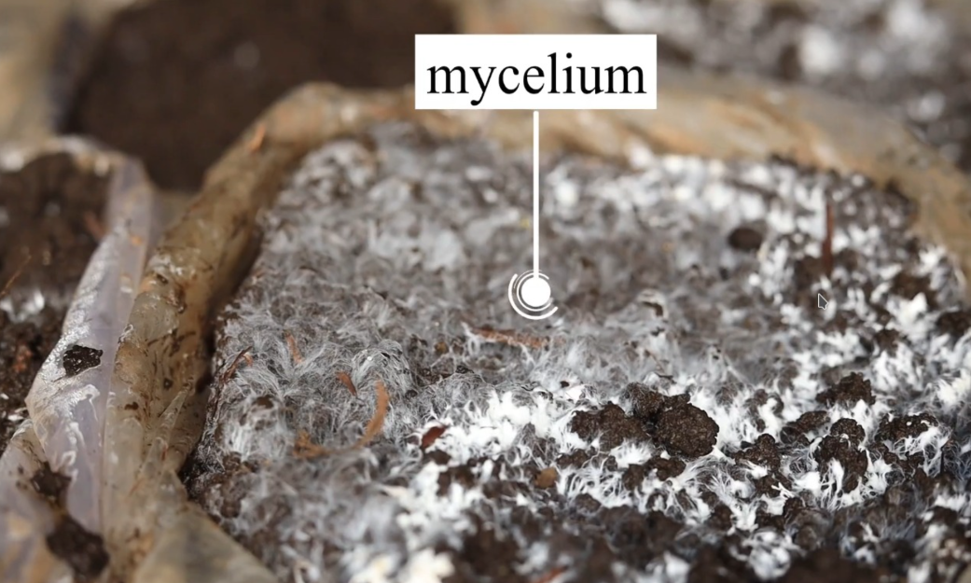
Summary
1 Integrating GenAI and IoT into mushroom farming for precision agriculture
2 Empowering 400+ farmers with digital tools and training
3 Creating sustainable livelihoods while protecting Kenya's forests

Slide 10
Thank You
Email
Address
Website
info.jhub@jkuat.ac.ke
P.o.Box 62000-00200, Nairobi, Kenya.
https://jhubafrica.com/

