Slide 1
Regression & 1D CNN Result Comparison with AEC, SMI
2026. 05. 13
JangHoon Chun
Department of, Medical Device Engineering & Management
Gangnam Severance Hospital,
Yonsei University College of Medicine

Slide 2
1. What’s discussed in the last meetings
SMI 데이터 확립 → TAMA, BMI, Height, Weight 등의 데이터로 확인 가능
AEC data Resampling → 256 point로 정규화
이후 주요 feature 추출 (mean, std, range, skewness 등 65개 feature)
이전 연구와 동일하게 비교 분석
Model | Feature 구성 | Feature_num
clinic_only | PatientAge, PatientSex, BMI | 3
aec_only | aec1 ~ aec256 (원시 AEC 시계열 통계) | 256
aec_feature_only | aec_feature_filtered 시트 전체 사용 | 65
aec_feature_selected | AEC 피처 fold별 선택 (|r|<0.8, VIF<10) | 가변
clinic_aec_feature | Age/Sex/BMI (고정) + AEC 피처 fold별 선택 | 가변

Slide 3
2. Research Summary
IMATA 값을 반영하여 SMI 데이터 재확인
SMI = (TAMA − IMATA) / Height²
SMI 기준 논문 5개 확인 후 남녀 SMI threshold 결정
‘한국 기준 하위 5%’로 설정
모델은 Logistic Regression과 ResNet1D만 사용 (Linear 제외)
Clinic [Age, Sex, BMI] vs Clinic + AEC 256 points vs Clinic + AEC +Scan[kVp, 제조사]

Slide 4
연구 프로토타입 정의

Slide 5
Research Overview – Main Study
연구 목적
Opportunistic CT Biomarker 기반 → 5년 내 vertebral compression fracture 예측
AEC의 incremental value 검증
데이터
Baseline APCT + follow-up imaging 보유 환자
주요 변수: Age, Sex, AEC, Muscle, Bone Density 등
모델 구조
Model A: Age + Sex
Model B: + Bone
Model C: + Muscle
Model D: + AEC (핵심 비교)

Slide 6
Research Overview – Pilot Feasibility Study (현재 진행 연구)
연구 목적
AEC가 단순 보조 변수인지 vs 독립적인 biomarker인지 검증
→ 본 연구 모델 포함 가능성 평가
핵심 질문
AEC는 age/sex 이상 정보를 가지는가?
Muscle/Bone과 독립적 연관성이 존재하는가?
Scanner/Center 보정 후에도 유지되는가?

Slide 7
Research Overview – Pilot Feasibility Study (현재 진행 연구)
분석 전략
분포 분석 (AEC by 센터, 성별, 연령) – Complete
회귀 분석 (muscle area / attenuation / bone density ~ AEC + age + sex)
고급 분석
Multivariable (center, scanner 보정)
Spline 분석 → 비선형 관계 확인
Center-stratified 분석
결과물
AEC distribution plot
AEC vs biomarker scatter
Regression Table
Stratified Result Figure 등

Slide 8
데이터 정리

Slide 9
3. Detailed progress
Data – 강남
Clinic Data 수 : 3,672 → 중복 PatientID 제거 : 2,025 → TAMA outlier(0, 1), BMI 제거 : 1,642
Axial Data 수 : 1,642 → Fixed Tube Current Value 제거 : 1,372
총 환자 수
남성
여성
1,372명
514명 (37.4%)
858명 (62.6%)
SMI 분포 SMI = (TAMA-IMATA)/Height(m)²
TAMA 분포
성별 | N | mean | std | P25 | median
Female | 858 | 38.27 | 5.95 | 34.58 | 37.67
Male | 514 | 48.38 | 8.54 | 43.27 | 48.42
성별 | N | mean | std | P25 | median
Female | 858 | 104.98 | 15.28 | 95 | 103
Male | 514 | 148.23 | 26.35 | 132 | 148

Slide 10
3. Detailed progress
데이터 분포 확인
구분 | Mean | Std | Min | p25 | Median | p75 | max
n slices | 168.6 | 32.0 | 44 | 151 | 165 | 184 | 460
z range (mm) | 469.6 | 52.6 | 215.0 | 441.0 | 467.5 | 497.5 | 918.0
구분 | 성별 | Mean | Std | Min | Median | Max
n slices (개수) | F | 168.61 | 32.05 | 50.0 | 165.0 | 460.0
 | M | 168.65 | 32.04 | 44.0 | 166.0 | 405.0
z range (mm) (범위) | F | 470.97 | 51.47 | 234.0 | 468.0 | 918.0
 | M | 467.58 | 54.34 | 215.0 | 465.0 | 808.0

Slide 11
3. Detailed progress
Train / Test Dataset Split & Distribution
Split | Sex | n | Normal | Normal % | Sarco | Sarco %
Train | M | 402 | 332 | 82.6% | 70 | 17.4%
 | F | 695 | 645 | 92.8% | 50 | 7.2%
 | All | 1097 | 977 | 89.1% | 120 | 10.9%
Test | M | 112 | 95 | 84.8% | 17 | 15.2%
 | F | 163 | 150 | 92.0% | 13 | 8.0%
 | All | 275 | 245 | 89.1% | 30 | 10.9%

Slide 12
3. Detailed progress
Train / Test Dataset Split & Distribution - Age
Split | Sex | n | Mean ± Std | Min | Median | Max
Train | M | 402 | 59.81 ± 12.51 | 18.00 | 60.00 | 89.00
 | F | 695 | 55.36 ± 12.15 | 11.00 | 55.00 | 91.00
 | All | 1097 | 56.99 ± 12.47 | 11.00 | 58.00 | 91.00
Test | M | 112 | 59.05 ± 12.52 | 23.00 | 59.50 | 84.00
 | F | 163 | 56.52 ± 12.29 | 22.00 | 56.00 | 87.00
 | All | 275 | 57.55 ± 12.45 | 22.00 | 58.00 | 87.00

Slide 13
3. Detailed progress
Train / Test Dataset Split & Distribution - BMI
Split | Sex | n | Mean ± Std | Min | Median | Max
Train | M | 402 | 24.22 ± 3.26 | 14.48 | 24.19 | 36.76
 | F | 695 | 23.09 ± 3.43 | 14.40 | 22.70 | 39.49
 | All | 1097 | 23.51 ± 3.41 | 14.40 | 23.30 | 39.49
Test | M | 112 | 24.07 ± 3.30 | 16.44 | 24.16 | 35.20
 | F | 163 | 22.99 ± 3.19 | 16.06 | 22.83 | 34.23
 | All | 275 | 23.43 ± 3.28 | 16.06 | 23.44 | 35.20

Slide 14
SMI Cutoff Setting

Slide 15
3. Detailed progress
성별에 따른 SMI Cutoff Value 분석
연구 논문 (저자) | 대상 국가 | 대상군 특성 | 평균 나이 (Mean±SD) | 나이 범위 (Range)
Prado et al. (2009) | 캐나다 | 전이성 유방암 환자 | 54.8 ± 10.4세 | 37~80세
Yoon et al. (2021) | 한국 | 건강한 간 기증자 | 31.5 ± 8.3세 | 20~59세
JSH (2016) | 일본 | 만성 간 질환 환자 | 71세 (중앙값) | 19~89세
Carey et al. (2017) | 북미 | 간 이식 대기 환자 | 58세 (중앙값) | (IQR: 51~62세)
Martin et al. (2013) | 캐나다 | 폐암 및 소화기암 환자 | 남성: 64.7세 / 여성: 64.8세 | (기술되지 않음)
현재 연구 데이터 |  |  | 남성 59.7 ± 12.5세 여성 55.6 ± 12.2세 | 11~91세

Slide 16
3. Detailed progress
성별에 따른 SMI Cutoff Value 분석
연구 논문 (연도) | 대상 국가 | 남성 Cutoff | 여성 Cutoff | 남성 비율 (강남) | 여성 비율 (강남)
Prado et al. (2009) | 캐나다 | 52.4 | 38.5 | 69.3% (356/514) | 57.2% (487/858)
Martin et al. (2013) | 캐나다 | 53.0 | 41.0 | 71.8% (369/514) | 73.3% (627/858)
Carey et al. (2017) | 미국/캐나다 | 50.0 | 39.0 | 58.2% (299/514) | 60.8% (518/858)
JSH (2016) | 일본 | 42.0 | 38.0 | 20.0% (103/514) | 52.9% (449/858)
Yoon et al. (2021) | 한국 | 39.33 (-2 STD) | 27.7 (-2 STD) | 12.3% (63/514) | 3.6% (22/858)
 |  | 40.96 (하위 5%) | 30.6 (하위 5%) | 17.3% (87/514) | 8.4% (63/858)

Slide 17
연구 결과

Slide 18
3. Detailed progress
CV Summary - Model 1 [Clinic]
Logistic Regression
ResNet1D
Fold | AUC-ROC | AUPRC | Brier | Accuracy | F1
1 | 0.8329 | 0.3651 | 0.1963 | 0.6864 | 0.3670
2 | 0.8095 | 0.3370 | 0.1612 | 0.7591 | 0.3765
3 | 0.7784 | 0.3403 | 0.2040 | 0.6804 | 0.3137
4 | 0.7233 | 0.2329 | 0.1830 | 0.7306 | 0.3059
5 | 0.8500 | 0.5234 | 0.1726 | 0.7489 | 0.3956
Mean | 0.7988 | 0.3598 | 0.1834 | 0.7211 | 0.3517
±Std | 0.0448 | 0.0936 | 0.0155 | 0.0322 | 0.0355
Fold | AUC-ROC | AUPRC | Brier | Accuracy | F1
1 | 0.8703 | 0.4683 | 0.2194 | 0.6409 | 0.3577
2 | 0.8444 | 0.3939 | 0.3022 | 0.4955 | 0.2930
3 | 0.7806 | 0.3370 | 0.0961 | 0.8584 | 0.1622
4 | 0.8415 | 0.4100 | 0.1840 | 0.8265 | 0.4062
5 | 0.8517 | 0.3597 | 0.1172 | 0.8265 | 0.4412
Mean | 0.8377 | 0.3938 | 0.1838 | 0.7296 | 0.3321
±Std | 0.0303 | 0.0452 | 0.0740 | 0.1400 | 0.0984

Slide 19
3. Detailed progress
Test Set Performance - Model 1 [Clinic]
Overall
Logistic Regression
Model | AUC-ROC | AUPRC | Brier | Accuracy | F1
Log. Reg. | 0.7527 | 0.3338 | 0.1992 | 0.7091 | 0.3333
ResNet1D | 0.7578 | 0.3240 | 0.3256 | 0.4691 | 0.2700
Model | Sex | n | AUC-ROC | AUPRC | Brier | Accuracy | F1
Log.Reg. | M | 112 | 0.7245 | 0.4141 | 0.2790 | 0.5357 | 0.3333
 | F | 163 | 0.7682 | 0.2498 | 0.1444 | 0.8282 | 0.3333
ResNet1D | M | 112 | 0.7152 | 0.3669 | 0.3875 | 0.3839 | 0.3030
 | F | 163 | 0.7985 | 0.3133 | 0.2830 | 0.5276 | 0.2376

Slide 20
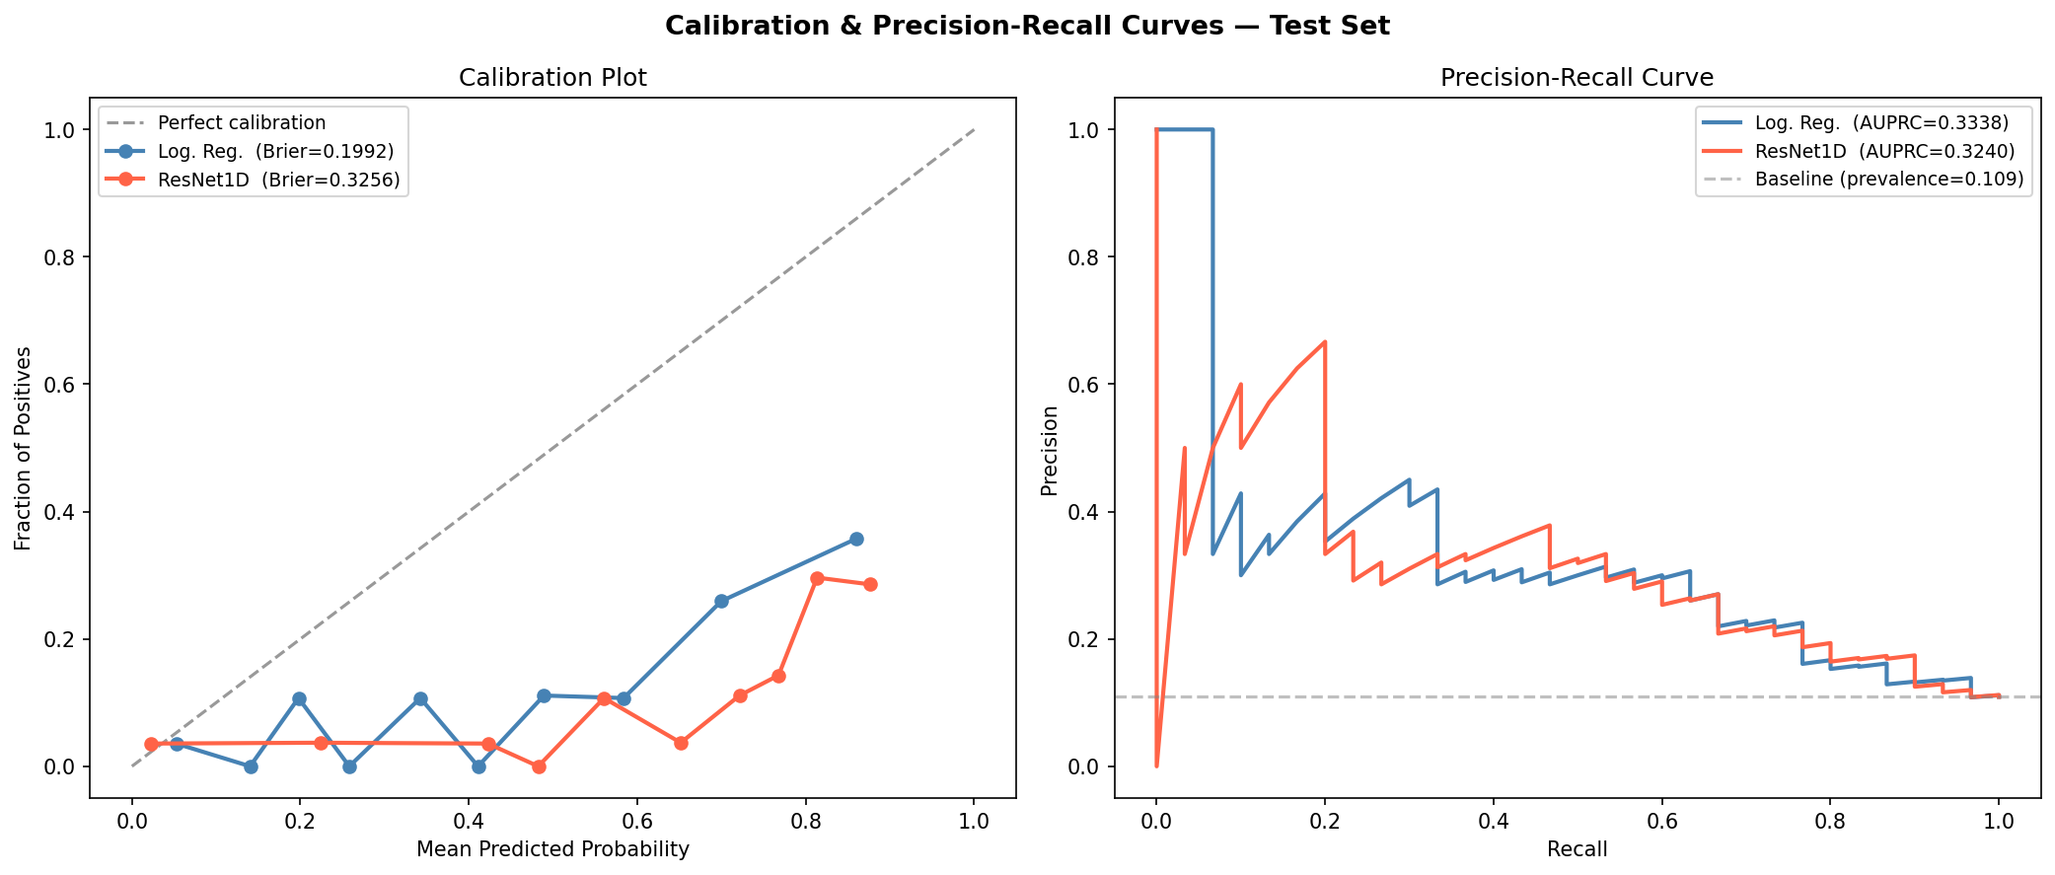
3. Detailed progress
Callibration Plot & PR Curve - Model 1 [Clinic]

Slide 21
3. Detailed progress
CV Summary - Model 2 [Clinic + AEC]
Logistic Regression
Cross Attention
Fold | AUC-ROC | AUPRC | Brier | Accuracy | F1
1 | 0.5512 | 0.1463 | 0.2465 | 0.6636 | 0.2128
2 | 0.6482 | 0.1913 | 0.1779 | 0.7591 | 0.2740
3 | 0.6662 | 0.2269 | 0.1950 | 0.7169 | 0.2619
4 | 0.6397 | 0.1946 | 0.1923 | 0.7306 | 0.2532
5 | 0.6316 | 0.1876 | 0.2120 | 0.7169 | 0.2439
Mean | 0.6274 | 0.1893 | 0.2047 | 0.7174 | 0.2491
±Std | 0.0398 | 0.0257 | 0.0235 | 0.0310 | 0.0207
Fold | AUC-ROC | AUPRC | Brier | Accuracy | F1
1 | 0.7651 | 0.3361 | 0.1945 | 0.7000 | 0.3400
2 | 0.8253 | 0.4046 | 0.1680 | 0.7818 | 0.3846
3 | 0.7692 | 0.3508 | 0.2285 | 0.6484 | 0.3186
4 | 0.6979 | 0.2423 | 0.2551 | 0.5799 | 0.2698
5 | 0.8825 | 0.5270 | 0.1503 | 0.7580 | 0.4301
Mean | 0.7880 | 0.3721 | 0.1993 | 0.6936 | 0.3486
±Std | 0.0622 | 0.0934 | 0.0384 | 0.0734 | 0.0550

Slide 22
3. Detailed progress
Test Set Performance - Model 2 [Clinic + AEC]
Overall
Logistic Regression
Model | AUC-ROC | AUPRC | Brier | Accuracy | F1
Log. Reg. | 0.6133 | 0.2317 | 0.2039 | 0.6873 | 0.2321
CrossAttn | 0.7071 | 0.2936 | 0.1801 | 0.7200 | 0.3304
Model | Sex | n | AUC-ROC | AUPRC | Brier | Accuracy | F1
Log. Reg. | M | 112 | 0.6495 | 0.3322 | 0.2387 | 0.6429 | 0.3103
 | F | 163 | 0.5477 | 0.1627 | 0.1801 | 0.7178 | 0.1481
CrossAttn | M | 112 | 0.6774 | 0.3597 | 0.2495 | 0.5893 | 0.3429
 | F | 163 | 0.7092 | 0.2638 | 0.1323 | 0.8098 | 0.3111

Slide 23
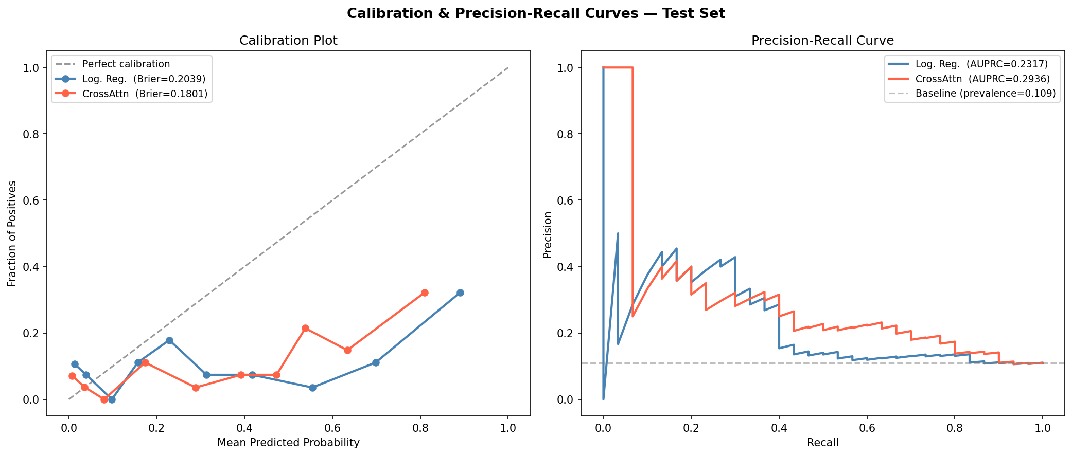
3. Detailed progress
Callibration Plot & PR Curve - Model 2 [Clinic + AEC]

Slide 24
3. Detailed progress
CV Summary - Model 2_2 [Clinic + AEC (Unmatching)]
Logistic Regression
Cross Attention
Fold | AUC-ROC | AUPRC | Brier | Accuracy | F1
1 | 0.6144 | 0.1641 | 0.2094 | 0.7182 | 0.2250
2 | 0.6386 | 0.1758 | 0.2066 | 0.7091 | 0.2195
3 | 0.5829 | 0.1611 | 0.2081 | 0.6986 | 0.2143
4 | 0.7147 | 0.2185 | 0.1734 | 0.7808 | 0.3143
5 | 0.7160 | 0.2467 | 0.2096 | 0.7078 | 0.3043
Mean | 0.6533 | 0.1932 | 0.2014 | 0.7229 | 0.2555
±Std | 0.0537 | 0.0337 | 0.0141 | 0.0296 | 0.0442
Fold | AUC-ROC | AUPRC | Brier | Accuracy | F1
1 | 0.8335 | 0.4235 | 0.1913 | 0.7000 | 0.3654
2 | 0.8386 | 0.3855 | 0.1378 | 0.8318 | 0.4308
3 | 0.7374 | 0.2623 | 0.2002 | 0.6941 | 0.3366
4 | 0.7682 | 0.2711 | 0.1571 | 0.7945 | 0.4000
5 | 0.8173 | 0.5119 | 0.2656 | 0.5160 | 0.2933
Mean | 0.7990 | 0.3708 | 0.1904 | 0.7073 | 0.3652
±Std | 0.0396 | 0.0945 | 0.0439 | 0.1095 | 0.0479

Slide 25
3. Detailed progress
Test Set Performance - Model 2_2 [Clinic + AEC (Unmatching)]
Overall
Logistic Regression
Model | AUC-ROC | AUPRC | Brier | Accuracy | F1
Log. Reg. | 0.6189 | 0.1600 | 0.2125 | 0.7127 | 0.2617
CrossAttn | 0.7140 | 0.3629 | 0.1843 | 0.7636 | 0.3564
Model | Sex | n | AUC-ROC | AUPRC | Brier | Accuracy | F1
Log. Reg. | M | 112 | 0.5895 | 0.2297 | 0.2262 | 0.6875 | 0.2857
 | F | 163 | 0.6441 | 0.1325 | 0.2031 | 0.7301 | 0.2414
CrossAttn | M | 112 | 0.7059 | 0.3746 | 0.2677 | 0.5982 | 0.3284
 | F | 163 | 0.6882 | 0.3553 | 0.1269 | 0.8773 | 0.4118

Slide 26
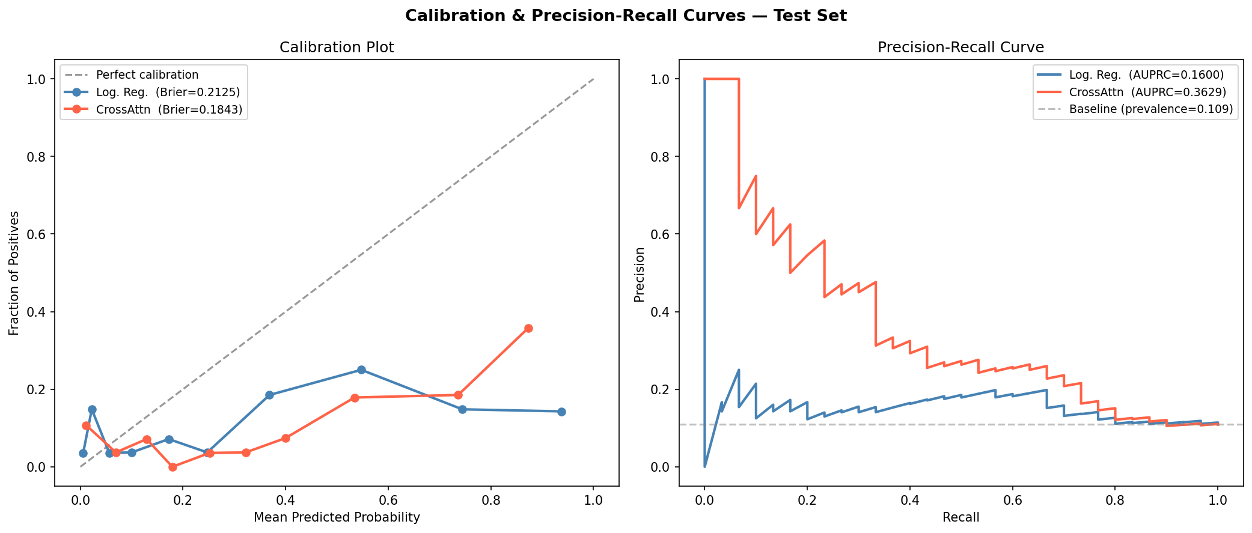
3. Detailed progress
Callibration Plot & PR Curve - Model 2_2 [Clinic + AEC (Unmatching)]

Slide 27
3. Detailed progress
CV Summary - Model 3 [Clinic + AEC + Scan]
Logistic Regression
Cross Attention
Fold | AUC-ROC | AUPRC | Brier | Accuracy | F1
1 | 0.6350 | 0.2601 | 0.1896 | 0.7548 | 0.2609
2 | 0.7452 | 0.2260 | 0.1925 | 0.7404 | 0.3864
3 | 0.7058 | 0.2919 | 0.1691 | 0.7885 | 0.2667
4 | 0.5431 | 0.1507 | 0.2444 | 0.6587 | 0.2022
5 | 0.7177 | 0.2781 | 0.1782 | 0.7391 | 0.3077
Mean | 0.6694 | 0.2414 | 0.1948 | 0.7363 | 0.2848
±Std | 0.0728 | 0.0504 | 0.0262 | 0.0427 | 0.0609
Fold | AUC-ROC | AUPRC | Brier | Accuracy | F1
1 | 0.7986 | 0.3567 | 0.1268 | 0.8269 | 0.3793
2 | 0.8021 | 0.3632 | 0.1994 | 0.5962 | 0.3115
3 | 0.8195 | 0.4050 | 0.1189 | 0.8221 | 0.4127
4 | 0.7727 | 0.2650 | 0.2901 | 0.5337 | 0.3022
5 | 0.8025 | 0.3577 | 0.2365 | 0.6570 | 0.3364
Mean | 0.7991 | 0.3496 | 0.1944 | 0.6872 | 0.3484
±Std | 0.0150 | 0.0459 | 0.0651 | 0.1187 | 0.0418

Slide 28
3. Detailed progress
Test Set Performance - Model 3 [Clinic + AEC + Scan]
Overall
Logistic Regression
Model | AUC-ROC | AUPRC | Brier | Accuracy | F1
Log. Reg. | 0.6713 | 0.1958 | 0.1956 | 0.7154 | 0.2745
CrossAttn | 0.7542 | 0.2410 | 0.1717 | 0.7423 | 0.2947
Model | Sex | n | AUC-ROC | AUPRC | Brier | Accuracy | F1
Log. Reg. | M | 98 | 0.6707 | 0.2723 | 0.2233 | 0.6939 | 0.3750
 | F | 162 | 0.6539 | 0.1399 | 0.1788 | 0.7284 | 0.1852
CrossAttn | M | 98 | 0.6890 | 0.2373 | 0.2437 | 0.6327 | 0.3571
 | F | 162 | 0.7428 | 0.2432 | 0.1281 | 0.8086 | 0.2051

Slide 29
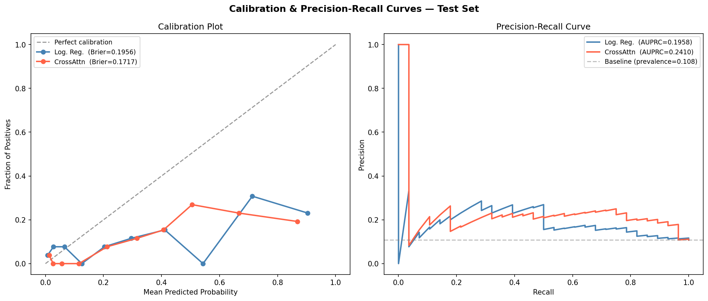
3. Detailed progress
Callibration Plot & PR Curve - Model 3 [Clinic + AEC + Scan]

Slide 30


