Slide 1
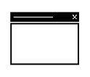





TensorRT Workflow
Input
●
Output
●
Pre-trained FP32 model and network
Optimized execution engine on GPU for deployment
Serialized a PLAN can be reloaded from the disk into the TensorRT runtime. There is no need to perform the optimization step again.
NEURAL NETWORK
OPTIMIZATION ENGINE
PLAN
EXECUTION ENGINE
11

Slide 2
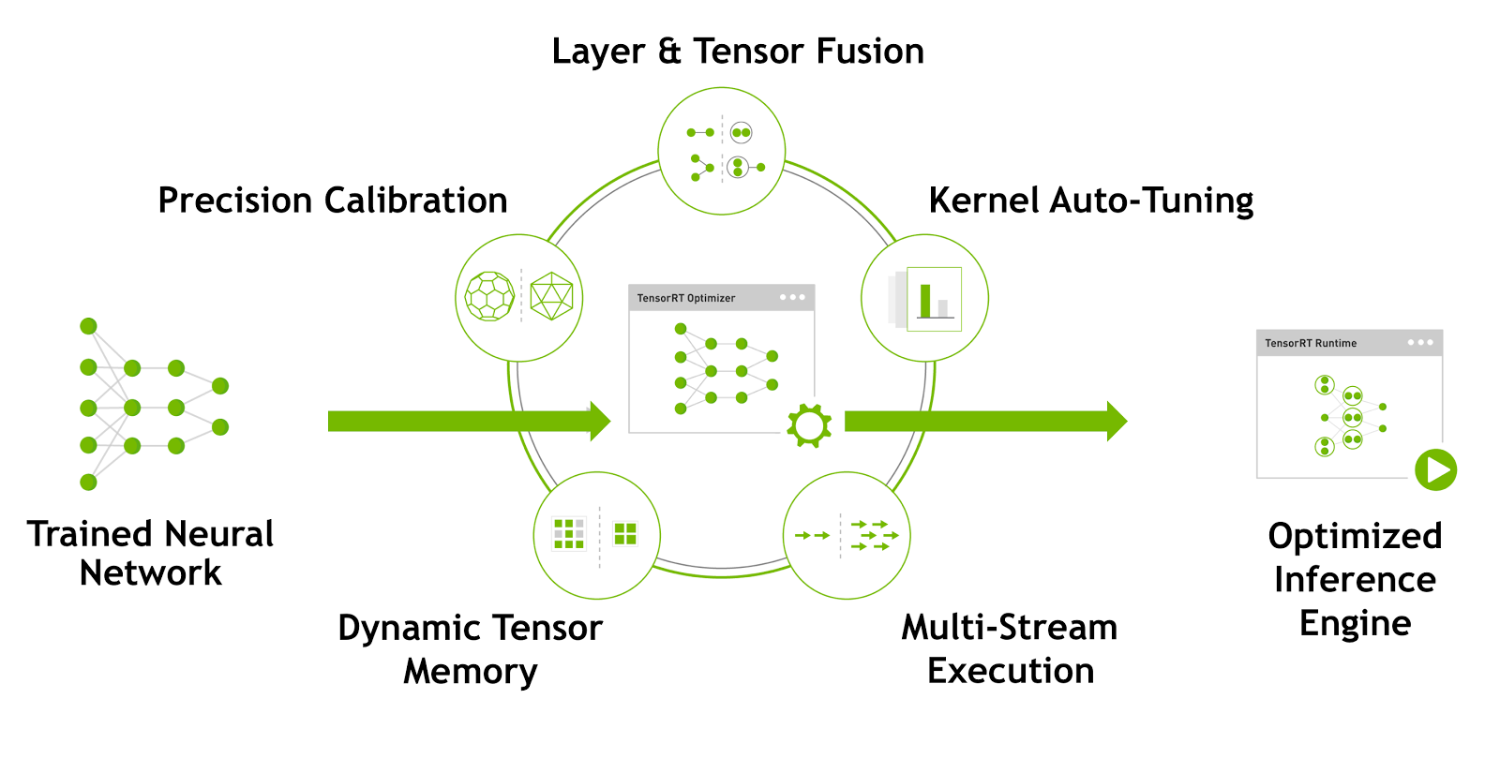
TensorRT

Slide 3
Fuse network layers
Inception structure in GoogleNet
next input
concat
relu
relu
relu
relu
bias
bias
bias
bias
1x1 conv.
3x3 conv.
5x5 conv.
1x1 conv.
relu
bias
1x1 conv.
relu
max pool
bias
1x1 conv.
input
concat

Slide 4
Fuse network layers
Vertical fusion
next input
concat
1x1 CBR
3x3 CBR
5x5 CBR
1x1 CBR
max pool
1x1 CBR
1x1 CBR
input
concat

Slide 5
Fuse network layers
Horizontal fusion
next input
concat
1x1 CBR
3x3 CBR 5x5 CBR
1x1 CBR
max pool
input
concat

Slide 6
Fuse network layers
Concat elision
next input
1x1 CBR
3x3 CBR 5x5 CBR
1x1 CBR
max pool
input

Slide 7
Fuse network layers
Concurrency
next input
max pool
3x3 CBR
5x5 CBR
1x1 CBR
1x1 CBR
input

Slide 8
TensorRT
创建Builder
创建Network
创建Parser
绑定输入、输出以
自定义组件
序列化或者反序列化
传输计算数据（host->device）
执行计算
传输计算结果（device->host）

Slide 9
TensorRT架构
Build engine:
create parser
setWrokSpace
setkType
serialize
free
PluginFactory:
createPlugin
deserialization plugin implementation
isPlugin
free
main()
do_inference:
bind the buffers
create GPU buffers and a stream
transfer data
enqueue
release the stream and the buffers
MyPlugin:
MyPlugin()/~Myplugin()
getNbOutputs()
getOutputDimensions()
initialize()
terminate()
enqueue()--→ Cuda kernel function
serialize()/deserialize()

Slide 10
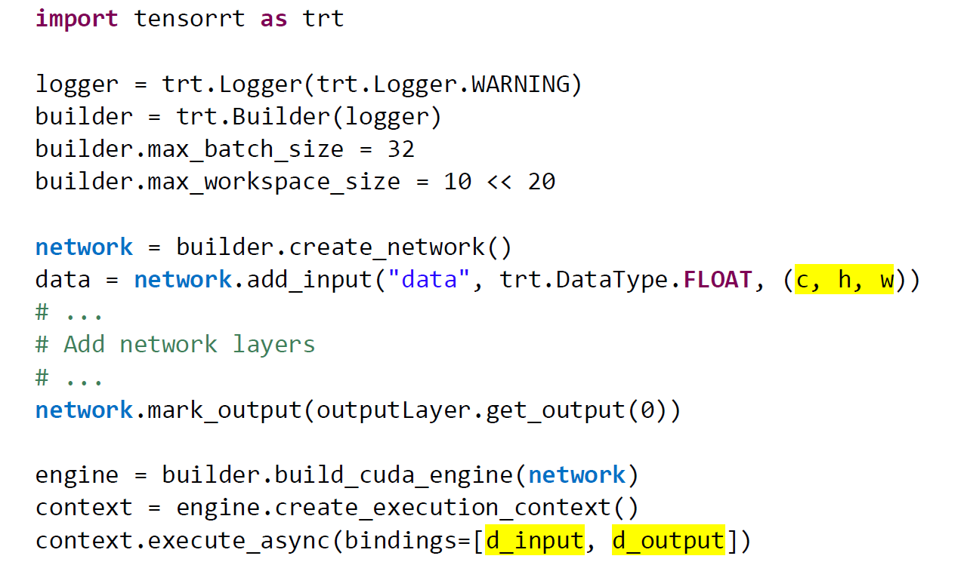
TensorRT基本框架

Slide 11
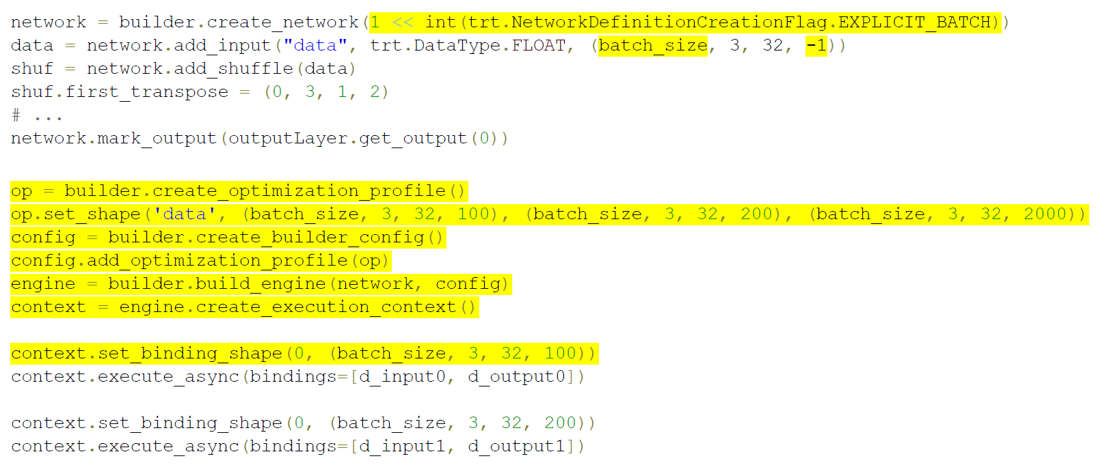
TensorRT基本框架
Dynamic reshape

Slide 12
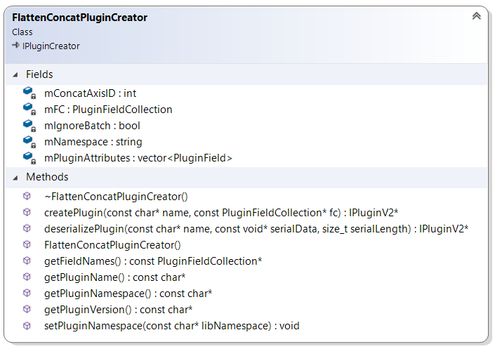
TensorRT架构
PluginFactory:
createPlugin
deserialization plugin implementation
isPlugin
free

Slide 13
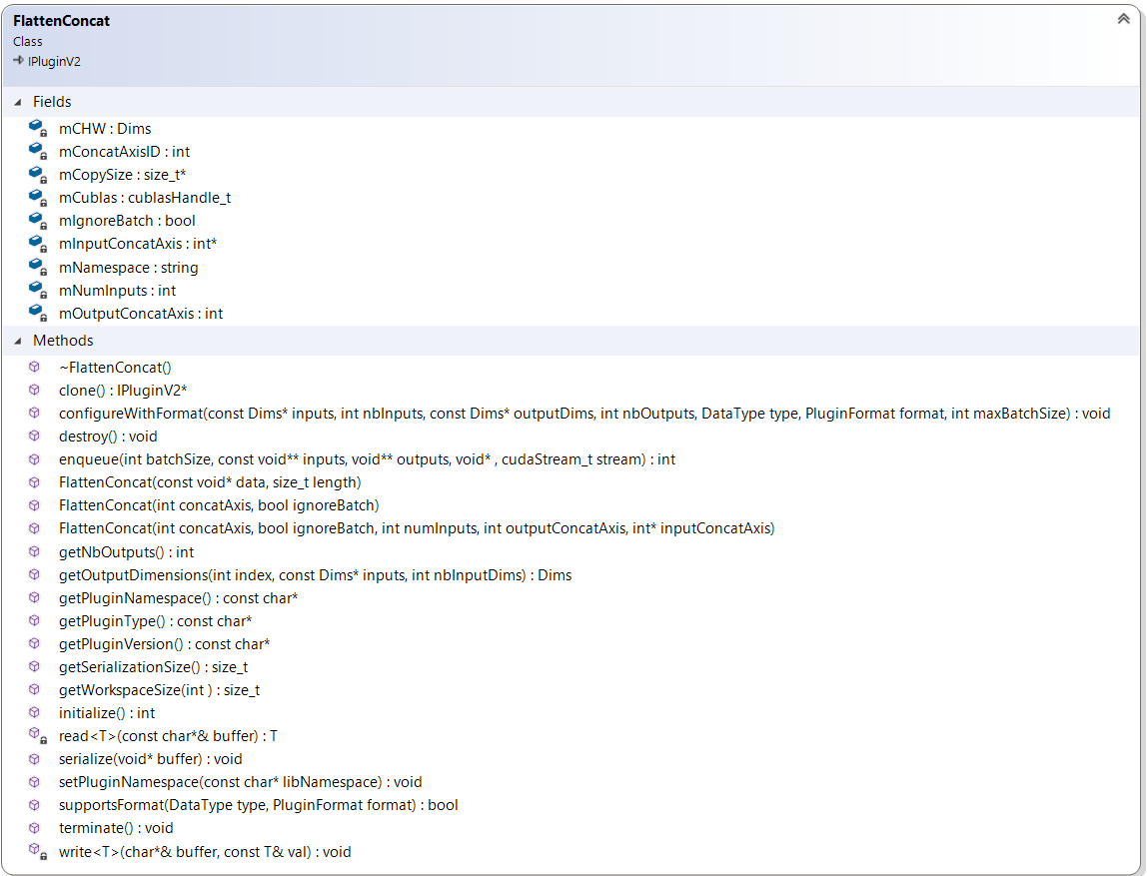
TensorRT架构
MyPlugin:
MyPlugin()/~Myplugin()
getNbOutputs()
getOutputDimensions()
initialize()
terminate()
enqueue()--→ Cuda kernel function
serialize()/deserialize()

Slide 14
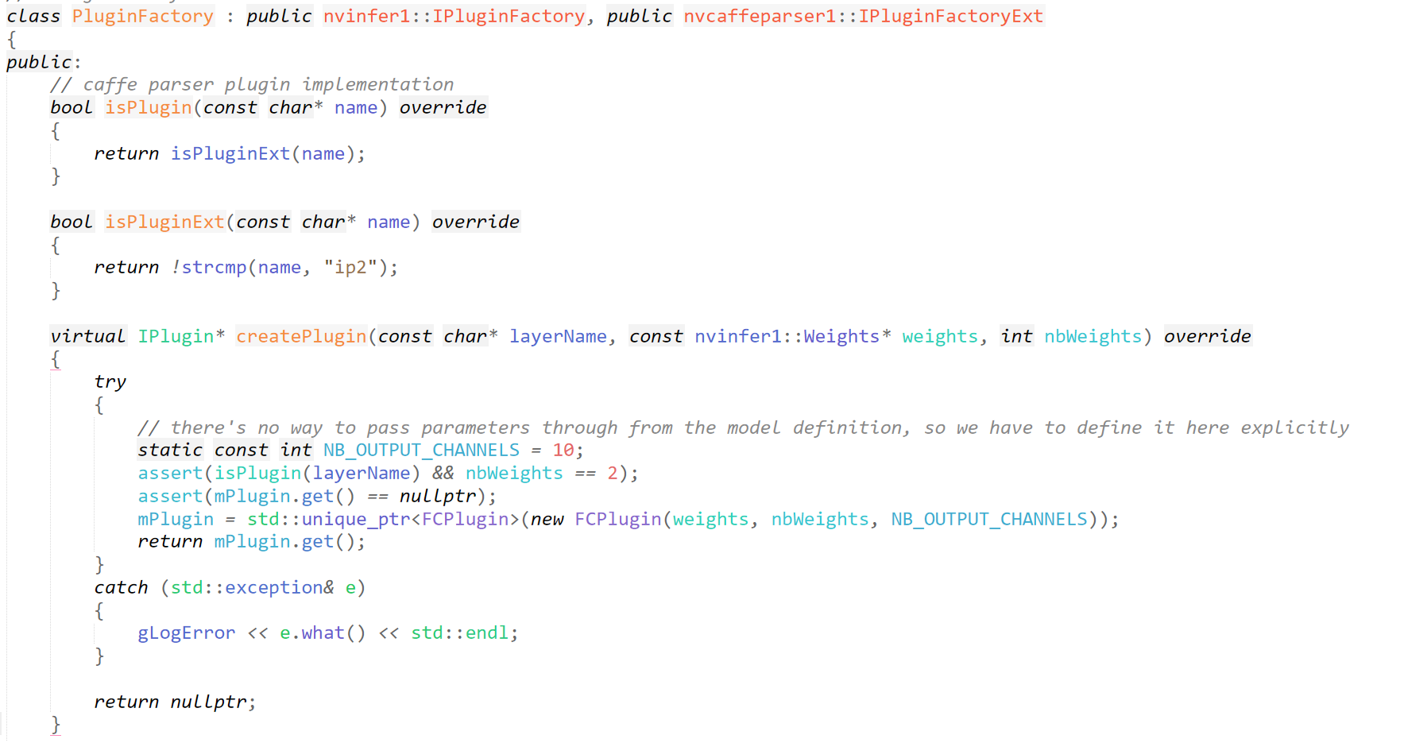
TensorRT基本框架
创建Plugin Factory

Slide 15
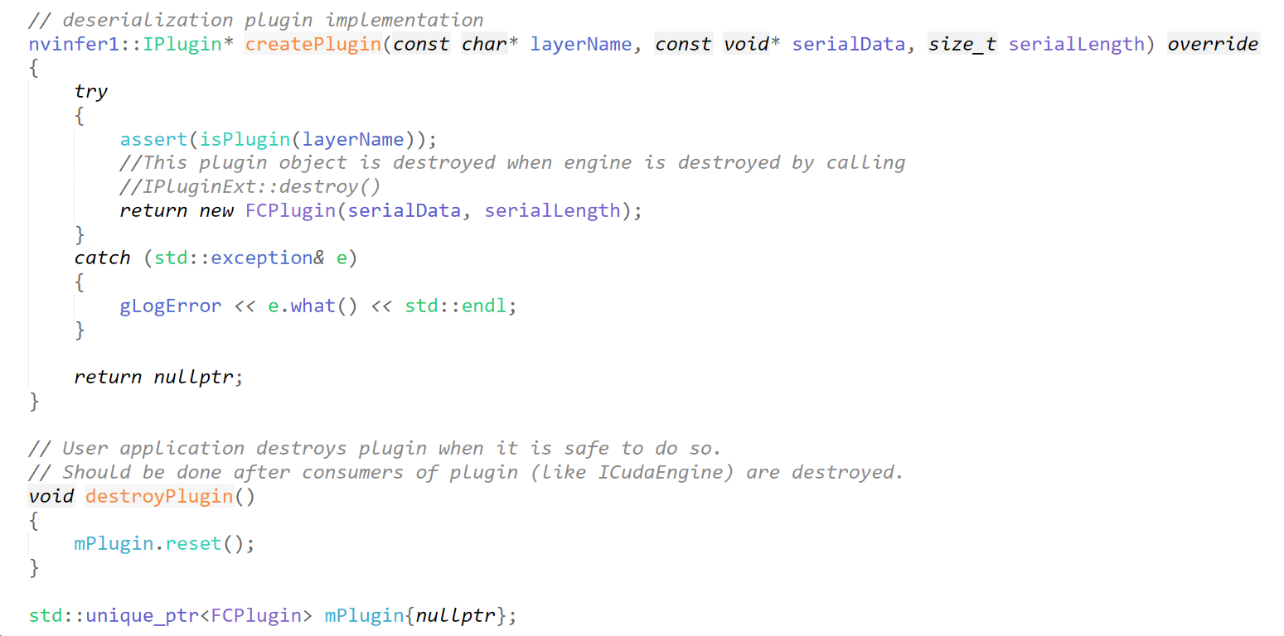
TensorRT基本框架
创建Plugin Factory

Slide 16
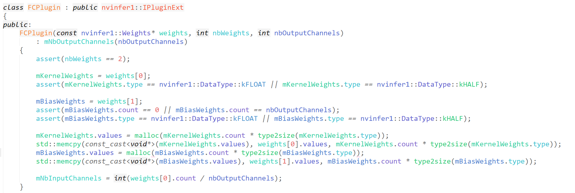
TensorRT基本框架
创建MyPlugin 构造函数

Slide 17
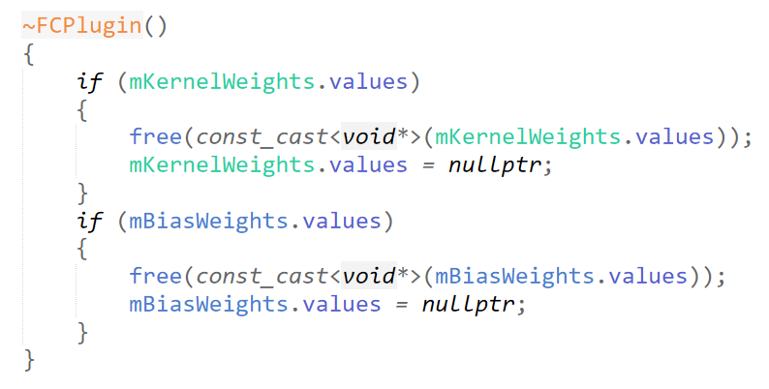
TensorRT基本框架
创建MyPlugin析构函数

Slide 18
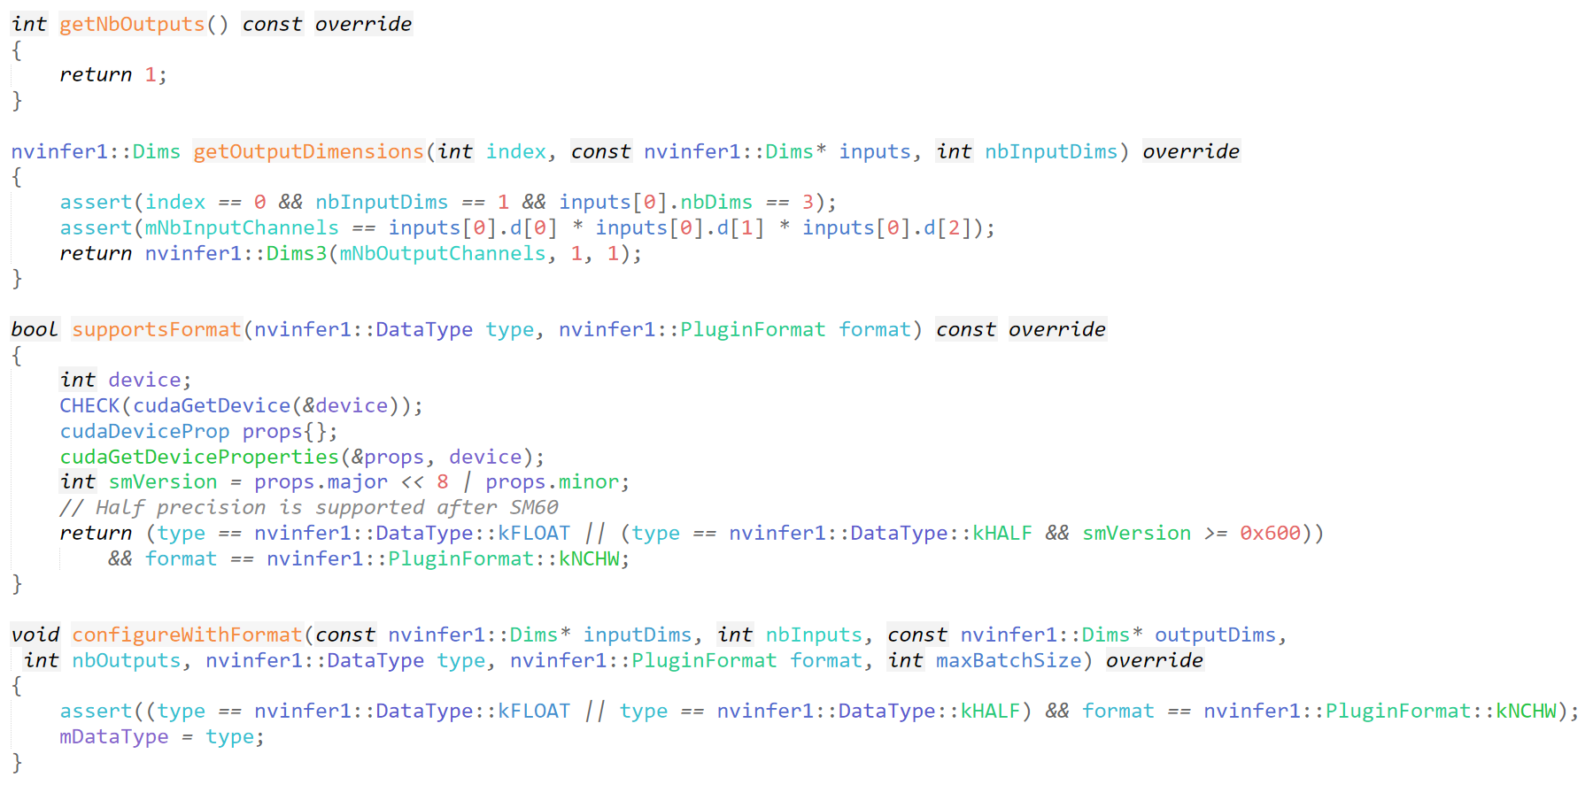
TensorRT基本框架
定义MyPlugin的一些参数

Slide 19
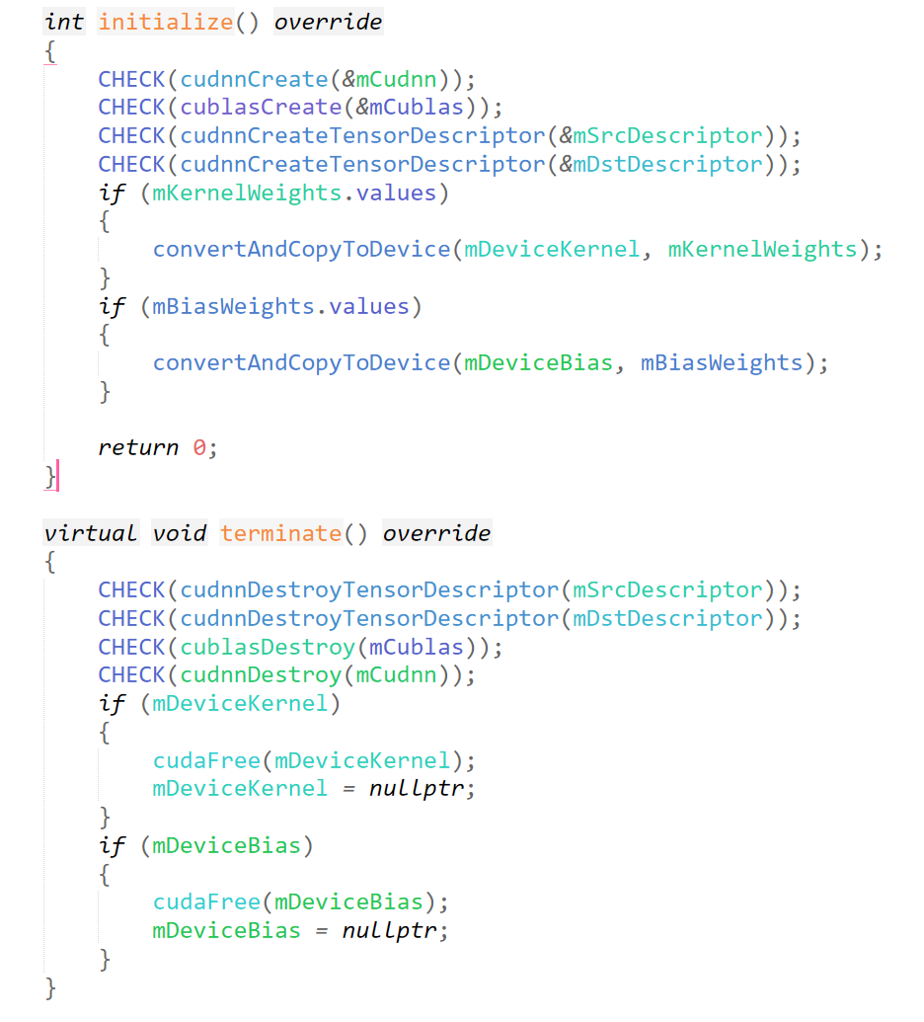
TensorRT基本框架
定义MyPlugin初始化和释放资源的方法

Slide 20
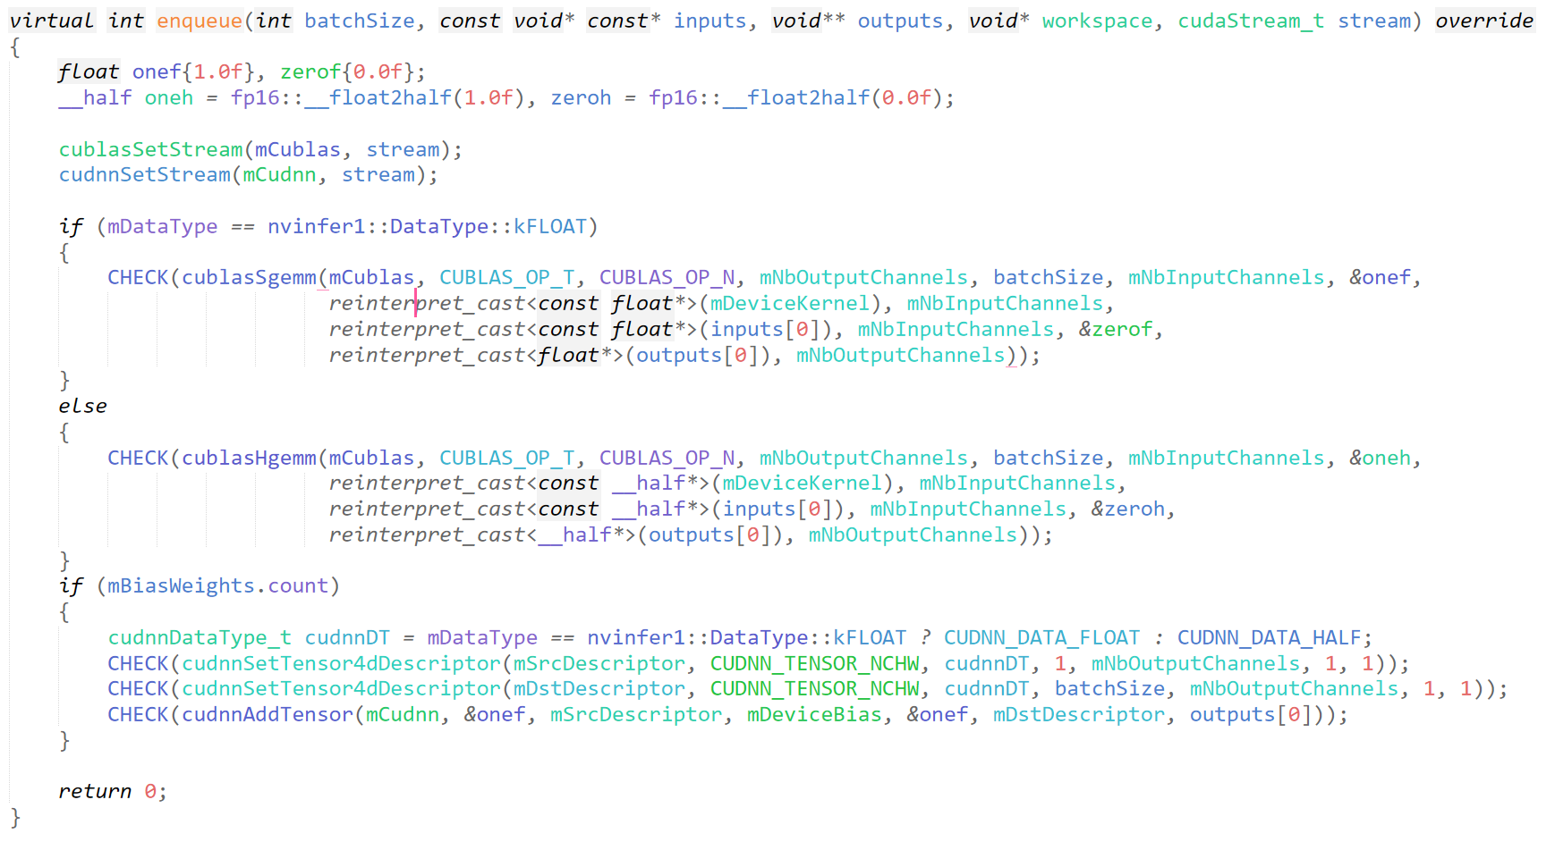
TensorRT基本框架
定义MyPlugin执行方法----使用cuBLAS和cuDNN

Slide 21
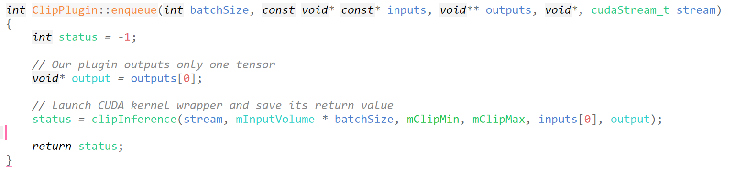
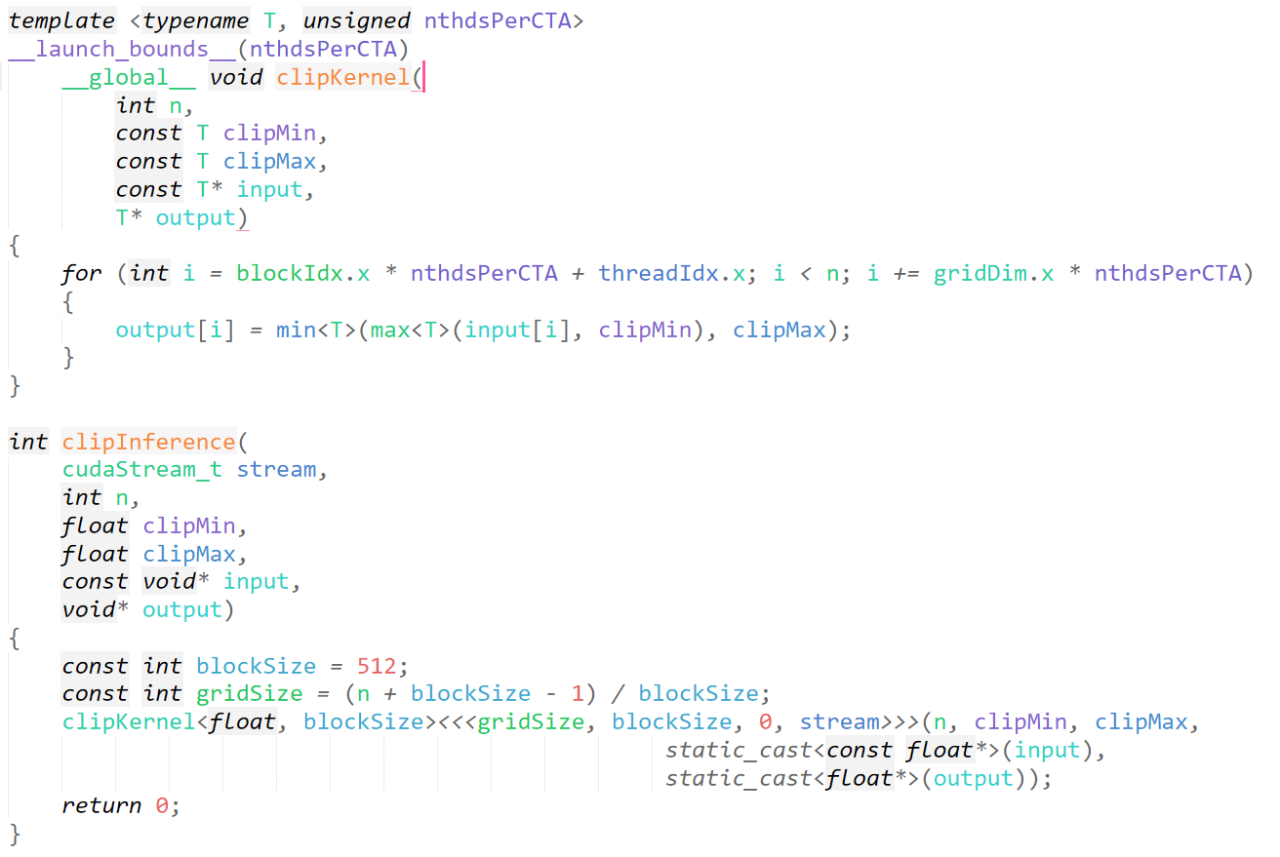
TensorRT基本框架
定义MyPlugin执行方法----不使用cuDNN和cuBLAS
MyPlugin
enqueue
Cuda Kernel

Slide 22
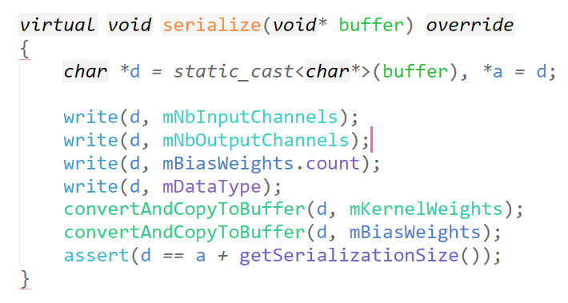
TensorRT基本框架
定义MyPlugin的序列化

