Slide 1
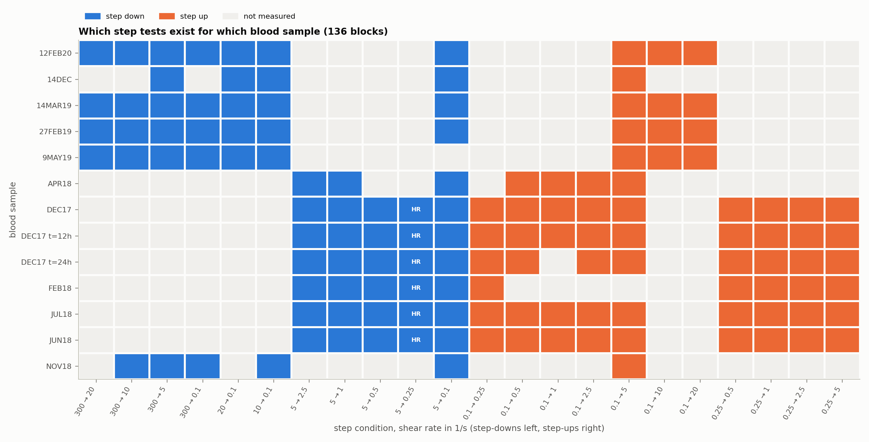
The data: 11 blood samples, 136 steps
Two protocol families, so step size is tied to the sample: we compare within families
15
workbooks received
11
blood samples with step tests
136
step tests after removing copies
22
matched up/down pairs
Data: Armstrong & Horner, ARES-G2 human blood rheology, Mendeley Data (2020–22); supplied workbooks.

Slide 2
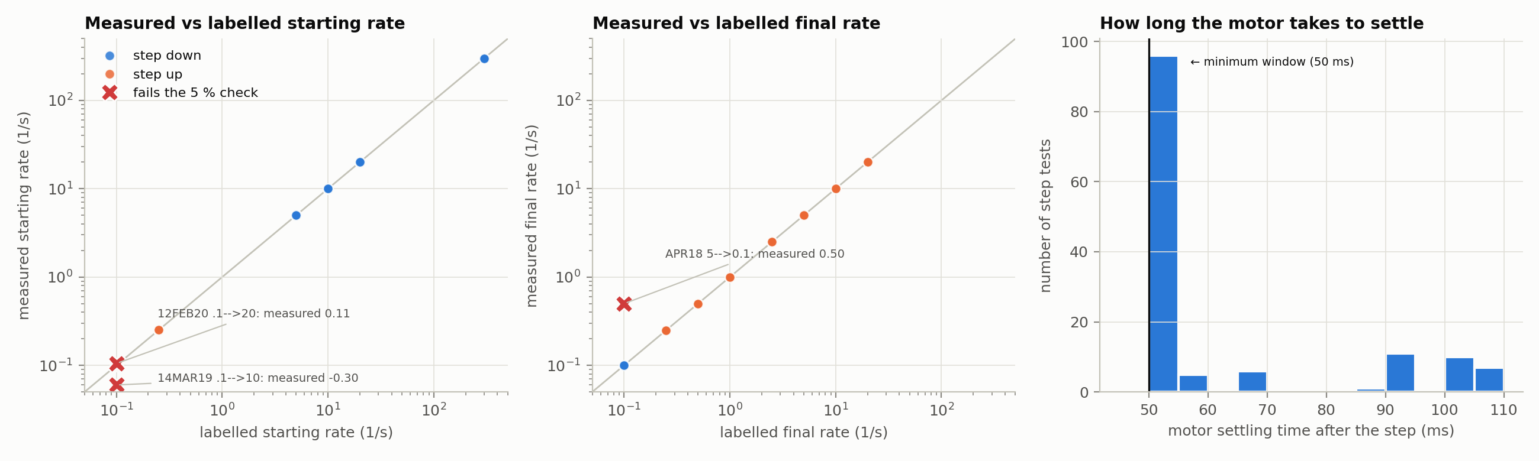
Checking the data before using it
Applied rates match their labels; three mislabelled blocks and seven copies are removed
133 / 136
steps match their labelled rates
7 copies
of other blocks removed
≤ 110 ms
motor transient, excluded
Protocol: Pincot & Armstrong (2021); instrument inertia: Das et al. (2024).

Slide 3
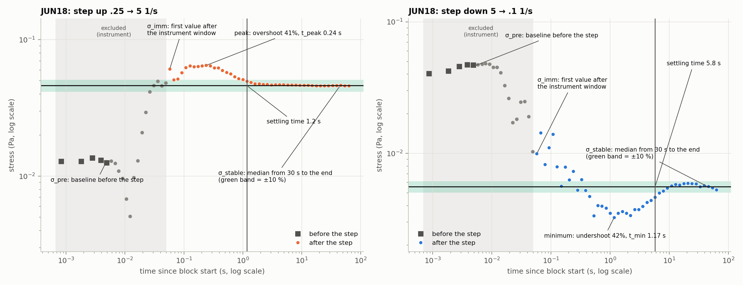
Anatomy of a step response
Breakdown after a step up is fast; rebuilding after a step down is about five times slower
Interpretation of overshoot and undershoot: Pincot et al. (2023); Armstrong et al. (2021).

Slide 4
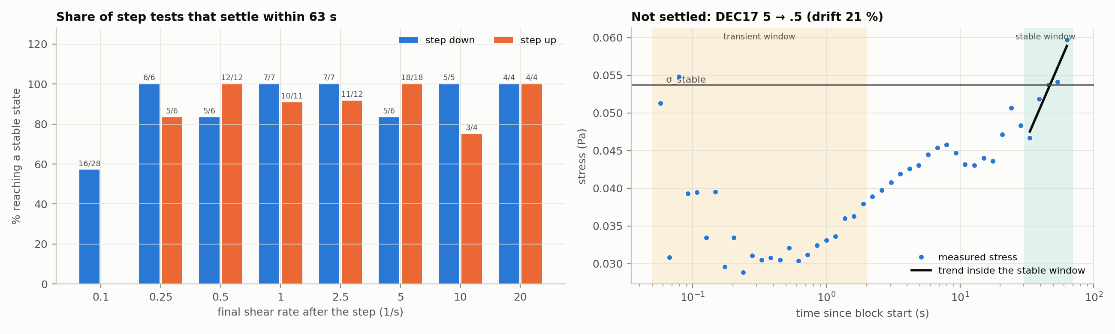
Transient and stable phases are distinct
Fixed time windows (transient to 2 s, stable from 30 s) separate the phases in every sample
87 %
of steps reach a stable state
16 / 28
steps down to 0.1 s⁻¹ settle
11 / 11
samples: transient ≠ stable
Window lengths set from the published structural time τλ ≈ 1.1 s (Armstrong et al., 2022).

Slide 5
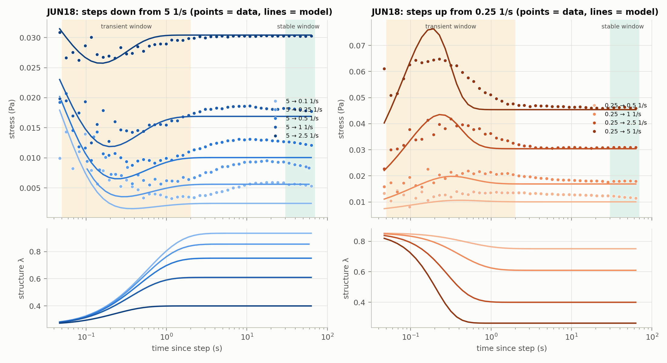
The model matches the literature
Fitted to each sample, the ethixo-EVP model gives τλ and G on the published scale
0.64 s
median τλ
published 0.55–1.13 s
0.27 Pa
median G
published 0.29 Pa, same model
13 / 13
fits converge, no parameter on a bound
Model: Armstrong et al. (2021), Eqs. 10–16; fitting: Armstrong et al. (2022), Eq. 12; Pincot & Armstrong (2021).

Slide 6
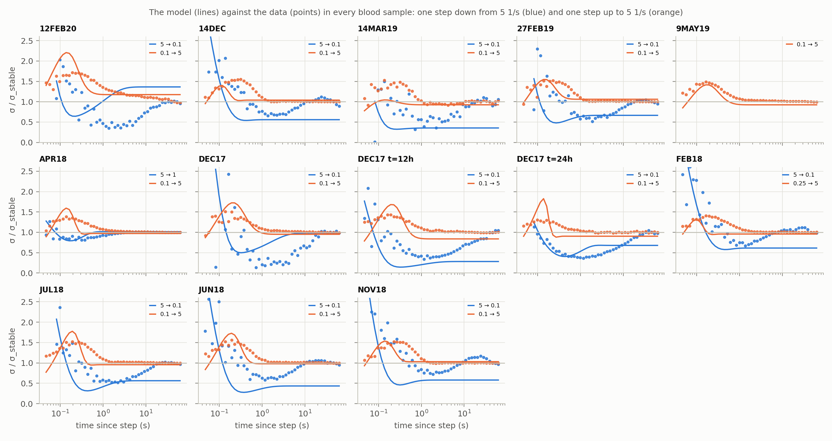
Where the model falls short
After a step down, stress keeps recovering for 10–60 s, a slower process the model lacks
50 / 133
steps fitted within the pre-set tolerance
49 %
of single-exponential τ values usable
Points to a second, slower structural time scale (Wei et al., 2018)
Stress divided by each step's own stable value, so all samples share one scale.

Slide 7
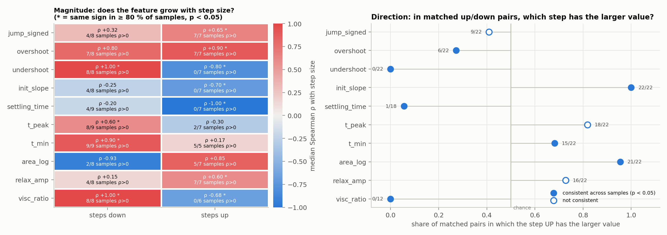
Step size and direction leave signatures
Different features carry step size in each direction; undershoot and initial slope carry direction
Statistics on per-sample summaries (11 independent samples); sign tests across samples.

Slide 8
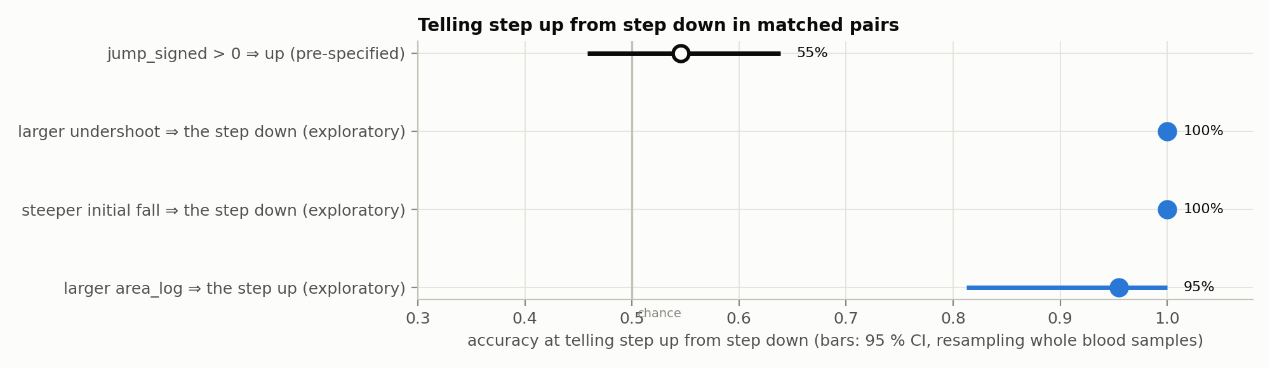
Telling step up from step down
Our planned rule failed; three rules found afterwards separate the pairs but need new samples
55 %
planned rule (chance = 50 %)
22 / 22
pairs: larger undershoot = step down
21 / 22
pairs: larger area = step up
Confidence intervals: bootstrap resampling whole blood samples (2,000 resamples).

Slide 9
References
Papers supplied by the team, the datasets they publish, and additional sources
Papers used
Armstrong, Scully, Clark, Corrigan & James (2021). J. Non-Newtonian Fluid Mech. 290, 104503.
Armstrong, Pincot, Rogers, Knight & Bailey (2022). Frontiers in Physics 10, 889065.
Pincot & Armstrong (2021). Scientific Reports 11, 22004.
Pincot, Burpo, Javadi, Jamali, Farrington & Armstrong (2023). Physics of Fluids 35, 113104.
Additional sources
Wei, Solomon & Larson (2018). J. Rheol. 62, 321–342.
Bureau, Healy, Bourgoin & Joly (1980). Biorheology 17, 191–203.
Das, Hudson-Kershaw, Yang, Curtis & McKinley (2024). J. Rheol. 68, 365–383.
Virtanen et al. (2020). SciPy 1.0. Nature Methods 17, 261–272.
Datasets (Armstrong & Horner, Mendeley Data)
JUN18: doi.org/10.17632/948ffnypjs.1
JUL18: doi.org/10.17632/s8w6s6f68b
DEC17: doi.org/10.17632/d43r5ydpx8.1
FEB18: doi.org/10.17632/jdzpx6hy6r.1
APR18: doi.org/10.17632/6jjryg2f8v.1
MAR19: doi.org/10.17632/6dx72mxmy9.1
MAY19: doi.org/10.17632/k8fxtjhcxj.1
Project documents
Group 24: project plan; Semester 1 report; Part 1 data-processing pipeline.

