Slide 1
Statistical Analysis for Monte Carlo Simulations

Slide 2
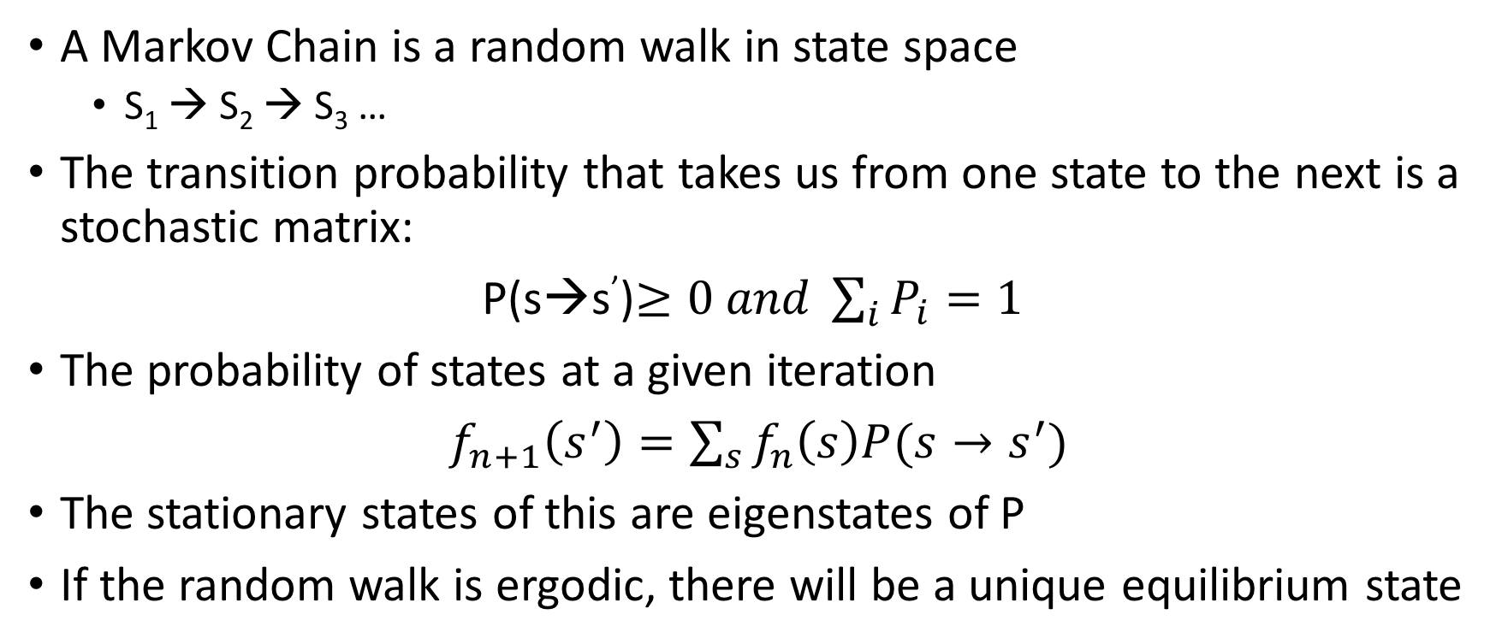
Markov Chains
A Markov Chain is a random walk in state space
S₁ → S₂ → S₃ …
The transition probability that takes us from one state to the next is a stochastic matrix:
P(s→s’)$≥0 and \sum_{i}{P_{i}=1}$
The probability of states at a given iteration
$f_{n+1}\left(s^{′}\right)=\sum_{s}{f_{n}\left(s\right)P(s→s^{′})}$
The stationary states of this are eigenstates of P
If the random walk is ergodic, there will be a unique equilibrium state

Slide 3
The Monte Carlo methods we will learn about are largely Markov Chains
Need to be able to understand the statistical data from them
A classic example of a Markov Chain is Brownian Motion
Imagine scattering some larger particles in a fluid
The initial positions are random
The positions of the particles evolve by collisions with the rest of the fluid
After some equilibration, the position of the particles satisfies the diffusion equation

Slide 4
Example Code
In the Day 1 directory of the git repository (https://github.com/lkwagner/StochasticSchool.git)
The code RandomWalk.py simulates a random walk of N particles in a quartic potential
Parameters such as the time step of the propagation, the number of walkers and the total number of time steps can be changed in the top of the file

Slide 5
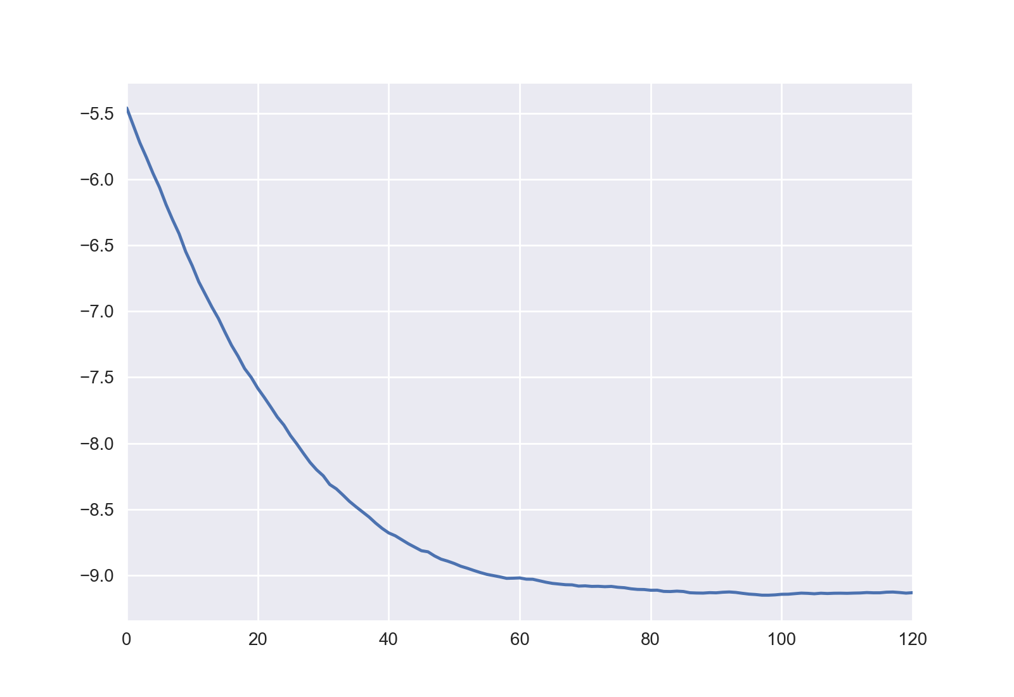
Example Code continued
Run the application with 128 walkers and a timestep of 0.01 to generate a time series like the following:
This is can be divided into two phases, equilibration and equilibrium
Potential energy
Timestep number

Slide 6
Exercise #1
Create an algorithm to divide the time series into equilibration and equilibrated phases
Hint: start from the end of the calculation

Slide 7
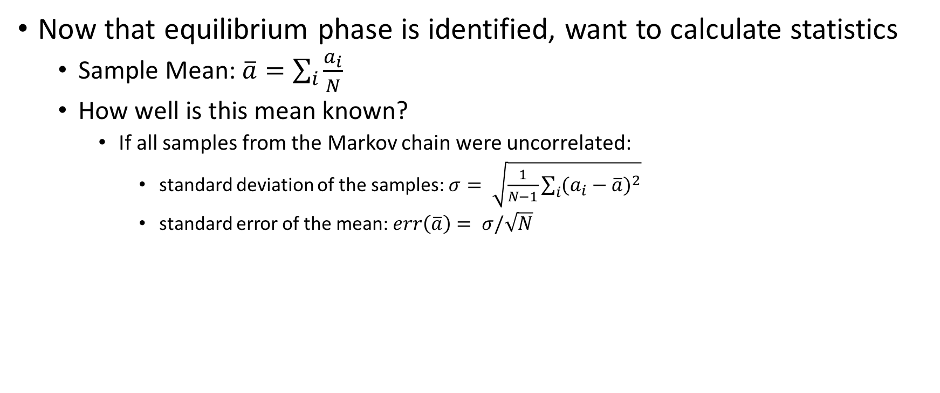
Calculating properties
Now that equilibrium phase is identified, want to calculate statistics
Sample Mean: $\overline{a}=\sum_{i}{\frac{a_{i}}{N}}$
How well is this mean known?
If all samples from the Markov chain were uncorrelated:
standard deviation of the samples: $σ= \sqrt{\frac{1}{N−1}\sum_{i}{{(a_{i}−\overline{a})}^{2}}}$
standard error of the mean: $err\left(\overline{a}\right)= σ/\sqrt{N}$

Slide 8
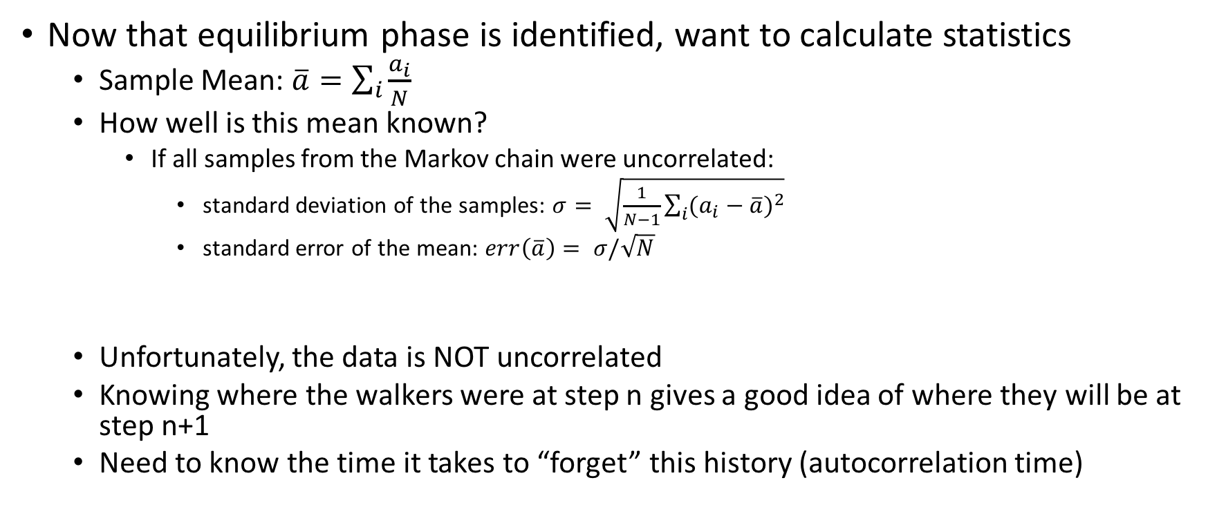
Calculating properties
Now that equilibrium phase is identified, want to calculate statistics
Sample Mean: $\overline{a}=\sum_{i}{\frac{a_{i}}{N}}$
How well is this mean known?
If all samples from the Markov chain were uncorrelated:
standard deviation of the samples: $σ= \sqrt{\frac{1}{N−1}\sum_{i}{{(a_{i}−\overline{a})}^{2}}}$
standard error of the mean: $err\left(\overline{a}\right)= σ/\sqrt{N}$
Unfortunately, the data is NOT uncorrelated
Knowing where the walkers were at step n gives a good idea of where they will be at step n+1
Need to know the time it takes to “forget” this history (autocorrelation time)

Slide 9
Two commonly used methods of handling this
Blocking
Direct use of autocorrelation function

Slide 10
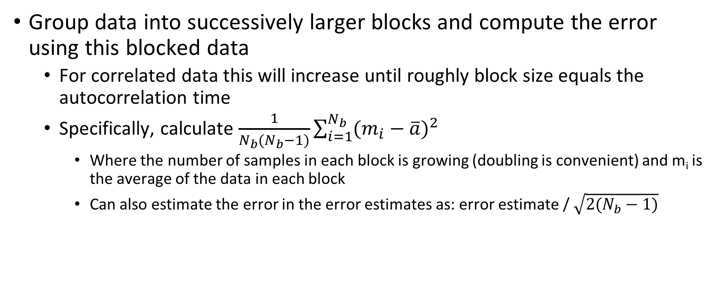
Blocking method
Group data into successively larger blocks and compute the error using this blocked data
For correlated data this will increase until roughly block size equals the autocorrelation time
Specifically, calculate $\frac{1}{N_{b}(N_{b}−1)}\sum_{i=1}^{N_{b}}{{(m_{i}−\overline{a})}^{2}}$
Where the number of samples in each block is growing (doubling is convenient) and m_{i} is the average of the data in each block
Can also estimate the error in the error estimates as: error estimate / $\sqrt{2(N_{b}−1)}$

Slide 11
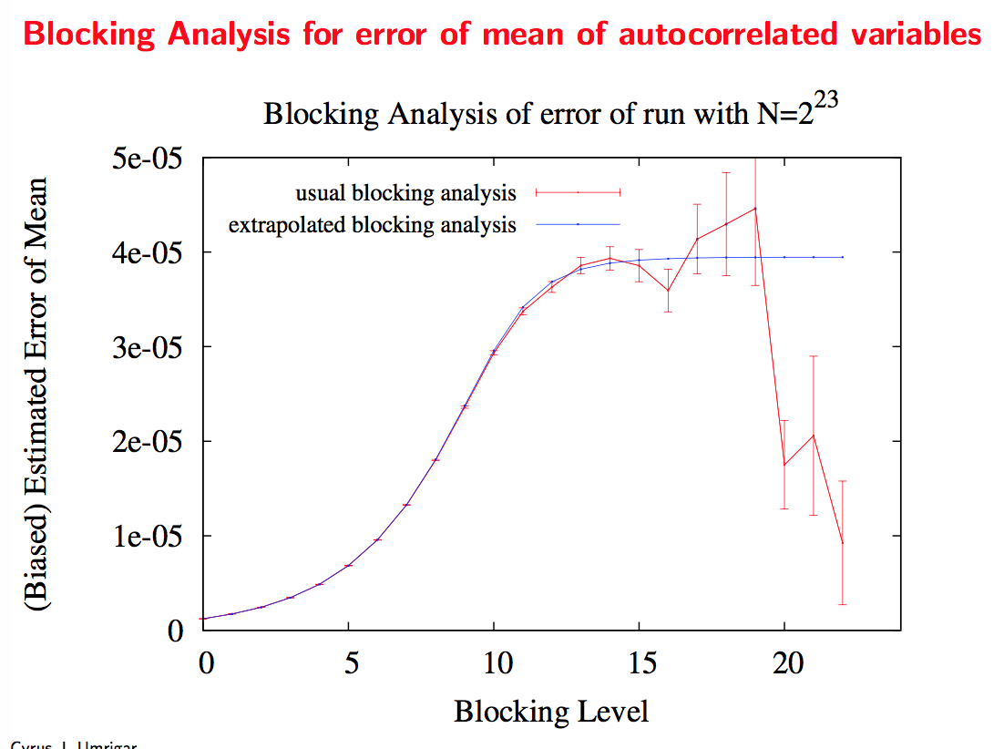
Blocking method example (courtesy C. Umrigar)

Slide 12
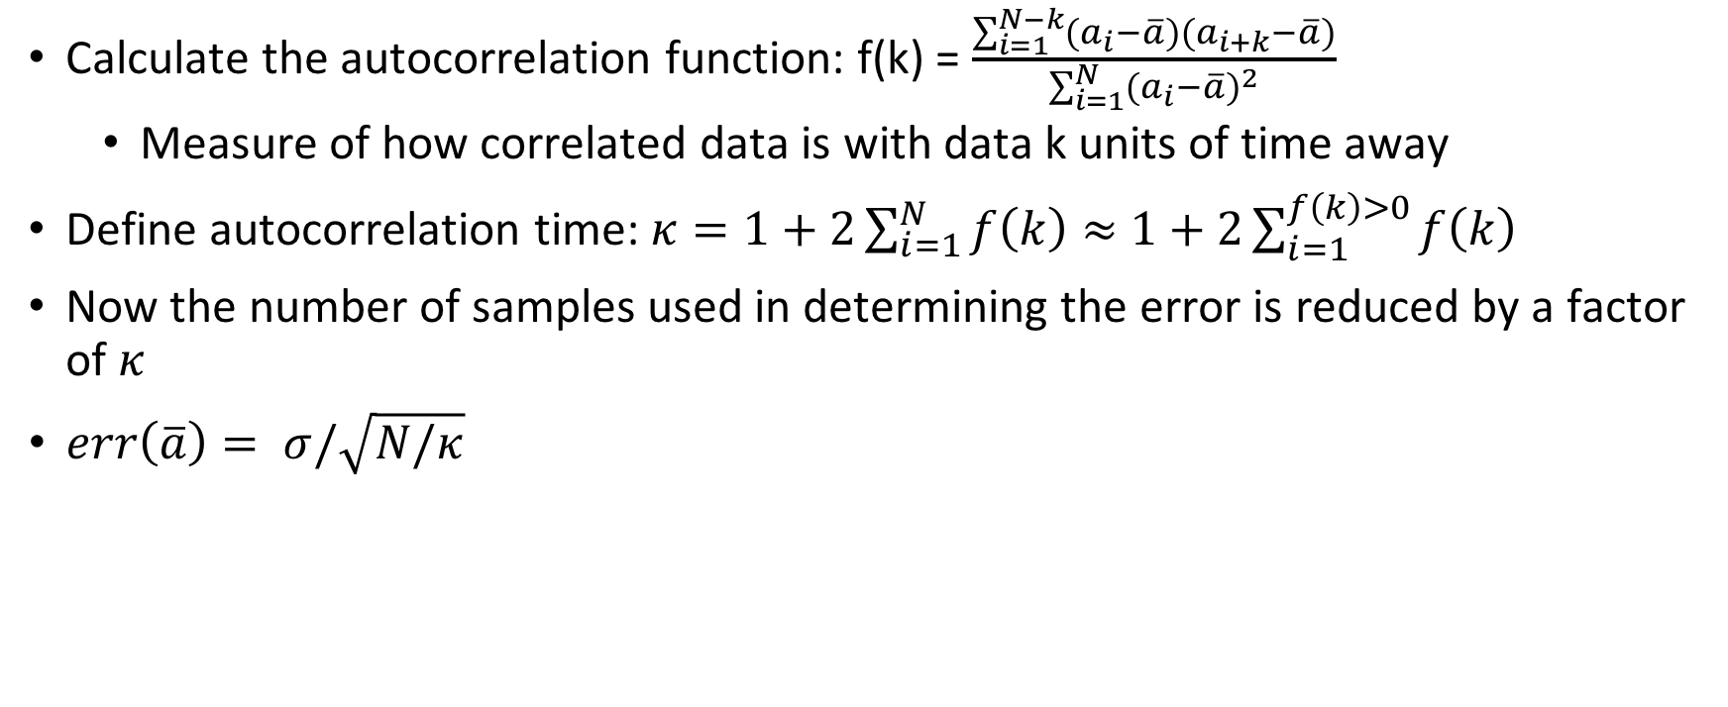
Direct calculation of autocorrelation function
Calculate the autocorrelation function: f(k) = $\frac{\sum_{i=1}^{N−k}{(a_{i}−\overline{a})(a_{i+k}−\overline{a})}}{\sum_{i=1}^{N}{{(a_{i}−\overline{a})}^{2}}}$
Measure of how correlated data is with data k units of time away
Define autocorrelation time: $κ=1+2\sum_{i=1}^{N}{f\left(k\right)≈}$ $1+2\sum_{i=1}^{f\left(k\right)>0}{f\left(k\right)}$
Now the number of samples used in determining the error is reduced by a factor of $κ$
$err\left(\overline{a}\right)= σ/\sqrt{N/κ}$

Slide 13
Exercise #2
Implement either the blocking method or the autocorrelation method to determine the average and error in that average for data from the equilibrated part of a Markov chain

Slide 14
Exercise #3
Combine the algorithms from exercises 1 and 2 and analyze the data from RandomWalk.py
Perform an initial calculation with 128 walkers, 2000 steps and a timestep of 0.005
Using the same number of walkers, how many steps would be necessary to get the same error bar with a timestep of 0.0025?
If you double the number of walkers, how many steps are necessary to get the same error bar?

Slide 15
Digression on ergodicity
In everything previous we have assumed ergodicity
Basically that given enough propagation time, a walker can come arbitrarily close to any point in space
Must always be aware of the possibility that this could be violated

Slide 16
Exercise #4
Alter RandomWalk.py so that walkers are initially distributed from -4 to 4 (rather than 2-3, see line ~45)
For various values of the timestep is it possible to enter into a nonergodic calculation?
Look at timeseries of energies
Use histogram of final positions (example code at end of file)

Slide 17
A set of advice from a D. Ceperely lecture…
“Shouldn’t the energy settle down to a constant”
NO. It fluctuates forever. It is the overall mean which converges.
“The cumulative energy has converged”.
BEWARE. Even pathological cases have smooth cumulative energy curves.
“Data set A differs from B by 2 error bars. Therefore it must be different”.
This is normal in 1 out of 10 cases. If things agree too well, something is wrong!
“My procedure is too complicated to compute errors”
NO! NEVER! Run your whole code 10 times and compute the mean and variance from the different runs. If a quantity is important, you MUST estimate its errors.

