Slide 1
Variational Monte Carlo: Practical Session
Luke Shulenburger
(adapted from previous school’s presentation by B. Busemeyer)

Slide 2
Classes in python:
Class Hamiltonian
Member data:
Self.Z
(ion charge) Member functions:
Def compute_energy(self, pos)
(compute an energy)
How to use:
Create instance: calls __init__(self,…) ham=Hamiltonian(Z=2)
Use functions ham.compute_energy(pos1) ham.compute_energy(pos2)

Slide 3
Goals
For a He atom:
Implement pieces (evaluation and sample)
Explore parameters
Explore the effect of including correlation in the wavefunction
Details are provided in “instructions.pdf”

Slide 4
Nota bene:
Test early and often
Do simplest implementation first
Avoid solutions until you’ve been stuck for quite some time. Ask questions first!!!
Discuss interpretation question with group

Slide 5
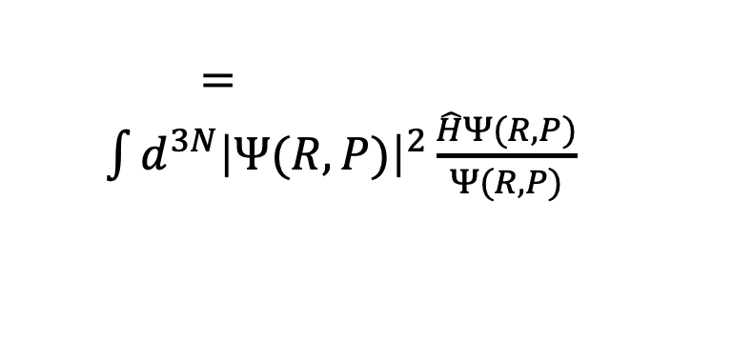
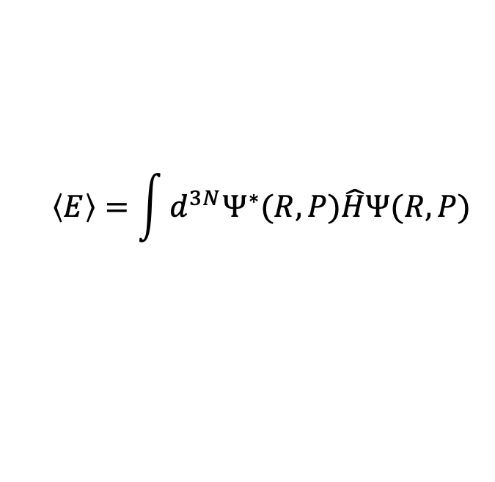
What are we trying to do in VMC
Compute an expectation value for a known (parameterized) wavefunction
$$\left\langle E\right\rangle =\int{d^{3N}Ψ^{∗}(R,P)\hat{H}Ψ(R,P)}$$
R: positions
P: parameters
$=\int{d^{3N}{\left|Ψ(R,P)\right|}^{2}\frac{\hat{H}Ψ(R,P)}{Ψ(R,P)}}$
Probability distribution
Some function of R: E(R) “local energy”

Slide 6
In this code
Including all pieces necessary to evaluate a gaussian wavefunction (eventually times a Jastrow factor) for the local energy
Using the metropolis algorithm to be able to sample the probability distribution from the square of the wavefunction
Once we can evaluate these for generic choices of parameter, can think about optimization

