Slide 1
Python Preliminaries
Luke Shulenburger
(adapted from previous school’s presentation by James Shepherd)

Slide 2
Pre - preliminaries
Class arrangement
Have working python (2 or 3), need numpy, scipy, matplotlib, pandas, seaborn
Anaconda works well for instance
Clone the git repository with materials from the school:
git clone https://github.com/lkwagner/StochasticSchool.git
Everything from today is in Day1 (update frequently)
Notes:
Will attempt to present everything so that it can be completed with no prior knowledge
However, let’s take some time to sort into groups, Groups of roughly 3 tend to work well, if possible, try to have at least 1 person experienced with python and one experienced with QMC in each group

Slide 3
Will use python throughout the week
Two parts
Introduce a few basic libraries
Exercises to solve in groups

Slide 4
Part 1: Basic Libraries
5 libraries are likely to be encountered
Numpy (essentials for scientific computing)
Class: numpy.ndarray – a multidimensional container
Function: numpy.array() – turns a list into an array
Method: numpy.ndarray.max – finds max of an array
Etc.
Powerful N-dimensional array object (ndarray or array)
Linear algebra, Fourier transform, and random number capabilities

Slide 5
Numpy example
~$ python
>>> import numpy as np
>>> a = np.array([2,3,4])
>>> a
array([2, 3, 4])
>>> print(a)
[2,3,4]

Slide 6
Numpy example
~$ python
>>> import numpy as np
>>> b = np.array([[1.2, 3.5, 5.1],[1.2, 3.5, 5.2]])
>>> print(b)
[[ 1.2 3.5 5.1]
[ 1.2 3.5 5.2]]
>>> b.shape
(2, 3)

Slide 7
Numpy quick functionality
array creation
np.random.randn – normally distributed random numbers
np.zeros – an array of zeros
np.arange – sequential array starting at 0 and going to n-1
np.newaxis – increase dimension of array
simple math
np.sqrt – square root
np.exp – exponential function
np.outer – outer product for vectors
statistics
np.sum – sum of elements
np.mean – average
np.std – standard deviation

Slide 8
Part 1: Basic Libraries
5 libraries are likely to be encountered
Numpy (essentials for scientific computing)
Scipy (augments numpy functionality)
More linear algebra, integration, interpolation, special functions, FFT, signal and image processing, ODE solvers and more

Slide 9
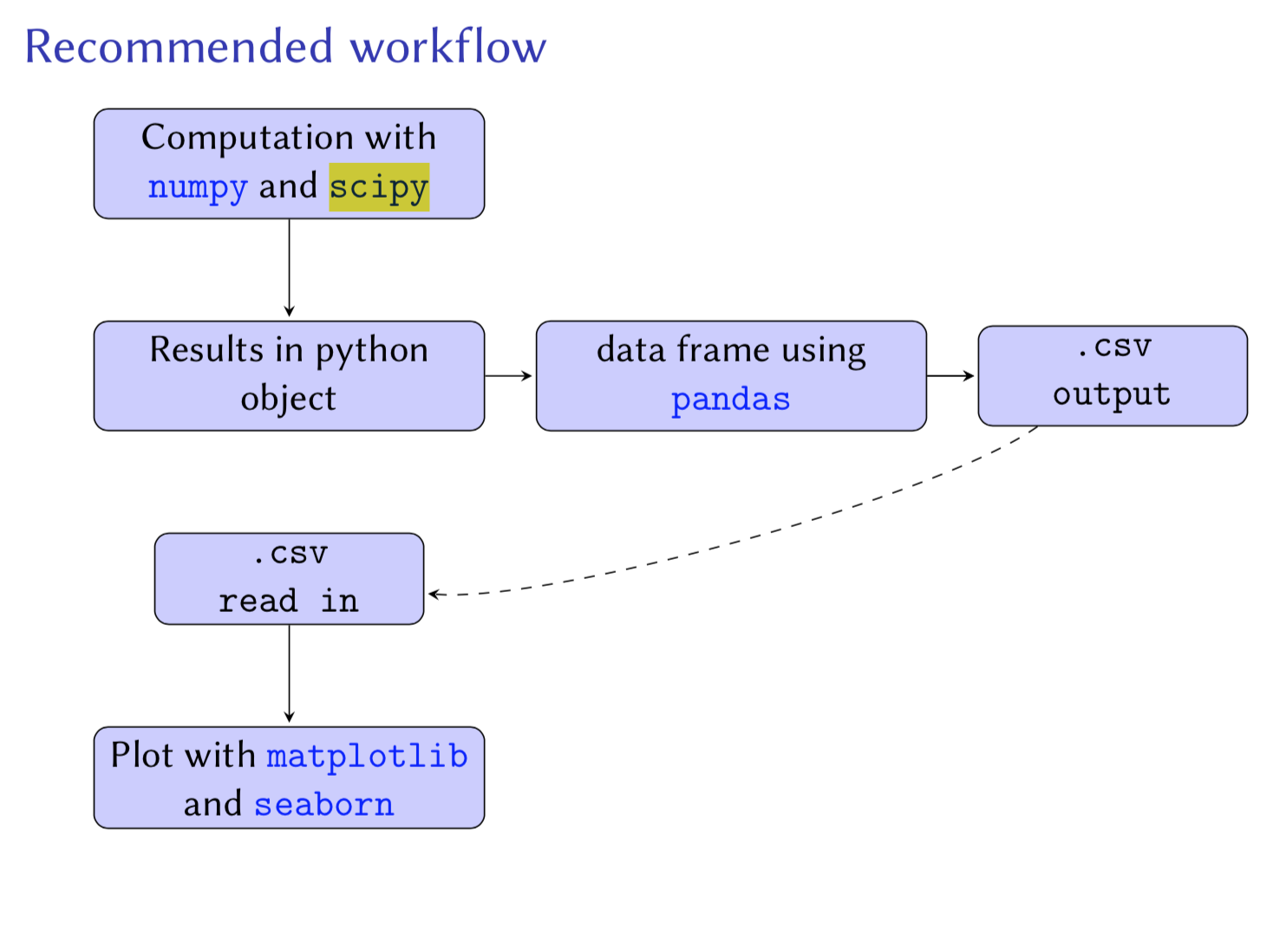

Slide 10
Part 1: Basic Libraries
5 libraries are likely to be encountered
Numpy (essentials for scientific computing)
Scipy (augments numpy functionality)
Pandas (data manipulation)

Slide 11
Pandas example
~$ python
>>> import numpy as np
>>> import pandas as pd
>>> npts = 50
>>> df={‘a’:np.random.random(npts),
’b’:np.random.random(npts),
‘category’:[‘cat1’]*int(npts/2) + [‘cat2’]*int(npts/2) }
>>> df=pd.DataFrame(df)

Slide 12
Part 1: Basic Libraries
5 libraries are likely to be encountered
Numpy (essentials for scientific computing)
Scipy (augments numpy functionality)
Pandas (data manipulation)
Matplotlib (a 2d plotting library)

Slide 13
Continuing previous example
>>> import matplotlib.pyplot as plt
>>> plt.figure()
>>> plt.scatter(‘a’,’b’,data=df)
>>> plt.xlabel(‘a’); plt.ylabel(‘b’);
>>> plt.savefig(“scatter.pdf”,bbox_inches=‘tight’)

Slide 14
Matplotlib quick functionality
plot creation
plt.figure – creates a canvas
plt.plot – produces a plot of bivariate data
plt.scatter – scatter plot
plt.subplots – return a subplot axes in a grid
simple formatting
plt.xlabel and plt.ylabel – set axis labels
plt.xlim and plt.ylim – set axis limits
Output
plt.savefig – save file
plt.show – see the plots on screen

Slide 15
Part 1: Basic Libraries
5 libraries are likely to be encountered
Numpy (essentials for scientific computing)
Scipy (augments numpy functionality)
Pandas (data manipulation)
Matplotlib (a 2d plotting library)
Seaborn (interfaces with matplotlib for drawing aractive statistical graphics)

Slide 16
Continuing previous example
>>> import seaborn as sea
>>> plt.figure()
>>> sea.regplot(x=‘a’, y=‘b’, data=df)
>>> plt.savefig(“regression.pdf”, bbox_inches=’tight’)

Slide 17
Part 2: Coding in groups
Exercise 1: Compare exponential evaluation of a random number (interval [1,2]) with a truncated Taylor series
Exercise 2: Generate list of points normally distributed in 3d around the origin and return a list of distances to the origin
Exercise 3: Monte Carlo evaluation of 𝜋

Slide 18
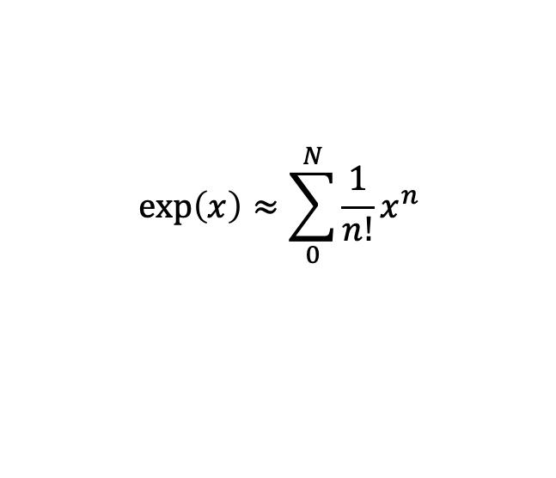
Exercise 1:Compare exponential evaluation of a random number (interval [1,2]) with a truncated Taylor series
$$\exp\left(x\right)≈\sum_{0}^{N}{\frac{1}{n!}x^{n}}$$
Explicitly import numpy as np, scipy as sp and scipy.special
Generate a random value with np.random.rand()
For Taylor series, use sp.special.factorial(i) and np.power(x,i)
Obtain comparison between exp(x) and Taylor series for 10 orders
Can use np.sum(array) and np.multiply(array1,array2)

Slide 19
import numpy as np
import scipy as sp
import scipy.special
n=10
estimates=np.arange(n,dtype='float64')
x=np.random.random()+1
for i in range(n):
d=np.arange(i)
c=1.0/sp.special.factorial(d)
d=np.power(x,d)
estimates[i]=np.sum(np.multiply(c,d))
print("x=",x, "Exp(x)=",np.exp(x))
print(estimates)
print(estimates-np.exp(x))

Slide 20
Exercise 2: Take an array of positions normally distributed about the origin and return the distance to the origin
Array of random points is generated for you (note randn instead of random)
Will need to use numpy.sqrt
Can take advantage of numpy.sum(x,axis=n)
For a given value of n, sums over the n’th indes of the array x
In the case of the example, the 0th index is the points, and the 1st index is the positions

Slide 21
import numpy as np
npts=10
pos=np.random.randn(npts,3)
#pos holds npts points in 3 dimensions where x,y and z are chosen
#as normally distributed around zero
#want to find the distance form the origin for each point in a new array dist
dist=np.sqrt(np.sum(pos**2,axis=1))
#alternative solution
import scipy as sp
import scipy.linalg
dist2=np.zeros(npts)
for i in np.arange(npts):
dist2[i]=sp.linalg.norm(pos[i,:])
print(dist)
print(dist2)

Slide 22
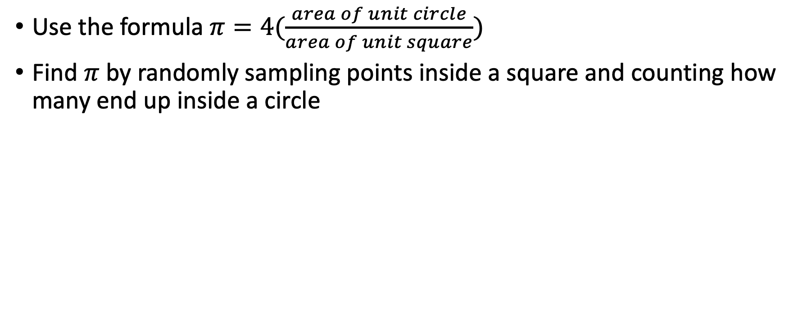
Exercise 3:Monte Carlo evaluation of pi
Use the formula $π=4(\frac{area of unit circle}{area of unit square})$
Find $π$ by randomly sampling points inside a square and counting how many end up inside a circle

Slide 23
import numpy as np; import scipy as sp
import scipy.linalg
import scipy.stats
import matplotlib.pyplot as plt
nsamples=18 # number of sample sizes
estimate=np.zeros(nsamples)*1.0 # data arrays
error=np.zeros(nsamples)*1.0
for j in np.arange(nsamples)+1:
npts=np.power(2,j) # double sampling points each time
acircle=np.zeros(npts)
pts=np.random.rand(npts,2)*2.0-1.0 # generate points inside unit square
for i in range(len(pts)):
if scipy.linalg.norm(pts[i]) < 1.0: # points inside the unit circle
acircle[i]=1
estimate[j-1]=np.mean(acircle)*4.0
error[j-1]=sp.stats.sem(acircle)*4.0
print (estimate[j-1], "+/-", error[j-1])

