Slide 1

Hallmark Assessment Task LEAD-411: HR Fundamentals Human Resource Job Analysis and Application Project Jen Hankins April 25, 2024
Notes:
My Hallmark Assessment Task for Lead 411 Human Resource Fundamentals is a job analysis and application project. The purpose of this project is to examine best practices in selecting, hiring, and training to design a selection and training process for the job analyzed. The job focus for this analysis project is a Director of Human Resources position. The data collection methods for my research included a personal interview (Appendix A), supporting documents shared by my interviewee – Behavioral Interview Questions (Appendix B), Job Description Template (Appendix C), and LinkedIn. The research and data collection methods advantages are that it provided a comprehensive view of the best practices and allowed me to formulate a solid design for selection, hiring, and training processes. There was no disadvantage to this method, but rather that the data itself could have easily resulted in a lengthier presentation. Overall, my research and data collection highlighted the importance of identifying interview objectives, explained in more detail in my conclusion.

Slide 2

Table of Contents
Introduction - Interviewee
Purpose and Job Analysis Method
Job Description
Job Specifications - Knowledge, Skills, and Abilities
Recommendations for Selection: Selection Plan Overview
Recommendations for Selection: Structured Interview Protocol
Recommendations for Training and Development
Conclusion
References
Appendices
Notes:
The Table of Contents highlights the project deliverables and presentation slides (15 total slides).

Slide 3
Introduction
Interviewee: Greer Thomas (Interview conducted via MS Teams)
Job Title: Director, Human Resources
Years of Experience: 25 years
Company: The Chenega Corporation
Corporate Office: Anchorage, Alaska
Employs: Over 7,700 nationwide and worldwide
Chenega History:
Founded in 1974, The Chenega Corporation invested in a business development plan focused on federal government contracting through a portfolio of strategic business units in areas of military, intelligence, operations support, environmental, health care, facilities management, professional services, and security services. Chenega is among the top 10 most successful Alaskan-owned businesses. “Our pledge is simple: we do it right, every time. Our corporate culture is steeped in the values and ethics that flow from our Alaska Native leaders” (Chenega, 2023).
Notes:
I interviewed a co-worker - Greer Thomas, Director of Human Resources position at The Chenega Corporation, located in Anchorage, Alaska. Greer holds a B.S. in Organizational Communications and a Master’s in Human Resources and Labor Relations and has over 25 years of experience in human resources. Chenega is a large Alaska Native corporation that owns many subsidiaries located throughout the United States and overseas, with over 7,700 employees. As a remote employee from Florida, she travels to the corporate office and headquarters offices for the four strategic business units located in Texas, Virginia, and the District of Columbia.
I’m the Corporate Paralegal at the Alaska office and along with in-house counsel attorneys, collaborate weekly with Greer regarding employment matters. Greer has extensive knowledge and experience in dealing with various agencies (e.g., the EEOC, National Labor Relations Board, and Department of Labor) and just about any employment matter you can imagine. She has a very real sense of people that highlights the need to hire based on emotional intelligence and experience to navigate the challenges in the field of human resources.

Slide 4

Purpose and Job Analysis Method
Examine required knowledge, skills, and abilities (KSAs) of the position of Director of Human Resources
Research best practices of selection, hiring, and training
Conduct a personal Interview of Subject
LinkedIn – job postings
Chenega Corporation website
Notes:
During my interview with Greer, she explained that her educational background had provided a solid basis of knowledge. However, it is experience that has proven more valuable. Experience is what she looks for in applicants, and while she recommends at least a certification, she looks for at least three years of experience for an applicant for an entry-level position in HR. Greer explains, “I consider my role as ‘the generalist’ meaning, all aspects of HR with a heavy emphasis on compliance, finding answers to questions through creativity, flexibility and emotional intelligence” (Thomas, 2024). She provided documents that support the selection, hiring, and training process I chose - (Appendix A) Interview Notes, (Appendix B) Behavioral Interview Questions, and (Appendix C) Job Description Template. LinkedIn provided a helpful context to industry trends.

Slide 5

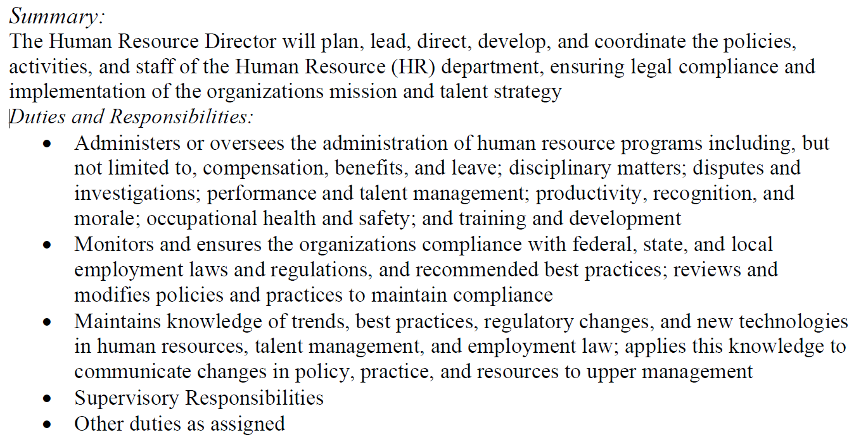
Job Description
Notes:
The snippet, the Chenega Corporation Job Description Template (Appendix B), shows the vast level of skills and responsibilities. During my interview, I asked Greer how much of her work is done independently, and she said, “About 75% of my time is spent working independently with a 50/50 use of instincts versus knowledge” (Thomas, 2024). She explained that an applicant must have a minimum of a bachelor’s degree or five years of experience, and it’s highly preferred that an applicant have a SHRM-CP or SHRM-SCP certification.
I searched LinkedIn for “Director of Human Resources”, and one of the searches, a Native American Indian company, had a similar job description very (e.g., “partnering with executive leadership, to understand… talent strategy, future talent needs of retention and succession planning, analyzing trends, and directives advising department directors of policy regarding equal employment opportunities, compensation plan, and employee benefits” (LinkedIn, 2024). This highlights the importance of the selection process to screen for highly qualified and experienced applicants.

Slide 6

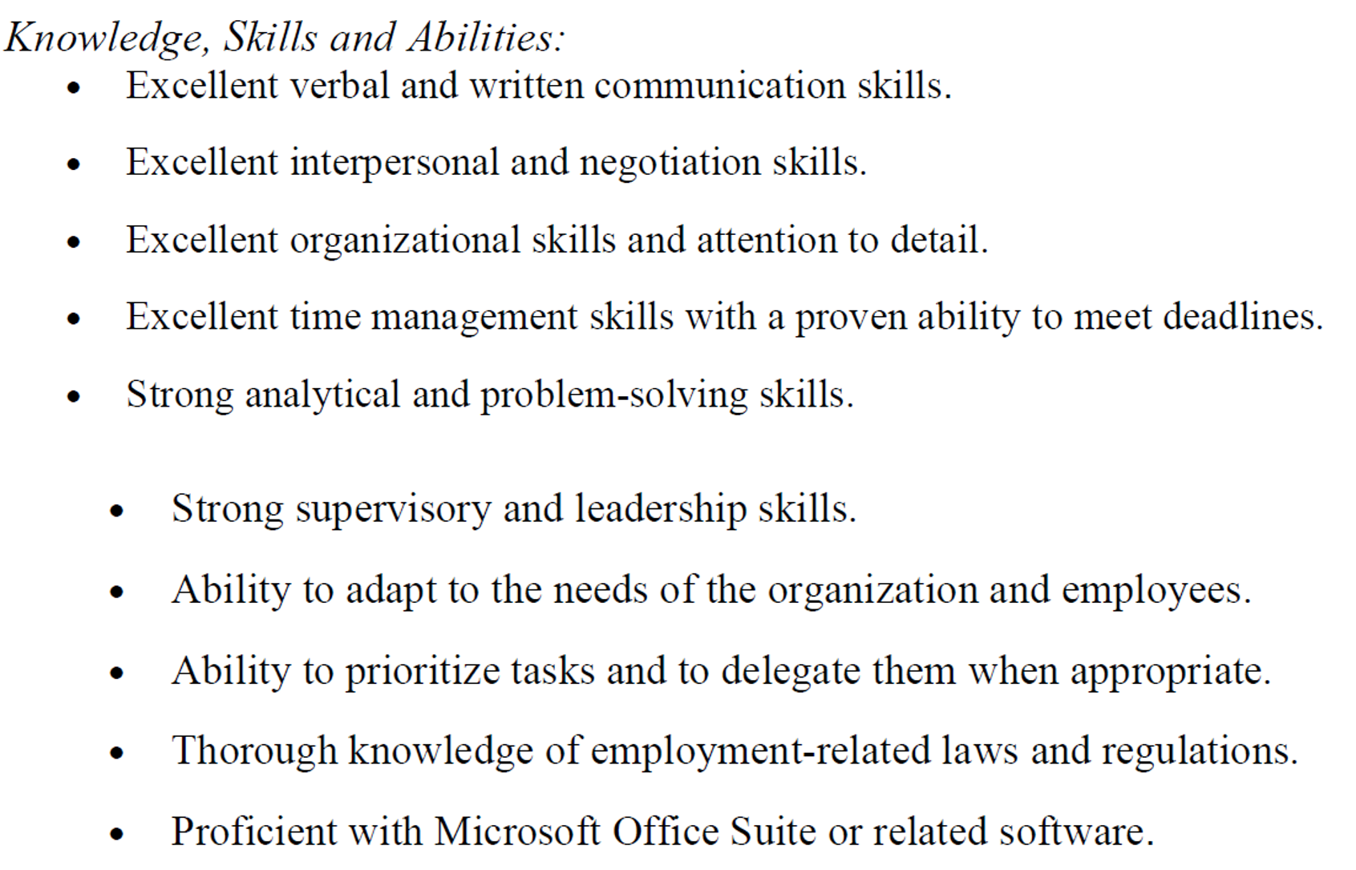
Job Specifications: Knowledge, Skills, and Abilities
Notes:
The knowledge, skills, and abilities (KSAs) for a Director of Human Resources (Appendix B) show that one must have an excellent and highly proficient skill set. Greer explained that during applicant selection, she uses a set of behavioral interview questions – the STAR method of Situation, Task, Action, Result - to test one’s strategic thinking, business acumen, leadership style, problem-solving skills, understanding of legal complexities, and employee relations (Thomas, 2024). Similarly, my research on LinkedIn also revealed standards of excellence in KSAs such as “High level of organizational skills, and ability to communicate effectively. Very strong interpersonal and effective communication skills” (LinkedIn, 2024).

Slide 7
Recommendations for Selection: Selection Plan Overview
Step 1: Job Posting & Application Process
Recruitment posting on required job posting websites, company webpage, and LinkedIn
Applicants submit resumes
Step 2: Resume Screening
Select all applicants that meet at least minimum education and experience level
Step 3: Schedule Interview
Schedule the interview (virtual or in-person)
Step 4: Interview & Assessment
Use the STAR method (Situation, Task, Action, Result) behavioral interview questions - to collect detailed examples of past experiences - testing for strengths in strategic thinking, business acumen, leadership, team management, change management, problem-solving, compliance, legal expertise, culture building, and employee relations.
Step 7: Decision and Job Offer
Phone call to extend verbal/informal job offer
Email formal offer detailing pay, pay type, signing bonus (if applicable), and benefits package
Step 5: Selection
Rank top applicants based on answers given in the assessment.
Select best candidate.
Step 6: Background Checks
Check for security background for the security position
Validate education records and work history
Notes:
Greer explained that during applicant selection, she really wants to see strong experience over education. Someone can “look good on paper” yet not be able to collaborate with internal or external clients, lack people skills, not communicate effectively, or not work well under pressure. First, selection begins with posting the job to required websites like SHRM, the company’s webpage, LinkedIn, and possibly other sites like Indeed. Second, applicants submit their resumes to apply. Third, resumes are screened to select applicants with minimum education and experience qualifications. Fourth, interviews are scheduled based on that selection; these interviews may be in-person or virtual (on camera). Fifth, the interview uses the STAR (Situation, Task, Action, Result) method to collect as much specific detail on the applicant’s past experiences to determine future performance and applicants are ranked. Sixth, a background check is performed on the top-scoring applicant. Seventh, an informal offer is given by phone – this is a chance to negotiate – and once agreed, a formal offer is sent via email.

Slide 8
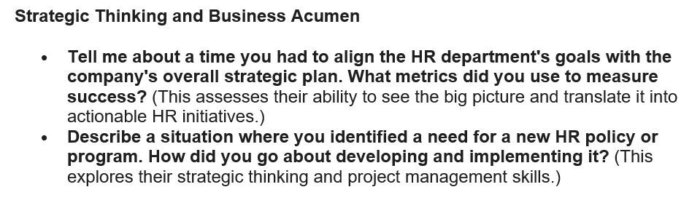
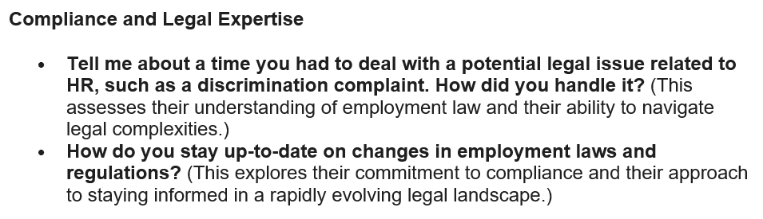
Recommendations for Selection: Structured Interview Protocol
Notes:
Greer explained that during applicant selection, she uses a set of behavioral interview questions to test one’s strategic thinking, business acumen, leadership style, problem-solving skills, understanding of legal complexities, and employee relations. The snippets are two examples of the behavioral interview questions she uses in applicant selection (Appendix C). This highlights the components of emotional intelligence and experience. This really emphasizes the need to identify the required skills for the position and your ability to capture this during a single interview.

Slide 9
Recommendations for Training & Development
Onboarding – remote workers receive onsite, one-on-one, intensive training, and workers who will be onsite, receive the same but over the course of a month or two
Continuing education via company-sponsored trainings and webinars
Staying apprised of changes in compliance laws and governing regulations – employees are expected to take initiative and ownership of their training, but are provided with reminders, and highlights via the HR company’s Yammer postings
Notes:
Greer explained that onboarding training differs – if the new hire will be remote or work onsite – if remote, then the onboarding is one-on-one and more intensive over a week or two, and if the employee will be an onsite worker, then training is over a month or two – both depend on the individual’s training and learning needs. The new hire is expected to continue education through company-sponsored training events and webinars and is required to stay apprised of policy, laws, and changes to regulations. The HR department posts, via Yammer, company-wide, the latest HR news and updates to policy and rule-making, and any updates to internal policies. All employees have mandatory training via Learn Upon reminders that are sent for one or two months prior to the due date.
I agree with these training approaches, that they are supported by leadership, but further agree that the employee themselves still has a level of responsibility to take ownership of their training and skillset. Greer stated, “Look for ways beyond mandatory and leadership-sponsored training to hone skills and gain that practical experience hiring managers are looking for, and what will further you as an asset to your organization” (Greer, 2024).

Slide 10

Conclusion
Continue your education and find new ways to adapt
Be willing to ask questions and take on new tasks as opportunities to learn and expand your knowledge and skillset
Notes:
In conclusion, I was able to identify the methods I would use to select, hire, and train someone in the field of Human Resources, especially someone at the level of Director. The key takeaways were using methods to identify experienced applicants by using the STAR method - Situation, Task, Action, Result – and fostering/supporting employee development.
As a hiring manager, to be able to select applicants with a strong skillset to navigate the ever-changing field of human resources and employment law. During my interview with Greer and in my research, it became clear that continuing your education, either formally or through other learning platforms, allows you to practice adaptability and makes you a more valuable member of your work team and employer. So as a HR hiring manager, encouraging my employee to take on new tasks as an opportunity to gain practical skills through experience, something you don’t get with a degree alone. Also, placing a value on internships and a chance for college students to gain practical experience as a competitive advantage to their colleagues. I have personally found that taking the initiative to learn new skills results in promotions and future job references. I asked Greer what advice she would offer to those looking to enter the HR field, and she said, “First, continue your education and be adaptable, and second, be willing to ask questions, admit when you need help, have failures, or needed guidance” (Greer, 2024). With the completion of this project and HR Fundamentals, I have a better understanding when I broaden my horizons into the field of HR and organizational leadership.

Slide 11
References
Chenega. (2023). Homepage - Chenega. Chenega. https://www.chenega.com/
Thomas, G. Personal Interview. (2024).
Paskenta Band of Nomlaki Indians. (n.d.). Home [LinkedIn page]. Retrieved April 22, 2024, from https://www.linkedin.com/jobs/view/3888370190/?alternateChannel=search&refId=oSOMFQrrSt5Wa8E%2FH%2BHjAA%3D%3D&trackingId=yT14pVFgs2MRmnf4sk%2FHuw%3D%3D#HYM

Slide 12
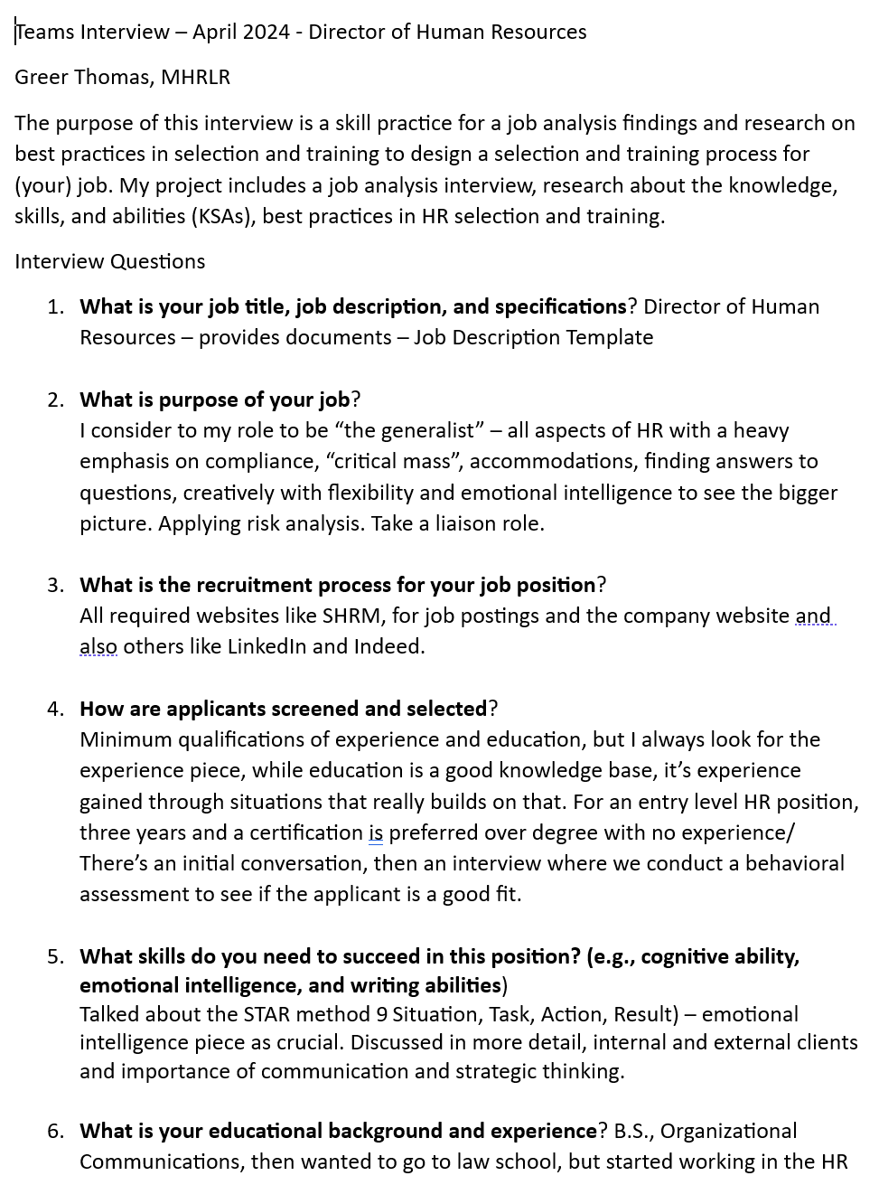
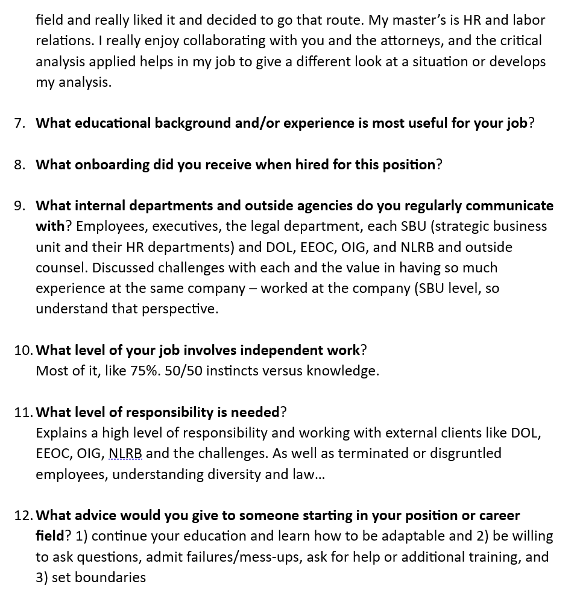
Appendix A – Interview Notes
Notes:
Appendix A – My interview with Greer was informative and was an in-depth glimpse into the world of HR management. The key takeaways - to be effective, a HR manager must develop themself first before they can effectively manage people and succeed. Also, adaptability – the HR field is constantly changing with laws, regulations, and employment challenges and the ability to flex with that and broaden your thinking to better understanding is crucial.

Slide 13
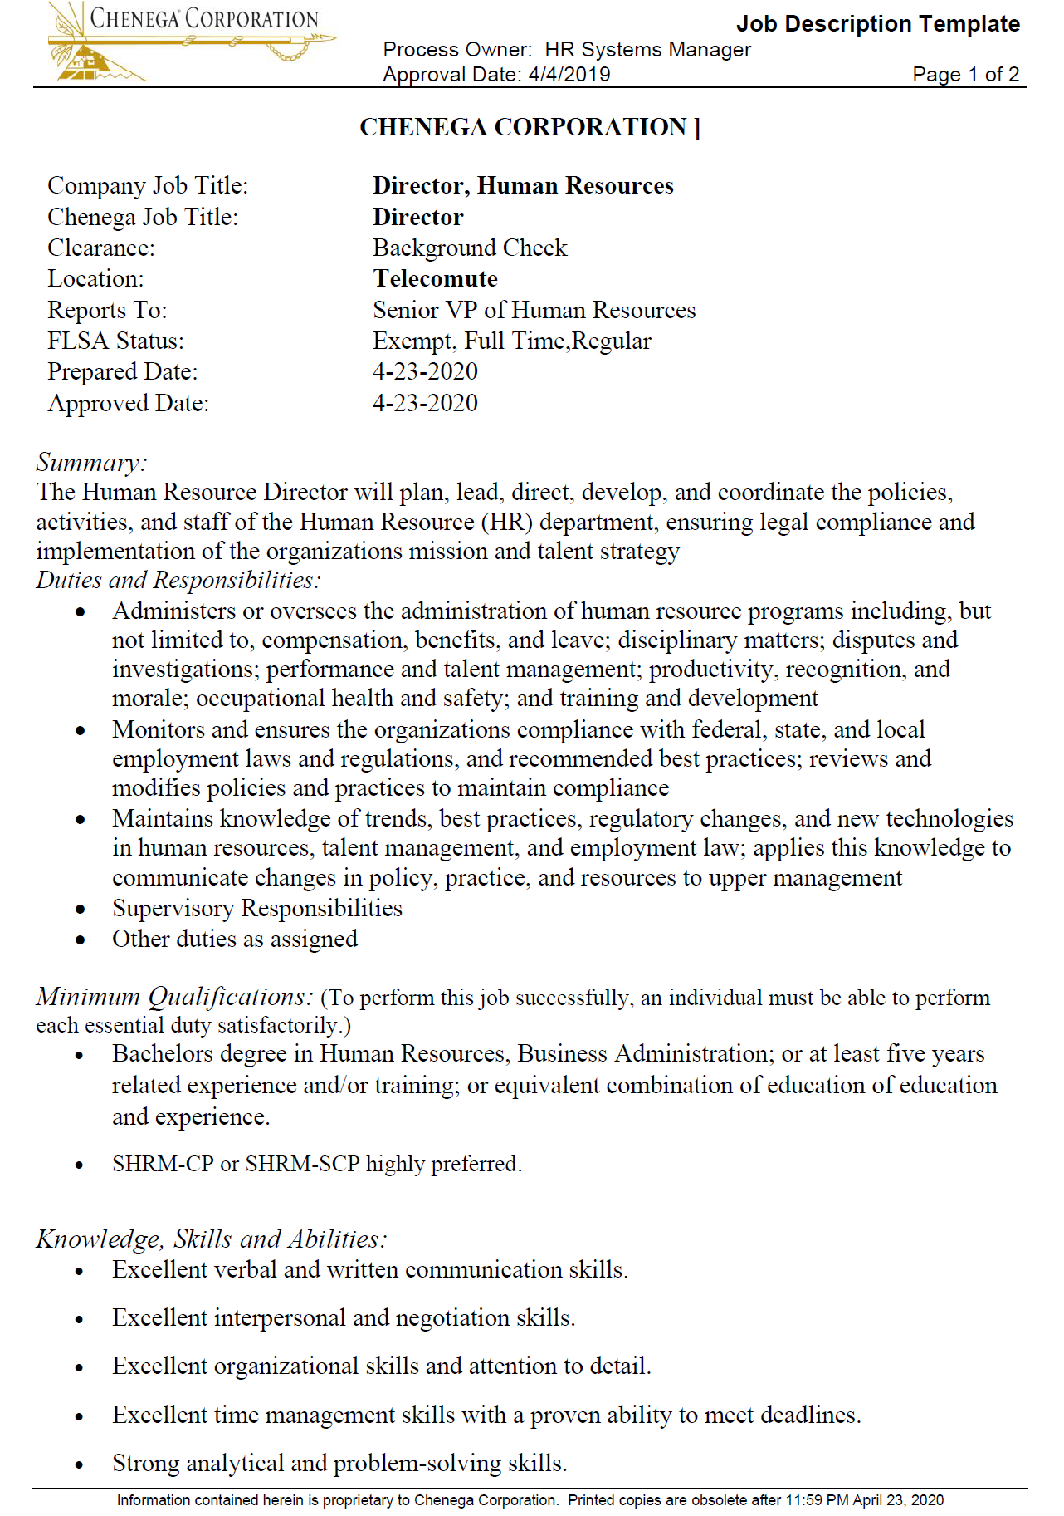
Appendix B – Page 1 Job Description Template for Director, Human Resources
Notes:
Appendix B – Job Description Template for Director, Human Resources. The position oversees, develops, and coordinates policies, legal compliances, and implementation of the organizations mission and talent strategy. There are several duties and responsibilities that require independent work and a strong skillset. While this is a direct report to the VP of Human Resources, it’s also a supervisory role.

Slide 14
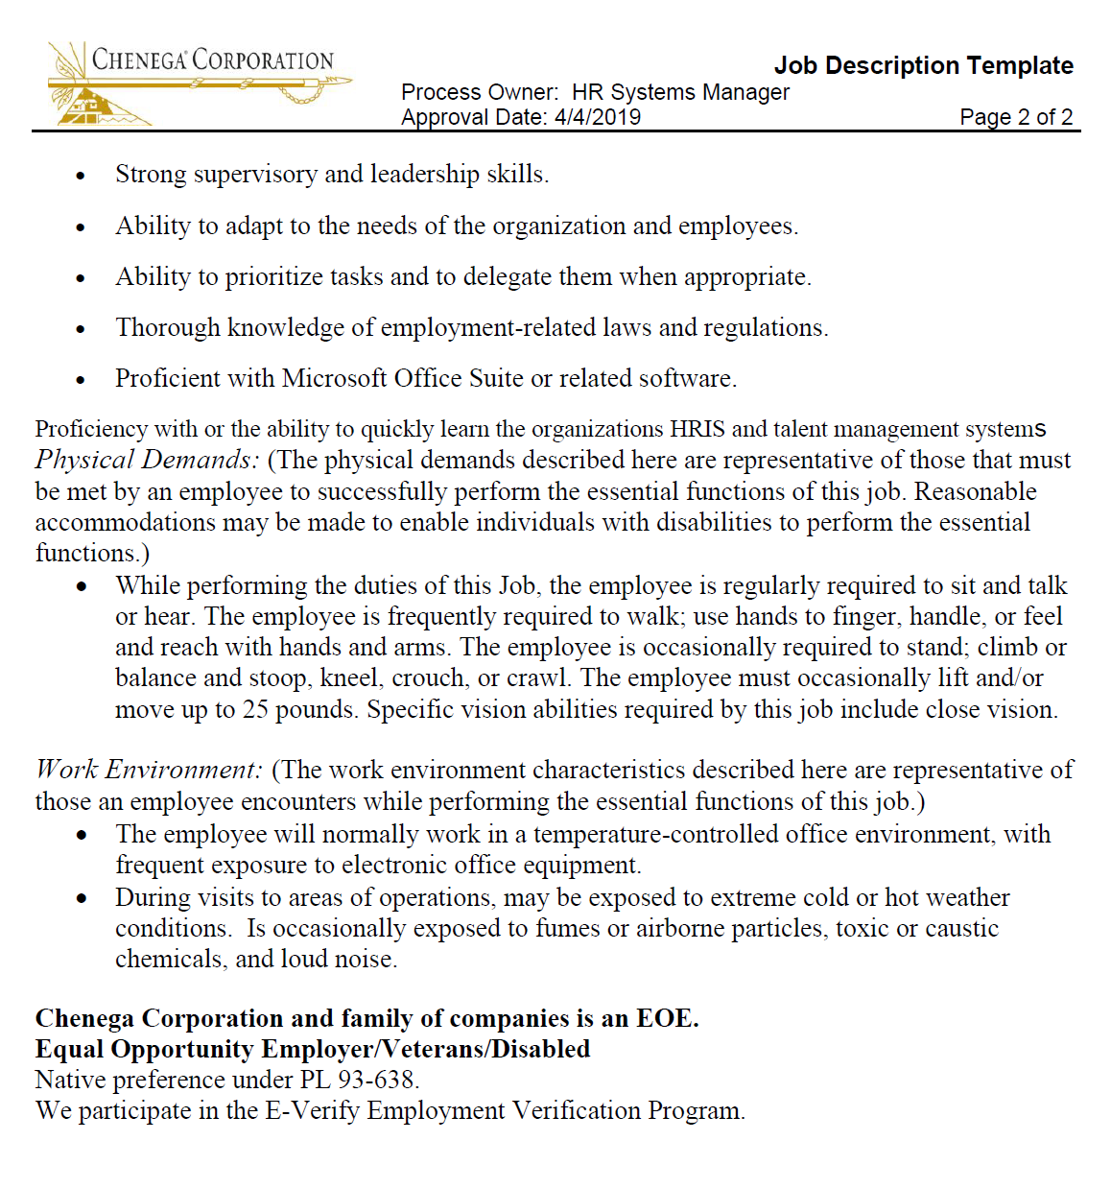
Appendix A - Page 2
Job Description Template for Director, Human Resources
Notes:
In the minimum qualifications – notice that five years of experience is equivalent to a four-year degree. Greer explained that experience is valuable and often preferred over education as it’s the practical knowledge that hones best practices and skills. The ability to adapt is one of the KSAs listed. This is also crucial for employee development.

Slide 15
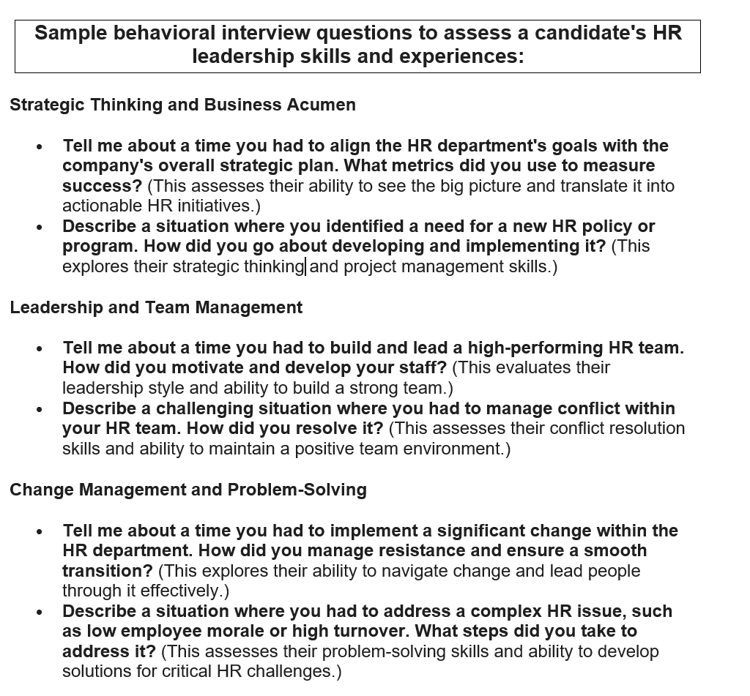
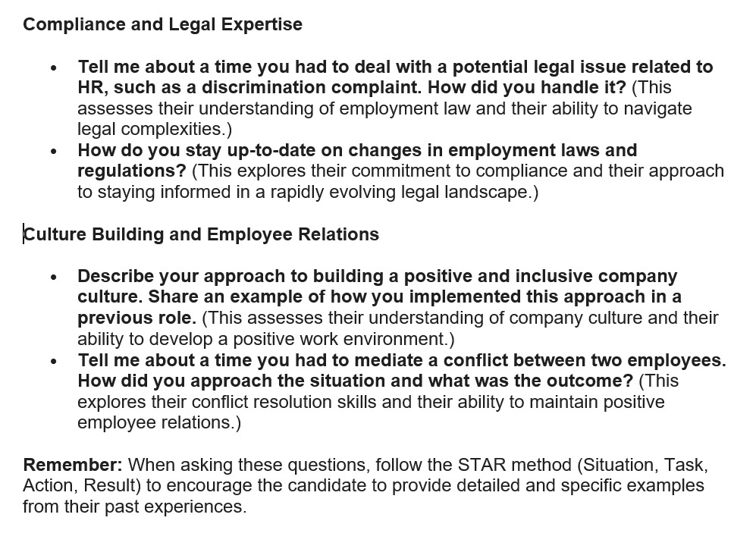
Appendix C
Behavioral Interview Questions Using the STAR method
Notes:
Appendix C - sample behavioral interview questions using the STAR method – Situation, Task, Action, Result - demonstrates the importance of experience and emotional intelligence in culture building and employee relations, especially when dealing with conflicts with terminated employees of the organization. The ability to think critically and strategically is also a skill developed with experience.

