Slide 1
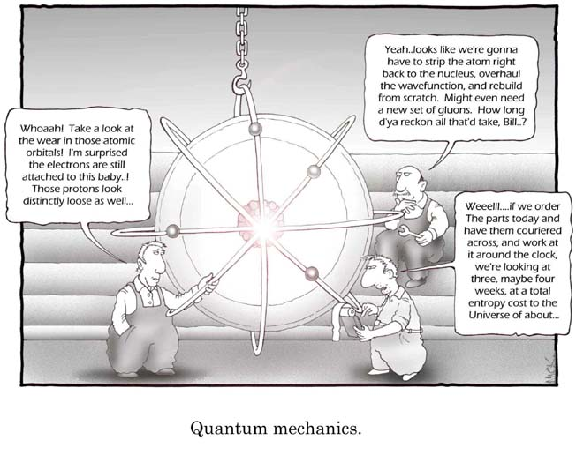
Electron Orbitals
Cartoon courtesy of lab-initio.com

Slide 2

The Bohr Model of the Atom
I pictured electrons orbiting the nucleus much like planets orbiting the sun.
But I was wrong! They’re more like bees around a hive.
Neils Bohr

Slide 3
Quantum Mechanical
Model of the Atom
Mathematical laws can identify the regions outside of the nucleus where electrons are most likely to be found.
These laws are beyond the scope of this class…

Slide 4
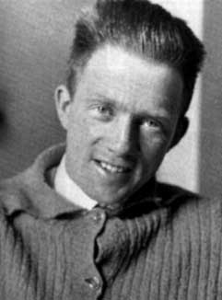
Heisenberg Uncertainty Principle
“One cannot simultaneously determine both the position and momentum of an electron.”
You can find out where the electron is, but not where it is going.
OR…
You can find out where the electron is going, but not where it is!
Werner
Heisenberg

Slide 5
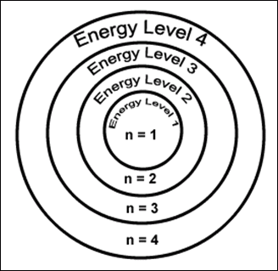
Electron Energy Level (Shell)
Generally symbolized by n, it denotes the probable distance of the electron from the nucleus. “n” is also known as the Principle Quantum number
Number of electrons that can fit in a shell:
2n²

Slide 6
An orbital is a region within an energy level where there is a probability of finding an electron.
Electron Orbitals
Orbital shapes are defined as the surface that contains 90% of the total electron probability.

Slide 7
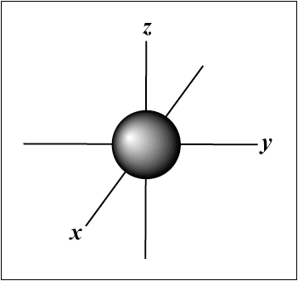
s Orbital shape
The s orbital has a spherical shape centered around
the origin of the three axes in space.

Slide 8
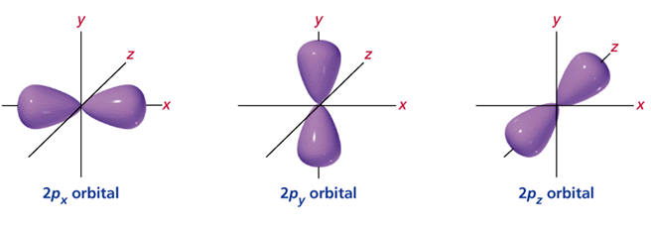
p orbital shape
There are three dumbbell-shaped p orbitals in each energy level above n = 1, each assigned to its own axis (x, y and z) in space.

Slide 9
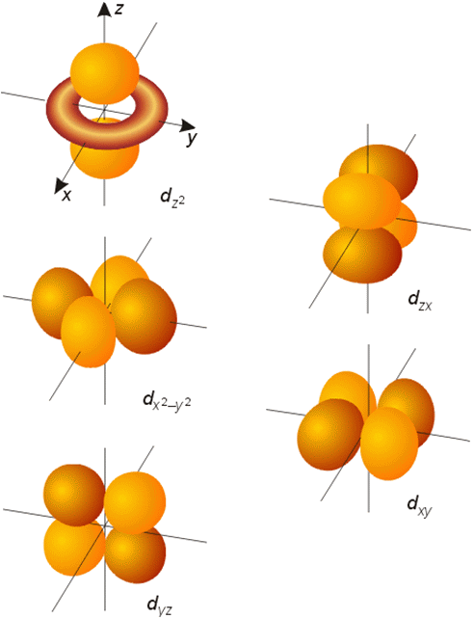
d orbital shapes
Things get a bit more complicated with the five d orbitals that are found in the d sublevels beginning with n = 3. To remember the shapes, think of “double dumbells”
…and a “dumbell
with a donut”!

Slide 10
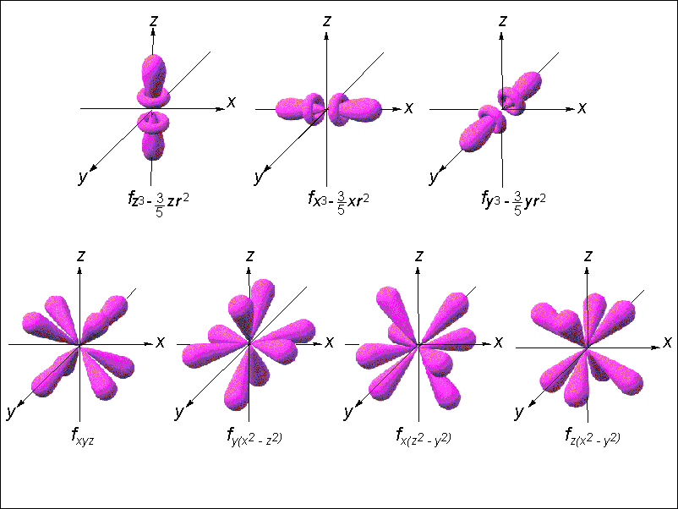
Shape of f orbitals

Slide 11
Energy Levels, Orbitals, Electrons
Energy Level (n) | Orbital type in the energy level (types = n) | Number of orbitals | Number of Electrons | Number of electrons per Energy level (2n²)
1 | s | 1 | 2 | 2
2 | s p | 1 3 | 2 6 | 8
3 | s p d | 1 3 5 | 2 6 10 | 18
4 | s p d f | 1 3 5 7 | 2 6 10 14 | 32

Slide 12
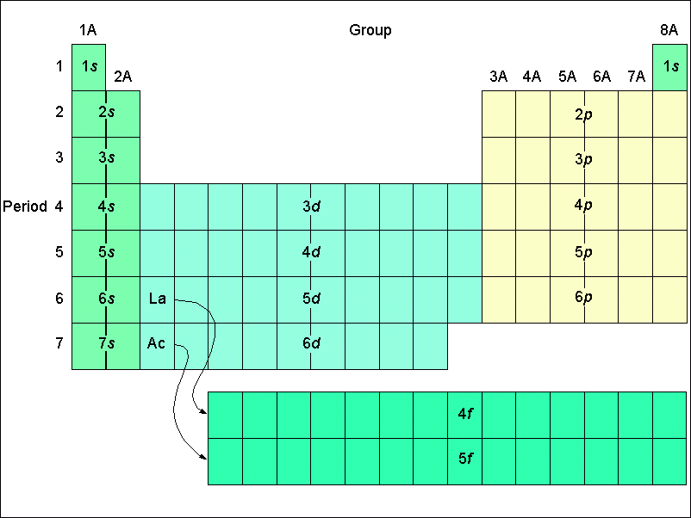
Orbital filling table

Slide 13
Electron Spin
Electron spin describes the behavior (direction of spin) of an electron within a magnetic field.
Possibilities for electron spin:

Slide 14
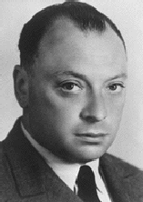
Pauli Exclusion Principle
Two electrons occupying the same orbital must have opposite spins
Wolfgang
Pauli

Slide 15
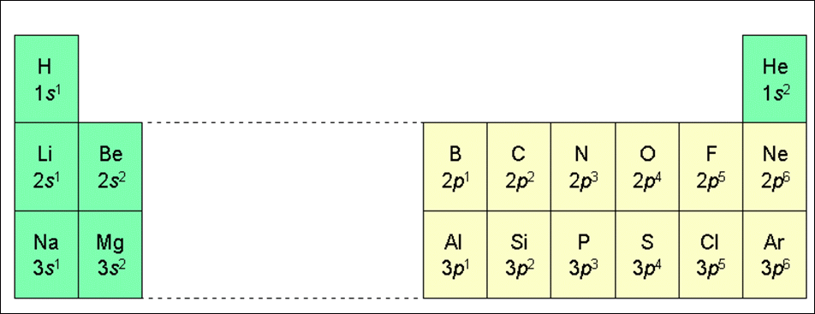
Electron configuration of the elements of the first three series

Slide 16
Element | Configuration notation | Orbital notation | Noble gas notation
Lithium | 1s²2s¹ | ____ ____ ____ ____ ____ 1s 2s 2p | [He]2s¹
Beryllium | 1s²2s² | ____ ____ ____ ____ ____ 1s 2s 2p | [He]2s²
Boron | 1s²2s²2p¹ | ____ ____ ____ ____ ____ 1s 2s 2p | [He]2s²p¹
Carbon | 1s²2s²2p² | ____ ____ ____ ____ ____ 1s 2s 2p | [He]2s²p²
Nitrogen | 1s²2s²2p³ | ____ ____ ____ ____ ____ 1s 2s 2p | [He]2s²p³
Oxygen | 1s²2s²2p⁴ | ____ ____ ____ ____ ____ 1s 2s 2p | [He]2s²p⁴
Fluorine | 1s²2s²2p⁵ | ____ ____ ____ ____ ____ 1s 2s 2p | [He]2s²p⁵
Neon | 1s²2s²2p⁶ | ____ ____ ____ ____ ____ 1s 2s 2p | [He]2s²p⁶

