Slide 1

The ELECTRON:
Wave – Particle Duality
“No familiar conceptions can be woven around the electron. Something unknown is doing we don’t know what.”
-Sir Arthur Eddington
The Nature of the Physical World (1934)

Slide 2
The Dilemma of the Atom
Electrons outside the nucleus are attracted to the protons in the nucleus
Charged particles moving in curved paths lose energy
What keeps the atom from collapsing?

Slide 3
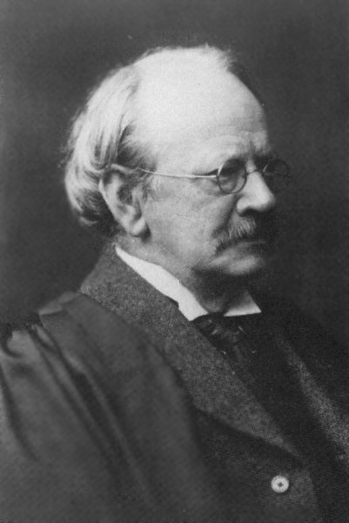
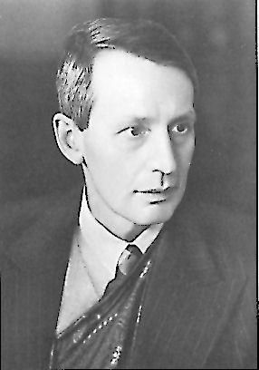
Wave-Particle Duality
JJ Thomson won the Nobel prize for describing the electron as a particle.
His son, George Thomson won the Nobel prize for describing the wave-like nature of the electron.
The electron is a particle!
The electron is an energy wave!

Slide 4
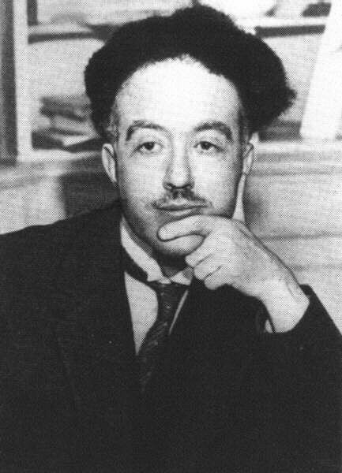
The Wave-like Electron
The electron propagates through space as an energy wave. To understand the atom, one must understand the behavior of electromagnetic waves.
Louis deBroglie

Slide 5
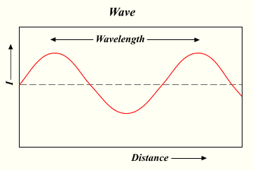
Electromagnetic radiation propagates through space as a wave moving at the speed of light.
c = νλ
c = speed of light, a constant (3.00 x 10⁸ m/s)
ν = frequency, in units of hertz (hz, sec⁻¹)
λ = wavelength, in meters

Slide 6
The energy (E ) of electromagnetic radiation is directly proportional to the frequency (ν) of the radiation.
E = hν
E = Energy, in units of Joules (kg·m²/s²)
h = Planck’s constant (6.626 x 10-34 J·s)
ν = frequency, in units of hertz (hz, sec⁻¹)

Slide 7
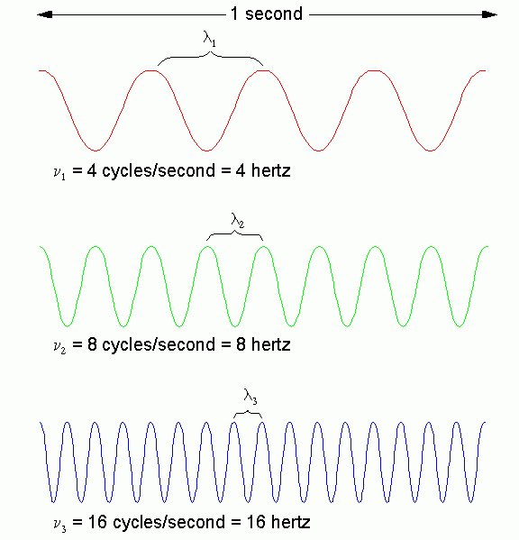
Wavelength Table
Long
Wavelength
=
Low Frequency
=
Low ENERGY
Short
Wavelength
=
High Frequency
=
High ENERGY

Slide 8
Answering the Dilemma of the Atom
Treat electrons as waves
As the electron moves toward the nucleus, the wavelength shortens
Shorter wavelength = higher energy
Higher energy = greater distance from the nucleus

Slide 9
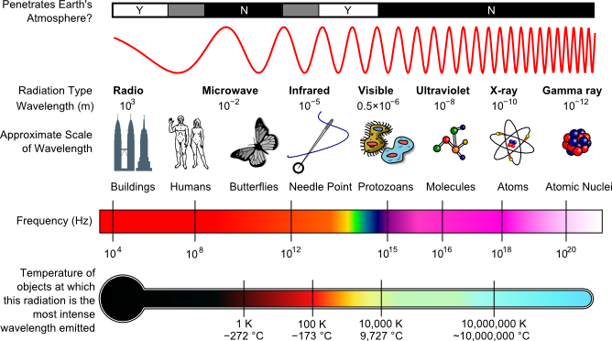
The Electromagnetic Spectrum

Slide 10
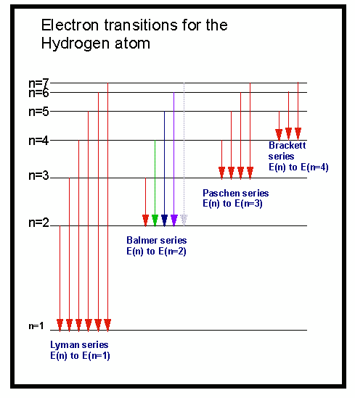
Electron transitions involve jumps of definite amounts of energy.
This produces bands
of light with definite wavelengths.

Slide 11
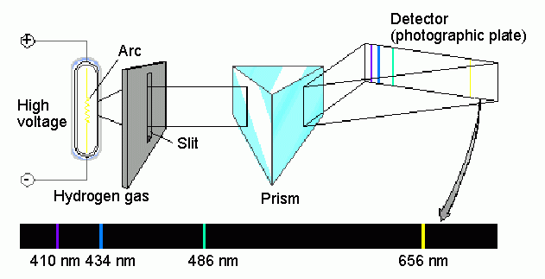
Spectroscopic analysis of the hydrogen spectrum…
…produces a “bright line” spectrum

Slide 12
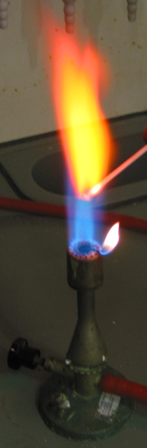
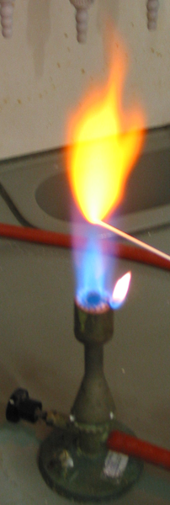
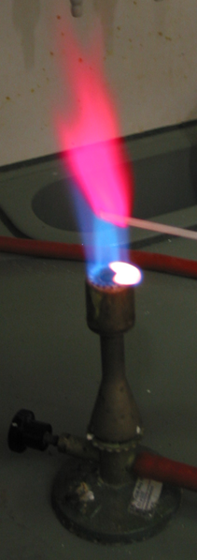
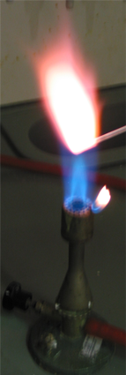
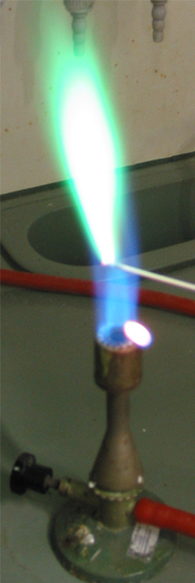
Flame Tests
Many elements give off characteristic light which can be used to help identify them.
strontium
sodium
lithium
potassium
copper

