Slide 1
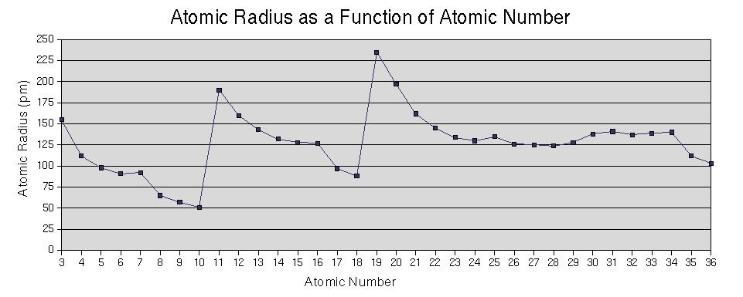
Periodic Trends

Slide 2
CA Standards
Students know how to use the periodic table to identify trends in ionization energy, electronegativity, and the relative sizes of ions and atoms.

Slide 3

Atomic Radius
Definition: Half of the distance between nuclei in covalently bonded diatomic molecule
Radius decreases across a period
  Increased effective nuclear charge due to decreased shielding
Radius increases down a group
  Each row on the periodic table adds a “shell” or energy level to the atom

Slide 4
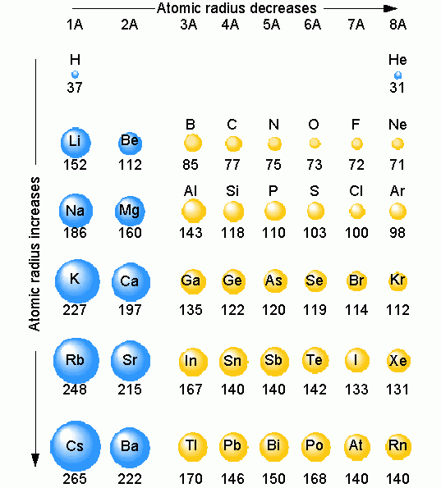
Table of
Atomic
Radii

Slide 5
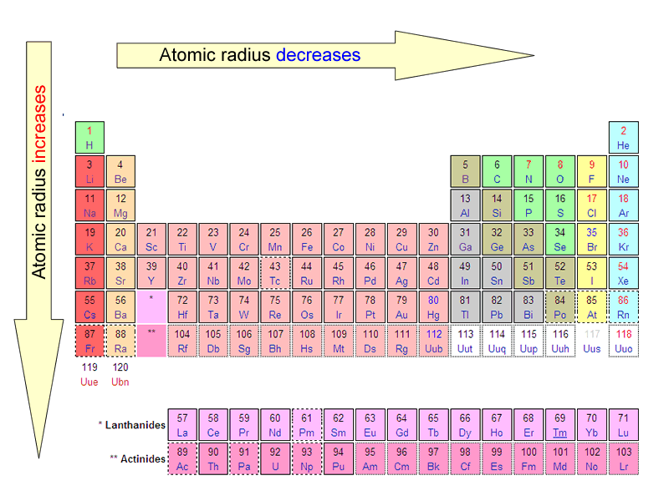
Period Trend:
Atomic Radius

Slide 6
Ionization Energy
Definition: the energy required to remove an electron from an atom
Tends to increase across a period
  As radius decreases across a period, the electron you are removing is closer to the nucleus and harder to remove
Tends to decrease down a group
  Outer electrons are farther from the nucleus and easier to remove

Slide 7

Periodic Trend:
Ionization Energy

Slide 8
Electronegativity
Definition: A measure of the ability of an atom in a chemical compound to attract electrons
Electronegativity tends to increase across a period
  As radius decreases, electrons get closer to the bonding atom’s nucleus
Electronegativity tends to decrease down a group or remain the same
  As radius increases, electrons are farther from the bonding atom’s nucleus

Slide 9
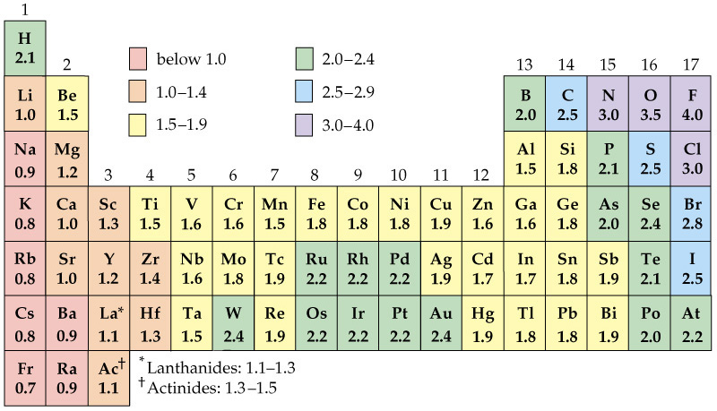
Periodic Table of Electronegativities

Slide 10

Periodic Trend:
Electronegativity

Slide 11
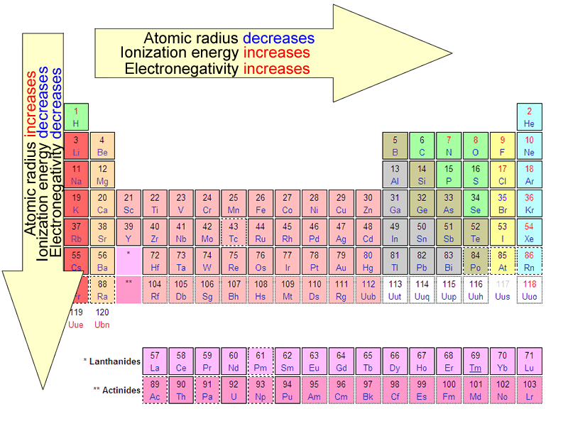
Summary of
Periodic Trends

Slide 12
Ionic Radii
Positively charged ions formed when
an atom of a metal loses one or
more electrons
Cations
Smaller than the corresponding
atom
Negatively charged ions formed
when nonmetallic atoms gain one
or more electrons
Anions
Larger than the corresponding
atom

Slide 13
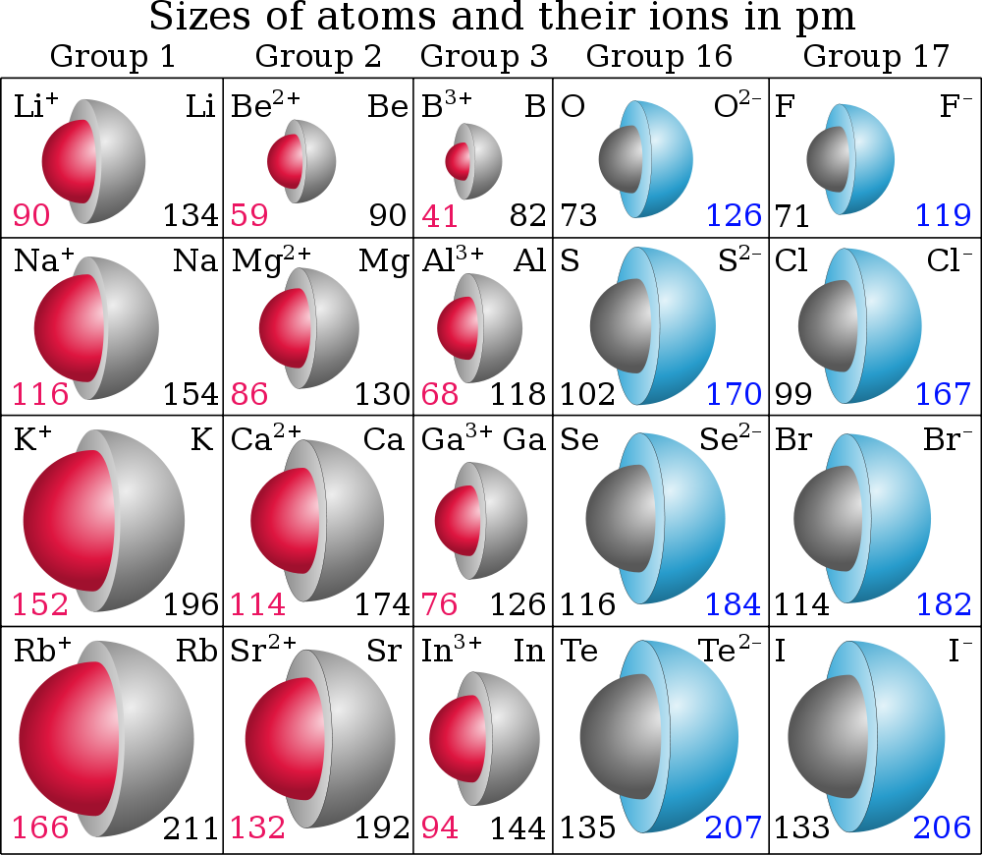
Graphic courtesy Wikimedia Commons user Popnose

