Slide 1

HECC 2018
2053 - Deploying Windows 10 With MDT (Part 1)
Section 3

Slide 2
Agenda
Build, Capture, Automation
Build and Capture
Image Factory
Factory Setup
Process
Demo
Questions
Class files and slide deck
Feedback

Slide 3
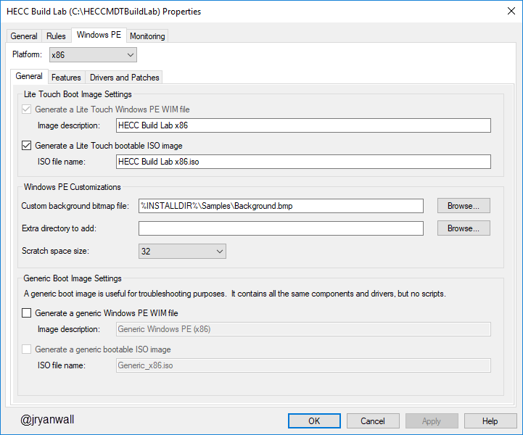
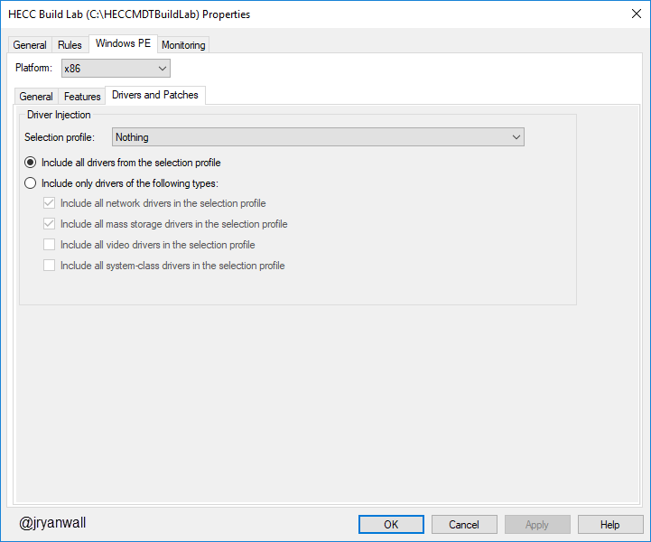
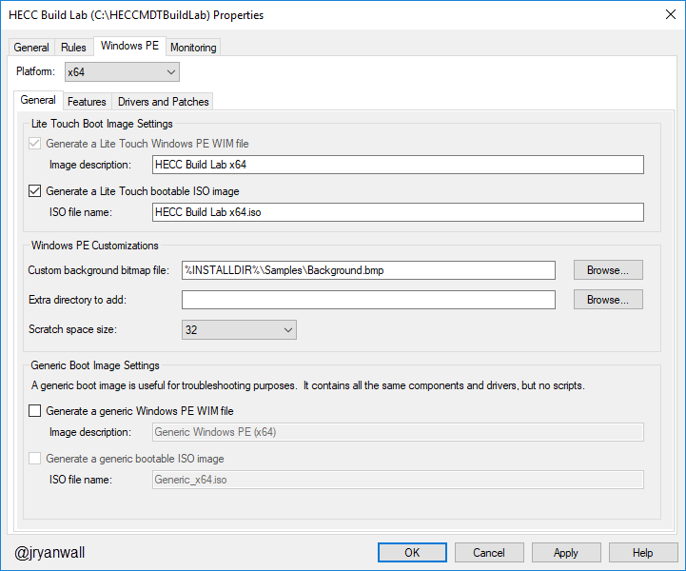

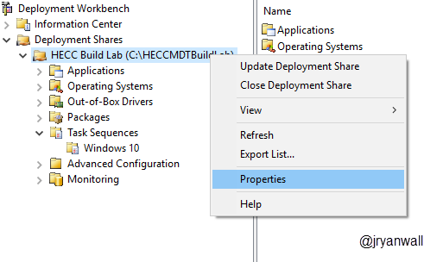
Build and Capture
Configure WinPE settings

Slide 4
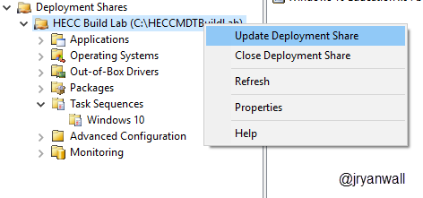
Build and Capture
After all changes are made update deployment share

Slide 5
Build and Capture
Create a new Hyper-V on build machine
2 Processors makes a big difference
Only need 4 GB of ram
Mount HECC Build Lab x64.iso from %DeploymentShare%\Boot\
Power on VM
Select you Task Sequence

Slide 6
Image Factory
This is a way to Automate building all of your images
Can be found here
https://github.com/DeploymentBunny/IMF4

Slide 7
Demo

Slide 8
Questions

Slide 9
Class files and slide deck
All the files used for class and slide deck can be found on my GitHub account.
https://github.com/jryanwall/HECC-2018
If you don’t find something or have questions shoot me an email or hit me up on Twitter
rwall@hccsc.k12.in.us
@JRyanWall
I also have a list on Twitter of related to OSD
https://twitter.com/jryanwall/lists/deployment

Slide 10
Thanks Please fill out class evaluation

