Slide 1
HECC 2018
2054 - Deploying Windows 10 With MDT (Part 2)
Section 3

Slide 2
Agenda
Bringing it all home
Old Computer Name
Final Task Sequence Adjustment
Local Admin changes
Local accounts
Activate Office
OEM Customization
Install Apps
Generate Windows Experience
Bringing it all home…
Logging
Website status page
Demo
Questions

Slide 3
Old PC Name
Made possible by UserExit.vbs script in %DeploymentRoot\Scripts folder
Must have setting in Control.ini to support
OSDComputername=#GetOfflineComputername()#
Pulls old computer name during imaging process
If there was no name, throws a non-fatal error

Slide 4
Logging
When things go wrong check the logs
Logs controlled by Control.ini
; Copy Logs if an error occurs or when deployment is successfully completed
SLShare=\\MDT01\HECCDeploy$\Logs
; Enable Dynamic Logging
SLSHAREDynamicLogging=\\MDT01\HECCDeploy$\DynLog\%OSDComputername%
Create both the Logs and DynLog folders in %DeploymentRoot%

Slide 5
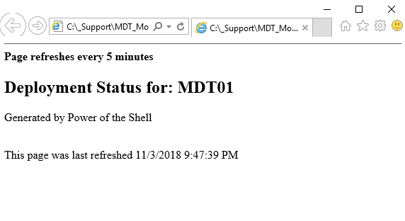
Website status page
PowerShell Script to query MDT Monitor and show status
Output file goes to IIS server running on MDT box
Simple page but helpful when running around school imaging PC’s

Slide 6
Demo

Slide 7
Questions

Slide 8
Break 10 Minutes

