Slide 1
HECC 2018
2053 - Deploying Windows 10 With MDT (Part 1)
Section 2

Slide 2
Agenda
Customize
Add Applications
Office 2016
Office 365 Pro Plus
Visual C++ run times
Other Apps
Import OS to MDT
Customizing/Tweaking OS
OEM Info
Set Default Applications
Background Changes
Lock Screen Changes
Start Menu Layout
Customize
Create Task Sequence
Adjust Power plan
Disable/Enable Windows Store Update Scripts
Clear WSUS Script
Cleanup Image Script
Demo
Questions

Slide 3
Things you will need
Software you want to install
Understanding of what you want to customize
Good lab setup to test
Time to test and tweak

Slide 4
Add Applications Office 2016
Need Office 2016 install media
Create MSP file by running setup.exe /admin
Add installer to MDT
Notes:
Walk through
https://web.sas.upenn.edu/jasonrw/2015/11/03/automate-the-install-of-microsoft-office-2016-with-an-msp-file/
PowerShell
Import-Module "C:\Program Files\Microsoft Deployment Toolkit\bin\MicrosoftDeploymentToolkit.psd1"
New-PSDrive -Name "DS001" -PSProvider MDTProvider -Root "C:\HECCMDTBuildLab"
import-MDTApplication -path "DS001:\Applications" -enable "True" -Name "Install - Microsoft Office 2016 x86" -ShortName "Install - Microsoft Office 2016 x86" -Version "" -Publisher "" -Language "" -CommandLine "setup.exe" -WorkingDirectory ".\Applications\Install - Microsoft Office 2016 x86" -ApplicationSourcePath "C:\_Setup\_AppInstallFiles\Microsoft Office 2016" -DestinationFolder "Install - Microsoft Office 2016 x86" -Verbose

Slide 5
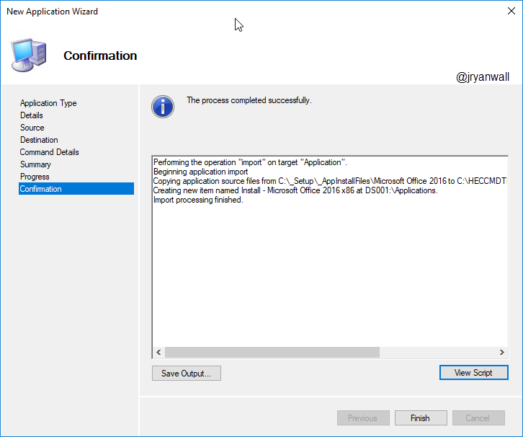
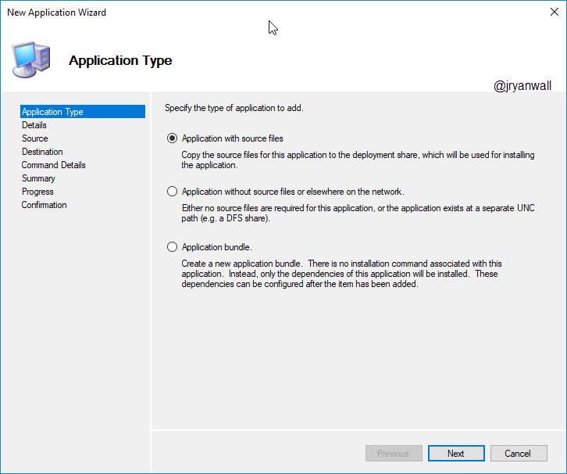
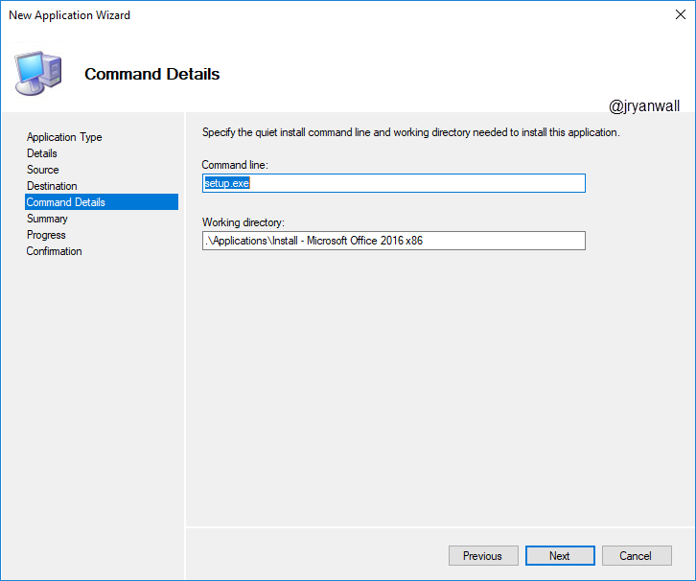
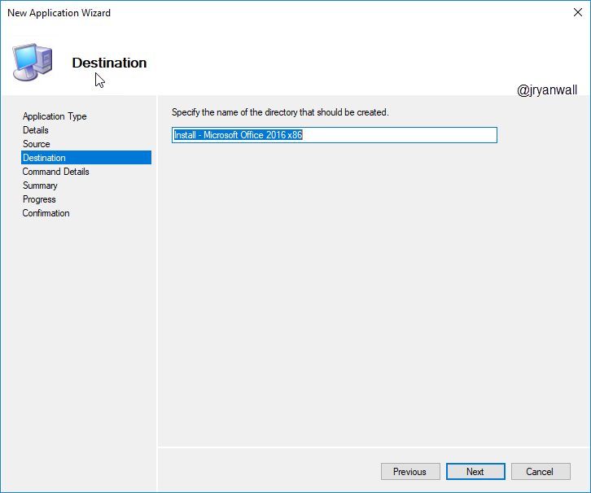
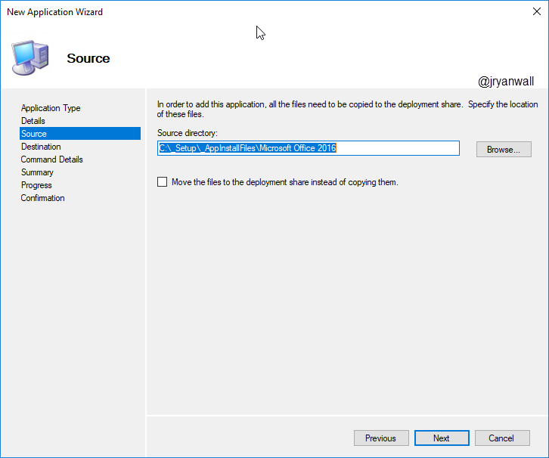
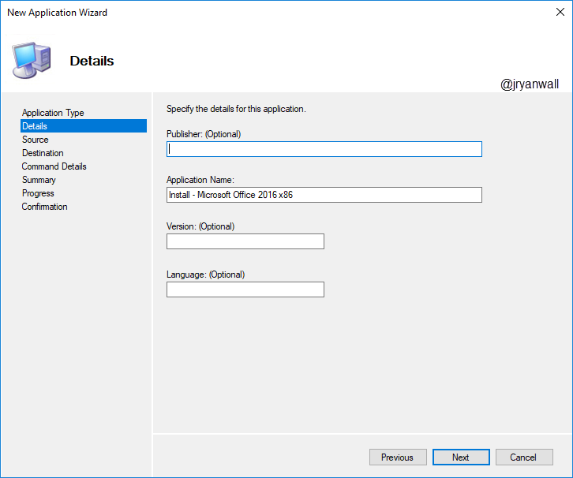
Add Applications Office 2016

Slide 6
Add Applications Office 365 Pro Plus
A work in progress
Informational links
https://sysadminedu.wordpress.com/2017/01/07/step-by-step-guide-to-deploying-office-365-pro-plus-with-device-based-activation-with-sccm/
http://www.scconfigmgr.com/2018/05/29/include-office-365-proplus-in-your-windows-10-reference-image/

Slide 7
Add Applications Visual C++ runtimes
C++ runtimes are used by a lot of applications
If you install x64 OS you will need both x86 and x64 C++ runtimes
Visual C++ runtimes (2010,2012,2013 and 2017) available on Microsoft Download Center.
Visual C++ runtimes install wrapper: https://github.com/DeploymentResearch/DRFiles/blob/master/Scripts/Install-MicrosoftVisualC%2B%2Bx86x64.wsf

Slide 8
Add Applications Other Apps
Microsoft Sysinternals Tools
Line of Business Apps
PLTW Apps
LoggerPro
MDSolids …
VLC

Slide 9
Import OS to MDT

Slide 10
Customizing/Tweaking OS OEM Info

Slide 11
Demo

Slide 12
Questions

Slide 13
Break 10 Minutes

