Slide 1

HECC 2018
2054 - Deploying Windows 10 With MDT (Part 2)
Section 1

Slide 2
Agenda
Setup
Create Deployment Share
Customize Deployment Share
Import Custom WIM
WDS and PXE setup
Create Task Sequence
Demo
Questions

Slide 3
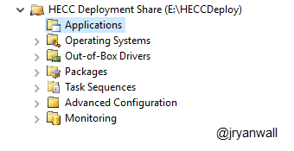
Deployment Share
Create Deployment Share – HECC Deployment
Open Deployment Workbench
Right Click on Deployment Share and select New Deployment Share
Deployment Share name HECCDeploy$
Deployment Share Description HECC Deployment Share
Notes:
PowerShell
New-SmbShare -Name "HECCDeploy$" -Path "E:\HECCDeploy" -FullAccess Administrators
Import-Module "C:\Program Files\Microsoft Deployment Toolkit\bin\MicrosoftDeploymentToolkit.psd1"
new-PSDrive -Name "DS002" -PSProvider "MDTProvider" -Root "E:\HECCDeploy" -Description "HECC Deployment Share" -NetworkPath "\\MDT01\HECCDeploy$" -Verbose | add-MDTPersistentDrive -Verbose

Slide 4
Deployment Share settings
Again focusing on Bootstrap.ini and CustomSettings.ini
Bootstrap.ini
For Demo I have share username and password in file. You need to make the call in your environment. Others will have access to this image
Different settings for Deployment. Some the same.
We will highlight some special cases later.
I put a copy of both files in class files.
Notes:
Bootstap.ini
https://itinlegal.wordpress.com/2017/10/17/mdt-tutorial-part-5/
CustomSettings.ini
https://itinlegal.wordpress.com/2017/10/15/mdt-tutorial-part-4/
https://deploymentbunny.com/2012/04/21/back-to-basic-customsettings-ini-explained/
https://deploymentbunny.com/2015/05/22/back-to-basic-customsettings-ini-converting-desktop-and-laptop-computer-types-into-roles/

Slide 5
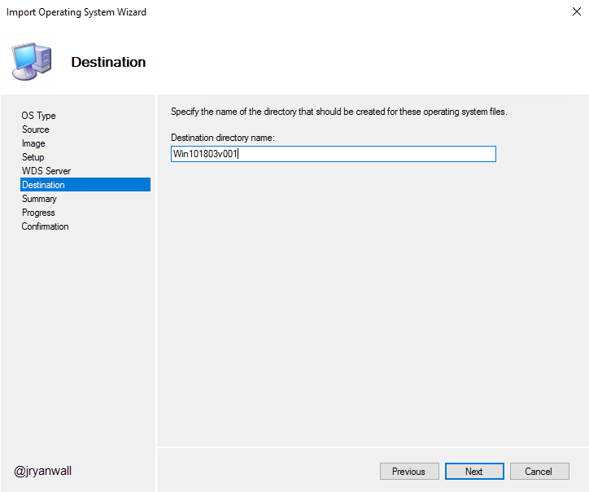
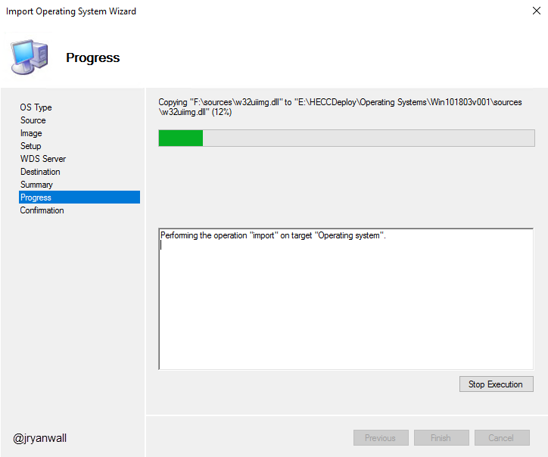
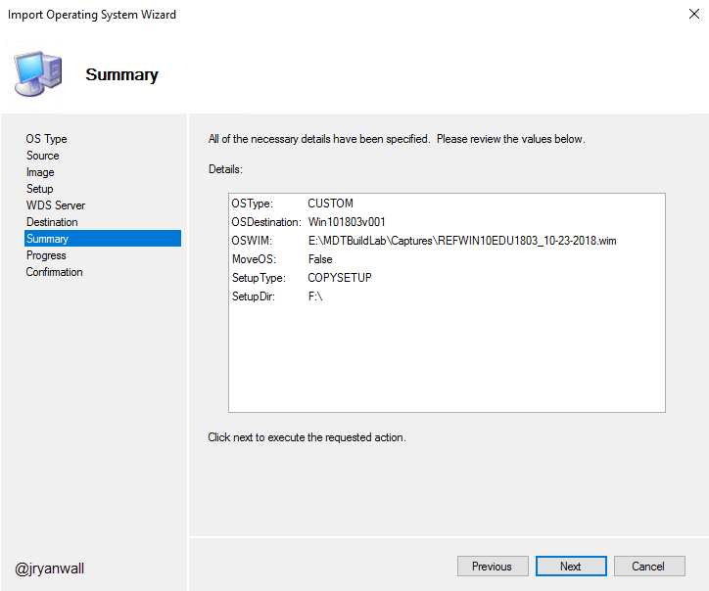
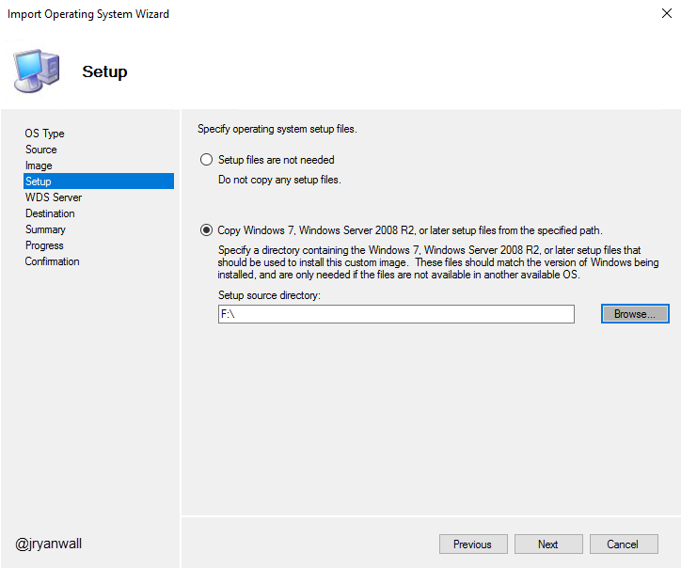
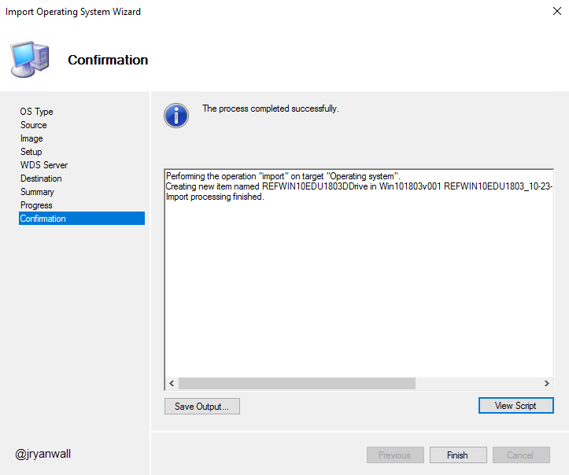
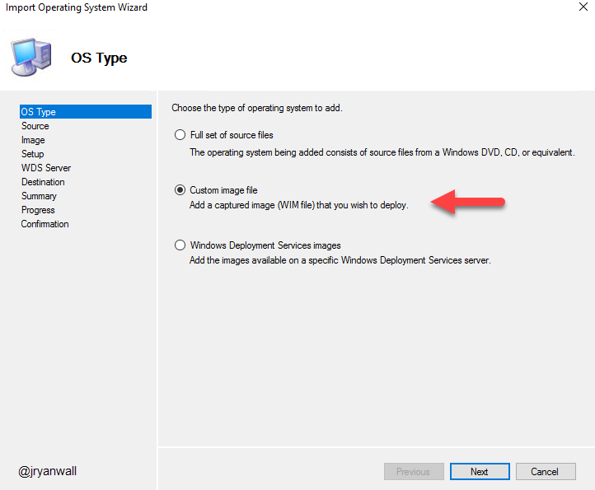
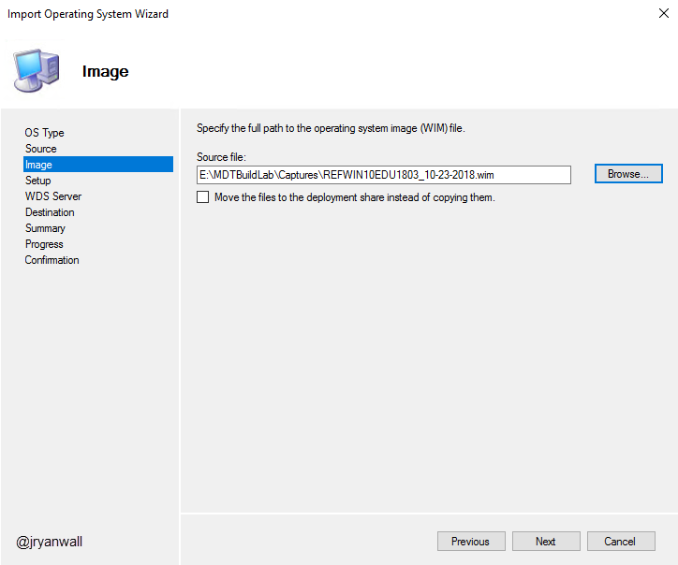
Importing WIM
You should have Golden Image WIM file created with process from last class
Also have Windows 10 1803 ISO mounted
Make folders for Each OS in Operating Systems fold in Workbench
Notes:
PowerShell Script
Import-Module "C:\Program Files\Microsoft Deployment Toolkit\bin\MicrosoftDeploymentToolkit.psd1"
New-PSDrive -Name "DS002" -PSProvider MDTProvider -Root "E:\HECCDeploy"
import-mdtoperatingsystem -path "DS002:\Operating Systems\Windows 10" -SourceFile "E:\MDTBuildLab\Captures\REFWIN10EDU1803_10-23-2018.wim" -DestinationFolder "Win101803v001" -SetupPath "F:\" -Verbose

Slide 6
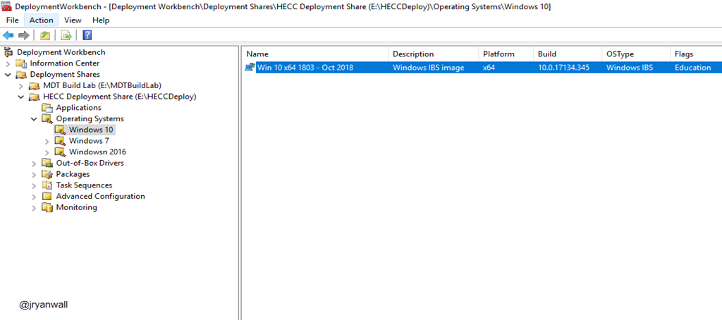
Importing WIM

Slide 7
WDS and PXE
WDS and PXE are used to Deploy the image
You need the Windows Deployment Services installed on your MDT Server
Only change I make to default install is on TFTP tab of WDS.
I increase Maximum Block Size to 16384
You will also import HECC_Deployment_x64.wim to be PXE image

Slide 8
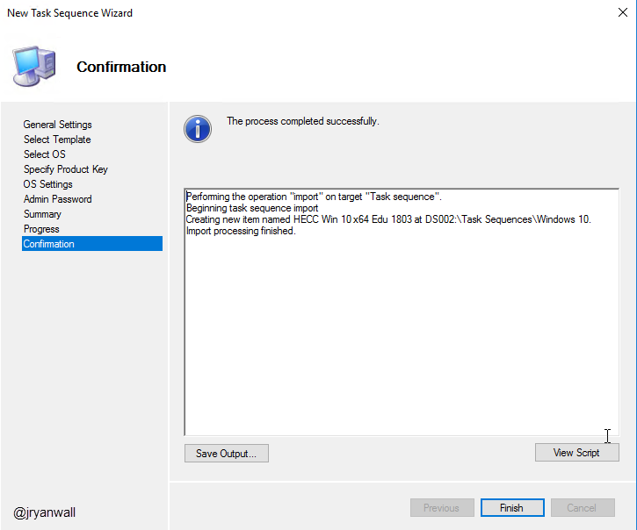
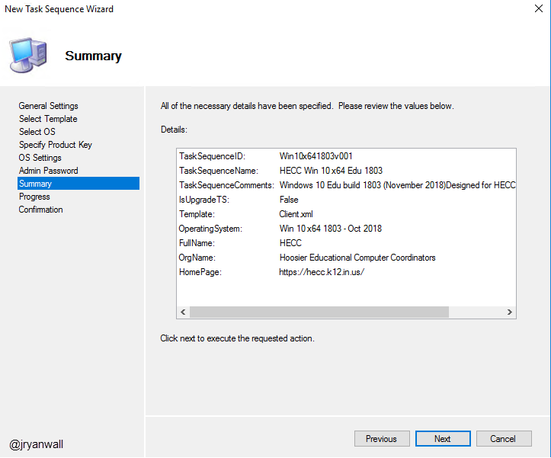
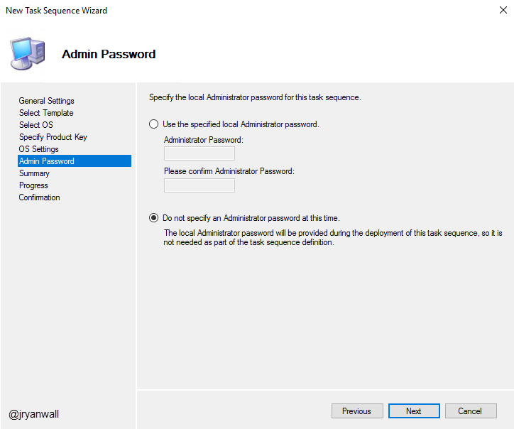
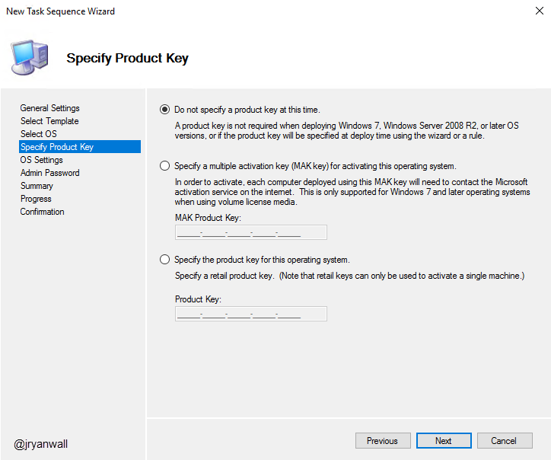
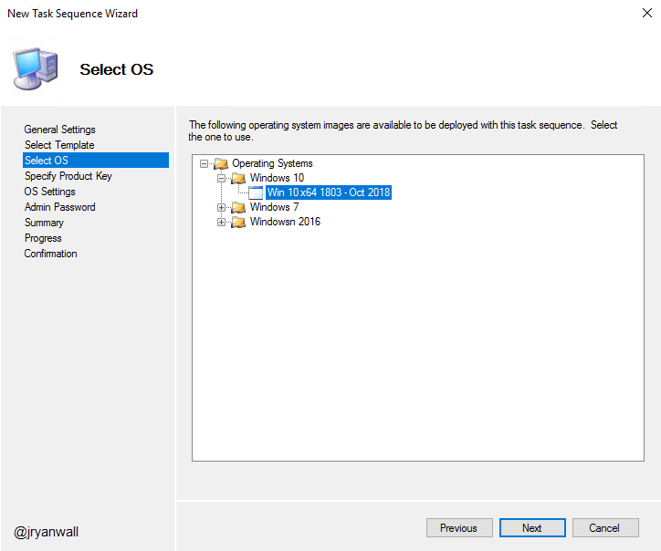
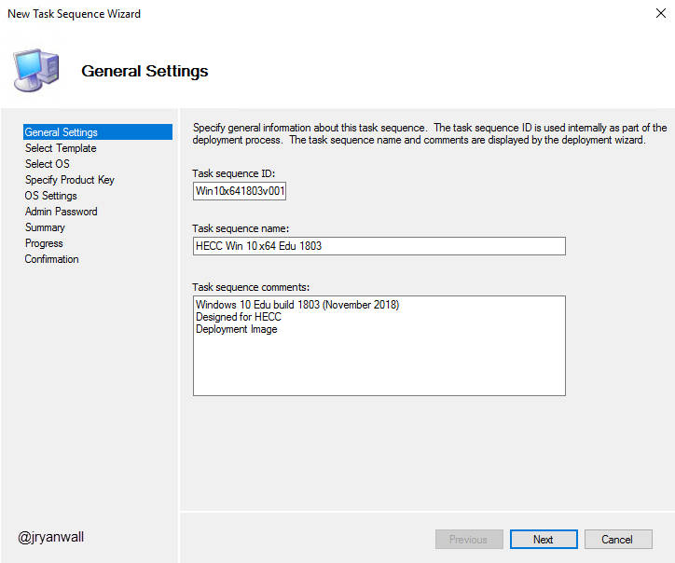
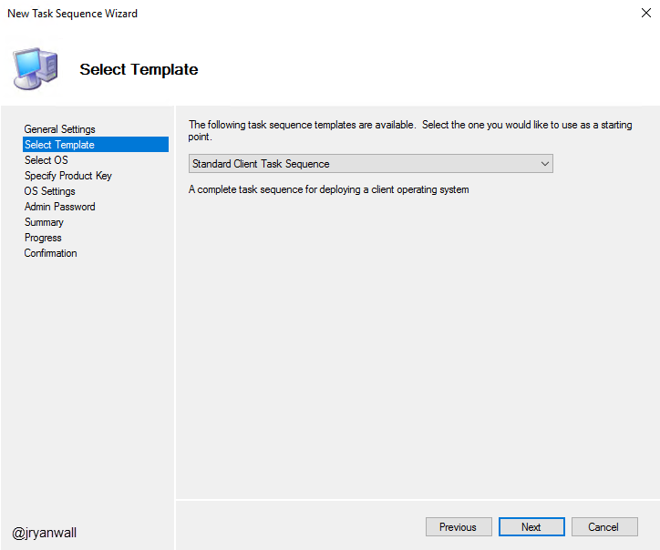
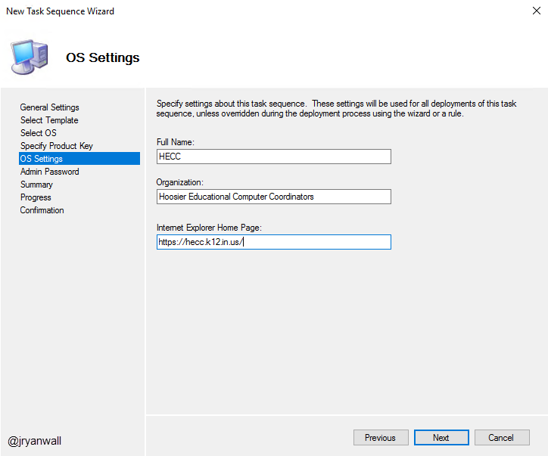
Create Task Sequence
Create folder for major OS’s
Win 10
Win 7
Win 2016

Slide 9
Demo

Slide 10
Questions

Slide 11
Break 10 Minutes

