Slide 1

HECC 2018
2053 - Deploying Windows 10 With MDT (Part 1)
Section 2

Slide 2
Agenda
Customize
Add Applications
Office 2016
Office 365 Pro Plus
Visual C++ run times
Other Apps
Import OS to MDT
Customizing/Tweaking OS
Set Default Applications
Background Changes
Lock Screen Changes
Start Menu Layout
Remove Built-in Apps
Task Sequence
Create Task Sequence
Adjust Power plan
Disable/Enable Windows Store Update Scripts
Enable RDP
Clear WSUS Script
Cleanup Image Script
Demo
Helpful Info
Questions

Slide 3
Things you will need
Software you want to install
Understanding of what you want to customize
Good lab setup to test
Time to test and tweak

Slide 4
Add Applications Office 2016
Need Office 2016 install media
Create MSP file by running setup.exe /admin
Add installer to MDT
Notes:
Walk through
https://web.sas.upenn.edu/jasonrw/2015/11/03/automate-the-install-of-microsoft-office-2016-with-an-msp-file/
PowerShell
Import-Module "C:\Program Files\Microsoft Deployment Toolkit\bin\MicrosoftDeploymentToolkit.psd1"
New-PSDrive -Name "DS001" -PSProvider MDTProvider -Root "C:\HECCMDTBuildLab"
import-MDTApplication -path "DS001:\Applications" -enable "True" -Name "Install - Microsoft Office 2016 x86" -ShortName "Install - Microsoft Office 2016 x86" -Version "" -Publisher "" -Language "" -CommandLine "setup.exe" -WorkingDirectory ".\Applications\Install - Microsoft Office 2016 x86" -ApplicationSourcePath "C:\_Setup\_AppInstallFiles\Microsoft Office 2016" -DestinationFolder "Install - Microsoft Office 2016 x86" -Verbose

Slide 5
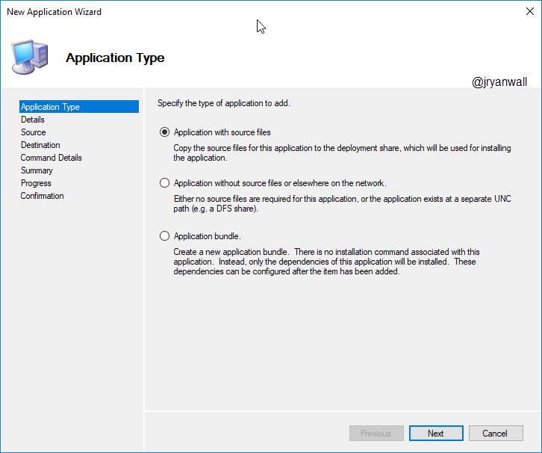
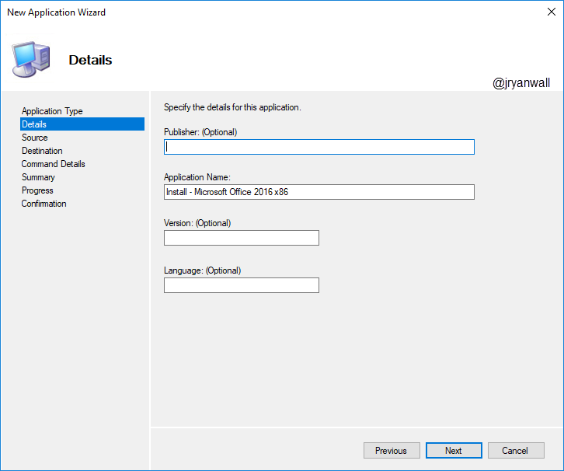
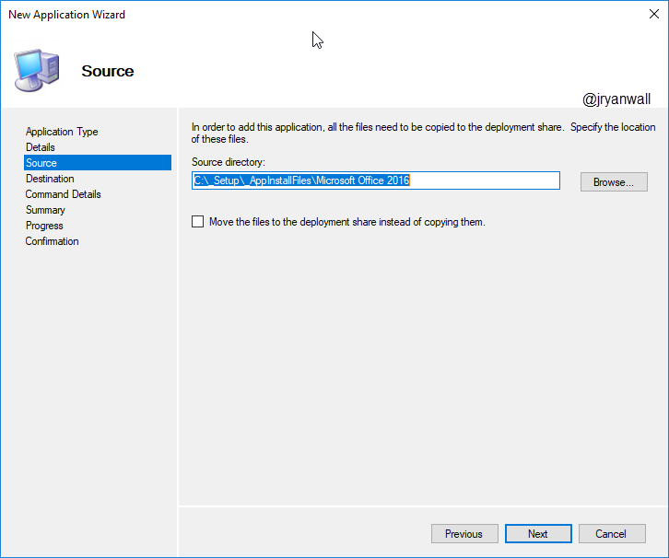
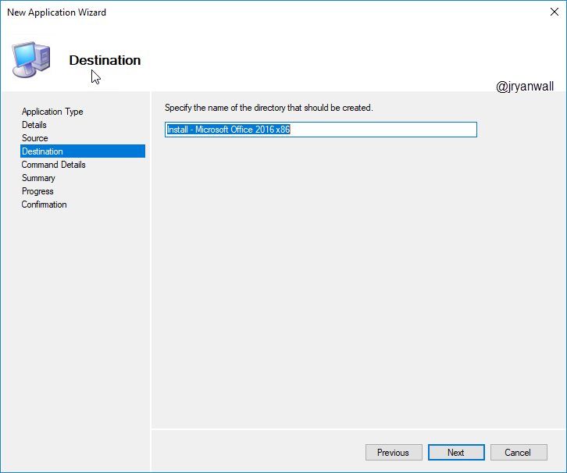
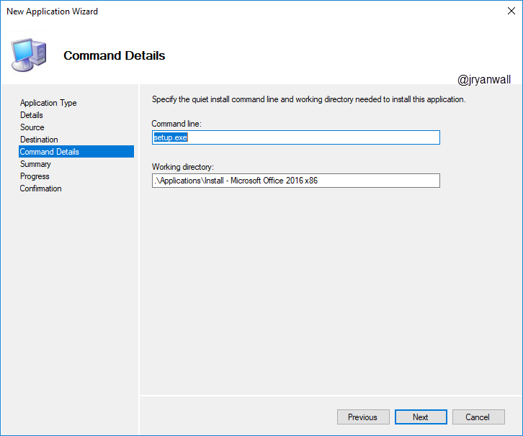
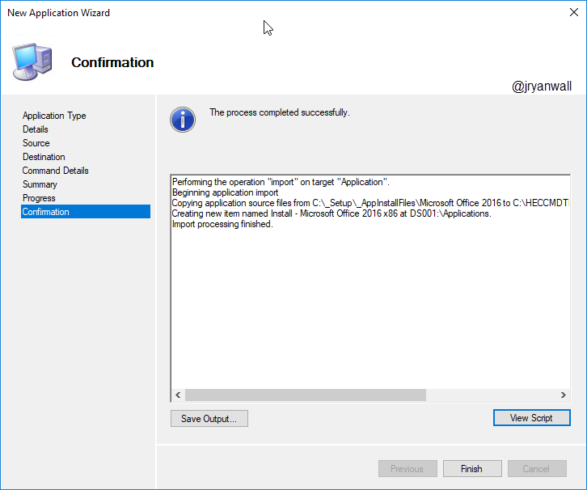
Add Applications Office 2016

Slide 6
Add Applications Office 365 Pro Plus
A work in progress
Informational links
https://sysadminedu.wordpress.com/2017/01/07/step-by-step-guide-to-deploying-office-365-pro-plus-with-device-based-activation-with-sccm/
http://www.scconfigmgr.com/2018/05/29/include-office-365-proplus-in-your-windows-10-reference-image/

Slide 7
Add Applications Visual C++ runtimes
C++ runtimes are used by a lot of applications
If you install x64 OS you will need both x86 and x64 C++ runtimes
Visual C++ runtimes (2010,2012,2013 and 2017) available on Microsoft Download Center.
Visual C++ runtimes install wrapper: https://github.com/DeploymentResearch/DRFiles/blob/master/Scripts/Install-MicrosoftVisualC%2B%2Bx86x64.wsf

Slide 8
Add Applications Other Apps
Microsoft Sysinternals Tools
Line of Business Apps
PLTW Apps
LoggerPro
MDSolids …
VLC
IE Short Cut
Notes:
PowerShell Script
Import-Module "C:\Program Files\Microsoft Deployment Toolkit\bin\MicrosoftDeploymentToolkit.psd1"
New-PSDrive -Name "DS001" -PSProvider MDTProvider -Root "C:\HECCMDTBuildLab"
import-MDTApplication -path "DS001:\Applications" -enable "True" -Name "Install - IE Short Cut (Win 10)" -ShortName "Install - IE Short Cut (Win 10)" -Version "" -Publisher "" -Language "EN" -CommandLine "powershell.exe -Command `"Set-ExecutionPolicy Unrestricted -Force; Copy-Item -Path 'Z:\Applications\Install - IE Short Cut (Win 10)\Internet Explorer.lnk' -Destination 'C:\ProgramData\Microsoft\Windows\Start Menu\Programs\Accessories' -Force; set-ExecutionPolicy Restricted -Force`"" -WorkingDirectory ".\Applications\Install - IE Short Cut (Win 10)" -ApplicationSourcePath "C:\_Setup\_AppInstallFiles\Install - IE Short Cut (Win 10)" -DestinationFolder "Install - IE Short Cut (Win 10)" -Verbose

Slide 9
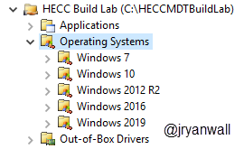
Import OS to MDT
Download Windows 10 ISO from Microsoft VLSC
Create folders for each OS

Slide 10
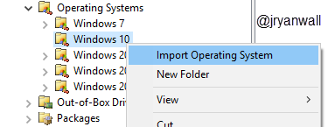
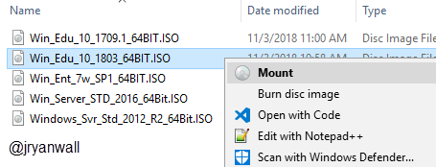
Import OS to MDT
Mount the downloaded ISO
Right click on Win 10 folder
Select Import Operating System

Slide 11
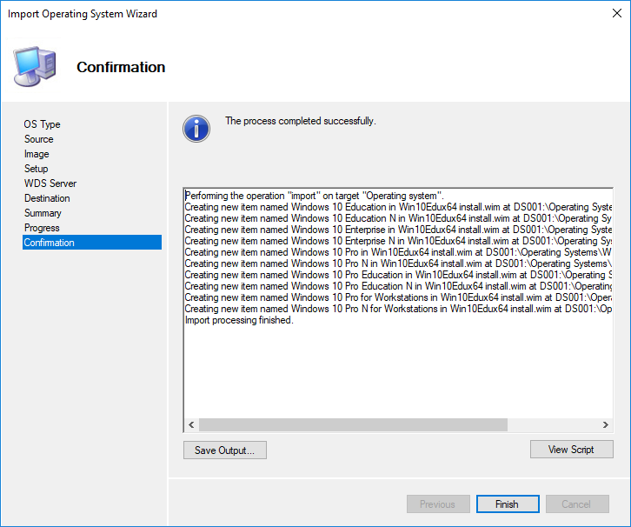
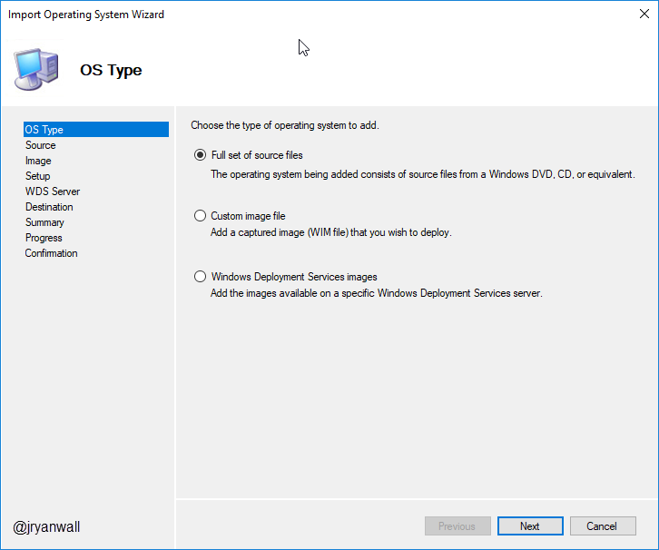
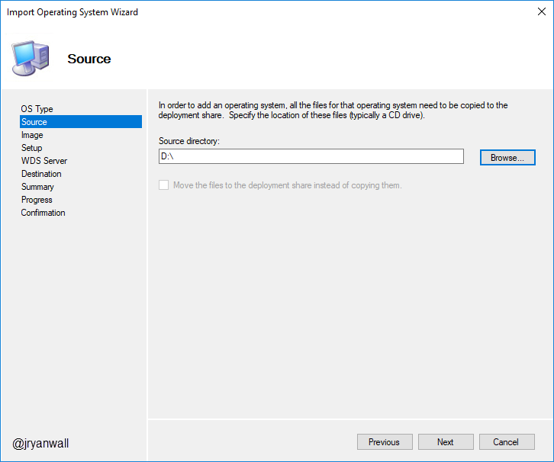
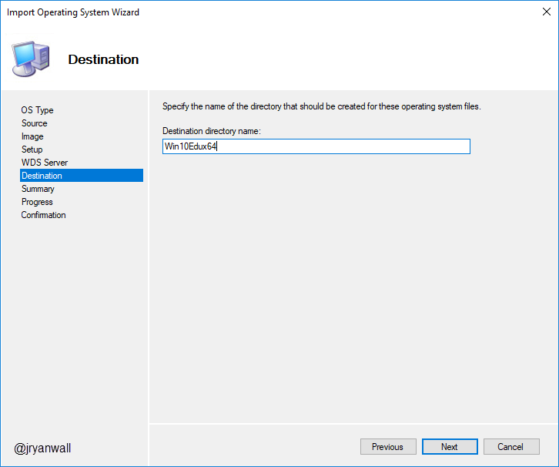
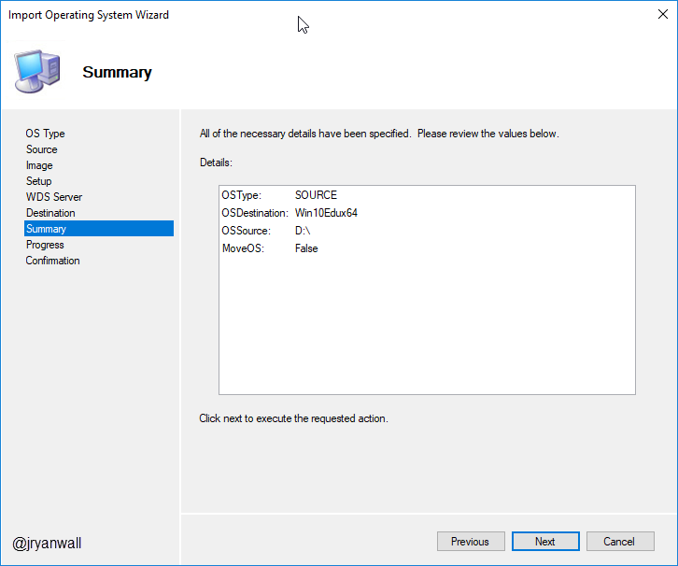
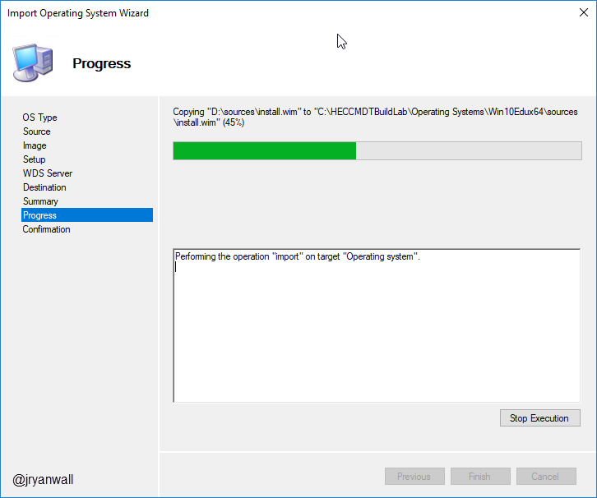
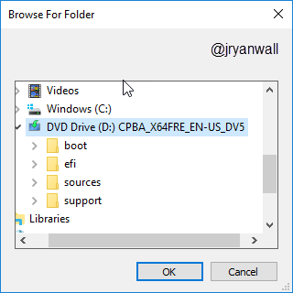
Import OS to MDT
Notes:
PowerShell Script
Import-Module "C:\Program Files\Microsoft Deployment Toolkit\bin\MicrosoftDeploymentToolkit.psd1"
New-PSDrive -Name "DS001" -PSProvider MDTProvider -Root "C:\HECCMDTBuildLab"
import-mdtoperatingsystem -path "DS001:\Operating Systems\Windows 10" -SourcePath "D:\" -DestinationFolder "Win10Edux64" -Verbose

Slide 12
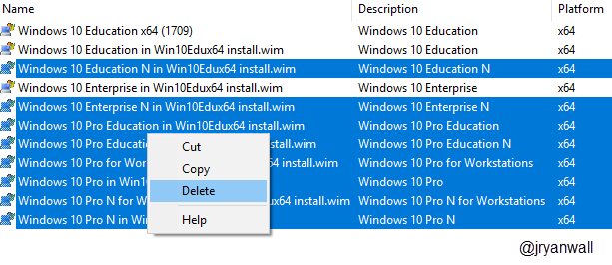
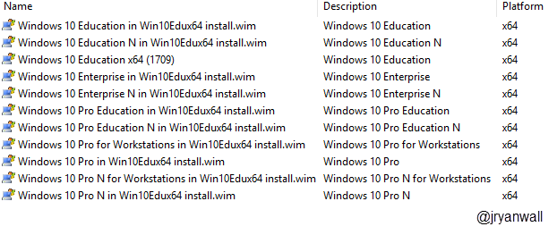
Import OS to MDT
After import you will have extra versions of the OS
Highlight what you don’t want and delete them

Slide 13
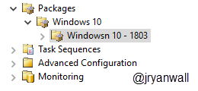
Import OS to MDT
Need to download Windows 10 v1803 updates (Optional)
https://support.microsoft.com/en-us/help/4099479
Or use PowerShell Script to find updates
Under Packages
Create a Windows 10 folder and then under that a Windows 10 – 1803 folder

Slide 14
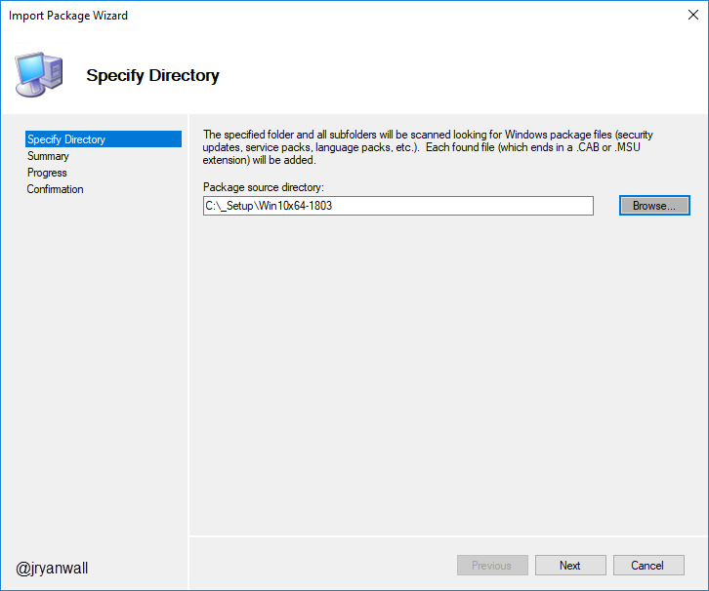
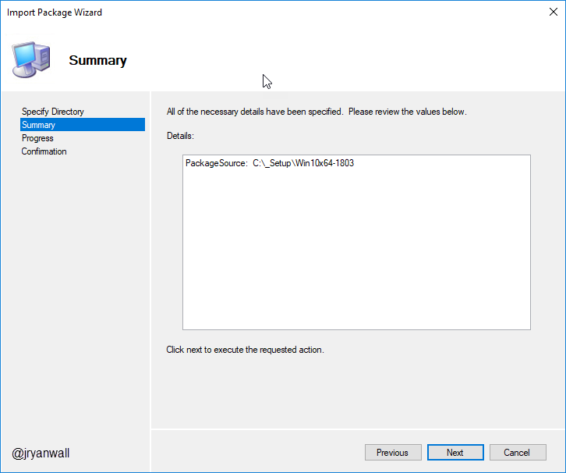
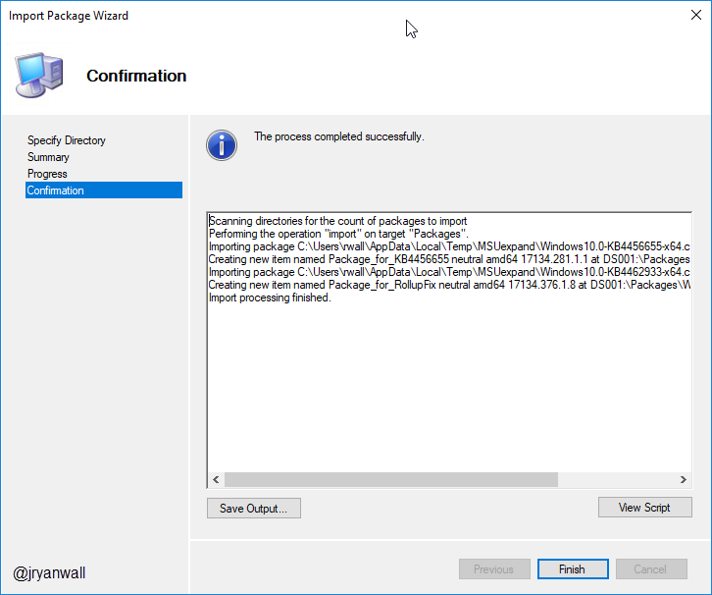
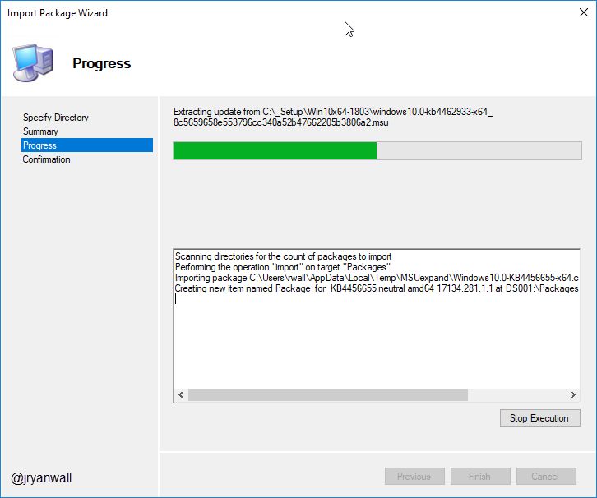
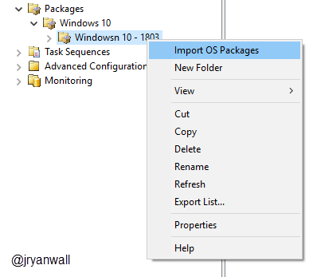
Import OS to MDT
Import OS Packages

Slide 15
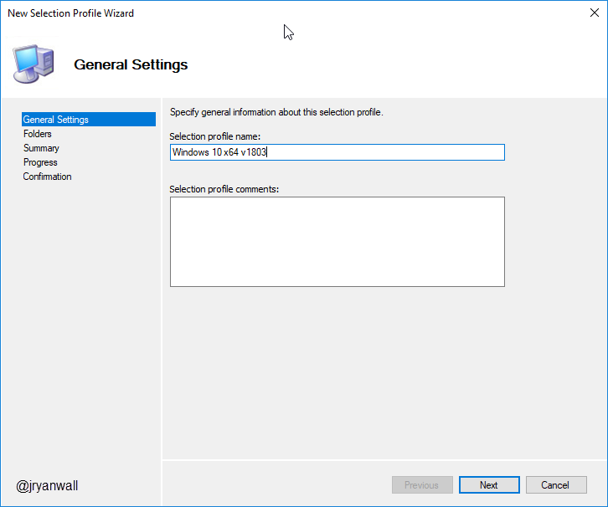
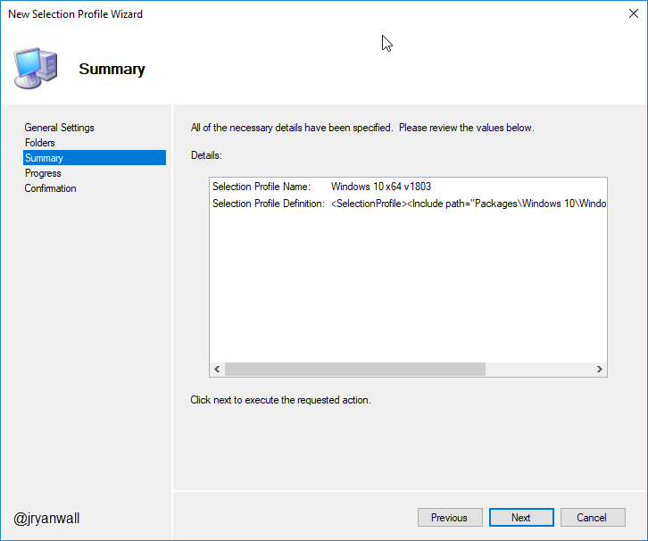
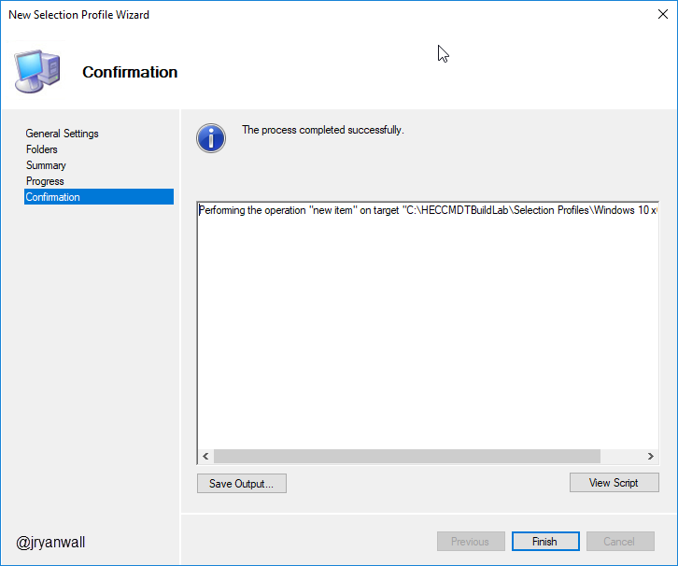
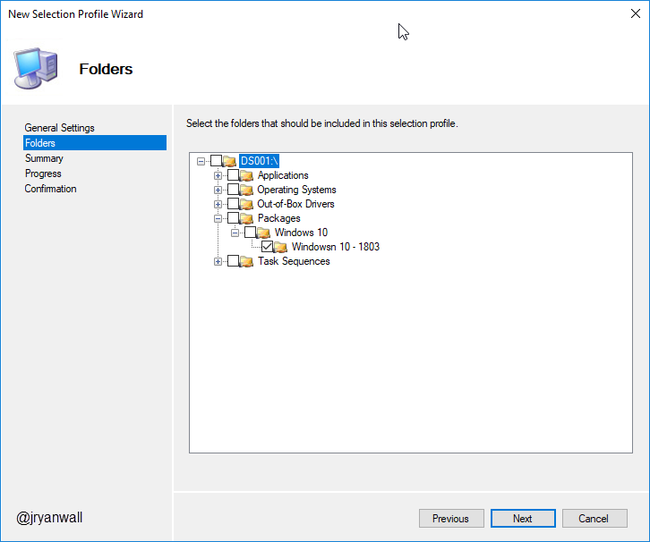
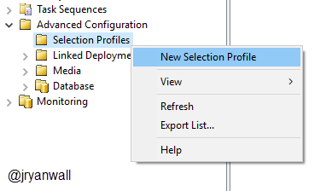
Import OS to MDT
Create Selection Profile

Slide 16
Customizing/Tweaking OS Set Default Applications

Slide 17
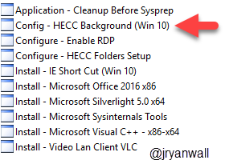

Customizing/Tweaking OS Background Tweak
Script comes from a post found here
https://garytown.com/windows-10-customizations-mms2017-demos
You basically overwrite default backgrounds
This will not survive a Feature Upgrade
I add it as an Application so that the script will run
Then just add it to Task sequence

Slide 18
Customizing/Tweaking OS Lock Screen Changes
This is part of Tweak - Windows 10 Settings
It also does other tweaks
Read the CMD to understand
This will be part of a future PowerShell script. Ran out of time
Reason to come back next year???

Slide 19
Customizing/Tweaking OS Remove Built-in Apps
Need 3 scripts to make work
2 from Deployment Research
https://deploymentresearch.com/Research/Post/615/Fixing-why-Sysprep-fails-in-Windows-10-due-to-Windows-Store-updates
And main script from SCConfigMgr.com
http://www.scconfigmgr.com/2018/05/13/remove-built-in-apps-for-windows-10-version-1803/
Copy all three scripts to %DeploymentRoot%\scripts folder

Slide 20
Customizing/Tweaking OS Start Menu Layout

Slide 21
Task Sequence Create Task Sequence
Create Folder under Task Sequences for Windows 10
Create Windows 10 Education x64 build 1803 (Nov 2018) Task Sequence
Input a unique Task sequence ID
Input a Task sequence name
Use the Standard Client Task Sequence
Select Windows 10 Education x64 1803 OS
Add OS Settings
Do not specify an Administrator password
Notes:
PowerShell Script
Import-Module "C:\Program Files\Microsoft Deployment Toolkit\bin\MicrosoftDeploymentToolkit.psd1"
New-PSDrive -Name "DS001" -PSProvider MDTProvider -Root "C:\HECCMDTBuildLab"
import-mdttasksequence -path "DS001:\Task Sequences\Windows 10" -Name "Windows 10 Education x64 build 1803 (Nov 2018)" -Template "Client.xml" -Comments "Windows 10 Education build 1803 (November 2018)
Designed for HECC" -ID "Win10Edu1803-001" -Version "1.0" -OperatingSystemPath "DS001:\Operating Systems\Windows 10\Windows 10 Education x64 (1803)" -FullName "HECC" -OrgName "Hoosier Educational Computer Coordinators" -HomePage "https://hecc.k12.in.us/" -Verbose

Slide 22
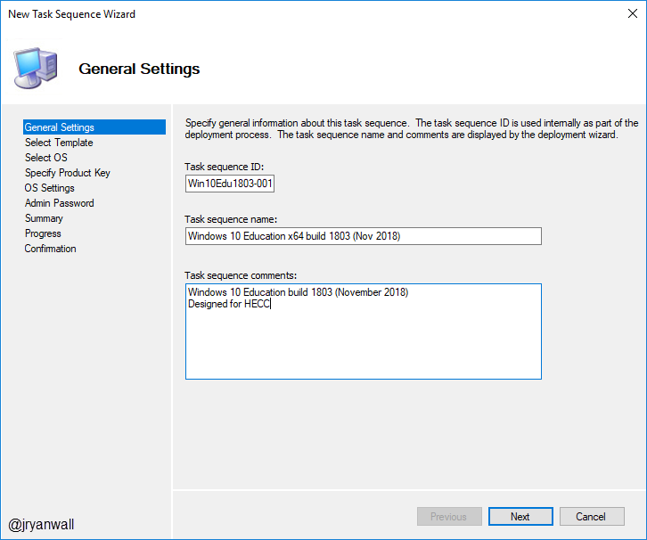
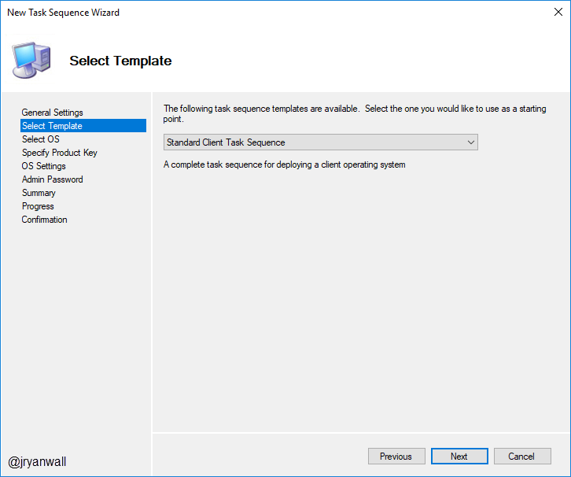
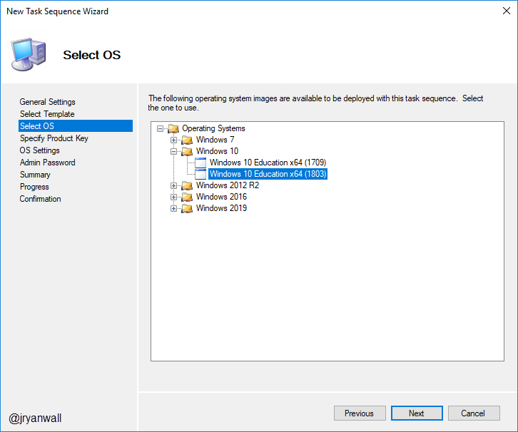
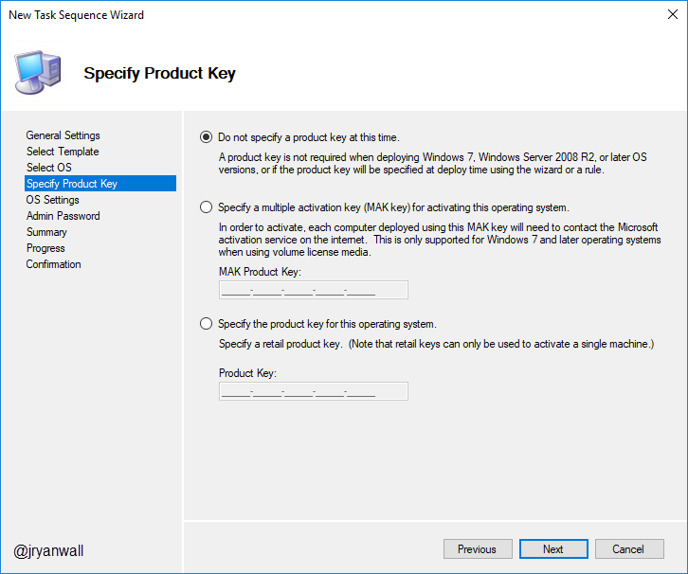
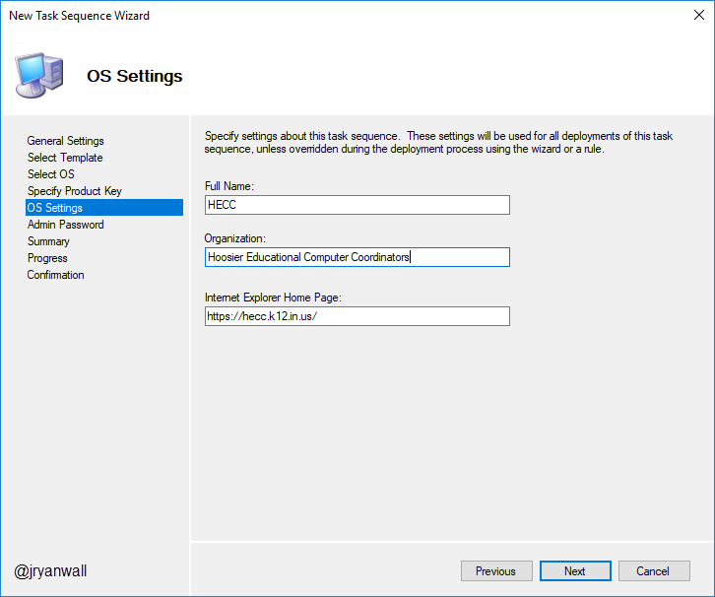
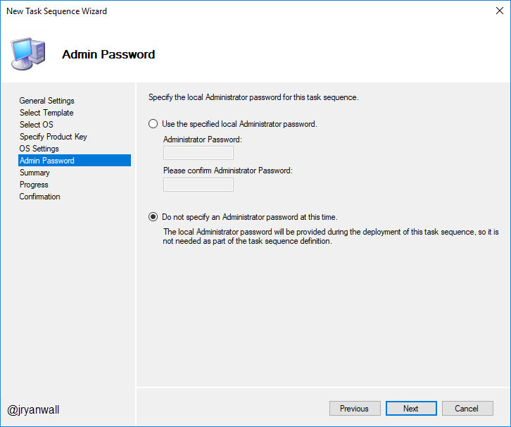
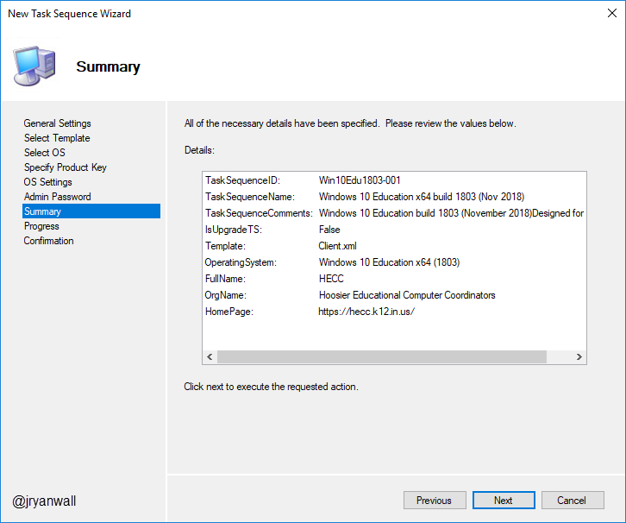
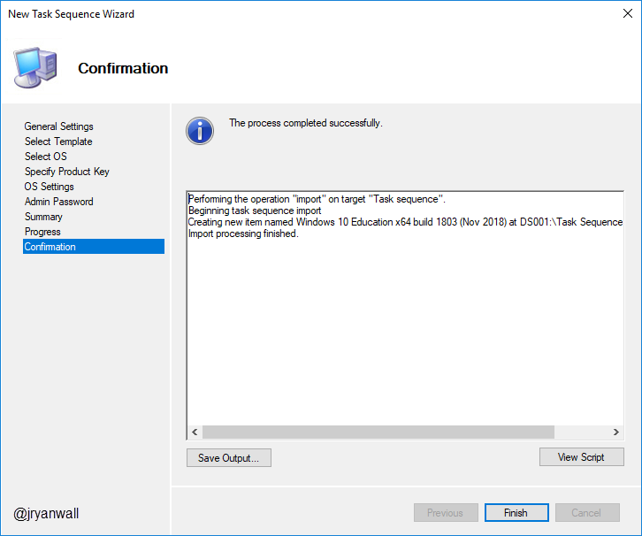
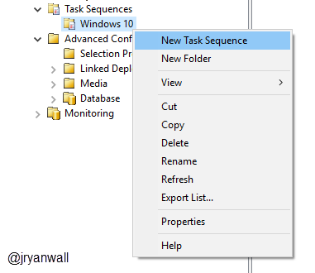
Task Sequence Create Task Sequence
Notes:
PowerShell Script
Import-Module "C:\Program Files\Microsoft Deployment Toolkit\bin\MicrosoftDeploymentToolkit.psd1"
New-PSDrive -Name "DS001" -PSProvider MDTProvider -Root "C:\HECCMDTBuildLab"
import-mdttasksequence -path "DS001:\Task Sequences\Windows 10" -Name "Windows 10 Education x64 build 1803 (Nov 2018)" -Template "Client.xml" -Comments "Windows 10 Education build 1803 (November 2018)
Designed for HECC" -ID "Win10Edu1803-001" -Version "1.0" -OperatingSystemPath "DS001:\Operating Systems\Windows 10\Windows 10 Education x64 (1803)" -FullName "HECC" -OrgName "Hoosier Educational Computer Coordinators" -HomePage "https://hecc.k12.in.us/" -Verbose

Slide 23
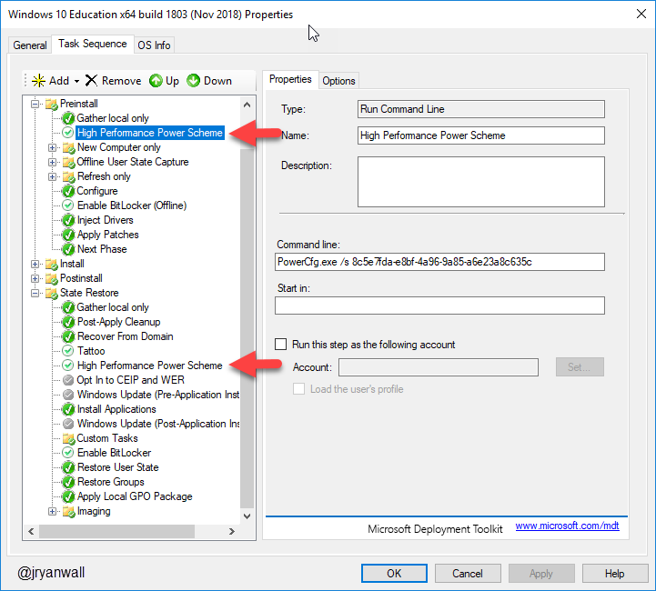
Task Sequence Adjust Power Plan
Adjust power plan to reduce deployment time
https://blogs.technet.microsoft.com/deploymentguys/2015/03/26/reducing-windows-deployment-time-using-power-management
PowerCfg.exe /s 8c5e7fda-e8bf-4a96-9a85-a6e23a8c635c

Slide 24
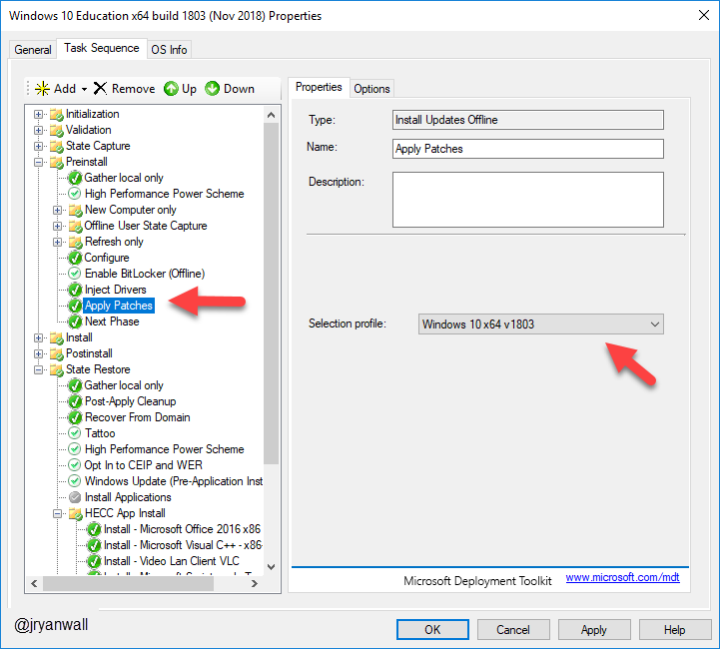
Task Sequence Apply OS Updates
Apply updates by selecting selection profile we set up earlier

Slide 25
Task Sequence Configure - Enable RDP
Add Application
Configure - Enable RDP
PowerShell Script
$rdp = Get-WmiObject -Class Win32_TerminalServiceSetting -Namespace root\CIMV2\TerminalServices -Authentication PacketPrivacy
$tmp_rdp = $rdp.SetAllowTSConnections(1,1) #first parameter rdp enable, second parameter firewall ports config
Notes:
PowerShell Script
Import-Module "C:\Program Files\Microsoft Deployment Toolkit\bin\MicrosoftDeploymentToolkit.psd1"
New-PSDrive -Name "DS001" -PSProvider MDTProvider -Root "C:\HECCMDTBuildLab"
import-MDTApplication -path "DS001:\Applications" -enable "True" -Name "Configure - Enable RDP" -ShortName "Configure - Enable RDP" -Version "" -Publisher "" -Language "EN" -CommandLine "powershell.exe -Command `"Set-ExecutionPolicy Unrestricted -Force; Copy-Item 'Z:\Applications\Configure - Enable RDP\Configure - Enable RDP.ps1' -destination c:\; c:\Configure - Enable RDP.ps1; Remove-Item c:\*.ps1 -Force; set-ExecutionPolicy Restricted -Force`"" -WorkingDirectory ".\Applications\Configure - Enable RDP" -ApplicationSourcePath "C:\_Setup\_AppInstallFiles\Configure - Enable RDP" -DestinationFolder "Configure - Enable RDP" -Verbose

Slide 26
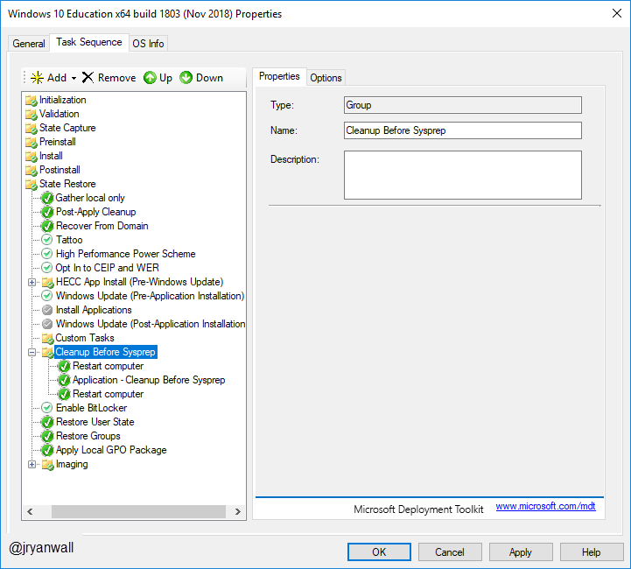
Task Sequence Cleanup Before Sysprep
Get rid of all junk before Sysprep and Capture when creating a reference image in MDT
https://deploymentbunny.com/2014/06/05/nice-to-know-get-rid-of-all-junk-before-sysprep-and-capture-when-creating-a-reference-image-in-mdt/

Slide 27
Demo

Slide 28
Helpful Info
Deployment Research
Building a Windows 10 v1809 reference image using Microsoft Deployment Toolkit (MDT)
https://deploymentresearch.com/Research/Post/1676/Building-a-Windows-10-v1809-reference-image-using-Microsoft-Deployment-Toolkit-MDT
Building a Windows 10 v1709 reference image using MDT
https://deploymentresearch.com/Research/Post/654/Building-a-Windows-10-v1709-reference-image-using-MDT
Building the perfect Windows Server 2016 reference image
https://deploymentresearch.com/Research/Post/578/Building-the-perfect-Windows-Server-2016-reference-image
Back to Basics - Building a Windows 7 SP1 Reference Image using MDT 2013 Update 2
https://deploymentresearch.com/Research/Post/521/Back-to-Basics-Building-a-Windows-7-SP1-Reference-Image-using-MDT-2013-Update-2

Slide 29
Questions

Slide 30
Break 10 Minutes

