Slide 1

HECC 2018
2054 - Deploying Windows 10 With MDT (Part 2)
Section 2

Slide 2
Agenda
Drivers and BIOS
Modern Driver Implementation
Model Alias
Driver Automation Tool
BIOS upgrade during deployment
Task Sequence adjustments for drivers and BIOS update
Demo
Questions

Slide 3
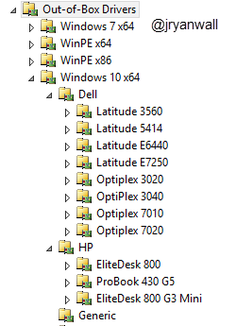
Modern Driver Implementation
Only install Drivers for the Machine and OS you are deploying to
Organized Drivers to make updating them less of a pain
Does require Model Alias Script

Slide 4
Model Alias
VB Script (AliasUserExit.vbs) to help with Modern Driver Implementation and other functions
Sits in %DeploymentRoot%\Scripts folder
Basically creates MDT custom variables about the deployment target machine
Written Originally by Mikael Nystrom
https://deploymentbunny.com/2012/05/01/modelalias-user-exit-for-microsoft-deployment-toolkit-20102012/

Slide 5
Driver Task Sequence Adjustment
Need to create 2 Set Task Sequence Variable Tasks under Preinstall before the Inject Drivers TS
Task 1
Name - DriverGroup001
Task Sequence Variable - DriverGroup001
Value - Windows 10 x64\%MakeAlias%\%ModelAlias%
Task 2
Name - DriverGroup002
Task Sequence Variable - DriverGroup002
Value - Windows 10 x64\Generic
Set Inject Drivers to Nothing

Slide 6
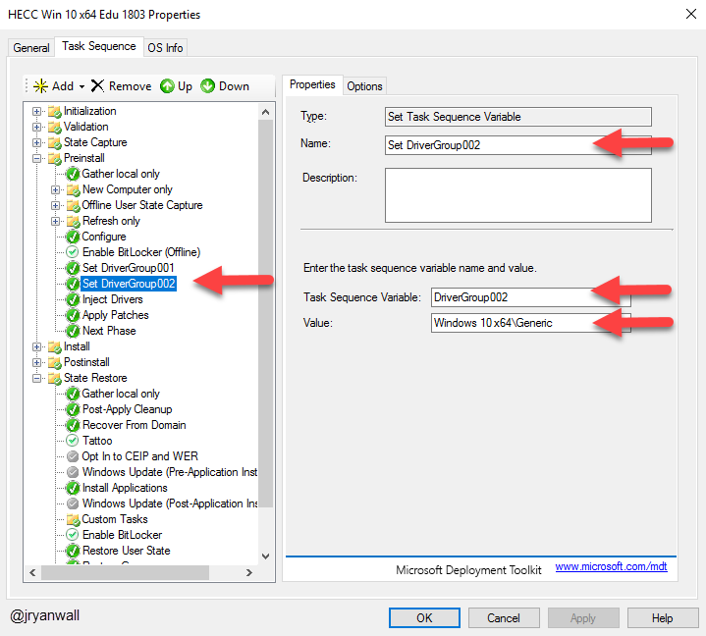
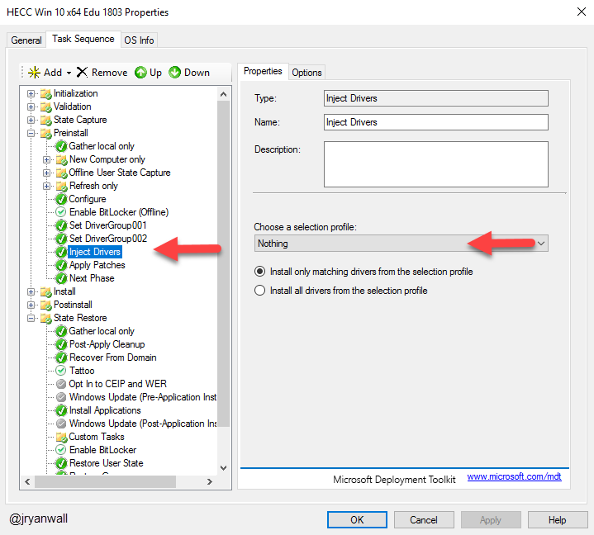
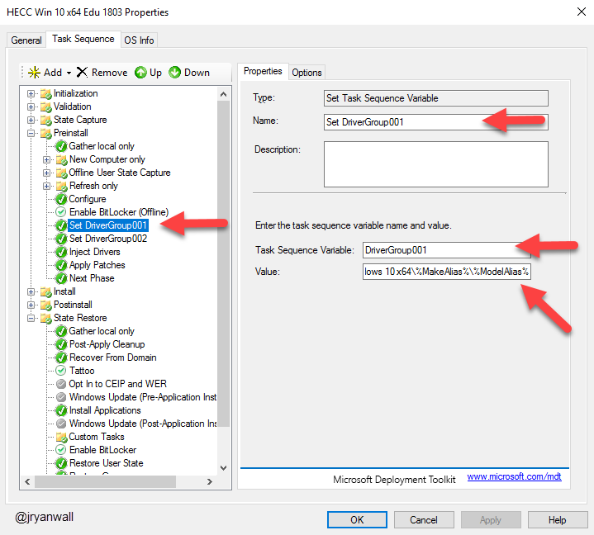
Driver Task Sequence Adjustment

Slide 7
Driver Automation Tool
Built by Maurice Daly - @modaly_it
Can be found at
http://www.scconfigmgr.com/2018/08/28/driver-automation-tool-6-1-0-released/
GUI Based
Works with MDT and SCCM
Works with
Dell
HP
Lenovo
Microsoft

Slide 8
BIOS upgrade during deployment
PowerShell script to install BIOS updates for HP and Dell machines
Idea taken from this post by Mikael Nystrom
https://deploymentbunny.com/2016/07/20/osd-bios-upgrade-during-os-deployment-in-mdtconfigmgr-v3/
I have tweaked it to make it work for me
Also depend on Model Alias

Slide 9
BIOS upgrade Task Sequence
Add the Application Install - BIOS Upgrade
In the State Restore Section
Create new Group called BISO Upgrade
Add TS to run Application Install – BIOS Upgrade
Add Restart Computer TS
Add TS variable check NeedReboot equals YES

Slide 10
Demo

Slide 11
Questions

Slide 12
Break 10 Minutes

