Slide 1

HECC 2018
2054 - Deploying Windows 10 With MDT (Part 2)
Section 3

Slide 2
Agenda
Bringing it all home
Old Computer Name
Final Task Sequence Adjustment
Local Admin changes
Local accounts
Activate Office
OEM Customization
Generate Windows Experience
Bringing it all home…
Logging
Website status page
Demo
Questions

Slide 3
Old PC Name
Made possible by UserExit.vbs script in %DeploymentRoot\Scripts folder
Must have setting in Control.ini to support
OSDComputername=#GetOfflineComputername()#
Pulls old computer name during imaging process
If there was no name, throws a non-fatal error

Slide 4
Final Adjustments Local Admin Changes
Create admin account on all PC’s using following commands
cmd.exe /c net user /add Admin Local!! && cmd.exe /c net localgroup administrators Admin /add
cmd.exe /c wmic useraccount where "Name='Admin'" SET PasswordChangeable=False

Slide 5
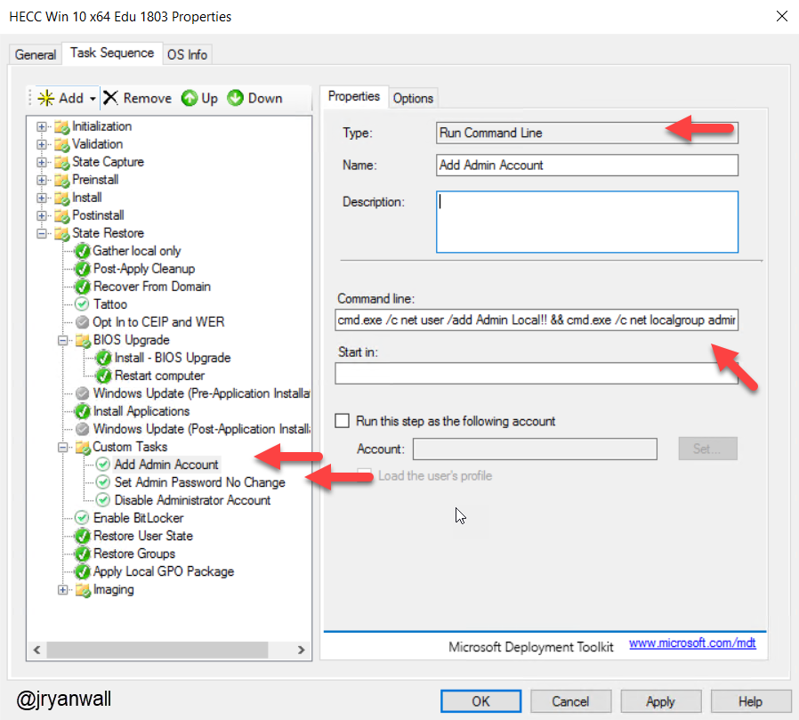
Final Adjustments Local Admin Changes

Slide 6
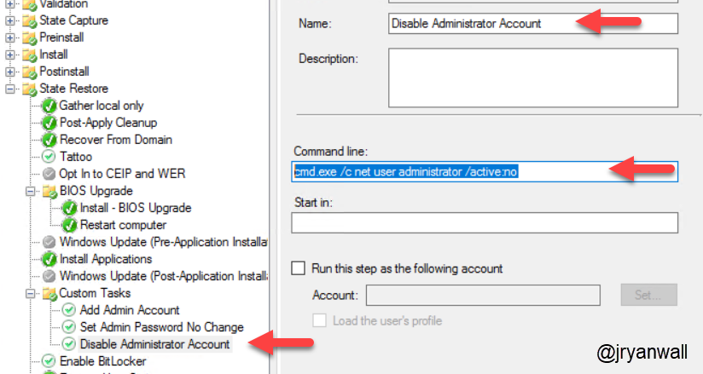
Final Adjustments Local accounts
Disable Administrator Account
cmd.exe /c net user administrator /active:no

Slide 7
Final Adjustments Activate Office 2016

Slide 8
Final Adjustments OEM Information

Slide 9
Final Adjustments Generate Windows Experience
Based of off following blog post
https://deploymentresearch.com/Research/Post/624/Why-adding-WinSAT-formal-to-your-task-sequence-can-be-a-shiny-thing-to-do
Help Windows know if SSD is installed on machine
I just created a batch file with command in it
winsat formal
Put batch file as an Application in MDT

Slide 10
Logging
When things go wrong check the logs
Logs controlled by Control.ini
; Copy Logs if an error occurs or when deployment is successfully completed
SLShare=\\MDT01\HECCDeploy$\Logs
; Enable Dynamic Logging
SLSHAREDynamicLogging=\\MDT01\HECCDeploy$\DynLog\%OSDComputername%
Create both the Logs and DynLog folders in %DeploymentRoot%

Slide 11
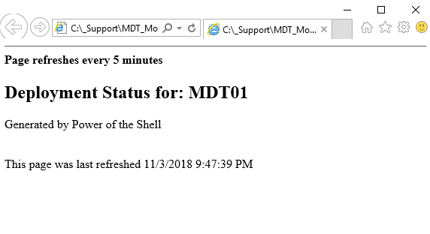
Website status page
PowerShell Script to query MDT Monitor and show status
Output file goes to IIS server running on MDT box
Simple page but helpful when running around school imaging PC’s

Slide 12
Demo

Slide 13
Questions

Slide 14
Class files and slide deck
All the files used for class and slide deck can be found on my GitHub account.
https://github.com/jryanwall/HECC-2018
If you don’t find something or have questions shoot me an email or hit me up on Twitter
rwall@hccsc.k12.in.us
@JRyanWall
I also have a list on Twitter related to OSD
https://twitter.com/jryanwall/lists/deployment

Slide 15
Thanks Please fill out class evaluation

