Slide 1

HECC 2018
2053 - Deploying Windows 10 With MDT (Part 1)
Section 1

Slide 2
Agenda
The Setup
Setting up Environment
Installing MDT 8450
Installing ADK 1809
Installing ADK WinPE 1809
Creating Build Share in MDT
Configure and Customizing Build Share
Bootstrap.ini
CustomSettings.ini
Demo
Questions

Slide 3
Things you will need
Computer to build images on (Laptop or Server)
Windows 10 Education iso (1809, 1803, or 1709)
Windows 10 ADK 10 v 1809
WinPE addon for Windows 10 ADK v1809
Microsoft Deployment Toolkit (MDT) 8450
Script to relax deployment share permissions

Slide 4
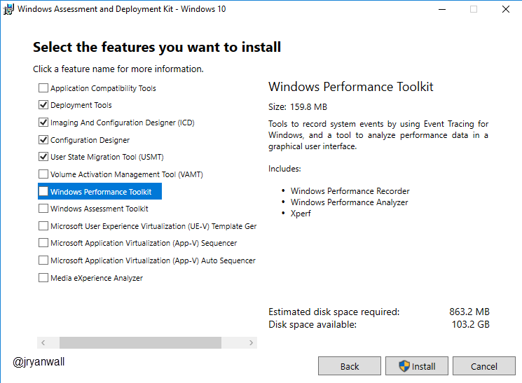
Windows ADK Install
You don’t need all options.
Only need
Deployment Tools
Imaging and Configuration Designer (ICD)
Configuration Designer
User State Migration Tool

Slide 5
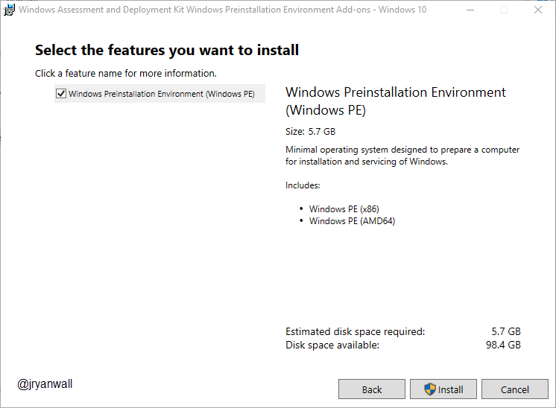
Windows ADK WinPE
No Options on this one
Just Next, Next, Next, Install

Slide 6
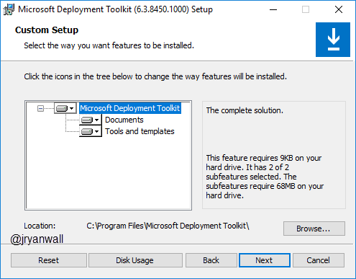
MDT 8450
Take everything

Slide 7
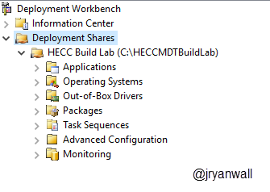
Create Deployment Share
Open Deployment Workbench
Right Click on Deployment Share and select New Deployment Share
For Lab Continuity use these settings…
Deployment share path C:\HECCMDTBuildLab
Share name HECCMDTBuildLab$
Except all other prompts

Slide 8
Create Deployment Share … Easy way
Run PowerShell script to do all above
New-Item -Path "C:\HECCMDTBuildLab" -ItemType directory
New-SmbShare -Name "HECCMDTBuildLab$" -Path "C:\HECCMDTBuildLab" -FullAccess Administrators
Import-Module "C:\Program Files\Microsoft Deployment Toolkit\bin\MicrosoftDeploymentToolkit.psd1"
new-PSDrive -Name "DS001" -PSProvider "MDTProvider" -Root "C:\HECCMDTBuildLab" -Description "HECC Build Lab" -NetworkPath "\\MDT01\HECCMDTBuildLab$" -Verbose | add-MDTPersistentDrive -Verbose
Notes:
New-Item -Path "C:\HECCMDTBuildLab" -ItemType directory
New-SmbShare -Name "HECCMDTBuildLab$" -Path "C:\HECCMDTBuildLab" -FullAccess Administrators
Import-Module "C:\Program Files\Microsoft Deployment Toolkit\bin\MicrosoftDeploymentToolkit.psd1"
new-PSDrive -Name "DS001" -PSProvider "MDTProvider" -Root "C:\HECCMDTBuildLab" -Description "HECC Build Lab" -NetworkPath "\\AS-TEC-PROBK-01\HECCMDTBuildLab$" -Verbose | add-MDTPersistentDrive -Verbose

Slide 9
Configuring Deployment Share
What is the point of the configurations
Simplify image creation process
Ultimately make image creation process scriptable or lite touch
Cleanup unneeded screens

Slide 10
Main files to configure
Bootstrap.ini
File is processed first
Only processed once
Located in %DeploymentShare%\Control\
CustomSettings.ini
Processed after Bootstrap.ini
Is the rules file processed by ZTIGather.wsf
Located in %DeploymentShare%\Control\
Notes:
Bootstap.ini
https://itinlegal.wordpress.com/2017/10/17/mdt-tutorial-part-5/
CustomSettings.ini
https://itinlegal.wordpress.com/2017/10/15/mdt-tutorial-part-4/
https://deploymentbunny.com/2012/04/21/back-to-basic-customsettings-ini-explained/
https://deploymentbunny.com/2015/05/22/back-to-basic-customsettings-ini-converting-desktop-and-laptop-computer-types-into-roles/

Slide 11
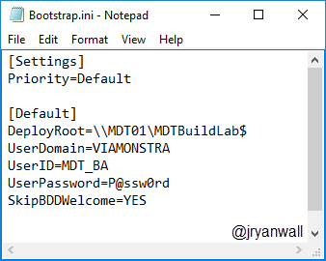
Bootstrap.ini
For golden image we need the following changes made

Slide 12
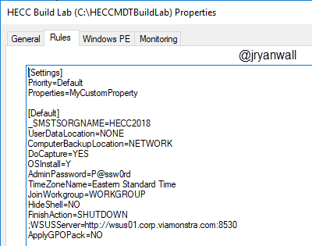
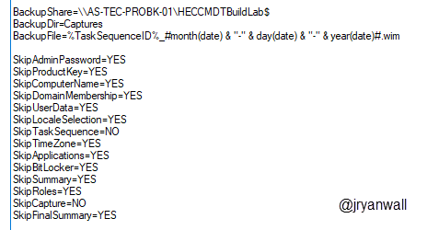
CustomSettings.ini
These are the settings I use. You may not need all of them and you may need to adjust some to your environment.

Slide 13
Demo

Slide 14
Questions

Slide 15
Break 10 Minutes

