Slide 1
HECC 2018
2053 - Deploying Windows 10 With MDT (Part 1)

Slide 2
Agenda
The Setup
Setting up Environment
Installing MDT 8450
Installing ADK 1809
Installing ADK WinPE 1809
Creating Build Share in MDT
Configure and Customizing Build Share

Slide 3
Things you will need
Computer to build images on (Laptop or Server)
Windows 10 Education iso (1809, 1803, or 1709)
Windows 10 ADK 10 v 1809
WinPE addon for Windows 10 ADK v1809
Microsoft Deployment Toolkit (MDT) 8450
Script to relax deployment share permissions

Slide 4
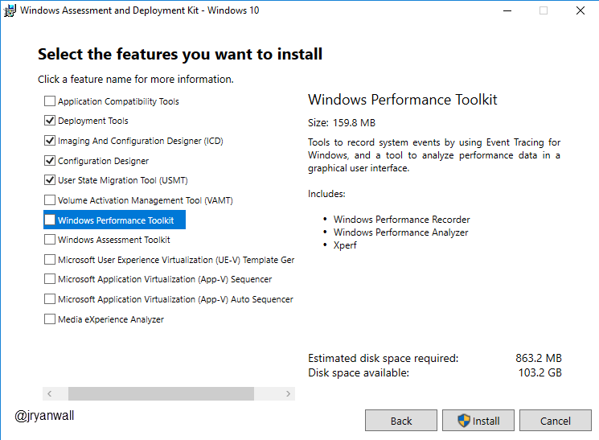
Windows ADK Install
You don’t need all options.
Only need
Deployment Tools
Imaging and Configuration Designer (ICD)
Configuration Designer
User State Migration Tool

Slide 5
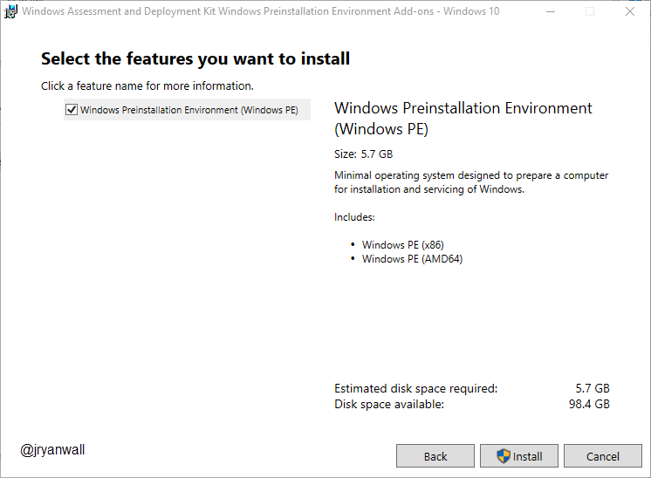
Windows ADK WinPE
No Options on this one
Just Next, Next, Next, Install

Slide 6
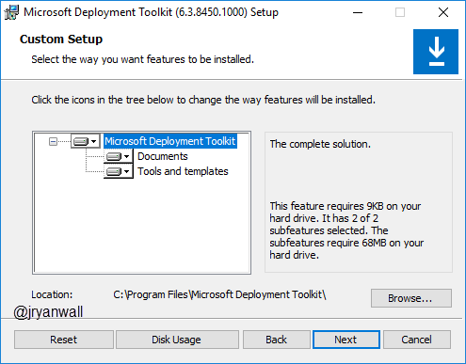
MDT 8450
Take everything

Slide 7
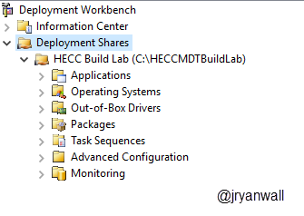
Create Deployment Share
Open Deployment Workbench
Right Click on Deployment Share and select New Deployment Share
For Lab Continuity use these settings…
Deployment share path C:\HECCMDTBuildLab
Share name HECCMDTBuildLab$
Except all other prompts

Slide 8
Create Deployment Share … Easy way
Run PowerShell script to do all above
New-Item -Path "C:\HECCMDTBuildLab" -ItemType directory
New-SmbShare -Name "HECCMDTBuildLab$" -Path "C:\HECCMDTBuildLab" -FullAccess Administrators
Import-Module "C:\Program Files\Microsoft Deployment Toolkit\bin\MicrosoftDeploymentToolkit.psd1"
new-PSDrive -Name "DS001" -PSProvider "MDTProvider" -Root "C:\HECCMDTBuildLab" -Description "HECC Build Lab" -NetworkPath "\\MDT01\HECCMDTBuildLab$" -Verbose | add-MDTPersistentDrive -Verbose
Notes:
New-Item -Path "C:\HECCMDTBuildLab" -ItemType directory
New-SmbShare -Name "HECCMDTBuildLab$" -Path "C:\HECCMDTBuildLab" -FullAccess Administrators
Import-Module "C:\Program Files\Microsoft Deployment Toolkit\bin\MicrosoftDeploymentToolkit.psd1"
new-PSDrive -Name "DS001" -PSProvider "MDTProvider" -Root "C:\HECCMDTBuildLab" -Description "HECC Build Lab" -NetworkPath "\\AS-TEC-PROBK-01\HECCMDTBuildLab$" -Verbose | add-MDTPersistentDrive -Verbose

Slide 9
Configuring Deployment Share
What is the point of the configurations
Simplify image creation process
Ultimately make image creation process scriptable or lite touch
Cleanup unneeded screens

