Slide 1
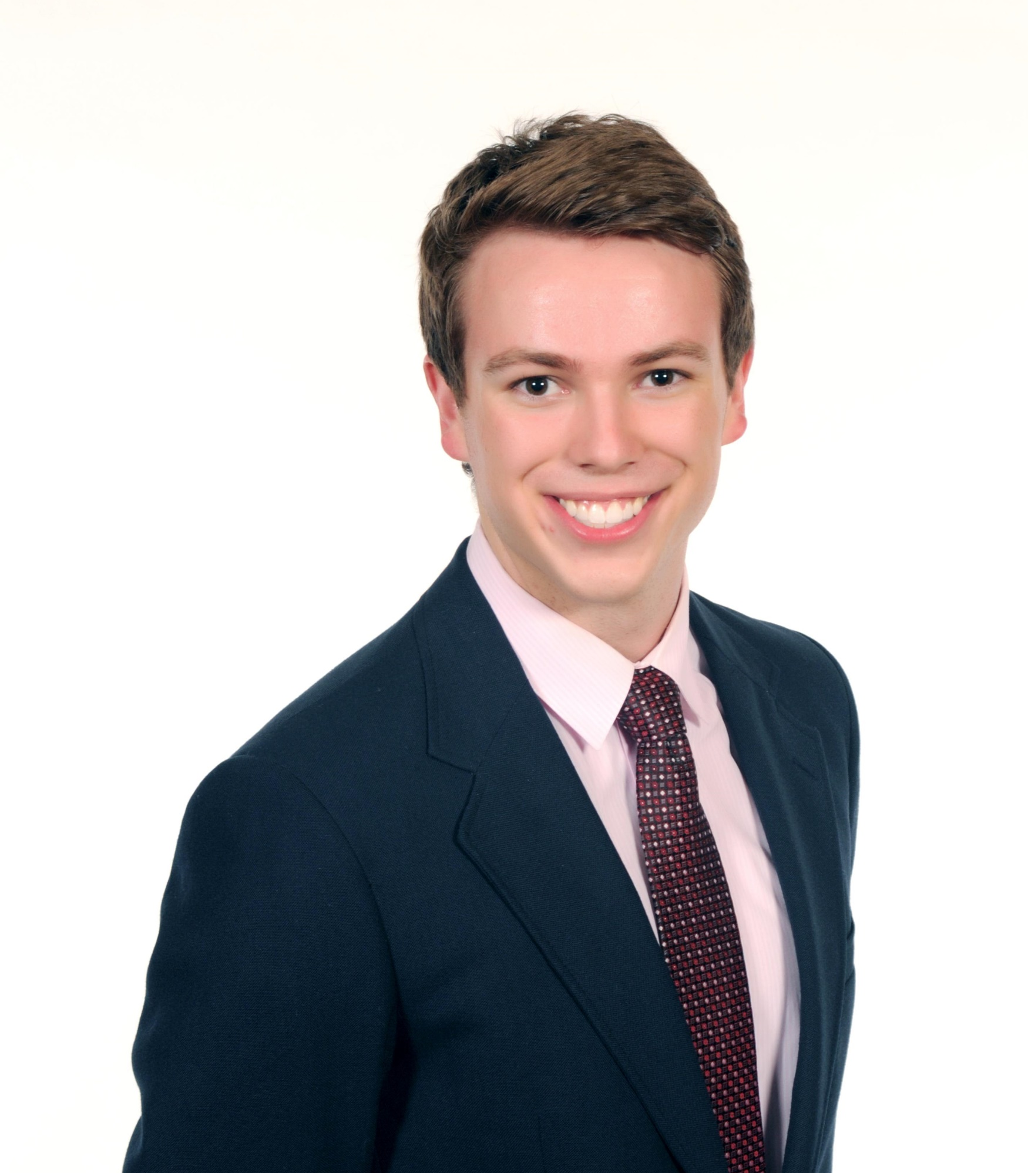
Jacob Hartzer MEEN Sophomore
After graduation, I would like to continue A&M’s fast track graduate school program and then go into industry afterwards.
I have reasonable programming experience, first learning in high school. I was a software developer at NXP semiconductors this past summer and I currently do research in both the department of Mathematics and Aerospace Engineering. I have experience in Python, C++, MatLab, and LabVIEW.
Learning Goals:
Further Develop programming experience
Solidify knowledge of differential equations and numerical solutions
Develop a deep understanding of how numerical methods operate and feel confident in being able to apply this learning in industry.
Prefers to be called Jacob

