Slide 1
Leicester Accomodation Reviwews

Slide 2
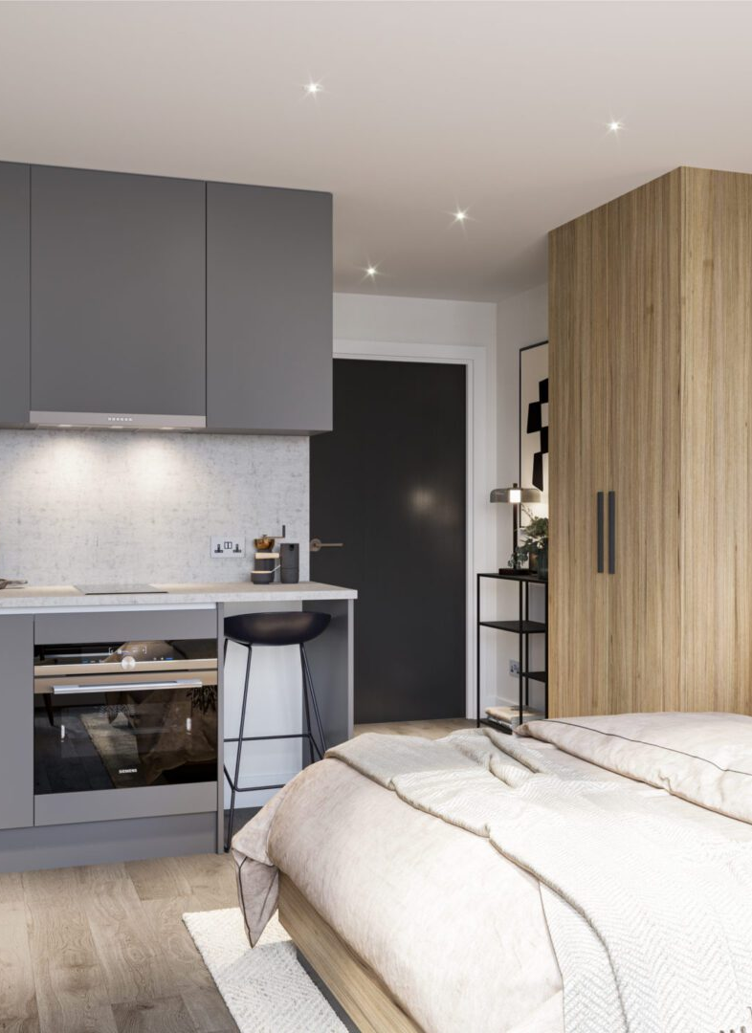
Our Idea
Students tend to have issues with accommodation
Currently, it is hard to find honest reviews on accommodations before applying.
Our solution is to create a website where students can leave and view honest, unbiased reviews.

Slide 3
Demo

Slide 4
Thank you

