Slide 1
Leicester Accomodation Reviews

Slide 2
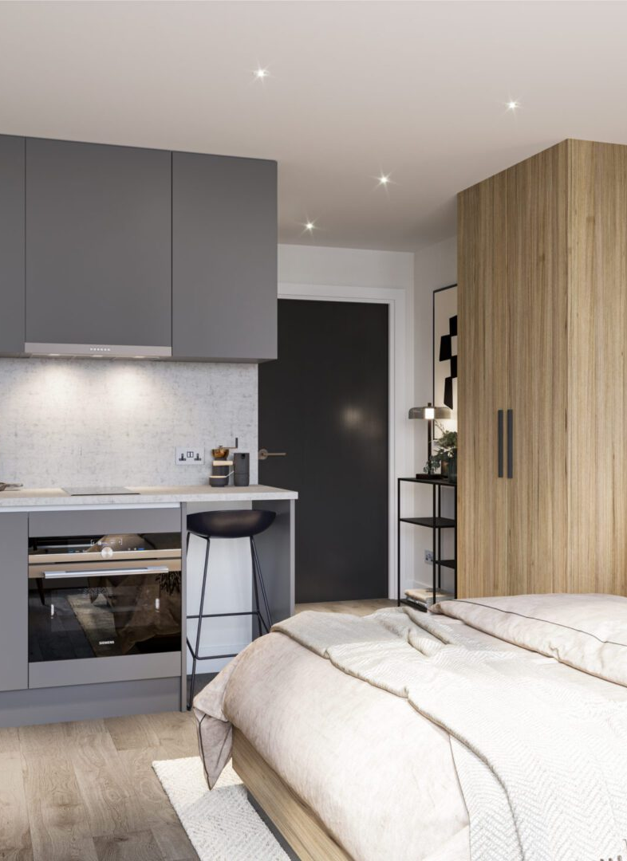
Our Idea
Students tend to have issues with accommodation
Currently, it is hard to find honest reviews on accommodations before applying.
Our solution is to create a website where students can leave and view honest, unbiased reviews.

Slide 3
Demo

Slide 4
Improvements:
With more time, we may be be able to improve the aesthetics and functionality of the website
May expand it to include private accommodations outside of University of Leicester

Slide 5
Thank you

