Slide 1
Map-Reduce and Scaling Big Data Processing

Slide 2
Contents
Understanding Map Reduce
Functional programming patterns applied for scalability
Hadoop
Map-reduce in Hadoop
Python
Java
HDFS
Yarn
Pig and Hive
Further reading

Slide 3
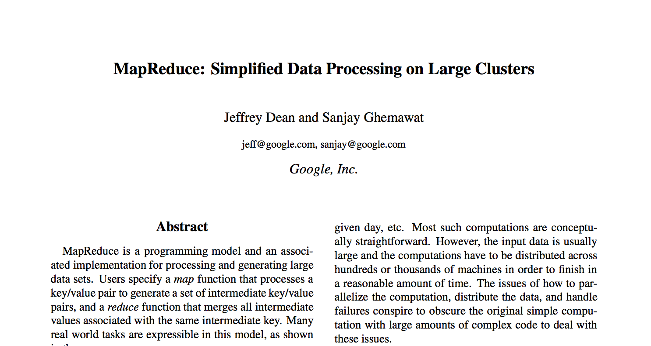
Original 2008 Google Paper

Slide 4
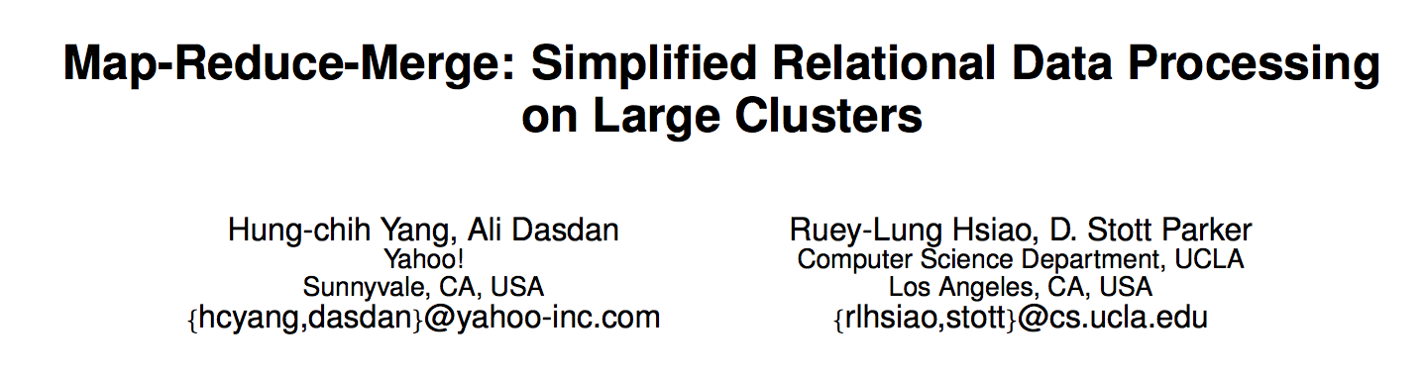
Yahoo 2007

Slide 5
Class Exercise
Find a small piece of paper and write your university and day/month of birth on one.
You don’t need the year
Portsmouth 5 October

Slide 6
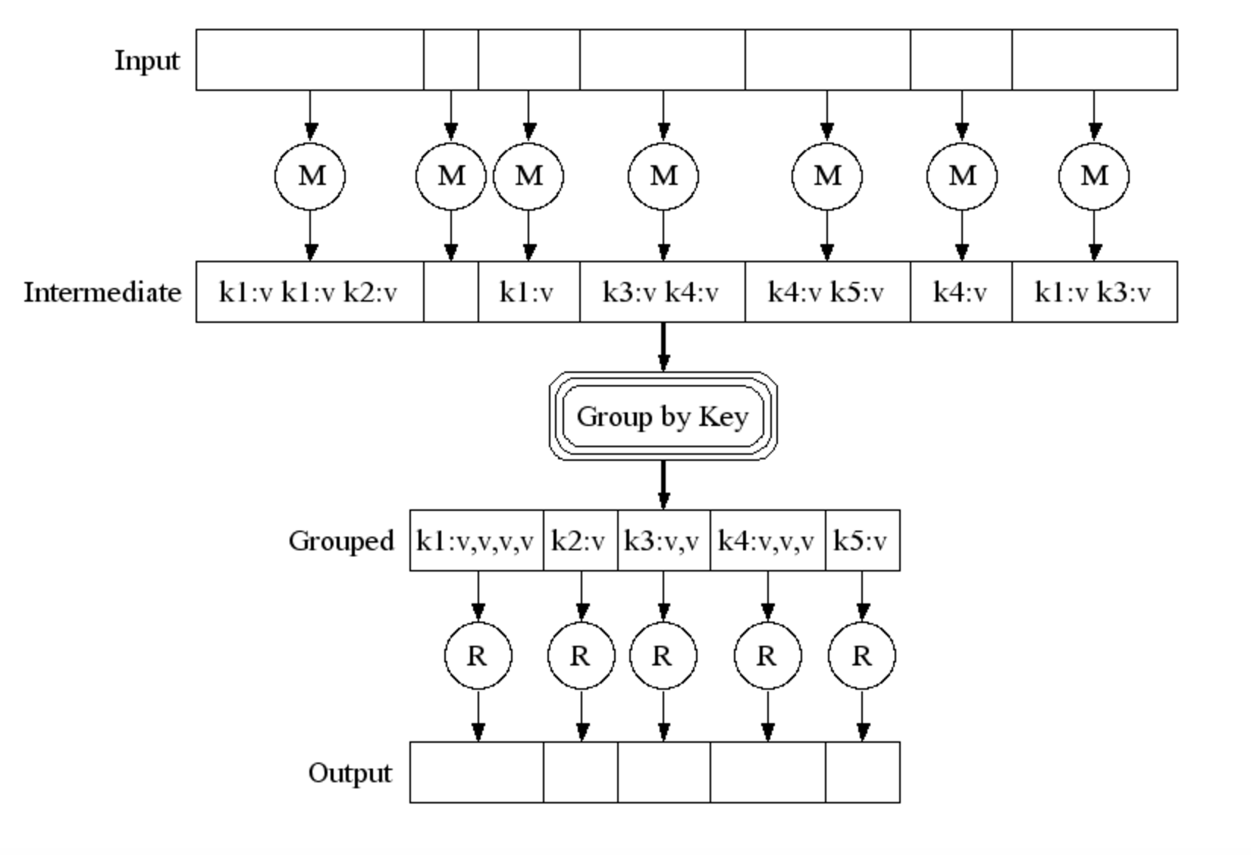
Pictorially

Slide 7
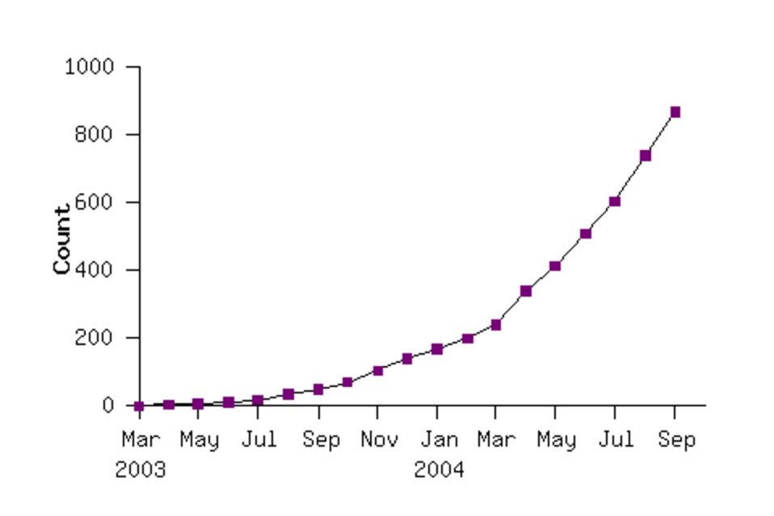
Google’s early use of MR Map Reduce programs in their code repository

Slide 8
Map Reduce example in words
Do a word count on 1000 books:
First count each book (map wc onto book)
Then reduce the outputs to a global wordcount across all books

Slide 9
Efficiency
Reduce phase:
We can theoretically process each word in parallel
How?
Shuffle / Sort the results from the map phase by key (word)
Partition by keys
Parallelize the reduce phase

Slide 10
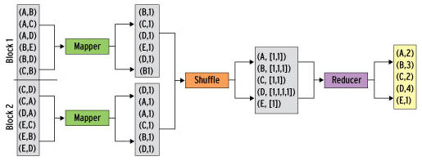
Map/Shuffle/Reduce

Slide 11
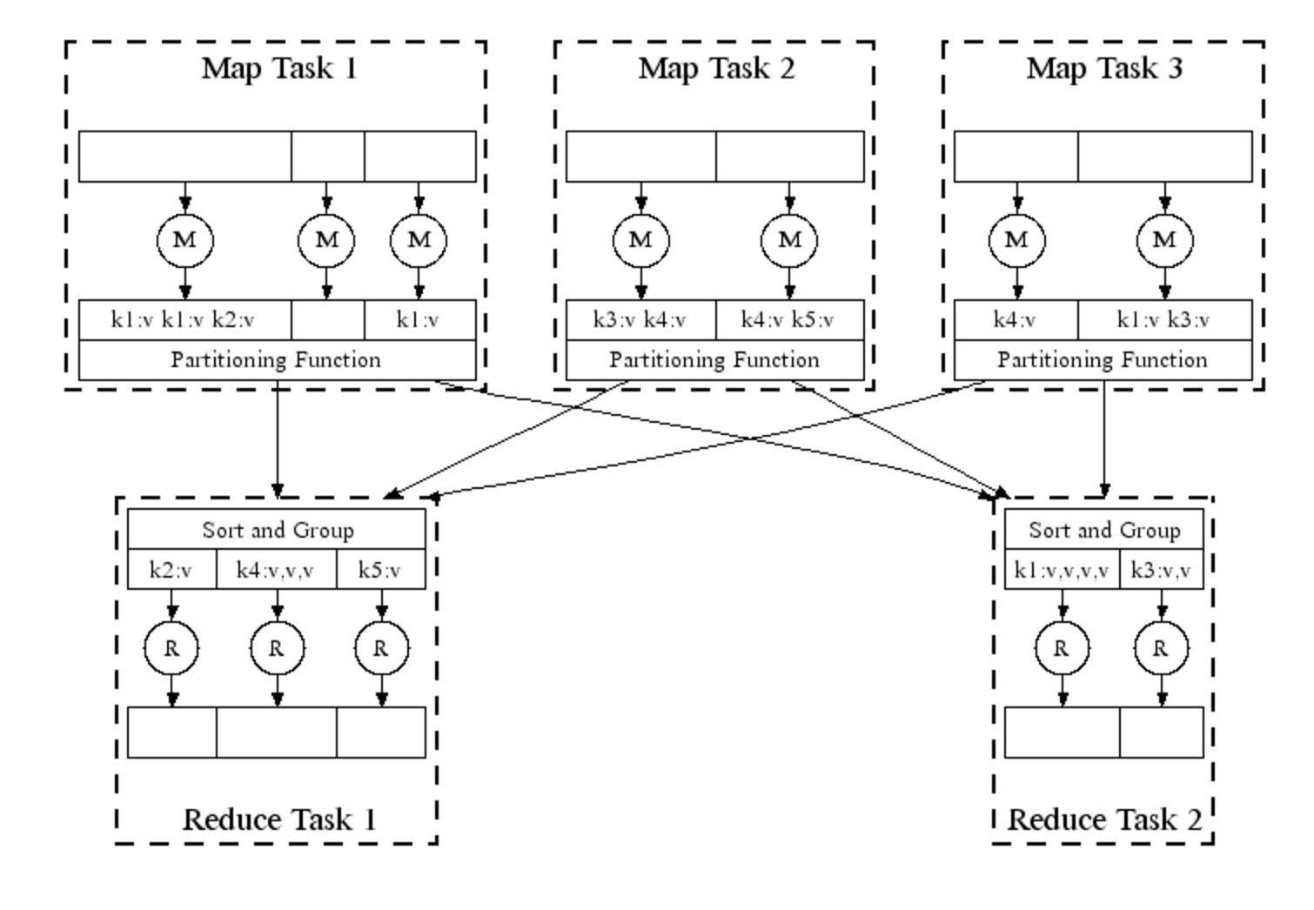

Slide 12
Map Reduce in Real Life
Analysing web logs
Summarise by user / cookie
Then aggregate to identify who did what
Analysing twitter data
Who retweeted
Who was retweeted the most
Almost all big data problems can be re-factored into Map Reduce
Some more efficiently than others

Slide 13
Tuning
Fault tolerance
Simply re-execute work that fails
Performance:
Partitioning the data
Moving the work to near the data

Slide 14
Apache Hadoop
The most famous and popular Map Reduce framework
Open Source
Written in Java, but supports other languages
Runs Map Reduce workloads across a cloud or cluster of machines
Supports a distributed filesystem to store data for these jobs
Provides reliability when servers in the cluster fail

Slide 15
Components of Hadoop
Map Reduce or Other Workloads
Java, Scala, Python, Apache Pig, Apache Hive, etc
YARN (Yet Another Resource Negotiator)
Cluster Resource Management
Hadoop Distributed File System (HDFS)
Redundant Reliable Distributed File System

Slide 16
Summary
Understanding the Map Reduce Model
How is it implemented in Hadoop
HDFS
Yarn
Notes:
see 06-additional tools

Slide 17
Questions?

