Slide 1


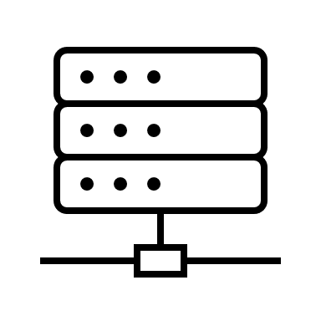





Azure Resource group (RedTeam)
Azure Virtual Network 10.0.0.0/16 (RedTeamVN)
Load Balancer Back End Pool
Availability Zone 1
Availability Zone 2
Availability Zone 3
DVWA-VM1
52.233.92.69
10.0.0.17
DVWA-VM3
52.148.153.245
10.0.0.19
Kibana Reporting
Jump-Box-Provisioner
52.183.33.163
10.0.0.4
SSH
SSH
SSH
DVWA-VM4
52.156.107.98
10.0.0.20
Internet
SSH
RedTeam NSG Security
VM w/Docker
VM w/Docker
VM w/Ansible
SSH
SSH
DVWA-VM2
52.233.92.70
10.0.0.18
ELK-Server
52.229.9.203
10.0.0.7
HTTP
Port 80
SSH
VM w/Docker
Local Workstation
Home
74.194.137.8
RedTeamLB
20.42.144.5
LOGS
HTTP
Port 5601
VM w/Docker
ELK Server
Load Balancer
Internet
HTTP Port 5601

