Slide 1
DATA ENGINEERING ASSESSMENT
Urbanisation Prospects
Global Market Opportunity Analysis
235
1950–2050
4
32
Countries Analysed
Data Range
Data Sources
High Opportunity Markets
Microsoft Fabric • PowerBI • Delta Lake • Medallion Architecture

Slide 2
The Business Problem
"Which global markets represent the best opportunity for product expansion?"
🌍
📊
💡
Global Scale
Multiple Sources
Actionable Insight
235 countries across 6 continents with data from 1950 to 2050
4 datasets with different formats, naming conventions and coverage
Sales and marketing teams need clear, ranked market recommendations

Slide 3
Solution Architecture
Medallion Architecture — Bronze → Silver → Gold
SOURCE
BRONZE
SILVER
GOLD
POWERBI
4 CSV Files
Raw Delta Tables
Cleaned & Joined
Business Ready
Report
Raw data landing zone
UN · WID · Continents · WHO
Exact copy + metadata
Audit trail preserved
Standardised, joined
23,735 rows
4 aggregated tables
Optimised for PowerBI
3-page dashboard
Interactive visuals
▶
▶
▶
▶
Key Principles: Separation of Concerns • Single Source of Truth • Idempotency • Transparency

Slide 4
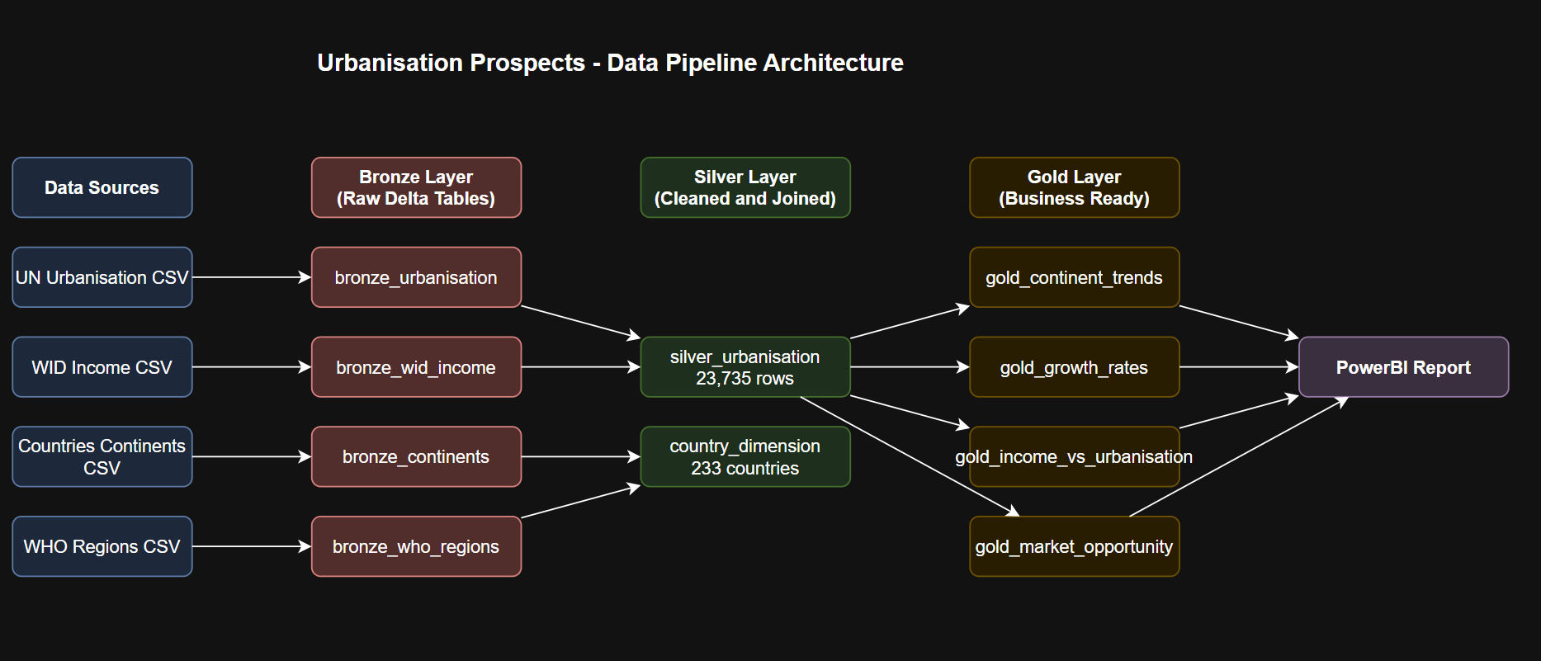
Urbanisation Prospects - Data Pipeline Architecture
Microsoft Fabric • PowerBI • Delta Lake • Medallion Architecture

Slide 5
Data Sources
Source | Rows | Key Columns | Challenge
UN World Urbanisation Prospects 2018 | 27,573 | Entity, Year, Urban Pop, Rural Pop | Contains regional aggregates — filtered out
World Inequality Database — Pretax Income | 7,078 | Entity, Year, Mean Income, Gini | Sparse coverage — 64% of countries
Countries & Continents | 285 | Entity, Continent | Name mismatches with other datasets
OWID Country to WHO Regions | 194 | Entity, WHO Region | Different country name format
🔑 Key Engineering Challenge
All four datasets refer to countries differently — full UN names, common names, ISO codes. I solved this by building a Country Dimension Table that standardises 233 countries into a single source of truth.

Slide 6
Real-World Data Engineering Challenge
The Country Name Problem
Dataset | How 'South Africa' appears
UN Urbanisation | South Africa
WID Income | ZA
Countries & Continents | South Africa
OWID WHO Regions | South Africa / ZAF
✅ Solution
Country Dimension Table
• 233 countries standardised
• Single source of truth
• Continent + WHO region
• Manual fixes applied
Country Name Fixes Applied:
• Swaziland → Eswatini
• Macedonia → North Macedonia
• Czech Republic → Czechia
• 38 regional aggregates removed

Slide 7
Pipeline Results
BRONZE LAYER
SILVER LAYER
GOLD LAYER
4 Tables
1 Table
4 Tables
• bronze_urbanisation 27,573 rows
• silver_urbanisation 23,735 rows
• gold_continent_trends 606 rows
• bronze_wid_income 7,078 rows
• 233 countries mapped
• gold_growth_rates 15,824 rows
• bronze_continents 285 rows
• 1950 – 2050 coverage
• gold_income_vs_urbanisation 4,158
• bronze_who_regions 194 rows
• Historical + Projected
• gold_market_opportunity 4,158
✅ Data Quality Check: PASS — All validations passing • 235 countries • Zero duplicates • 64% income coverage documented

Slide 8
Key Business Insights
01
32 High Opportunity Markets Identified
Our composite scoring model — combining urbanisation rate, mean income and population size — identified 32 countries that score in the top tier across all three dimensions. These are the markets the sales team should prioritise for product expansion.
02
Africa is Urbanising Faster Than Any Other Region
Sub-Saharan Africa is projected to double its urban population by 2050. Combined with a young demographic and rising incomes in key markets, this represents the most significant long-term growth opportunity — though high income inequality in many markets remains a risk factor.
03
The Urbanisation Inflection Point
Countries crossing the 50–60% urbanisation threshold show accelerating income growth. Countries currently approaching this threshold — particularly in Southeast Asia and East Africa — represent the highest near-term growth opportunity.

Slide 9
What I Would Do Next
Performance
Reliability
Quality
⚡
🔄
🛡️
Incremental Data Loads
Automated Orchestration
Formal Data Quality Contracts
Replace full refresh with watermark-based incremental loading using Delta Lake MERGE. Only process new or changed records each run.
Schedule notebooks via Fabric Data Factory with dependencies — Bronze → Silver → Gold → DQ check. Pipeline stops and alerts on failure.
Replace informational DQ checks with hard tops Define expected row counts, value ranges and referential integrity.
Maintainability
Enrichment
Usability
🔀
📈
⚙️
CI/CD via GitHub Actions
Additional Data Sources
Configurable Opportunity Score
Automated testing and deployment of notebook changes through pull requests before reaching production.
World Bank GDP data for fuller income coverage. IMF financial inclusion data showing % of population with bank accounts.
Move scoring weights to a config table so the investment team can run scenario analysis without touching code.

Slide 10
Thank You
235
23,735
32
3
Countries
Rows Processed
Opportunities
Report Pages
🔗 GitHub Repository
https://github.com/JHaywardNinetyOne/urbanisation-prospects-assessment
Microsoft Fabric • PowerBI • Delta Lake • PySpark • Medallion Architecture • GitHub

