Slide 1
NetLogoWeb
What it is and how to use it

Slide 2
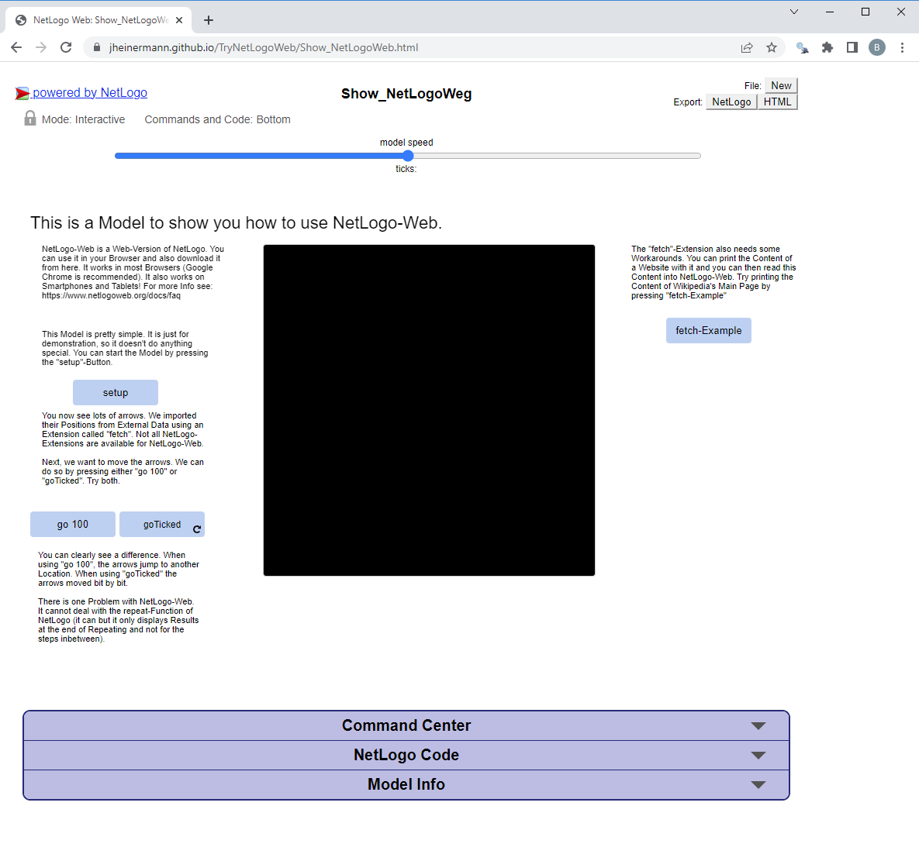
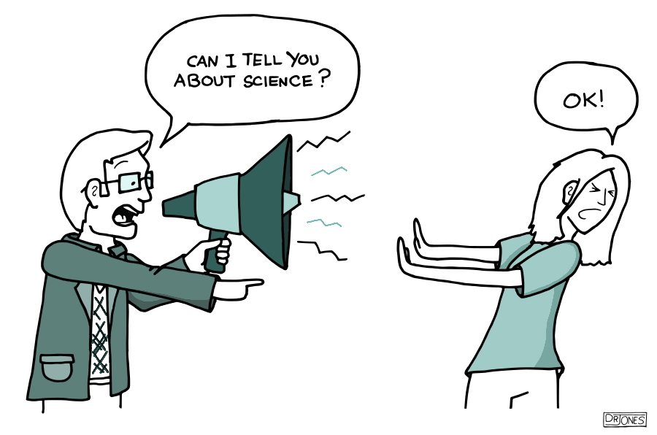
What is NetLogoWeb
A NetLogo Environment that runs on Browsers (including Tablets, Smartphones, …)
A handy Tool for Science Communication

Slide 3
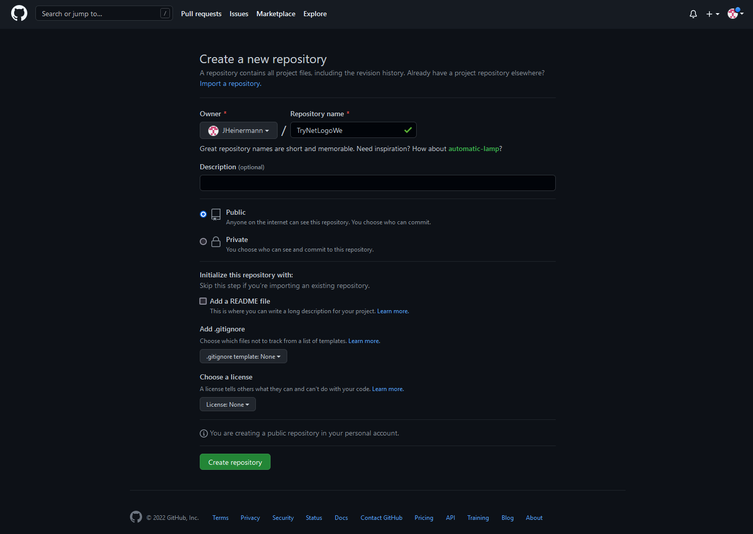
Steps to get your Model running on GitHub
Create a new Repository
Make it Public (otherwise you cannot create a page)

Slide 4
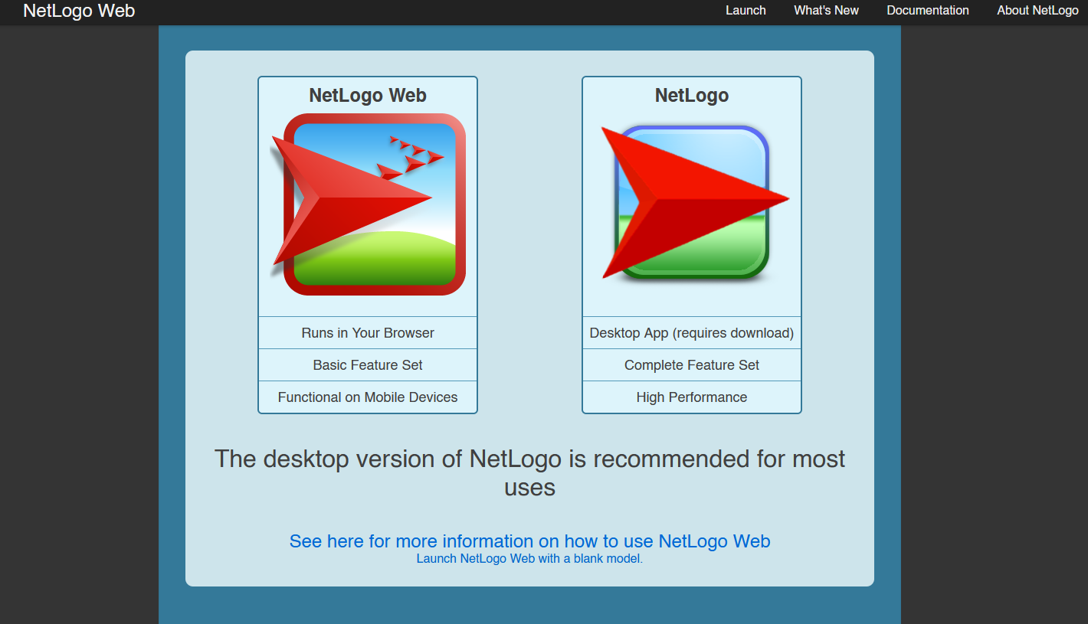
Steps to get your Model running on GitHub
Go to NetLogo Web (https://www.netlogoweb.org/)
Klick on NetLogo Web

Slide 5
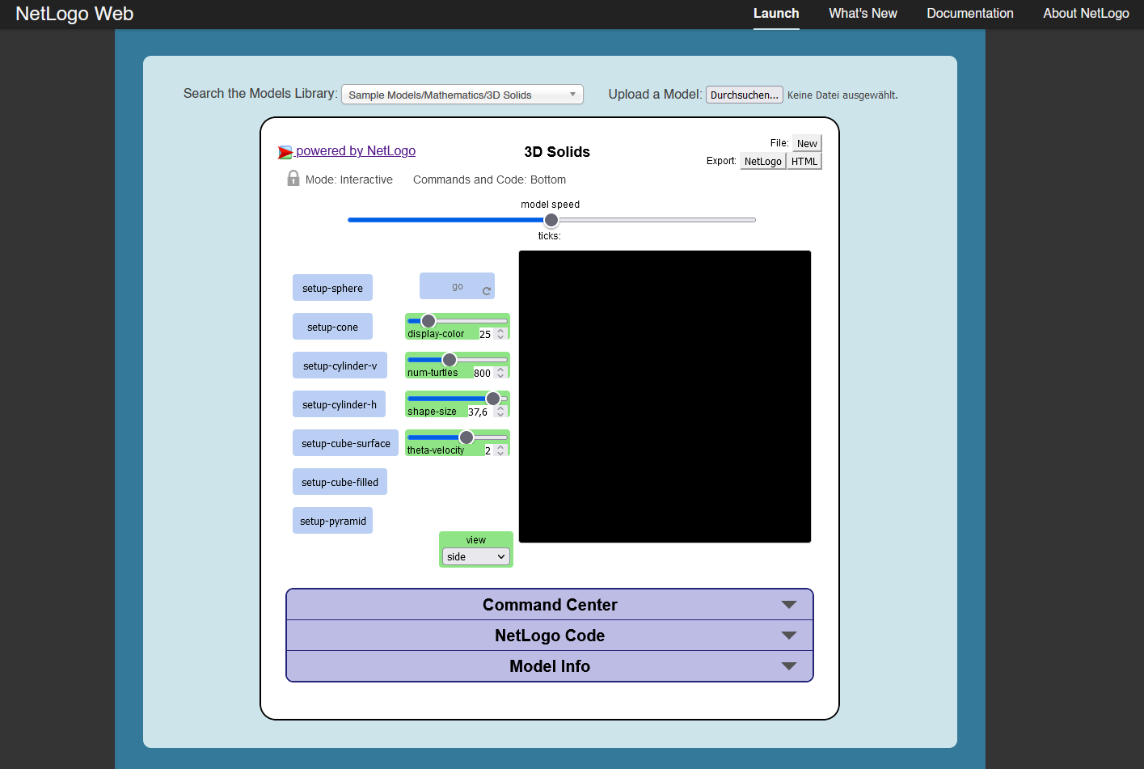
Steps to get your Model running on GitHub
Upload a Model

Slide 6
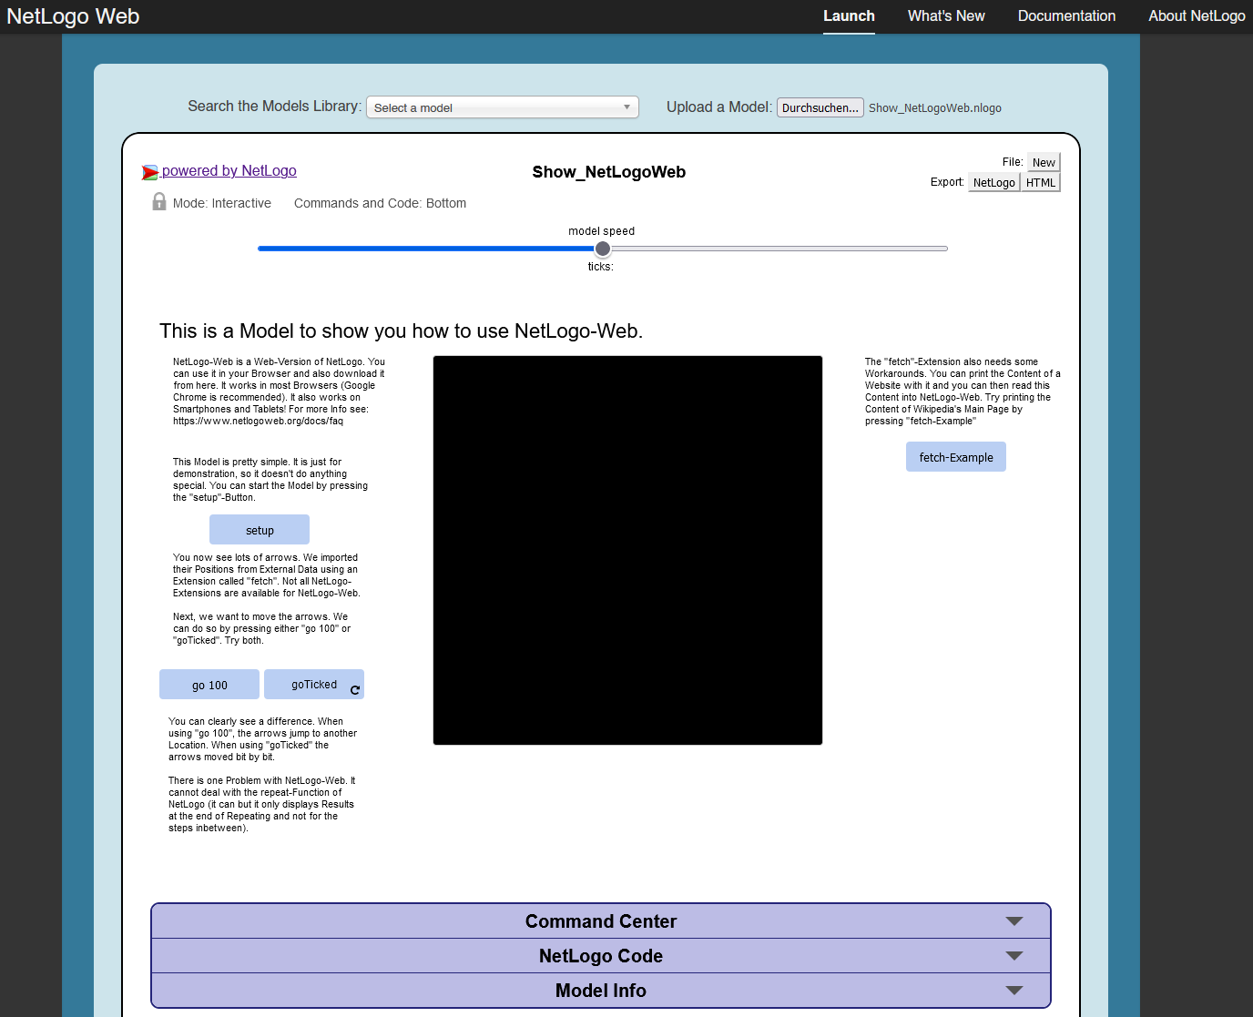
Steps to get your Model running on GitHub
Export the HTML

Slide 7
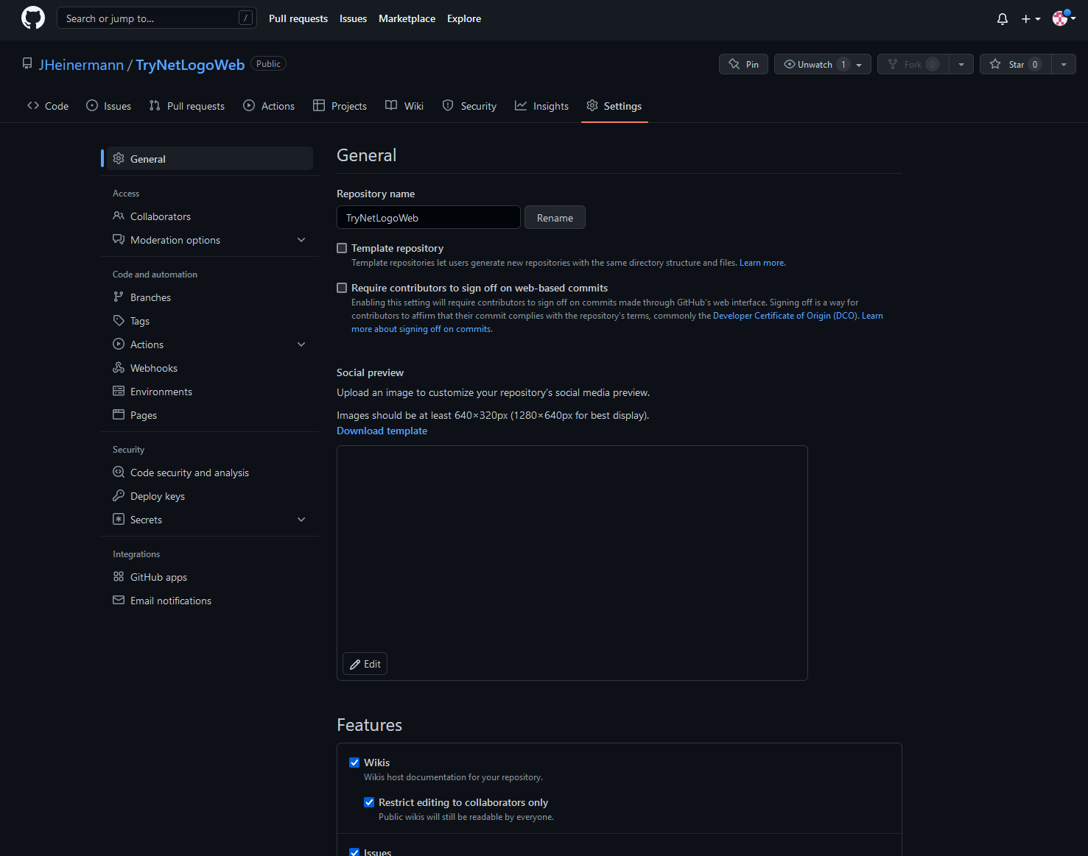
Steps to get your Model running on GitHub
Upload your HTML-File
Go to Settings
Go to Pages

Slide 8
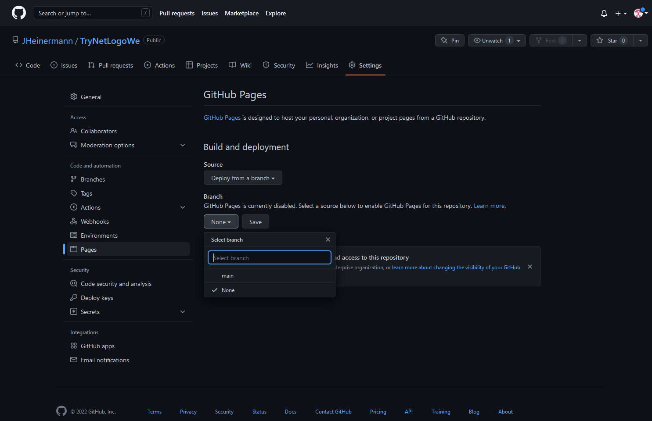
Steps to get your Model running on GitHub
Create a GitHub Page (basically a Website on GitHub). The Browser then ready the HTML instead of displaying it as code.
Under „Branch“, select a branch that you want to transform into a Page (I used the Main Branch here)

Slide 9
Steps to get your Model running on GitHub
After a couple of moments you can access your Model through: http://YourUsername/YourRepository/FileName.html

Slide 10
Extensions
Not all NetLogo Extensions are supported e.g.:
Arduino
Bitmap
GIS
Gogo
LevelSpace
Network
Palette
Profiler
Python
R
Rnd
Sound
Time
Vid
View2.5D

Slide 11
Two Tipps for NetLogo Web
Importing External Data is possible but a little tricky
Repeating is not the way to go in NetLogo Web

Slide 12
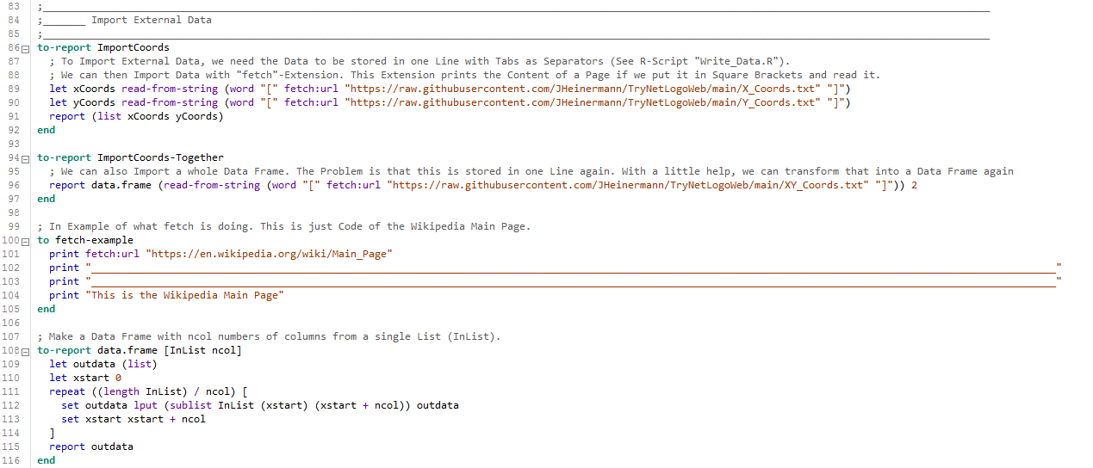
Import Data
Importing External Data is possible either locally or from a Website using the „fetch“-Extension
You can use fetch:url „http://xyz“ to print (or save) the code of a Website. You can Import Data if it is available as .txt (for example on GitHub).

Slide 13
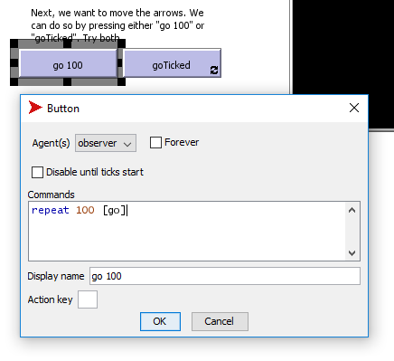
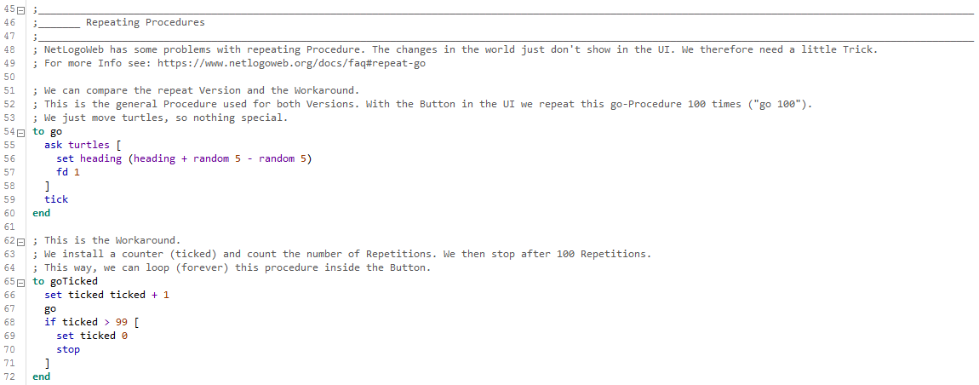
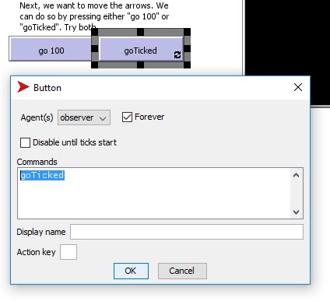
Go repeat
does not work with UI
NetLogo Web cannot display changes inside a „repeat“-Loop in the UI. You therefore need a little Workaround:
You create a looping button and stop it after the desired amount of repetitions.
does work

Slide 14
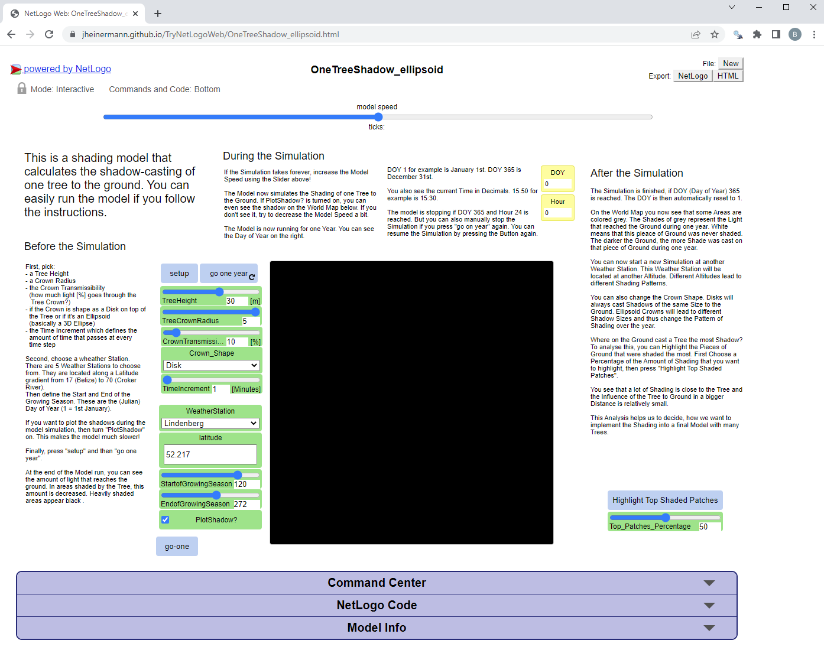
Examples of Models

Slide 15
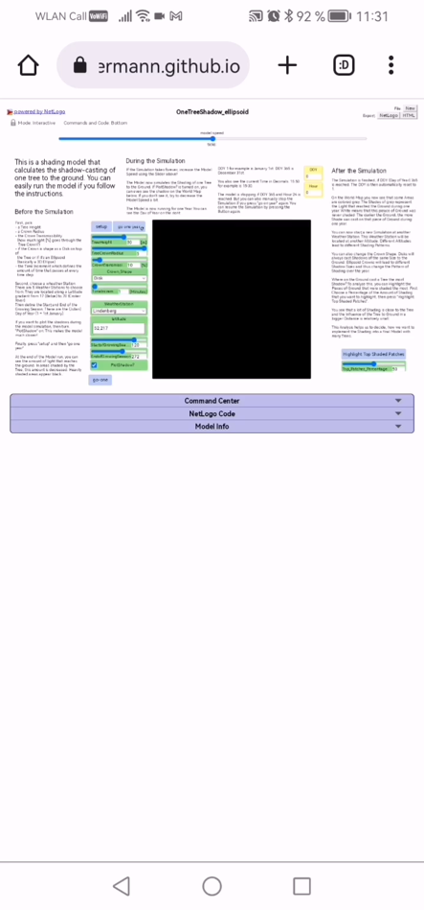
You can use it on your smartphone!

Slide 16

Why NetLogo Web is great!
Easy to use for people without modelling experience
Easy to access for everyone with an internet connection
Easy to download
Easy to share
You can get a DOI for your Repository

Slide 17
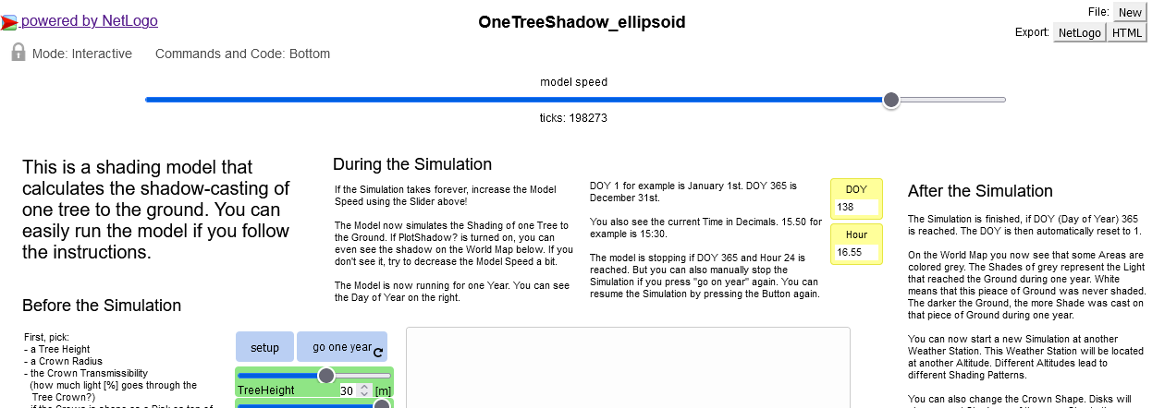
What to consider
People might open the model before they read something about it
You need a self-explanatory description inside the model
I recommend to split the description into 3 parts:

Slide 18
Two Examples
https://jheinermann.github.io/TryNetLogoWeb/Show_NetLogoWeb.html
https://jheinermann.github.io/TryNetLogoWeb/OneTreeShadow_ellipsoid.html

