Slide 1
Behaviour Driven Development (BDD)

Slide 2
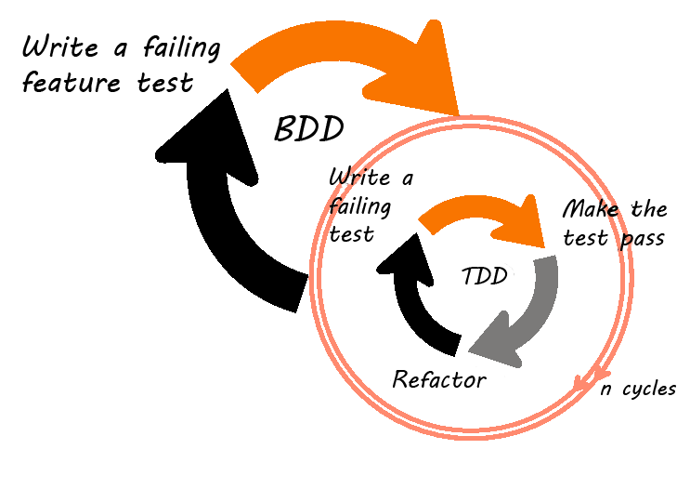
BDD - Definition
BDD is a set of best practices for writing great tests. BDD can, and should be, used together with TDD and unit testing methods.

Slide 3
Principles
Is a refinement of TDD and Acceptance Driven Development (ATDD)
Apply the "Five Why's" principle to each proposed user story, so that its purpose is clearly related to business outcomes
Thinking "from the outside in", in other words implement only those behaviours which contribute most directly to these business outcomes, so as to minimize waste
Describe behaviours in a single notation which is directly accessible to domain experts, testers and developers, so as to improve communication
Apply these techniques all the way down to the lowest levels of abstraction of the software, paying particular attention to the distribution of behaviour, so that evolution remains cheap
This means that all development work can be traced back directly to the business objectives.

Slide 4
The Five Why’s
5 Whys is an iterative interrogative technique used to explore the cause-and-effect relationships underlying a particular problem.
The vehicle will not start. (the problem)
1. Why? - The battery is dead.
2. Why? - The alternator is not functioning.
3. Why? - The alternator belt has broken.
4. Why? - The alternator belt was well beyond its useful service life and not replaced.
5. Why? - The vehicle was not maintained according to the recommended service schedule.

Slide 5
Benefits of BDD
BDD offers more precise guidance on organizing the conversation between developers, testers and domain experts
Notations originating in the BDD approach, in particular the given-when-then canvas, are closer to everyday language and have a shallower learning curve compared to those of other tools
Tools targeting a BDD approach generally afford the automatic generation of technical and end user documentation from BDD "specifications"

Slide 6
BDD Tool
We will be using the Cucumber software tool
It utilises a plain language parser called Gherkin.
Written in Ruby
It is designed to run automated Tests in a BDD style.

Slide 7
Cucumber
Allows the easy creation of specific tests with the collaboration of multiple members of a team.
Such as Testers, Developers and Business Analysists.
Used with multiple Languages – we will be using it with Java

Slide 8
How it works
Works using two files:
1. A Feature File
2. A Step Definition File

Slide 9
Feature file
A feature file is the main part of Cucumber.
It works using a specific notation called Given-When-Then.
It is very similar to the notation used in a user story, i.e. As a X-I want to Y-So that Z
It is not a .txt file, but actually a .feature file.

Slide 10
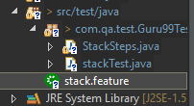
Feature File
A feature file Is built up of several layers
The first being the Feature that is being tested
This is written like so:
Feature: [The Feature to be tested]
Feature files are placed into the project structure like so:

Slide 11
Feature File
The second part is made up of the individual scenarios
The scenarios are the different paths that can be taken within the feature.
They are written like so:
Scenario: [Scenario to be tested]

Slide 12
Feature File
The final part of a feature file is the contents of the Scenario
This forms what we are going to test in this feature.
This is written using Given-When-Then notation
Which is written like the following:
Given I want to go to www.google.com
When I search for QA
Then a link to www.qa.com should be visible

Slide 13
Feature file example
Feature: [The Feature to be tested]
Scenario: [Scenario to be tested]
Given I want to go to www.google.com
When I search for QA
Then a link to www.qa.com should be visible

Slide 14
Feature file example - additional
Given an empty stack
When I push an item into the stack
And I push another item into the stack
Then the stack contains two items

Slide 15
Feature File
A final note about feature files is that they can contain multiple scenarios
However you should not put lots of scenarios in one file as it would soon become unreadable.

Slide 16
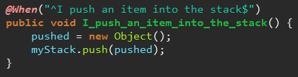
Step Definition File
The Step definition file is a class/file within your programming language that holds what’s known as the ‘glue’ code
This is where we translate the steps from our feature file into code that we can use to perform the tests.
You will also need to go to the Eclipse Marketplace and install the Cucumber Plugin, this will make running your feature files much easier.

Slide 17
Cucumber and Step Definition Files
In order to start using Cucumber you will need 2 dependencies
<dependency>
<groupId>info.cukes</groupId>
<artifactId>cucumber-java</artifactId>
<version>1.2.4</version>
<scope>test</scope>
</dependency>
<dependency>
<groupId>info.cukes</groupId>
<artifactId>cucumber-junit</artifactId>
<version>1.2.4</version>
<scope>test</scope>
</dependency>

Slide 18
Thank you
QA hopes you enjoyed your course,
as much as we enjoyed teaching you.

