Slide 1
PYTHON AND LIBRARIES INSTALLATION
Necessary steps
Anaconda
Install anaconda
Run Jupyter notebook
Javier Hipólito Marsal

Slide 2
1.Necessary steps
Python 3.3 (programming lenguage)
Install Jupyter notebook
?
open-source web application that allows you to create and share documents that contain live code, equations, visualizations and narrative text
It is possible to install BOTH + Python important libraries
MORE AND ALTERNATIVE
ANACONDA

Slide 3
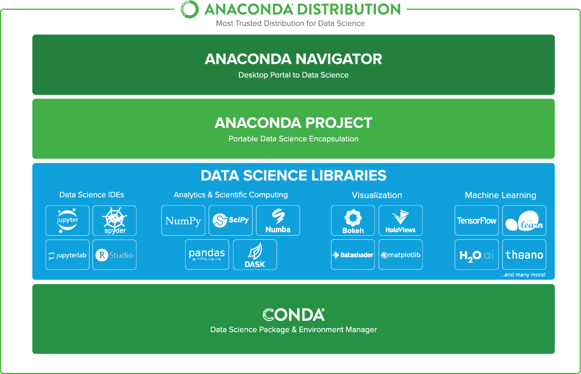
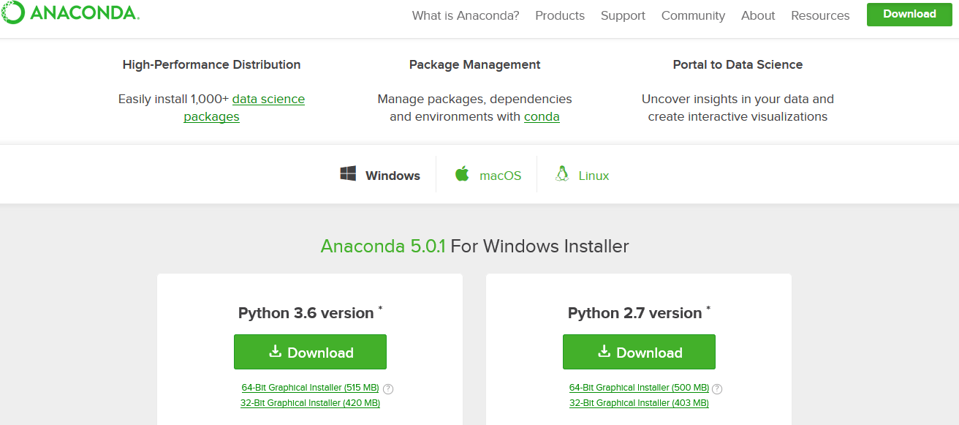
2. Anaconda
https://www.anaconda.com/download/
CLICK TO SEE ITS SCIENTIFIC LIBRARIES

Slide 4
3. Install Anaconda
Follow installation asistant.
MORE INFO

Slide 5

4. Run Jupyter notebook
Open Command prompt
Change directory to your workspace where you will store/use your python file notebooks.
Call
jupyter notebook
MORE

