Slide 1
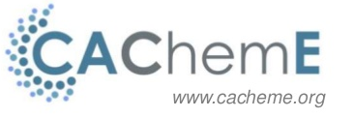
Introduction to high-level scientific computing with Python
4. SIGNAL PROCESSING

Slide 2
Fast Fourier Transform
Theoretical background
Scipy
Signal processing
1. Sampling
Frequency resolution
Filtering
Windowing
Convolution of signals
Study your own audio file

Slide 3

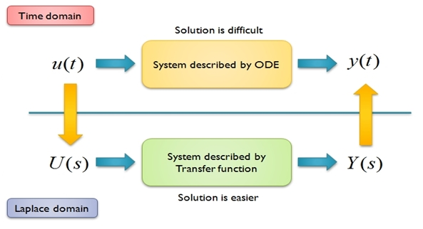
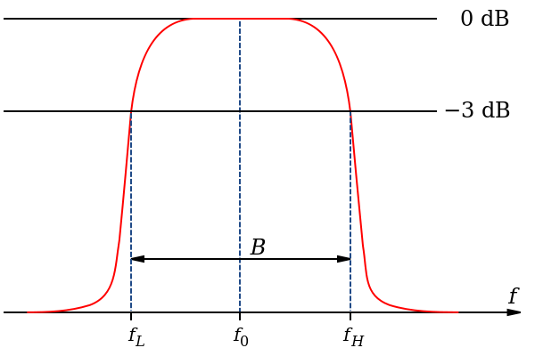

FOURIER TRANSFORM
1. THEORETICAL BACKGROUND
¿What is it?
¿Why is it useful?
- SIGNAL BANDWITH ANALISYS
- MAKES SIMPLE
See rotations and light interpretation

Slide 4
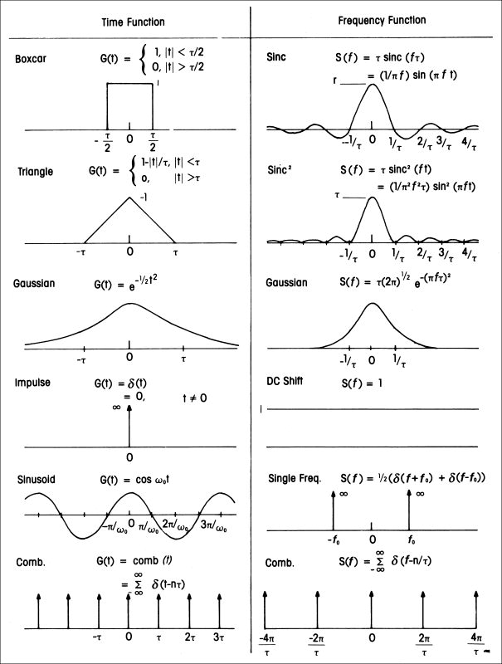
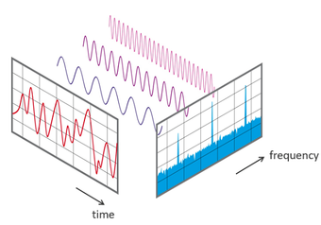
FOURIER TRANSFORM
1. THEORETICAL BACKGROUND
¿What produces?

Slide 5
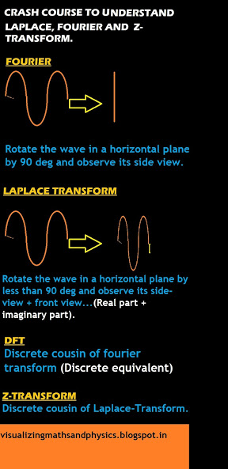
FOURIER TRANSFORM
1. THEORETICAL BACKGROUND
Vs Laplace Transform

Slide 6
FAST FOURIER TRANSFORM
COOLEY AND JONH TUKEY ALGORITHM
Discrete Fourier Transform
Exploit symmetries
Create FFT numpy function
Create FFT numpy vectorized function
UNDERSTANDING THE FFT ALGORITHM

Slide 7
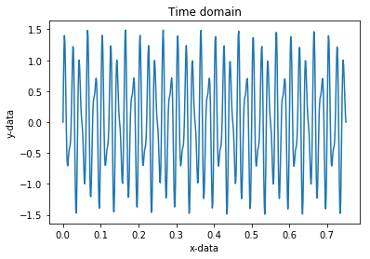
FAST FOURIER TRANSFORM
2. SCIPY
Sum of 2 sin functions -> Frequency response
¿Frequency response?
See examples scipy FFT
SCIPY FFT
CLICK
THEORETICAL BACKGROUND
http://www.ni.com/white-paper/4844/es/#

Slide 8
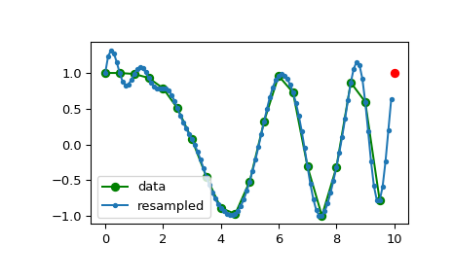

2. SIGNAL PROCESSING
SAMPLING
Nyquist–Shannon sampling theorem
Continuos function -> SAMPLING -> Discrete function.
¿Why? Computer needs binary information.
Stablishes sufficient condition for a sample rate to calpure all the information of a finite bandwith
$T≥2B$
T = Sampling rate
B = Bandwith
See examples scipy FFT
SAMPLING
https://en.wikipedia.org/wiki/Time%E2%80%93frequency_analysis

Slide 9
2. SIGNAL PROCESSING
2. FREQUENCY RESOLUTION
With appropiate time sampling increasing DFT is useful!
Frequency resolution

Slide 10
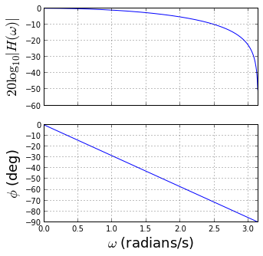


2. SIGNAL PROCESSING
3. FILTERING
Preserving some signals while supressing others -> many approaches available
A popular approach is using a finit impulse responde (FIR) filter, it is a filter without feedback, it stops producing output when the input is out.
Signal transformation is based on moving averages. M -1 is the order of the filter and
M the number of coefficients.
Example
FILTERING

Slide 11
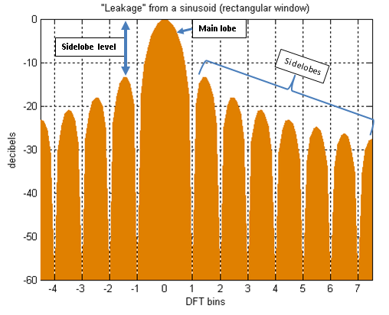

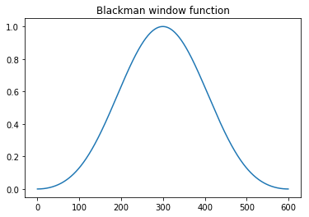
2. SIGNAL PROCESSING
4. WINDOWING
Frequency response can be formed of several signals with different amplitudes
Mitigates spectral leakeage
WINDOWING

Slide 12


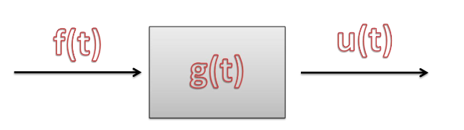
2. SIGNAL PROCESSING
5. CONVOLUTION OF SIGNALS
See more about convolution

Slide 13
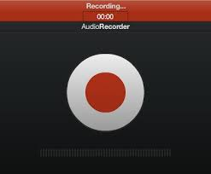
2. SIGNAL PROCESSING
6. STUDY YOUR OWN AUDIO FILE
http://myinspirationinformation.com/uncategorized/audio-signals-in-python/
http://www.microsiervos.com/archivo/musica/gran-experimento-calidad-mp3.html

