Slide 1

Introduction to high-level scientific computing with Python
INTRODUCTION:
Scikit AND AstroPy

Slide 2
SCIKIT
¿What is Scikit? ¿Why should I use it?
Machine learning
Stimulus example: Decision Tree
Stimulus example: Detection of contourns
2. AstroPy
1. Example: Determining and plotting
the altitude/azimuth of a celestial object

Slide 3
SCIKIT
¿What is Scikit? ¿Why should I use it?
Machine learning and image Python library
Includes several functions easy to use for several applications
Interoperates with other scientific libraries

Slide 4
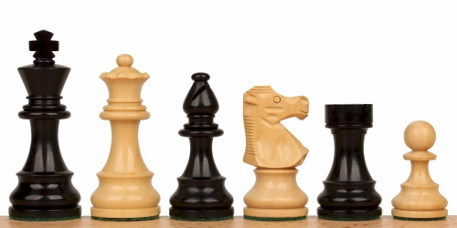

SCIKIT
2. Machine learning
¿How a machine plays chess?
¿Can you beat the machine?
Historical event: 1996 WCC Garry Kasparov defeated
by Deep Blue. ¡A computer beats a human at considered
one of the most complex games!
IA: Minimax
https://www.research.ibm.com/deepblue/meet/html/d.3.2.html
- Program gets feedback -> Improve its evaluating fuction ->Learns

Slide 5
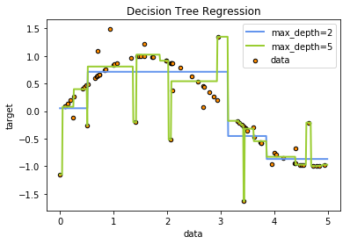
SCIKIT (LEARN)
3. Stimulus example
Decision Tree
Goal: classification and regression.
- Basis: Learns decision rules from data
http://scikit-learn.org/stable/modules/tree.html

Slide 6
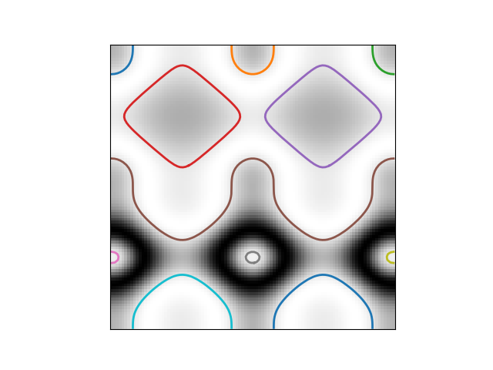

SCIKIT (IMAGE)
3. Stimulus example
Contourn
- Goal: Detect picture contourns.
- Basis: Continuity of same color.
http://scikit-image.org/docs/stable/auto_examples/edges/plot_convex_hull.html#sphx-glr-auto-examples-edges-plot-convex-hull-py
http://users.polytech.unice.fr/~lingrand/MarchingCubes/algo.html
$$R^{2} space$$

Slide 7

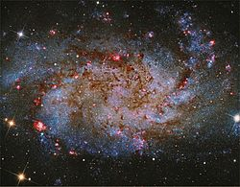
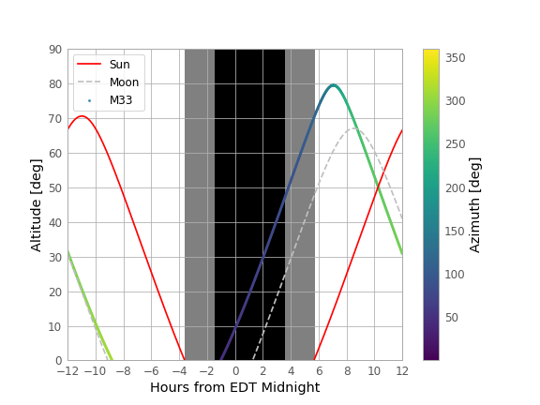
2. AstroPy
Example:
Determining and plotting the altitude/azimuth of a celestial object
¿Can I observe M33 spiral galaxy that night from my residence place? (altitude, azimuth)
LINK

