Slide 1





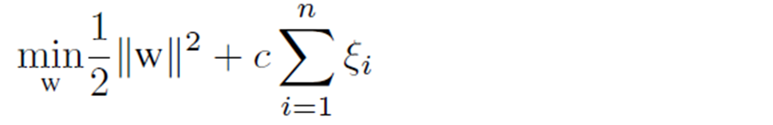
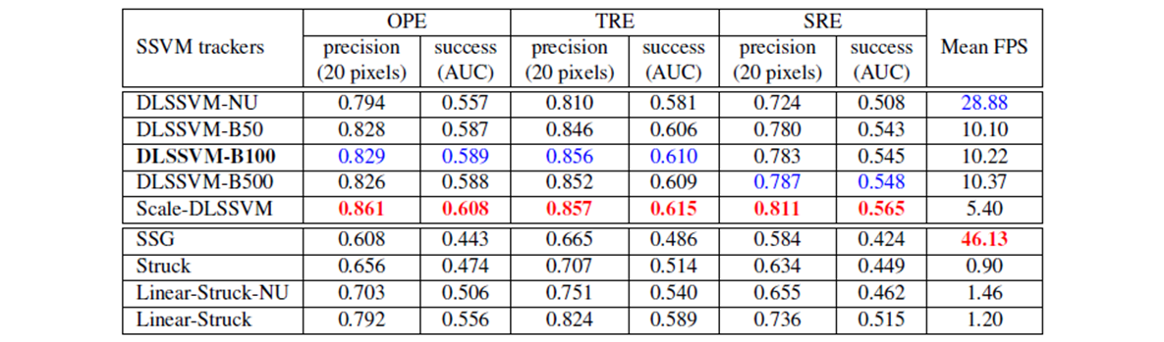

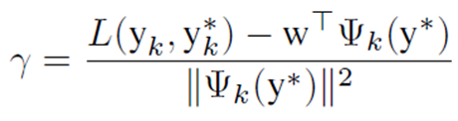
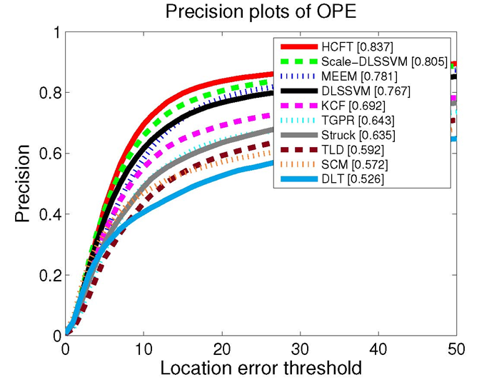
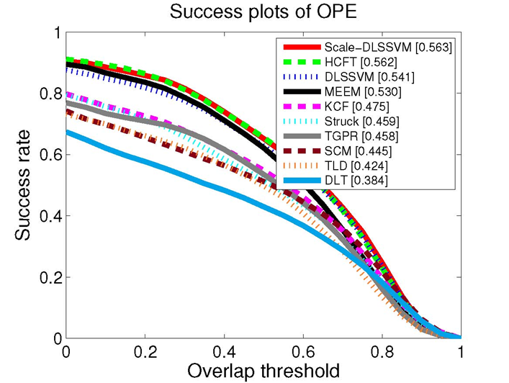

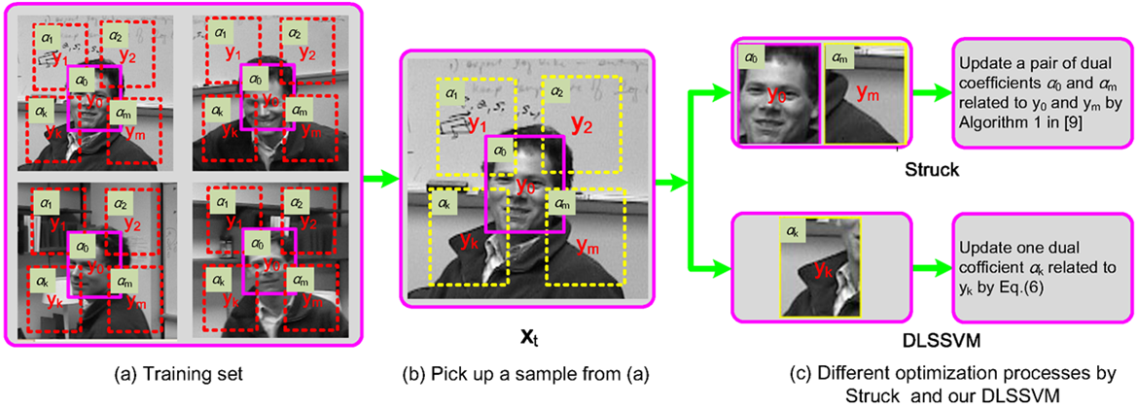

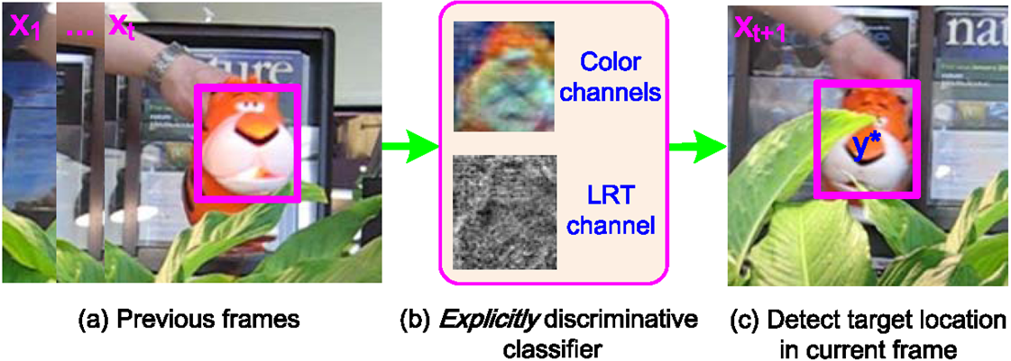
Object Tracking via Dual Linear Structured SVM and Explicit Feature Map
Jifeng Ning¹, Jimei Yang², Shaojie Jiang¹, Lei Zhang³ and Ming-Hsuan Yang⁴
¹Northwest A&F University, China, ²Adobe Research, USA,
³Hong Kong Polytechnic University, China, ⁴UC Merced, USA
IEEE 2016 Conference on Computer Vision and Pattern Recognition
Introduction:
  Structured Support Vectors Machines (SSVM) based tracking:
      Struck tracker (ICCV2011, PAMI2015) provides a novel discriminative classifier via global SSVM optimization for visual tracking.
      Struck shows the state-of-the-art performance in the recent tracking benchmarks.
  Some problems still exist for efficient SSVM tracking:
      Simple optimization process, useful for speeding up training.
      Linear kernel or Nonlinear kernel?
      Can we use linear kernel to approximate non-linear decision for improving tracking performance?
Formulation:
  We learn a discriminative classier w in a large-margin framework from a sample set by solving the following optimization problem:
  Similar to Struck, we solve the Lagrange dual of Equation (1) by
Experimental Results:
  Analysis of proposed DLSSVM and related SSVM tracker
  Comparisons with state-of-the-art trackers
Table 1. Experimental comparisons of the proposed DLSSVM and related trackers with different parameters settings.
(1)
(2)
Simple optimization with closed form solution:
  Follow the dual coordinate descent (DCD) optimization process for the dual SSVM. Only one dual variable is solved in each iteration.
(3)
Algorithm Overview:
  Design a simple yet efficient dual linear SSVM (DLSSVM) algorithm to enable fast learning and execution during tracking.
      Dual Coordinate Descent (DCD) optimization, only handling one dual coefficient each time
      Linear kernel with explicit feature map
Linear kernel:
  We use linear kernel to explicitly compute the primal parameter w. Linear kernel leads to simpler training and detection process:
(4)
Efficient Feature Map:
  Explicit feature maps approximate non-linear kernels in SSVM, which implements non-linear decision.
(5)
Figure 3: Experimental results on OTB100
Conclusions:
  A novel SSVM based tracking framework via a dual linear SSVM optimization method and an explicit feature map.
      Simple optimization process – low computational complexity for visual tracking
      Linear kernel – can use high dimension features for better performance with fast speed
      Explicit feature map – non-linear decision vie linear SSVM for further improving tracking
Figure 1: Comparing optimization processes for the Struck and DLSSVM methods
Figure 2: Main steps of the proposed DLSSVM tracker.

