Slide 1
Development of a Vehicle Service Management System for Ztrios
Prepared For Practicum Defence Committee International University of Business Agriculture and Technology
Supervised by Presented by
Arifa Tur Rahman Rasal Molla
Assistant Professor ID:18303060

Slide 2
Contents
Organization Overview
Project Introduction
Project Objectives
Project Feasibility
Process Model
Requirement Engineering
Analysis Modeling
System Planning
Risk Management
System Testing
Project Demonstration
Conclusion

Slide 3

Organization Overview
Ztrios is a “Tech for Social Goods” inspired IT Company. The company reveal itself as a all-in-one business solution company. This company works smartly and systematically rather working day and night.
Website and Web Application Development
Digital Marketing and Content Creation
Maintenance and Support
Business Solution

Slide 4
Project Introduction
Vehicle service management system is a web-based application that work as a platform, where user can get the access and take the service from service center. Service center will provide the service to the customer. Customer can easily find the service center and they can visit it.

Slide 5
Project Objectives
Provide an online based service booking system.
It helps customer to find service center easily.
It save customer valuable time.
Service center also get the booking through the system.
This system develop in such a way that user can easily get find everything easily.
Customer will get all the information about service and service center.

Slide 6
Project Feasibility
Technicall feasibility
Easily available, efficient, and serve the purpose well enough.
Economic feasibility
Easily upgradeable, customizable.
Operational feasibility
Very easy user interface
This system is also be easily acceptable.

Slide 7
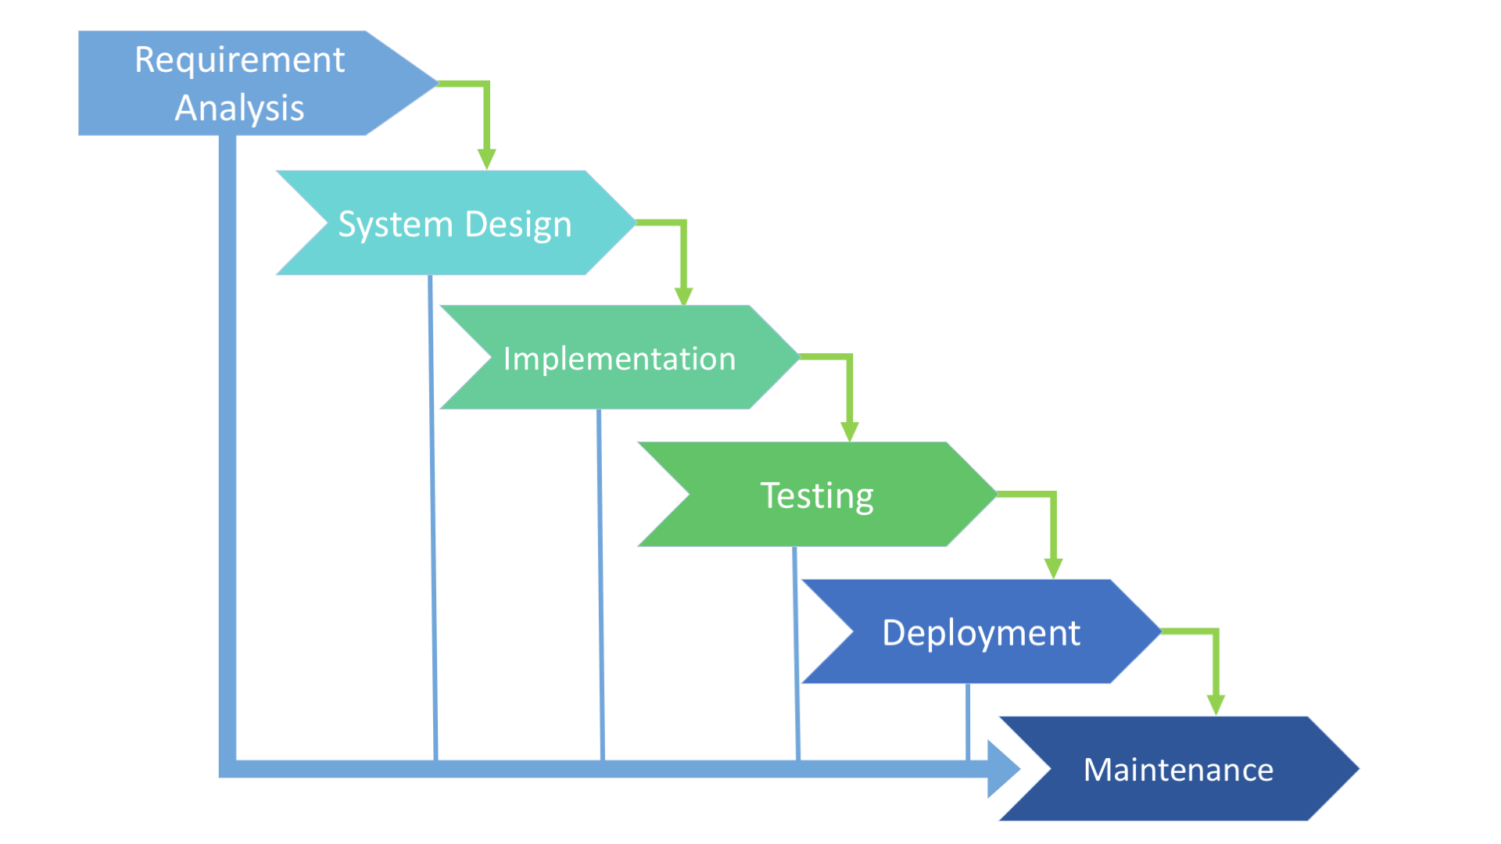
Processed Model
Figure: Waterfall Process Model

Slide 8
Process Model
Reason for choosing this model
Requirements are clearly defined
Requirement are not changing frequently
Clearly defined stages
Easy to manage and arrange tasks
Process and results are well documented

Slide 9
Requirement Engineering
User Requirements
System Requirements
Functional Requirements
Non-Functional Requirements

Slide 10
User Requirements
User Requirements for Admin
Can login.
User.
Category
Brand.
Service.
Can generate report.

Slide 11
User Requirements(Cont.)
User Requirements for Service Center
Can registration.
Can login.
Create Category.
Create brand.
Create service.
Manage booking.
Can generate report.

Slide 12
User Requirements(Cont.)
User Requirements for Customer
Can registration.
Can login.
View Category.
View brand.
View Service.
Can create booking service.
Can pay the payment.
Print invoice

Slide 13
System Requirements
System requirements for Admin:
Admin will have to login in order to get access to dashboard
Monitor the category, user, brand & services.
Can print the report based on booking.
System requirements for Service Center:
Service center will login & get the access to the system.
Create all the services, brand & category.
Manage the booking & take action.
Print the report.
System requirements for Customer:
Customer create a account & get the access to the system
Can view all the brands, services & all the categories.
Can booking the service & pay the money.

Slide 14
Functional Requirements
Admin monitor the whole system.
Admin dashboard show calculate data from the database
Service center can insert, delete, edit service/brand/categories and take any action in booking.
Customer and unauthorized visitor can view the all service.
Only customer is payment for the service.

Slide 15
Non-Functional Requirements
Separate login panel for admin
Same login panel for service center & customer
System will need email and password information from admin
Password will be encrypted
System will have secure login
Admin cannot change user profile information
User cannot create more than one account using one email
User cannot access their account without validating their email and password
User cannot see or edit their profile without login
Only registered user can booking for service

Slide 16
Use Case Diagram
Login
<<include>>
Registration
<<extends>>
Logout
Manage User
Manage Service
Admin
Manage categories
Manage brand
Manage booking
Customer
Payment
Service center
Generate report
Figure: Use case diagram

Slide 17
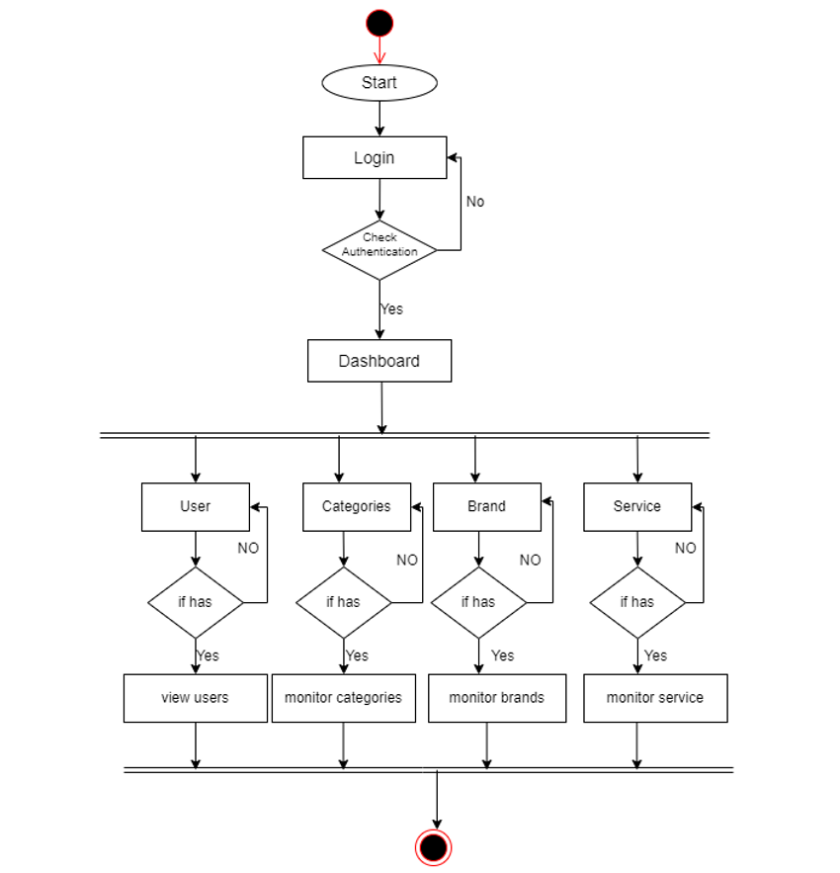
Activity Diagram for Admin
Figure: activity diagram for admin

Slide 18
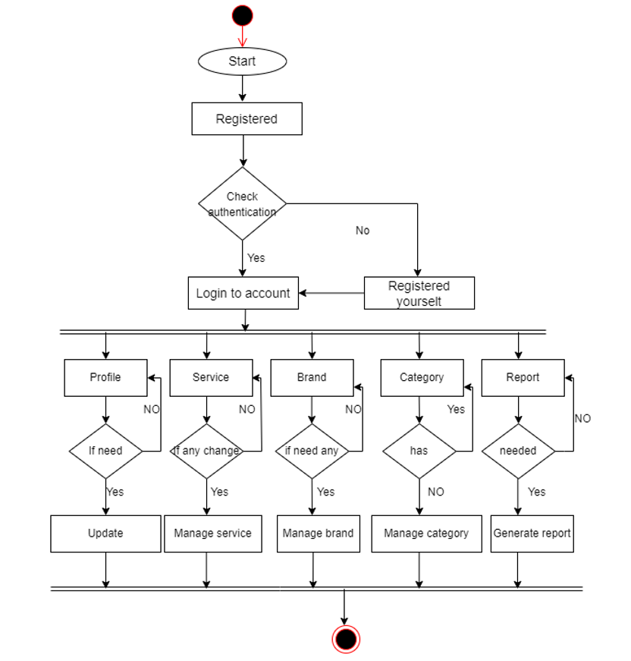
Activity Diagram for Service center
Figure: activity diagram for service center

Slide 19
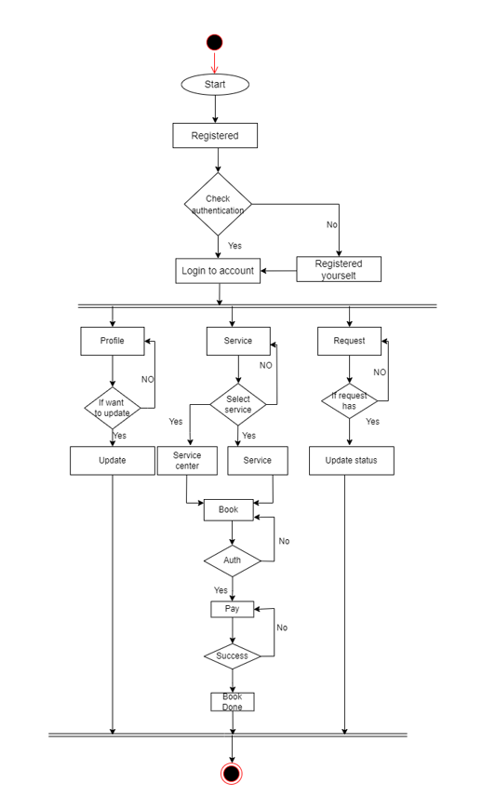
Activity Diagram for Customer
Figure: activity diagram for customer

Slide 20
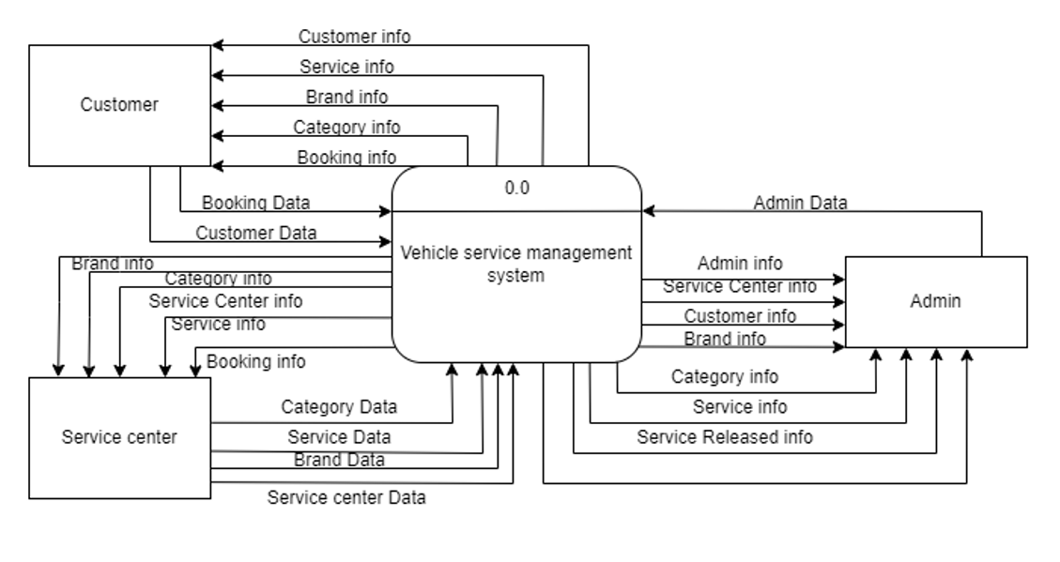
Data Flow Diagram
Context level :
Figure: Context level DFD

Slide 21
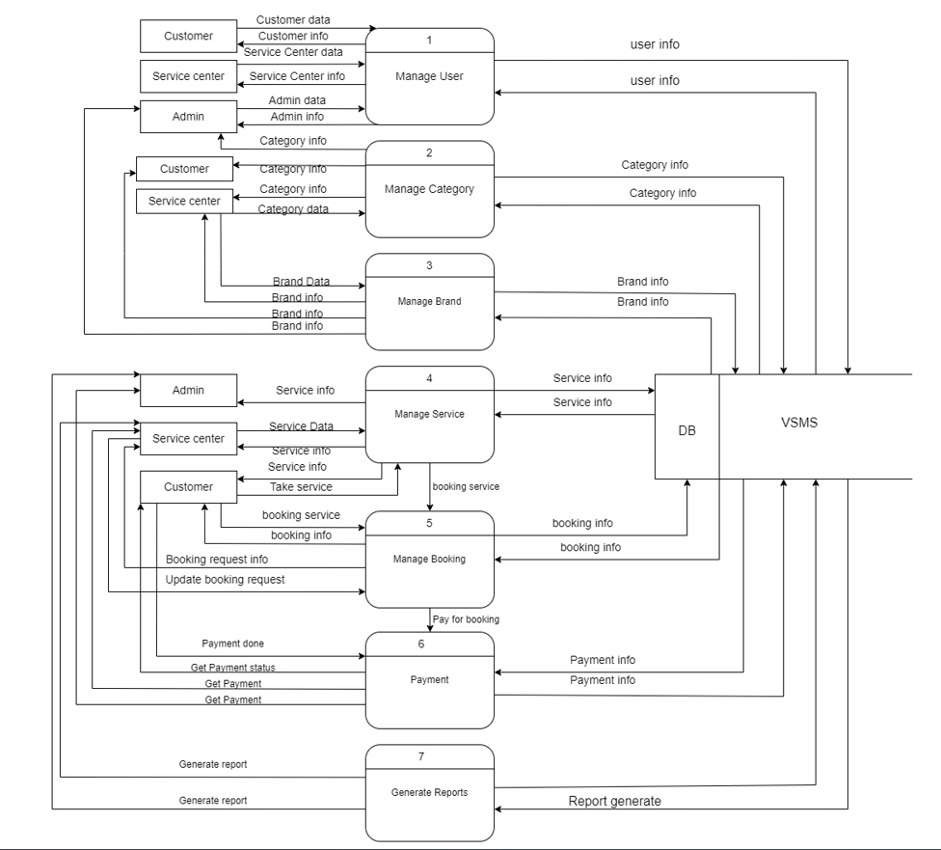
Data Flow Diagram(Cont.)
Figure: DFD level 1

Slide 22
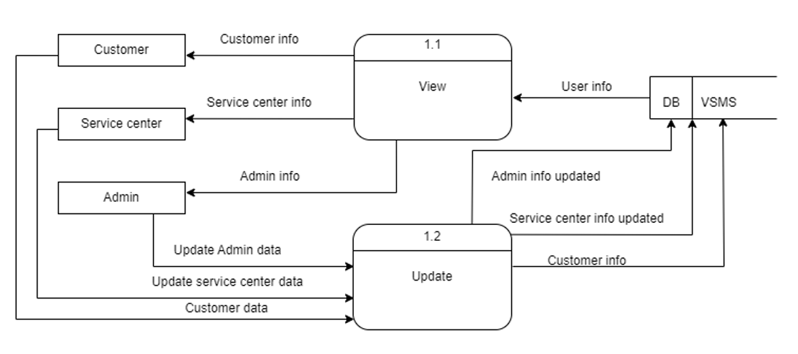
Data Flow Diagram(Cont.)
Figure: DFD level 2 process 1(Manage User)

Slide 23
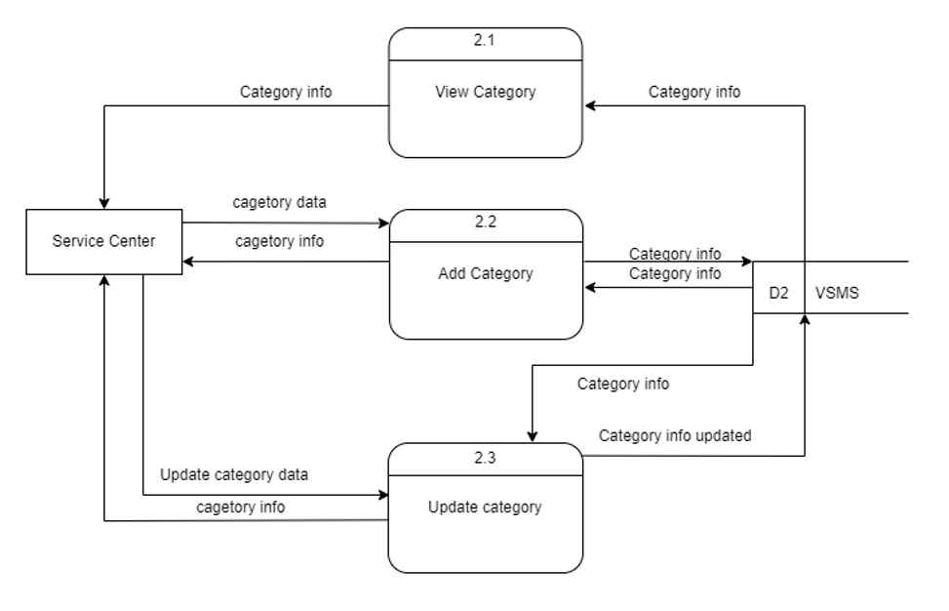
Data Flow Diagram(Cont.)
Figure: DFD level 2 process 2(Manage category)

Slide 24
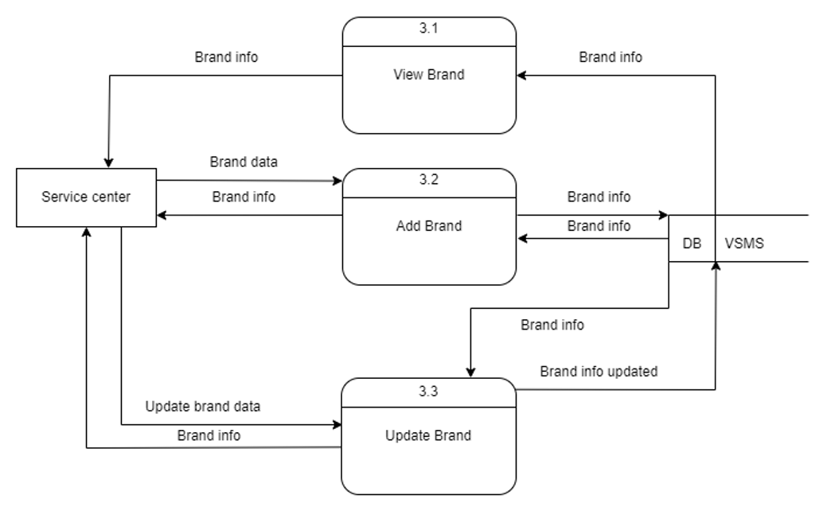
Data Flow Diagram(Cont.)
Figure: DFD level 2 process 3(Manage brand)

Slide 25
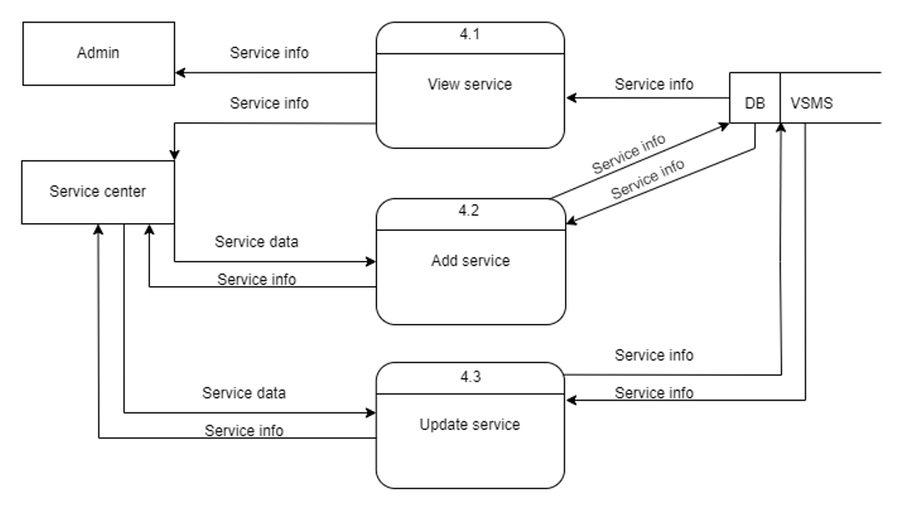
Data Flow Diagram(Cont.)
Figure: DFD level 2 process 4(Manage service)

Slide 26
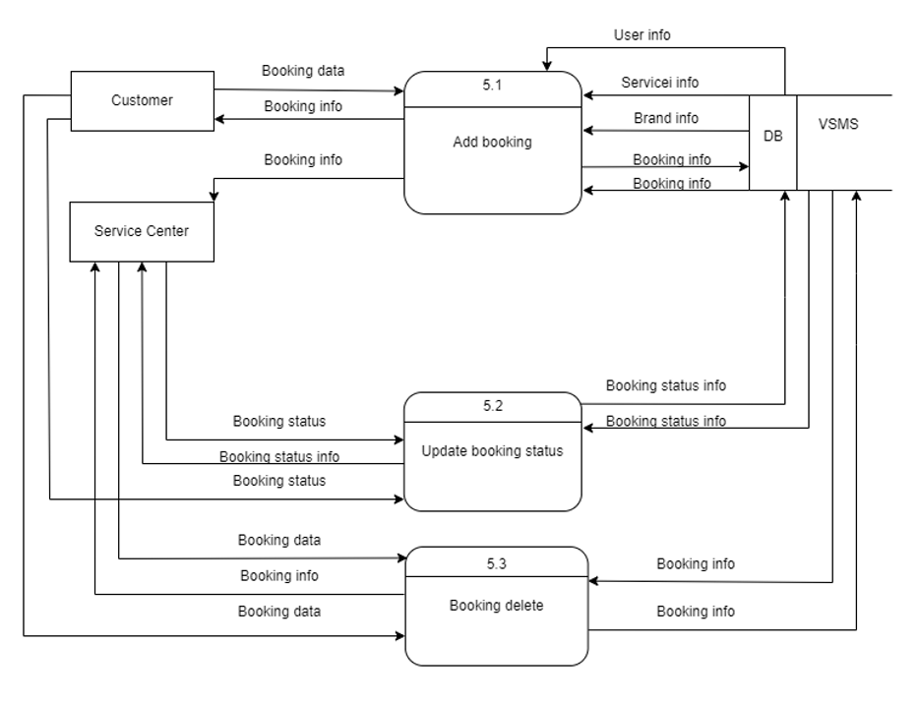
Data Flow Diagram(Cont.)
Figure: DFD level 2 process 5(Manage booking)

Slide 27
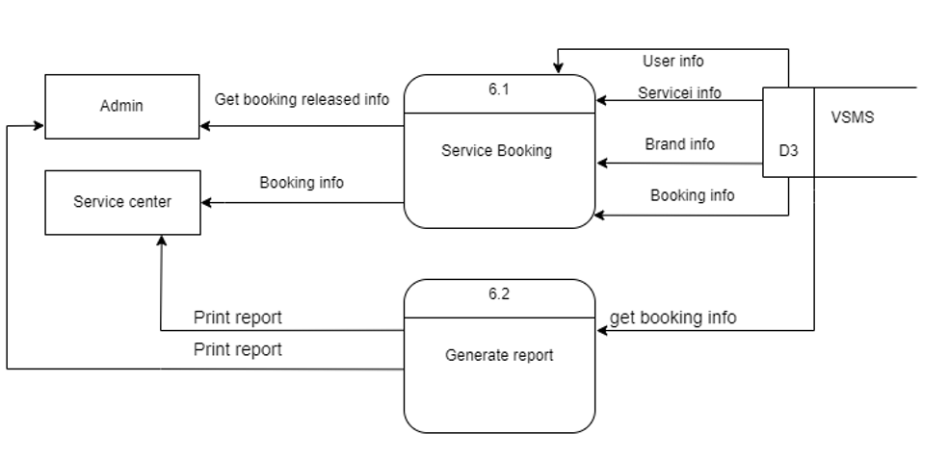
Data Flow Diagram(Cont.)
Figure: DFD level 2 process 6(Report generate)

Slide 28
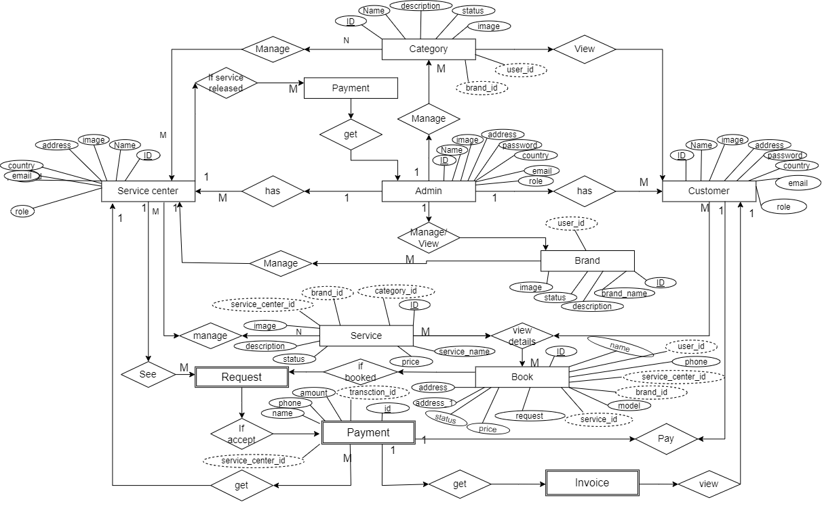
Entity Relationship Diagram
Figure: entity relationship diagram

Slide 29
Adjusted Function Points Calculation
Value adjustment factor (VAF) = (0.65 + (0.1 * TDI))
= (0.65+ (0.1 * 35))
= 1
Now, UFP = UFP (Data function) + UFP (Transaction function)
= 49+ 87 = 136
Adjusted Function Point Count = UFP * VAF
=136* 1
=136
Effort for the project = AFP * Productivity
= 136 * 15.5 (productivity for PHP)
= 2108 person hours / 12 hours (1 day = 12 hours)
= 175.6 person days /25 days
= 7.024 / 2 persons
= 3.512 months

Slide 30
Effort Distribution

Slide 31
Project Scheduling Chart
Table: Project scheduling chart
Week Activities | W 1 | W 2 | W 3 | W 4 | W 5 | W 6 | W 7 | W 8 | W 9 | W 10 | W 11 | W 12 | W 13 | W 14 | W 15 | W 16
Requirements Analysis
System Design
Implementation
Testing
Deployment

Slide 32
Cost Estimate
Table: Cost estimate
Description | Cost
Personal cost | 55,000 BDT
Hardware cost | 33,000 BDT
Software cost | Free
Other cost | 17,000 BDT
Total | 105,000 BDT

Slide 33
Risk Management
Risk | Probability | Effects
Organizational financial problems force reductions in the project budget | Low | Catastrophic
Security of the system. | High | Serious
Reusable software components contain defects that mean they cannot be reused as planned. | Moderate | Serious
Changes to requirements that require major design rework are proposed | Moderate | Serious
Customers fail to understand the impact of requirements changes | Moderate | Tolerable

Slide 34
Test Scenario 1
Scenario | Admin Login
Input’s | Email & Password
Desired Output’s | When enter all basic info correctly, user will be logged in.
Actual Output’s | Admin login works
Verdict | Getting result from desired outputs and actual output decided this system is successful for admin login.

Slide 35
Test Scenario 2
Scenario | Customer Login
Input’s | Email & Password
Desired Output’s | When enter all basic info correctly, user will be logged in.
Actual Output’s | User login works
Verdict | Getting result from desired outputs and actual output decided this system is successful for user login.

Slide 36
Test Scenario 3
Scenario | Service center Login
Input’s | Email & Password
Desired Output’s | When enter all basic info correctly, user will be logged in.
Actual Output’s | User login works
Verdict | Getting result from desired outputs and actual output decided this system is successful for user login.

Slide 37
Test Scenario 4
Scenario | Add Service
Input’s | Name, Status, Description, Price, Image
Desired Output’s | When enter all basic info correctly, services will be added.
Actual Output’s | Adding new service works
Verdict | Getting result from desired outputs and actual output decided this system is successful for adding new services works.

Slide 38
Test Scenario 5
Scenario | Place Booking
Input’s | Customer name, phone, address, model, brand, Service Center, price, advance payment
Desired Output’s | When enter all basic info correctly, service booking will be placed
Actual Output’s | Booking is placed
Verdict | Getting result from desired outputs.

Slide 39
Future Plan
Login or Signup through google account or social media account.
Admin payment integration.
Customer feedback will be added.
Mechanic panel will be added.
Booking notification.
Email verification.
A mobile app will be developed.
Tracking service center on google map direction.

Slide 40
Project Demonstration

Slide 41
Conclusion
This application develops for human so that they can easily take any service. And they can easily find out the nearby service center so that they can came easily to get the information form the website about service center. It reduce their time and also view the service have or not.

Slide 42
Thank You

