Slide 1

Buoyancis
Prove you can pay rent — without showing your bank account

Slide 2


The Rent Verification Bottleneck
Why now: PSD2 Open Banking is live across EU · GDPR expectations are tightening · 3.5M first residence permits were issued to non-EU citizens in the EU in 2024
Tenant Privacy Nightmare
Landlord Friction & Fraud
Some tenants are asked to upload bank statements, which can reveal salary details and sensitive personal spending to letting agents.
Property managers may spend significant time reviewing financial documents, while PDFs can be difficult to authenticate—adding operational overhead and rental-default risk.

Slide 3

Mathematical Affordability Proofs
Trust Without Disclosure
Buoyancis leverages Zero-Knowledge Proofs (ZKP) and Open Banking to mathematically verify tenant rent eligibility.
Landlords receive a cryptographically sealed PASS/FAIL verification without seeing raw bank transactions or private income details.

Slide 4

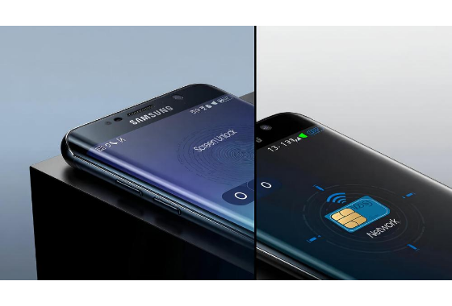
How Buoyancis Works
•
1. Connect Open Banking: Tenant securely links bank account via Tink / Plaid API.
•
2. Time-Decay Engine: Parses 90-day cash flow with exponential weighting.
•
3. Local ZK Circuit: Computes proof on the tenant device; raw transactions are not uploaded to the Buoyancis server (MVP design).
•
4. Instant Verification ID: Landlord verifies proof via single-click dashboard API.

Slide 5






Engine & Algorithm
Time-Decay Inflows
Heuristic Filtering
ZK Rule Circuit
Applies exponential time-decay weighting to recent 90-day cash flows:
Detects and excludes round-trip transfers, self-deposits, and temporary loan spikes to prevent balance manipulation.
Verifies affordability rule without exposing balances:
Prioritizes fresh, stable incoming revenue.

Slide 6
Market Opportunity
€80M+
New-Arrival Demand Signal
3.5M first residence permits were issued to non-EU citizens in the EU in 2024; 1.1M were work-related.
Serviceable European Rental Verification Market (SAM)
Buoyancis provides instant, fraud-proof verification standard for European property managers and letting agencies.
TAM: 15M+ EU rental transactions/yr · SAM: ~10M modeled cross-border / international cases · SOM: Nordic market, Year 1
Migration source: Eurostat, Migration and asylum in Europe – 2025 edition (2024 data). TAM/SAM are Buoyancis estimates.

Slide 7
Competitive Landscape
Buoyancis is not replacing credit checks or open banking — it adds a privacy-preserving proof layer for financial eligibility.
Dimension | Bank Statements | UC / Samtrygg | Tink Open Banking | Buoyancis
Data disclosure | Full document shared | Screening data; flow varies | Verified income / affordability insights | Proof can disclose only the required result
Primary signal | Documents + manual review | Credit / background screening | Bank-linked income & affordability | Policy-specific financial eligibility
Cross-border use | Manual / fragmented | Depends on local identity & credit data | European bank connectivity | Designed for cross-border verification
Speed | Days | Screening workflow | Near real-time | Target: < 60 sec proof verification
Sources: Tink Income Check · Samtrygg screening & credit-check process · UC credit information | Buoyancis capabilities are prototype targets.

Slide 8
Execution Roadmap
Phase 2: Architecture & Prototype
Phase 4: Grant & Pilot
Build Open Banking integration skeleton & time-decay engine prototype.
Submit Vinnova / Almi applications & pitch pilot package to property managers.
Phase 1: Customer Discovery
Phase 3: ZK Circuits
Conduct 12 customer discovery calls with letting agents, landlords & relocation partners.
Compile Circom/Noir verification circuit & proof generator engine.

Slide 9




Business Model & Pilots
B2B Letting SaaS
PropTech Integrations
Charge property managers €3 - €8 per completed verification pass via subscription API tier.
Embed verification API directly into property listing platforms and applicant tracking systems.

Slide 10
Team
Jiahao Zhang
Seeking Co-founder
Founder & CEO · BlackPalace AB (Buoyancis)
Lead ZKP Engineer · CTO Role
• B.S Business Economics – Entrepreneurship, Bentley University
• BSc Computer Science & Engineering, KTH Royal Institute of Technology
• Coursework: Applied Cryptography (DD2520), Computer Security (DD2395), Privacy Enhancing Technologies (DD2496), Distributed Systems (ID2201)
• Thesis: Privacy-Preserving Cross-Border Trust Mapping with Time-Decaying Weights
• BlackPalace AB registered entity in Sweden
• Circom / Noir / Halo2 ZK circuit experience
• Rust or TypeScript backend development
• 4-year vesting + 1-year cliff equity structure
• Interested in FinTech / privacy infrastructure
Contact: jiazhang718@gmail.com

Slide 11
Join Buoyancis
Looking for pilot property managers in Stockholm — and Vinnova / Almi grant partners
jiazhang718@gmail.com| Stockholm, Sweden

Slide 12




Image Sources
https://st2.depositphotos.com/23455380/86145/i/450/depositphotos_861451708-stock-photo-abstract-digital-network-wave-background.jpg
Source: depositphotos.com
https://cdn.box.co.uk/.renditions/wysiwyg/samsung-smartphone-screen-lock-vs-network-lock.jpg_1.jpg
Source: box.co.uk
https://img.magnific.com/premium-photo/apartment-residential-building-exterior-housing-structure-blue-modern-house-europe-rental-home-city-district-summer-architecture-business-property-investment-vilnius-lithuania_250132-3777.jpg?w=360
Source: www.freepik.com
https://stewartvaluation.com/wp-content/uploads/2022/04/Female-working-with-homebuyer-couple.jpg
Source: stewartvaluation.com

