Slide 1
Comparison of Charging Speeds of Different Solar Panels
Experiment: Find a Super Capacitor and Use Solar Panels to Charge It

Slide 2
Introduction
Objective: To compare the charging speeds of a commercial solar panel and Xiping's solar panel.
Components used:
- Supercapacitor: KYOCERA AVX SCMT32H755MRBB0 (7.5 F, 6 V)
- Commercial Solar Panel: 5x3 cm
- Xiping's Solar Panel: 5x5 cm
Method: Measure and compare the charging speeds of the supercapacitor using both solar panels under similar conditions.

Slide 3
Experiment Setup
Setup for measuring voltage and current using a multimeter.
Initial voltage of the supercapacitor before charging.
Time intervals for measuring the voltage.

Slide 4
Data Collection
Commercial Solar Panel:
Initial voltage measured at 11:45 AM = 0.24 V
Time and corresponding voltage measurements.
Xiping's Solar Panel:
Initial voltage measured at 4:20 PM = 0.24 V
Time and corresponding voltage measurements.

Slide 5
Data Analysis
Compare the charging curves of both solar panels.
Normalize the charging speed to account for the difference in solar panel sizes.
Recalculate the charging times for the supercapacitor using the scaled power output.

Slide 6
Commercial Solar Panel Data
Time (minutes) | Voltage (V)
0 | 0.24
15 | 0.65
30 | 0.98
45 | 1.27
60 | 3.49
75 | 3.45
90 | 3.46
105 | 3.48
120 | 3.57
135 | 3.63
150 | 3.72
165 | 3.77
180 | 3.88
195 | 3.95
210 | 4.2
225 | 4.13
240 | 4.2
255 | 4.29
270 | 4.37
285 | 4.46
300 | 4.53
315 | 5.55
330 | 5.6

Slide 7
Xiping's Solar Panel Data
Time (minutes) | Voltage (V)
0 | 0.24
15 | 0.8
30 | 1.73
45 | 3.53
60 | 4.83
75 | 5.25
90 | 6.0
105 | 6.0
120 | 6.01
135 | 6.0
150 | 6.0

Slide 8
Conclusion
When normalized to the same size, Xiping's 5x5 solar panel is significantly more powerful and efficient than the commercial 5x3 solar panel.
Average charging rate of Xiping's panel: 0.064 V/min
Average charging rate of the commercial panel (5x3 cm): 0.042 V/min
If scaled to 5x5 cm, the commercial panel's rate: 0.07 V/min
When scaled, the commercial panel charges the supercapacitor marginally faster than Xiping's panel.

Slide 9
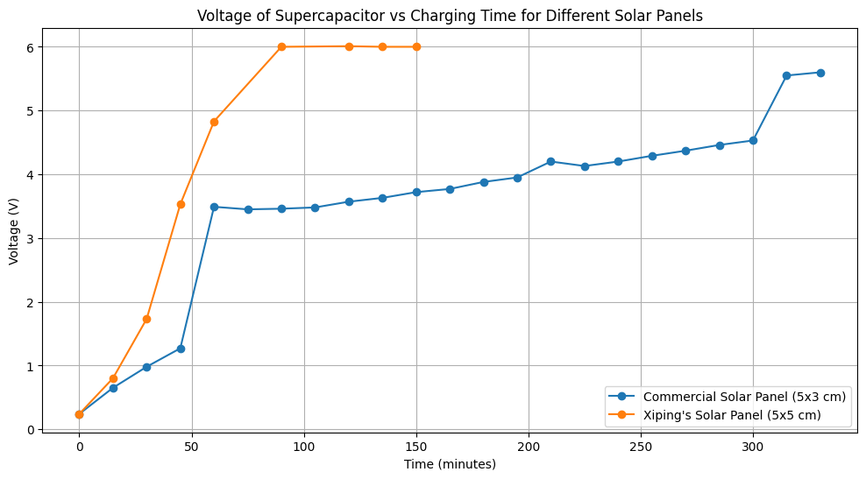
Graph Comparison

