Slide 1
Descriptive Analysis of Tracheostomy Resource Utilization Study

Slide 2
Analysis Objective
Describe the demographics of pediatric patients discharged after undergoing tracheostomy at the University of Maryland Medical Center with respect to establishing both risk and protective factors for resource utilization after tracheostomy.
Describe the resource utilization of patients after tracheostomy at 1-, 3-, and 5-years post tracheostomy.

Slide 3
Analysis Plan Schematic
Summary of demographics and outcomes
Variable selection
Longitudinal trajectories for FSS_total
Descriptive Analysis
Recompute age
Facet plots of FSS_total and outcomes in year1 and year 3

Slide 4
Demographics
age_attrach |  | race
Mean (SD) | 17.2 (36.2) | African American/Black | 4 (7.5%)
Median [Min, Max] | 5.47 [0.200, 182] | Asian | 1 (1.9%)
mortality_year1 |  | Caucasian | 8 (15.1%)
No | 51 (96.2%) | Missing | 40 (75.5%)
Yes | 2 (3.8%) | insurance
age_year1 |  | Medicaid or Medicare | 1 (1.9%)
Mean (SD) | 29.7 (36.8) | Medical Assistance | 1 (1.9%)
Median [Min, Max] | 17.5 [12.2, 194] | None | 3 (5.7%)
Missing | 2 (3.8%) | Private Insurance | 4 (7.5%)
mortality_year3 |  | Unknown | 1 (1.9%)
No | 44 (83.0%) | Missing | 43 (81.1%)
Yes | 8 (15.1%) | hospital_lengthofstay
Missing | 1 (1.9%) | Mean (SD) | 100 (93.9)
age_year3 |  | Median [Min, Max] | 77.0 [7.00, 372]
Mean (SD) | 55.9 (39.2) | Missing | 2 (3.8%)
Median [Min, Max] | 42.0 [36.2, 218]
Missing | 9 (17.0%)
53 subjects in total. Ages are in months. Total hospital stay is in days. Deaths are included in ages’ Missing.

Slide 5
Summary of Resource Utilization Outcomes
 | Year 1 | Year 3 | Year 5
admissions
Mean (SD) | 3.04 (2.48) | 1.79 (1.95) | 1.13 (0.957)
Median [Min, Max] | 2.50 [0, 9.00] | 1.00 [0, 8.00] | 1.00 [0, 3.00]
Missing | 3 (5.7%) | 14 (26.4%) | 37 (69.8%)
edvisits
Mean (SD) | 1.48 (1.47) | 0.872 (1.34) | 0.563 (0.629)
Median [Min, Max] | 1.00 [0, 5.00] | 0 [0, 6.00] | 0.500 [0, 2.00]
Missing | 3 (5.7%) | 14 (26.4%) | 37 (69.8%)
medications
Mean (SD) | 8.30 (4.00) | 6.84 (4.19) | 6.00 (4.35)
Median [Min, Max] | 8.00 [0, 18.0] | 5.00 [1.00, 16.0] | 5.00 [1.00, 19.0]
Missing | 3 (5.7%) | 15 (28.3%) | 37 (69.8%)

Slide 6
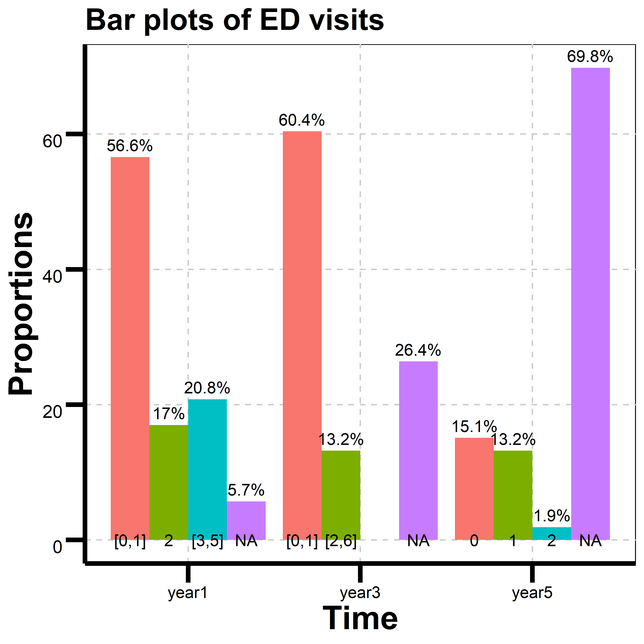
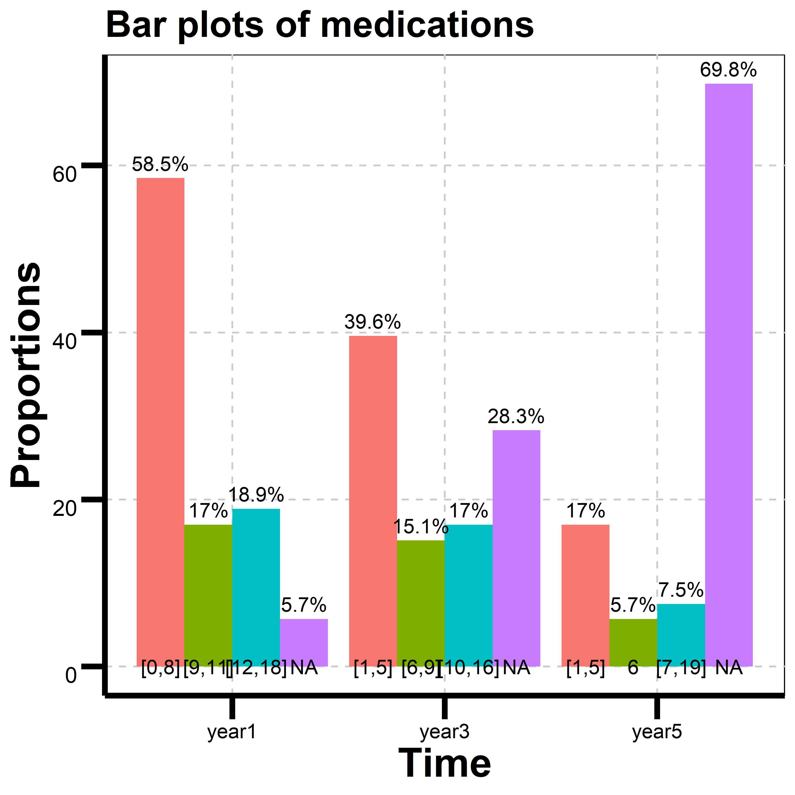
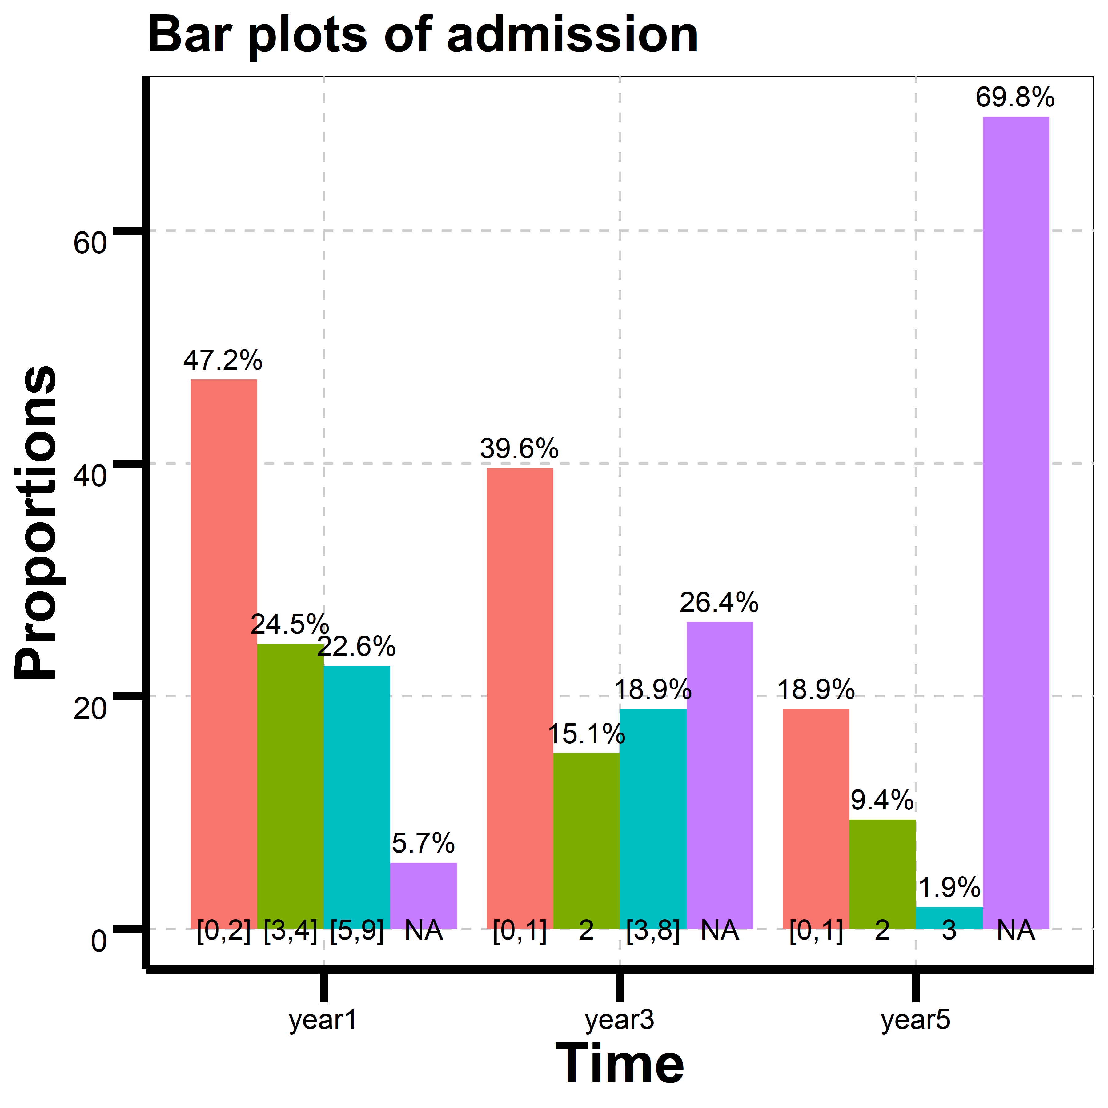
Proportions of Resource Utilization Outcomes
Cutoff points are 50th and 75th percentiles.

Slide 7
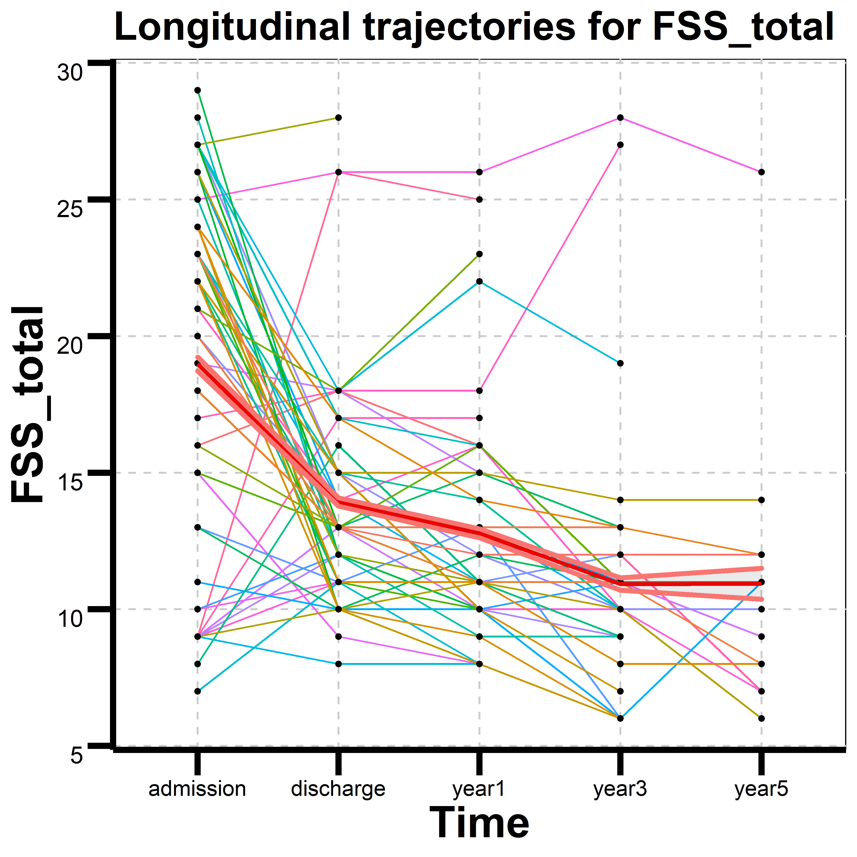
Longitudinal trajectories for FSS_total for each individual
FSS_total stands for Functional Status Score (FSS) TOTAL
The mean of FSS_total decreases from admission to year3.
Time(Number of patients): admission(53); discharge(53); year1(50); year3(40); year5(16)

Slide 8
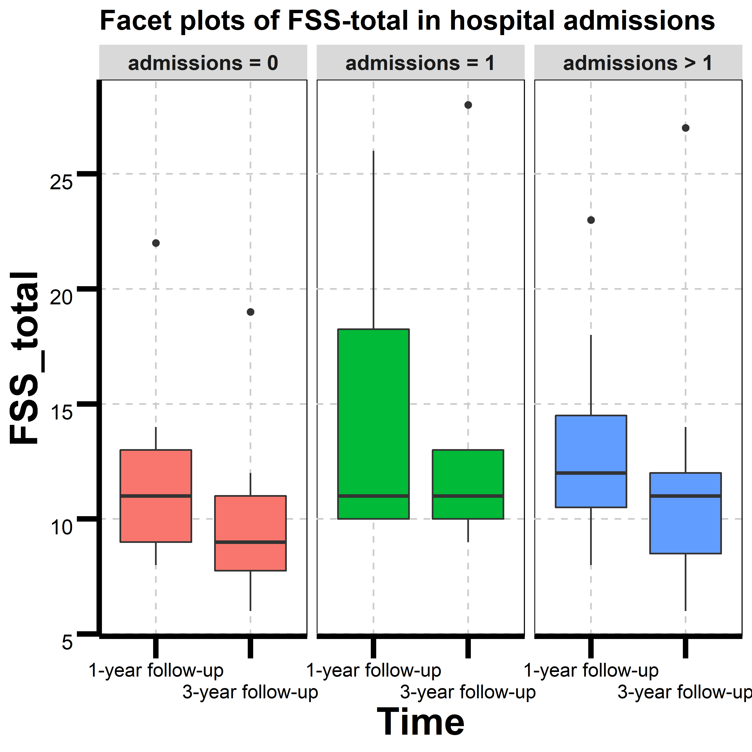
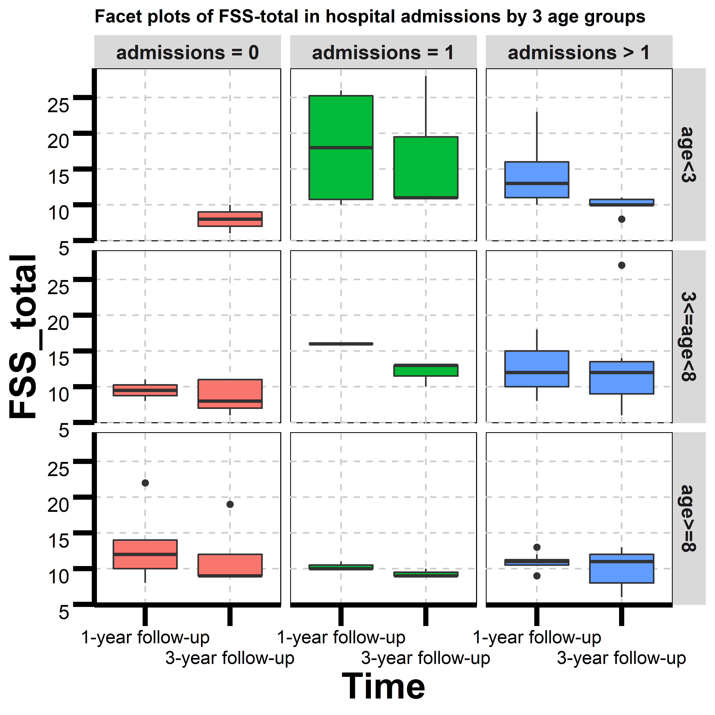
Association of FSS-total to hospital admissions
In admissions, the box plot in 1-year follow up is higher than the plot for 3-year follow up.
When admissions=1, FSS_total in 1-year follow up has the same median as FSS_total in 3-year follow up.
Age means ages of patients at tracheostomy in months. Number of patients: age<3(17); 3<=age<8(20); age>=8(16).

Slide 9
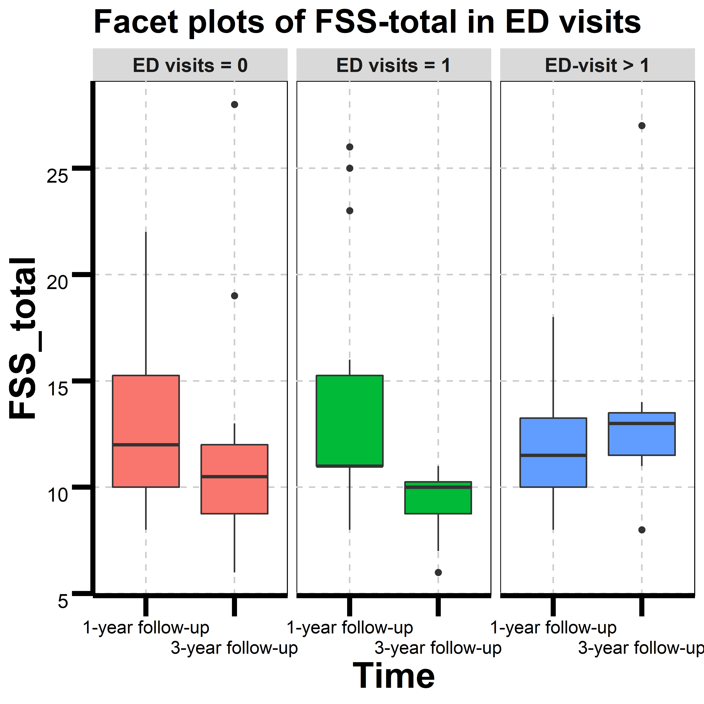
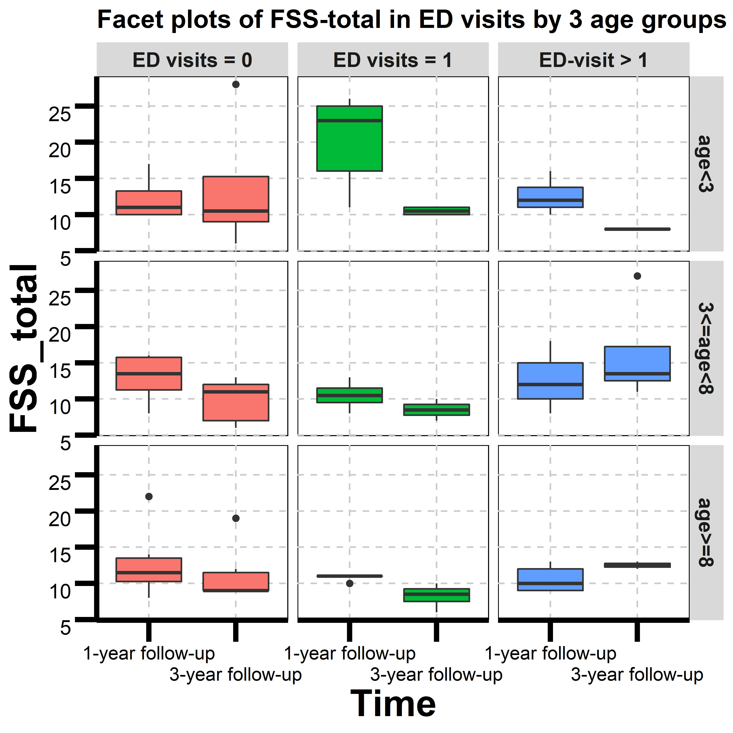
Association of FSS-total to ED visits
When ED visits=0 (and ED visits=1), the box plot for 1-year follow up is higher than the plot for 3-year follow up.
When ED visits more than 1 and the age at trach>=3, the box plot for 1-year follow up is slightly lower than the plot for 3-year follow up.

Slide 10
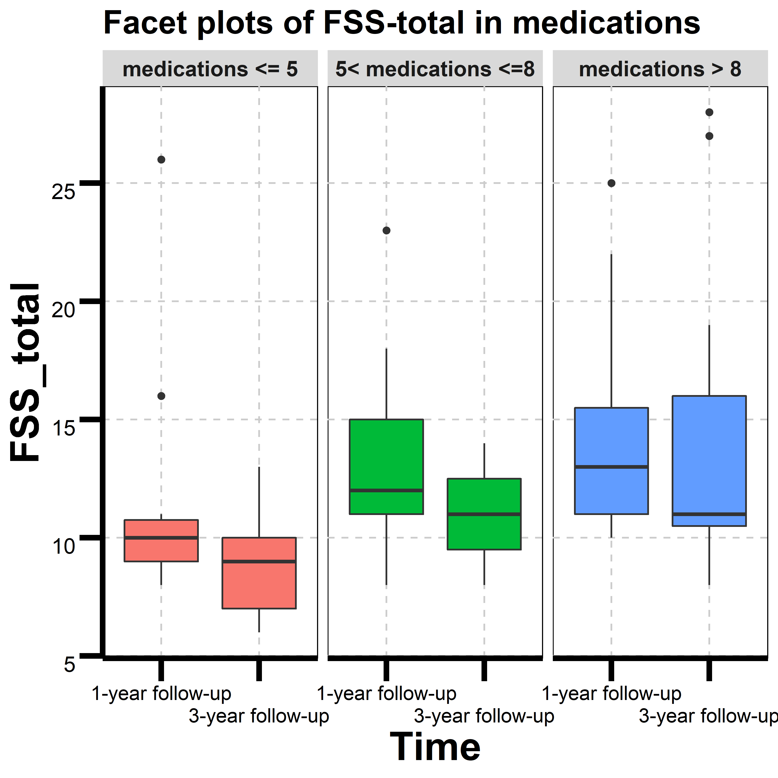
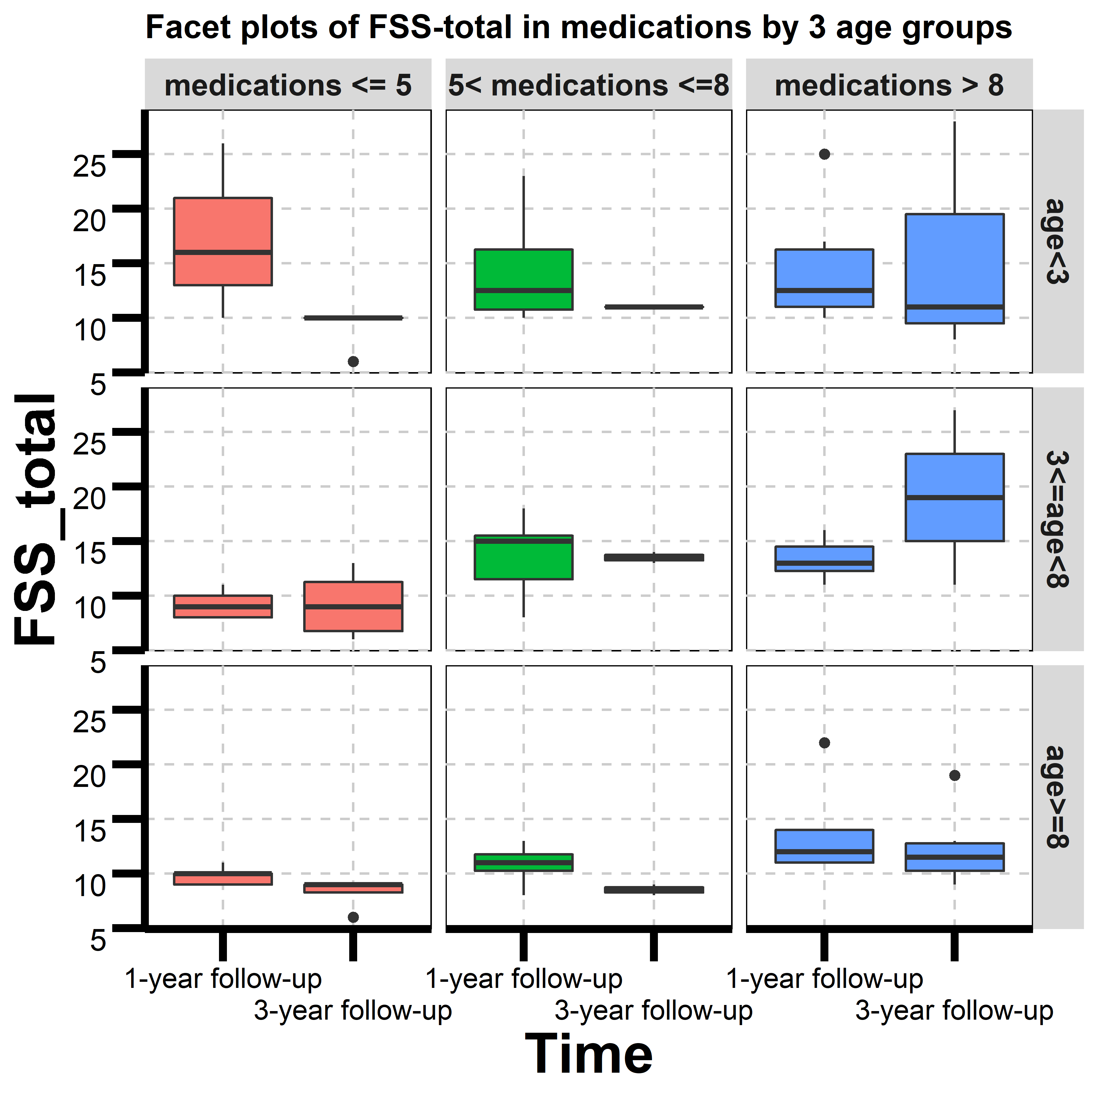
Association of FSS-total to medications
Cutoff points are 25th and 50th percentiles in 1-year follow up.
When medications>8 and 3<=age<8, the box plot in 1-year follow up is lower than the plot for 3-year follow up.
In other situations, the box plot in 1-year follow up is higher than the plot for 3-year follow up.

Slide 11
Analysis Objective and Next Steps
Analysis Objective
Describe the demographics of pediatric patients by summary tables.
Describe the resource utilization of patients after tracheostomy at 1- and 3-years post tracheostomy by facet plots.
Next Steps
Given 1-year or 3-year follow up, find out how FSS_total affects resource utilization outcomes when we adjust other covariates.
Logistic regression and Poisson regression can be used in the prediction model.

Slide 12
Proportions of Resource Utilization Outcomes
 | Year 1 | Year 3 | Year 5
admissions
range (proportion) | [0,2] 47.2% | [0,1] 39.6% | [0,1] 18.9%
 | [3,4] 24.5% | 2 15.1% | 2 9.4%
 | [5,9] 22.6% | [3,8] 18.9% | 3 1.9%
 | NA 5.7% | NA 26.4% | NA 69.8%
edvisits
range (proportion) | [0,1] 56.6% | [0,1] 60.4% | 0 15.1%
 | (1,2] 17.0% | [2,6] 13.2% | 1 13.2%
 | [3,5] 20.8% | NA 26.4% | 2 1.9%
 | NA 5.7% |  | NA 69.8%
medications
range (proportion) | [0,8] 58.5% | [1,5] 39.6% | [1,5] 17.0%
 | [9,11] 17.0% | [6,9] 15.1% | 6 5.7%
 | [12,18] 18.9% | [10,16] 17.0% | [7,19] 7.5%
 | NA 5.7% | NA 28.3% | NA 69.8%
Cutoff points are 50% and 75% percentiles.

Slide 13
Numbers of data in facet plots
ED visits | =0 | =1 | > 1
sum | 36 | 26 | 27
age<3 | 8 | 11 | 7
3<=age<8 | 15 | 6 | 13
age>=8 | 13 | 9 | 7
medications | <= 5 | (5,8] | >8
sum | 35 | 23 | 30
age<3 | 8 | 6 | 11
3<=age<8 | 18 | 9 | 8
age>=8 | 9 | 8 | 11
admission | =0 | =1 | > 1
sum | 19 | 17 | 53
age<3 | 2 | 7 | 17
3<=age<8 | 7 | 4 | 23
age>=8 | 10 | 6 | 13
Age means ages of patients at tracheostomy (in months).
Numbers in the table are the total numbers in 1-year and 3-year follow ups.

