Slide 1

END – TO – END
CREDIT CARD FRAUD DETECTION
RAJAT DAXESH DESAI ( 0698360 )
JIMISH PRAMOD KHOLAPURE ( 0692165 )

Slide 2

What Is Credit Card Fraud ?
Credit card fraud - situation when an individual uses another individual’s credit card for personal reasons while the owner is not aware of this fact.
An act of criminal deception by use of unauthorized account and/or personal information.
illegal or unauthorized use of account for personal gain.

Slide 3
Abstract
Credit Card has become an integral part of every individual. People use credit-cards in their day-to-day life for various transactions.
Credit Cards are also used by the banks to lend money to their customers.
Banks keep track of the individuals daily credit history in order to generate a credit score, which helps them to determine a customer’s buying capacity and who is eligible for loan of a certain amount.

Slide 4
Current System
To detect credit card fraud, methods such as Cluster Analysis, SVM, Bayesian network, Logistic Regression, Nave Bayer's, Hidden Markov model, and others are utilized.
The existing system's methods are based on unsupervised learning, and the accuracy of these methods is around 60-70 percent.

Slide 5
Proposed System
To classify the credit card dataset in the proposed system, we employ the Random Forest technique. Random Forest is a classification and regression algorithm.
The Random Forest Algorithm can handle a big quantity of information. Even for big datasets, this technique is highly quick and can achieve a 98 percent accuracy rate.
Finally, the number of fraudulent transactions will be determined and depicted in the form of a matrix of confusion.

Slide 6
Advantages of Proposed System
The fraud usage of the card is detected significantly faster than with this method.
The log that is kept will also serve as documentation of the transaction to the bank
Using this strategy, we can discover the best accurate detection.
A bank employee's arduous task will be reduced as a result of this.

Slide 7
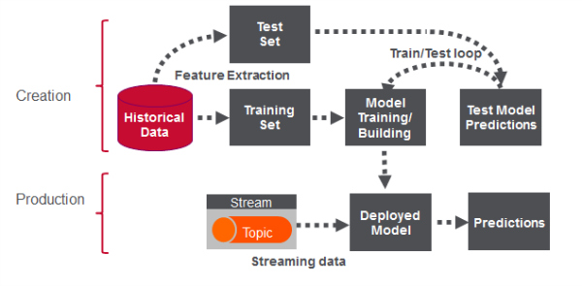
Architecture of ML Based Fraud Detection

Slide 8
Technologies Implemented
Python and Jupyter Notebook
Apache Kafka : An open-source distributed event streaming platform used by thousands of companies for high-performance data pipelines, streaming analytics, data integration, and mission-critical applications.
Docker is an open source containerization platform. It enables developers to package applications into containers—standardized executable components combining application source code with the operating system (OS) libraries and dependencies required to run that code in any environment.

Slide 9
Prevention for Credit Card Fraud
Keep your credit card in a safe place
limit the number of credit cards you carry with you
Cover the keypad with your hand or body when entering your PIN so no one can see it
Keep your credit card in sight at all times when making a purchase
Report anything you think is suspicious about a credit card device at a business or ATM to the business’s head office and your credit card issuer

Slide 10

Thank You !!

