Slide 1
Nome3
An Overview of the Architecture and Codebase
Notes:
Those are the ideas that we have accumulated over the past a few years and many pitfalls that we have fell into implementing Nome.
Innerworkings of nome so that you can get started coding!

Slide 2
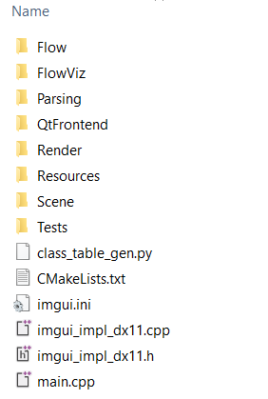
High level overview
Flow – implements the dependency graph
FlowViz – supposedly a visualizer, not done yet
Parsing – front-end that parses .nom files
Render – interfaces with the hardware
Scene – main implementation of the scene graph (generators are in there as well)
QtFrontend – the GUI you see

Slide 3
Interlude: C++ Memory Management
C-style manual memory management
new/delete
malloc()/free()
RAII (Resource allocation is initialization)
Constructor/destructor of stack allocated objects are automatically called!
Statically allocated objects are constructed BEFORE main()
Reference counting
Shared ownership: you “new” an object but not sure when to delete
Smart pointer using RAII

Slide 4
Foundation Library
A collection of random helper functions/classes
Examples:
Reference counted pointers
Get current directory path
Get current executable path
FStringUtils::Split(“ ”)
VectorPool
...

Slide 5
ImGui
A third party GUI library
Super duper convenient to use! Very helpful for debugging.
Example (show a hello world window):
ImGui::Begin(“Title”);
ImGui::Text(“Hello world”);
ImGui::End();

Slide 6
Flow graph and lazy evaluation
Var: x
Result
Op1
Add
Result
Var: y
Outputs x+5y
Op2
Mul
Result
Point
Constant: 5
PosX
Call stack:
x.Result.MarkDirty()
Add.Op1.NotifyDirty()
Add.Result.MarkDirty()
Point.PosX.NotifyDirty()

Slide 7
Using flow graph
See Transform.h/cpp

Slide 8
Scene = Entities + Scene Nodes
mesh m1
mesh m2
point p1
beziercurve bz1
group g1
instance c1 of m1
instance c2 of m2
instance i1 of g1
instance i2 of g1
Entity/Generator
They are all Flow graph nodes!
Scene node

Slide 9
Scene Graph
A spatial representation of the scene. Encodes transformations.
A DFS tree of the scene graph is the scene tree!
https://people.eecs.berkeley.edu/~sequin/CS184/IMGS/HierSceneComp.GIF

Slide 10
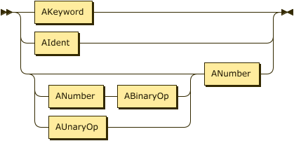
Parser – grammar elements
Defines the grammar of the .nom file format
Reads in a text file, outputs a parse tree (or AST, abstract syntax tree)
Example:
Point
AExpr
point p0 ( 0 0 {expr x} ) endpoint
Notes:
We go one level lower

Slide 11
Parser – AST Classes Inheritance Tree
AExpr
AKeyword
AIdent
ANumber
ABinaryOp
AUnaryOp
ACommand
Point
Mesh
…
Instance

Slide 12
Scene Builder
AST
Point
p1
(x y z)
Instance
i1
p1
Instance
i2
p1
Entities
p1
Scene Nodes
i1
i2
Notes:
In case the prev two slides weren’t clear, the AST looks like this on the left.

Slide 13
QtFrontend
Implements the GUI you see
File open/save
Direct3D 11 viewport and input handling
Calls into the rest of Nome

Slide 14
QtFrontend – file opening [MainWindow.cpp]
//Init
SourceManager = new CSourceManager();
SourceFile = SourceManager->Open(filePath);
ASTContext = new CASTContext();
//Parsing
CNomeDriver driver{ ASTContext, SourceManager, SourceFile };
driver.ParseToAST();
//Build Scene
Scene::CASTSceneBuilder builder{ *ASTContext, SourceManager, SourceFile }; builder.Traverse();
Scene = builder.GetScene();
//Create Viewport ViewportClient = new CEditorViewportClient(Scene, SourceManager, SourceFile);
ViewWidget = new CNomeViewWidget(this, ViewportClient);
setCentralWidget(ViewWidget);

Slide 15
Pulling everything together! Example: Rendering a frame
Looks really simple:
Do DFS and for every scene tree node N:
Update N->LocalToWorldMatrix
Parent transformation dirty?
Scene node transformation dirty?
Update N->AssociatedEntity
// Rendering
Scene->Render();

Slide 16
Roadmap
More generators – torus knot, sweeps, custom generators
Mesh morphing operators – merge, border smooth
Ultimate goal – automatic surface filling

