Slide 1

BANKRUPTCY PREDICTION USING ML
Presented by –
Indrajith S.

Slide 2
Table of Content:
Problem Explanation
Understanding the data
Exploratory Data Analysis
Methods
Data Pre-processing
Model Training
Summary and Conclusion
Observation from Features

Slide 3

First We will understand the term Bankruptcy,
When an organisation is unable to honour its financial obligations or make payment to its creditors, it files for bankruptcy. A petition is filed in the court for the same where all the outstanding debts of the company are measured and paid out if not in full from the company’s assets.
We have the dataset that contains what are aspects that company fall into bankruptcy and not in bankruptcy, using this we need to predict if any other company will fall into bankruptcy or not.

Slide 4
Problem Explanation:
As bankruptcy due to business failure can negatively affect the enterprise as well as the global economy, it is crucial to understand and predict whether a company is showing symptoms of getting bankrupt or not. The idea is to analyse the distresses in the corporate by taking into considerations of different aspects of the company. These distresses often lead to bankruptcy of the company if not alerted at the right time.
The problem statement is to develop a prediction model which will predict whether a company can go bankrupt or not. This will help the company to take appropriate decisions.
This is the classification problem specifically Binary classification, We need to predict whether 0 or 1.

Slide 5
Understanding the data:
The dataset consists of multiple financial ratio features such as:
Return on Assets (ROAs)
Gross Profits
Operating & Net income and Expenses
Cash flows
Taxes
Growth rate
Debt
Turnover, Revenue, Liability, etc.
As this data has lot of features and shape is (6819,95),Will give explanation for important features in upcoming slides.

Slide 6
Data Overview:
There are total 6819 samples in dataset and 96 features , Out of these 6819, 6599 are negative class and only 220 are positive class.
This dataset is highly imbalanced. It makes this problem very challenging to generalise well for final predictions.
All the features in the datset are normalized in the range 0 to 1.
The target column is “Bankrupt” which has two values ‘0’ and ‘1’ for Not Bankrupt and Yes Bankrupt respectively.
It is important to predict the positive class(1) with very high accuracy even if we are not able to predict the negative class. For example, there are total 100 companies out of which 90 are safe and 10 are going to get bankrupt. We should be focused on finding those 10.

Slide 7
Import Libraries:
Import the necessary libraries, we are trying to create machine learning model, So most of the libraries are from sklearn and some basic lib like numpy,pandas,matplotlib and seaborn are used.
LoadDataset:
As our dataset is in .csv file so we are using pd.read_csv(“file_name”), When I worked with this dataset i noticed that due to space in the column name it is very difficult to select the names, So I am removing extra spaces in the column name.
Explore the dataset:
Checked some basic needs like Null Values, Unique Values, duplicated,etc
There is no null values and duplicated values present in this dataset.
It is difficult to select columns due to some unwanted spaces present in index of the all the column names, So I removed all the spaces using strip function.

Slide 8
PIE Chart for Target Variable:

Slide 9
Exploratory Data Analysis (EDA):
Observation-1:
While checked for the uniqueness, I observed that column name ‘Liability-Assets Flag’ has value counts of 0 and 1, But most of the counts from 0 only, It is not important for our model,So I dropped this feature.
Observation-2:
All the columns are float data type, only bankrupt is int dtype.
Observation-3:
only 3.23% Of company is finanacially unstable and 97.77% are financially stable.
Observation-4:
This is highly imbalanced dataset, we need use some method to balance otherwise our model will predict only majority class as correct.

Slide 10
Understanding Relationships with Scatter Plots:
Plotted scatter plot for all the features to understand the relationship between the features and target variable
Observations:
The plots show a very fine linear separation between bankrupt and non-bankrupt. It seems lower values of “net income to Total assets” have more tendency to lead to bankruptcy.
Since we have very less data for positive class, we cannot claim anything, Lets explore more
Higher values of Debt ratio have more tendency to lead to bankruptcy.
Lower values of net income to Total assets have more tendency to lead to bankruptcy

Slide 11
Correlation Analysis Using Heatmap:
I performed heatmap analysis on columns to check for collinearity amongst them. After heatmap, I observed:
All three Return On Assets (ROA(A), ROA(B) and ROA(C) are positively correlated amongst each other.
Net value per share A, B and C are also highly correlated between each other.
‘ Debt ratio %’, ‘ Net worth/Assets’ are negatively correlated.
After tax net interest rate and pre-tax net interest rate are also highly correlated.
‘ Non-industry income and expenditure/revenue’ is negatively correlated with Operating Profit Rate.
‘ Operating Profit Growth Rate’,’ After-tax Net Profit Growth Rate’ and ‘ Regular Net Profit Growth Rate’ are also highly correlated.
‘ Per Share Net profit before tax (Yuan ¥)’ and ‘ Persistent EPS in the Last Four Seasons’ are highly correlated.
We can drop any one of the highly correlated values as it contains almost same data, dropping this correlated features can help model to perform better and also for feature selection, Similarly lets check multicollinearity after feature selction.

Slide 12
METHODS:
Approach
1
Approach
2
Approach
3
(RFE + SMOTE)
Feature selection using RFE,Handled outliers and used Smote to balance the data, Then create some models.
(RFE + Undersampling)
The same DF from approch-1 is used but instead of oversampling I performed undersampling to balnce the data and created model
Feature Engg with model building + Smote
As I can see lot of data in outliers,So I had decided to create a model along with feature selction and used Smote to balnce the data,then created model.

Slide 13
Approach-1
RFE + SMOTE
We have a problem regarding the large number of features to choose from the dataset so we are going to use feature selection using the random forest classifier which is great for reducing computational load.
Recursive feature elimination (RFE):
It is a feature selection process that suits a model and eliminates the weakest feature (or features) before the required number of features is achieved. Features are rated by the model's coef or feature importances attributes, and RFE aims to remove dependencies and collinearity by recursively deleting a small number of features per loop.
I had mentioned n-number features and choose the best fit feature, RFE gives "Test score: 0.964 and number of features: 15“, So I am using 15 features.

Slide 14
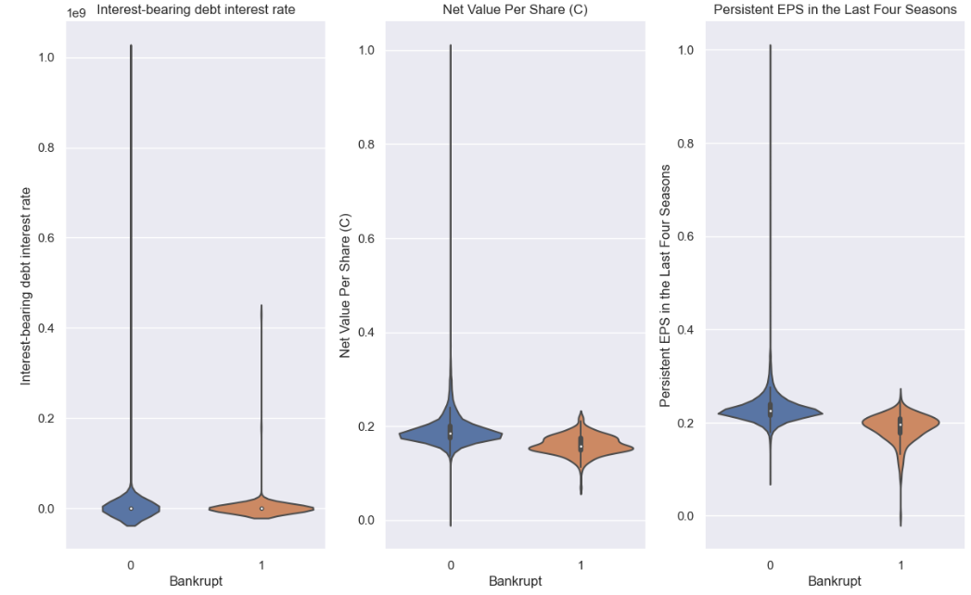
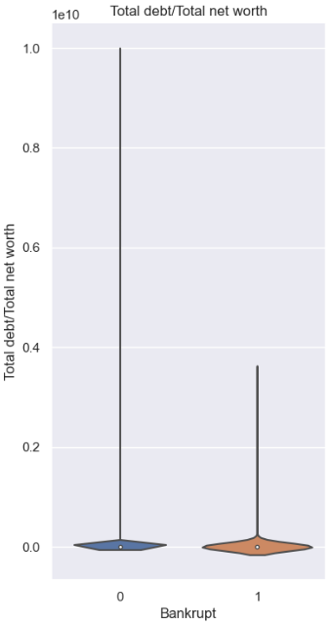
Added target variable Bankrupt to the list of selected 15 features to do some analysis, Now the shape is (6819,16)
Plotted violinplot and boxplot qith respect to target variable and observed some points,Here are some observations,

Slide 15
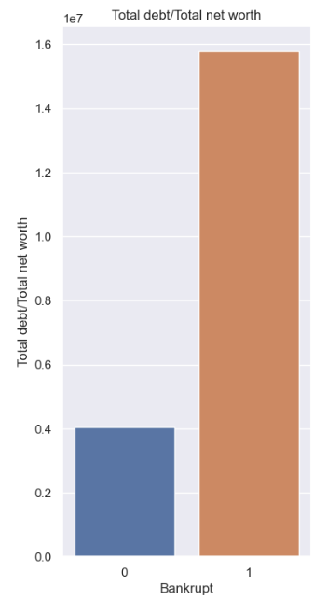
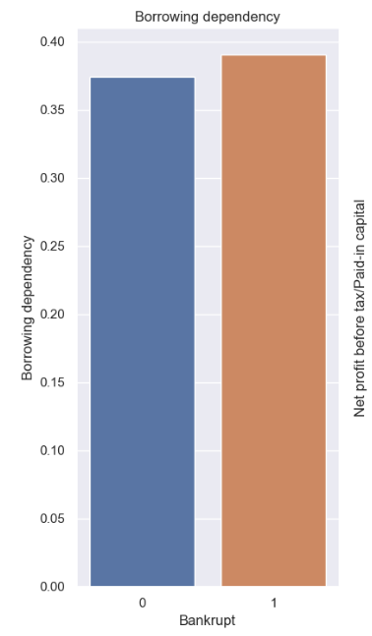
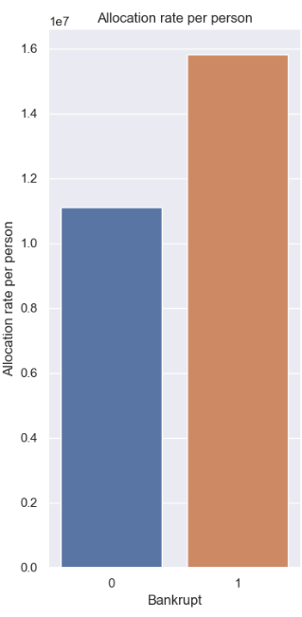
Here are some Plots with bar plot with respect to target variable

Slide 16
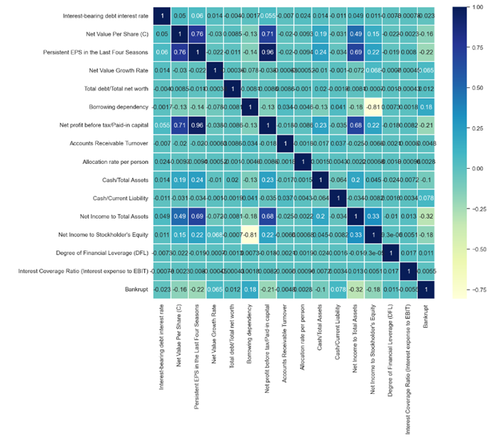
Multicollinearity:

Slide 17
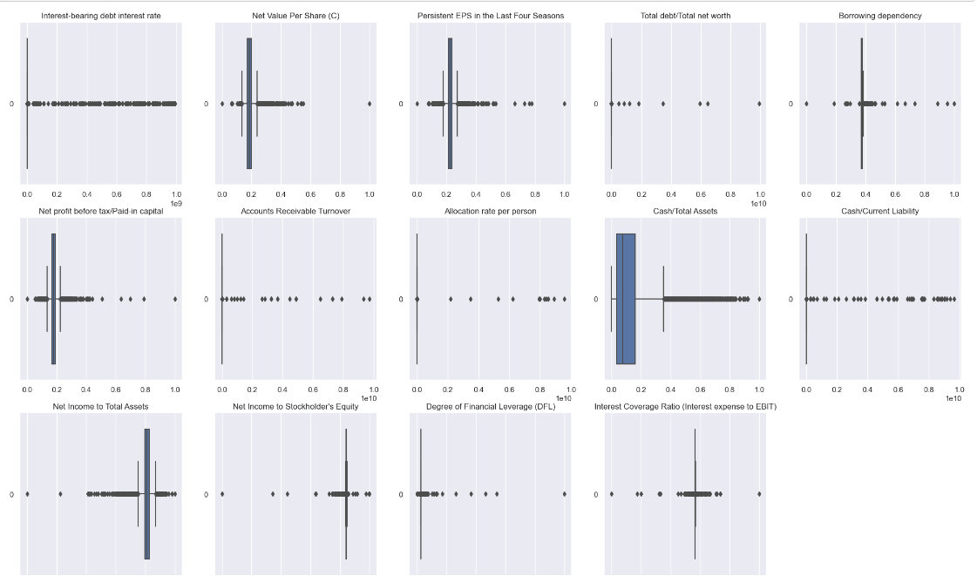
Outliers: We can observe lot of outliers present in our data, So we will try to cap the outlier with the IQR Treatment

Slide 18
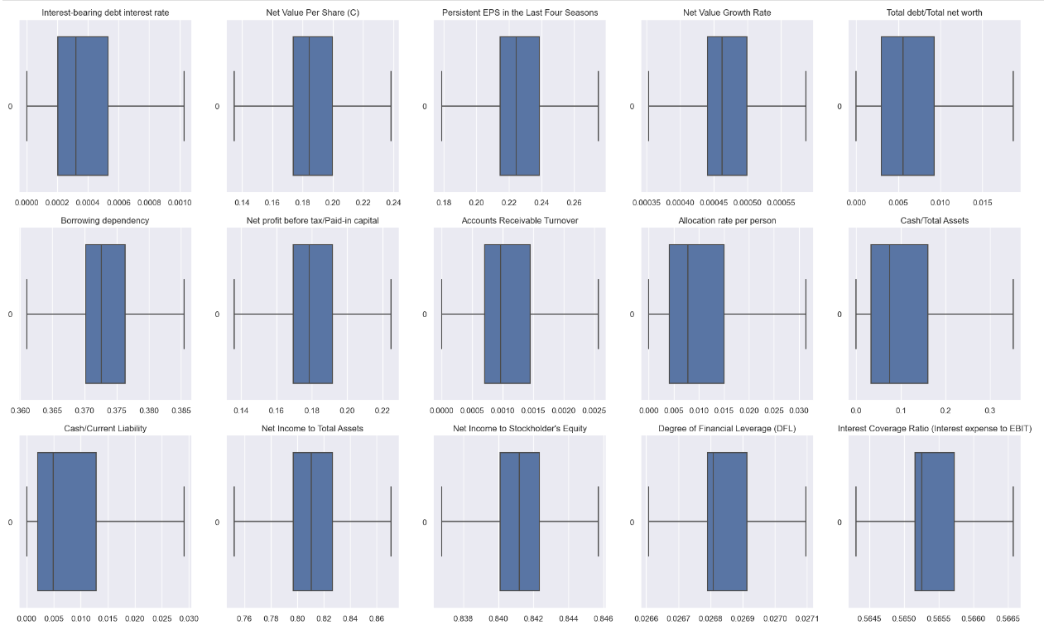
Checking after Outlier Treatment:
Outliers are handled by capping method using IQR treatment, Now this boxplot shows the outliers are capped

Slide 19
Imbalance treatment:
Data has Class-0 count are high due to this our model may not predict the class-1 correctly, Which is our main aim, to avoid this we are using SMOTE.
Split the data into Test and train and apply these smote to only training data, The test data will be untouched, it will be used only to evaluate our model performance.
Before Smote |  | After Smote
Class | Count | count
0 | 6599 | 6599
1 | 220 | 6599

Slide 20
Model Building in Approach-1:
I had created a var_models_smote dictionary to create 9 models simultaneously, it contains model name and model.
Executed in the loop to train all the model.
Created the function evaluation_report function which will create a classification report for all the models.
Plotted a confussion matrix to see the predictions for all the models.
As per the problem statement we don’t need give more concentration in accuracy, We can evaluate with other metrics like recall,Precission,etc.
Roc line is plotted for all the models created in this approach.

Slide 21
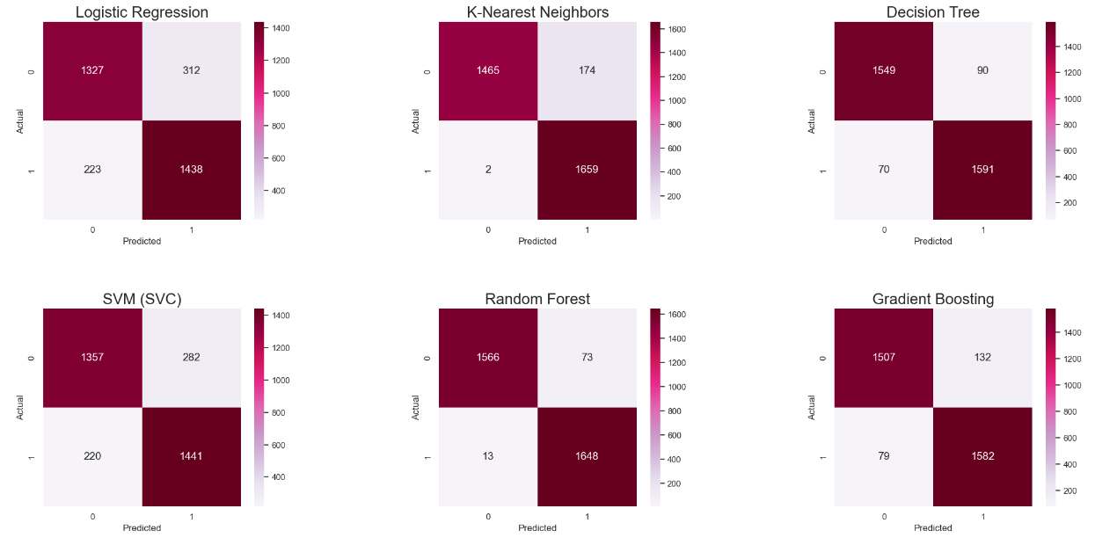
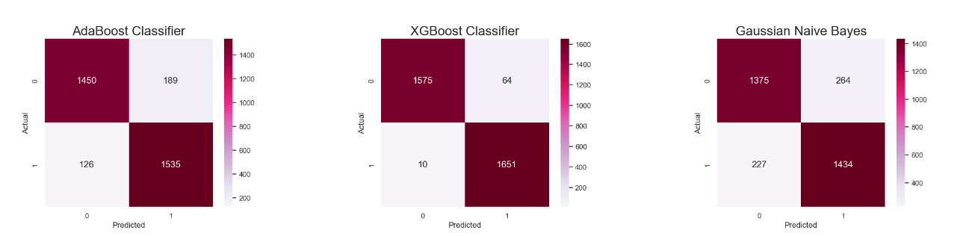
Confusion Matrix:

Slide 22
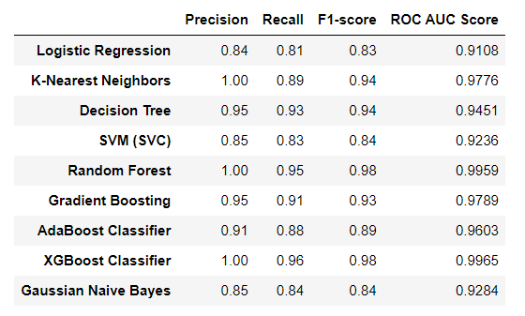
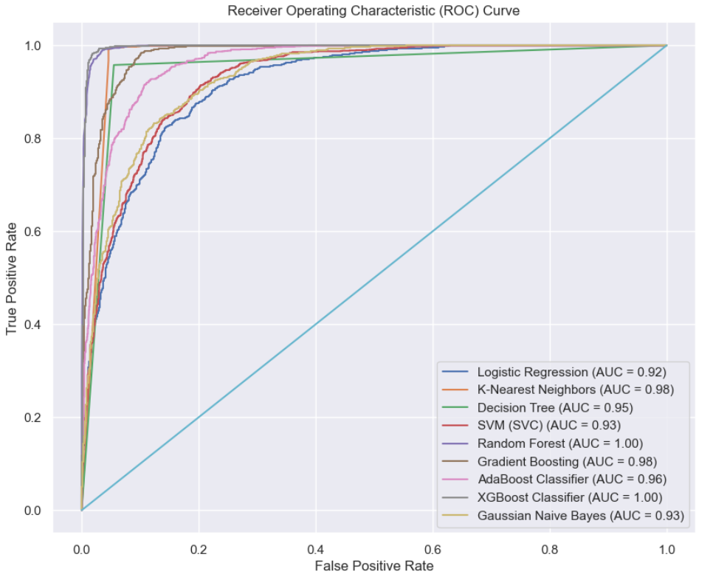
Model Metrics and ROC

Slide 23
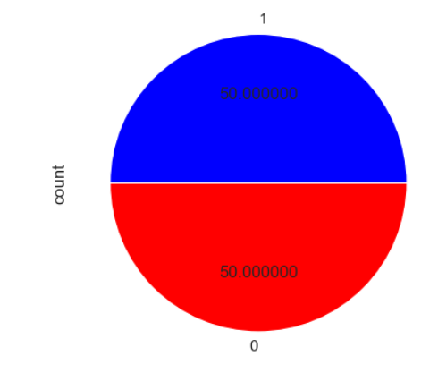
Approach-2
RFE + Undersampling
In this approach, we will use the same dataframe new_bank_df which contains feature selection from RFE and outlier capped data.
Undersampling:
Since there were just 220 positive class samples and 6599 negative class samples, I under sampled data and remove most the data from majority class to balance my dataset. After sampling the data size reduced to total of 440 samples (220 to each class). Then after splitting training and test set, I trained four machine learning models.
shape of the dataset before undersampling
(6819, 16)
shape of the dataset After undersampling
(440, 16)
Here majority class-0 is under sampled to the count of
Minor samples.

Slide 24
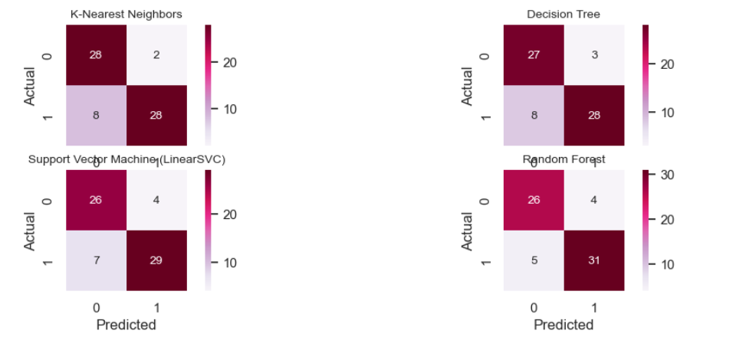
Model building(approch-2):
For this Approach I am creating 4 models, Lets trains and see the performance of the model.
Confussion matrix

Slide 25
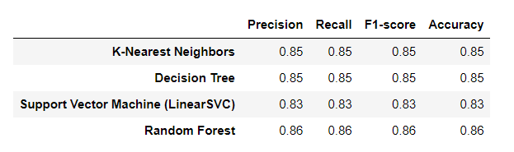
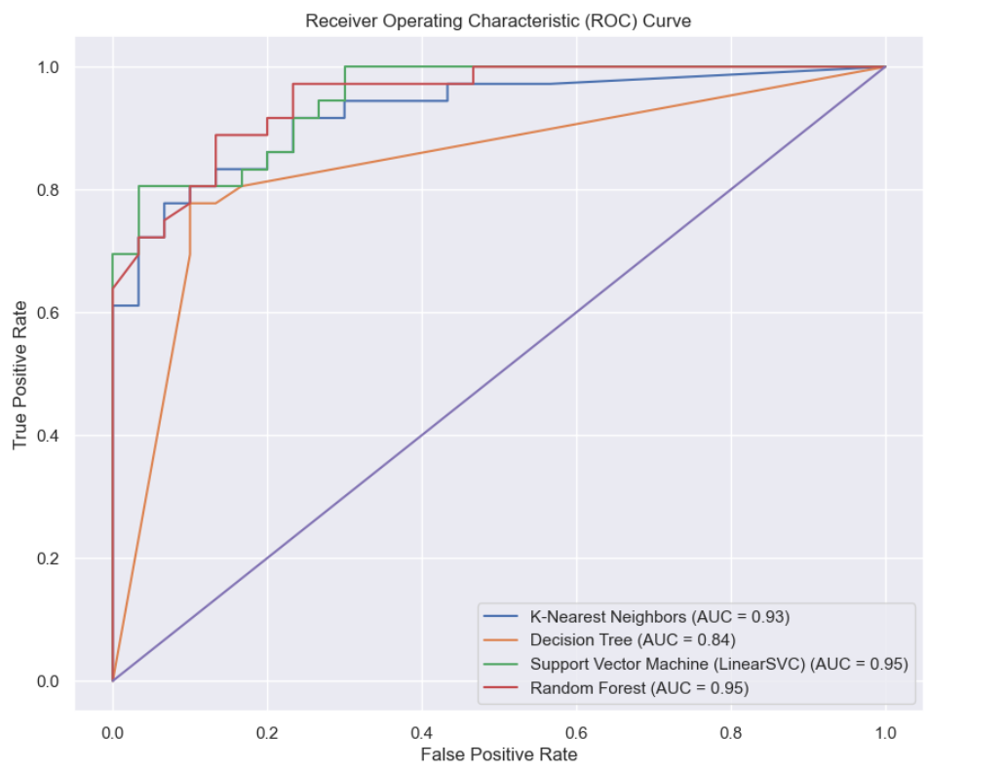
Observation in approach 2: Here we can see all the model metrics for this approach and ROC curve

Slide 26
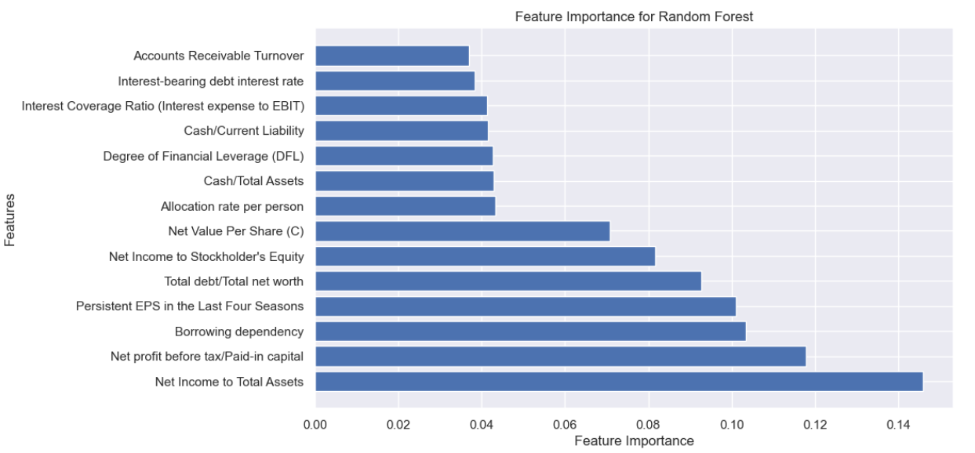
Feature Importance:

Slide 27
Approach-3
Feature Engg along with model Building
In this approach I had used the original dataset without outlier treatment and implemented smote to balance the data, then created a model.
The features are sorted in the descending order according to their model feature importance, Then dropped the features which are equal to 0.
Almost 25 features are dropped now the shape of our dataset is (6819,59)
Here I used 4 models Random forest,XGB classifier, Decission tree,SVM(svc-classifier).
When we observe previous approach it looks slightly overfitting so here I had also applied cross validation method for random forest and xgb.

Slide 28
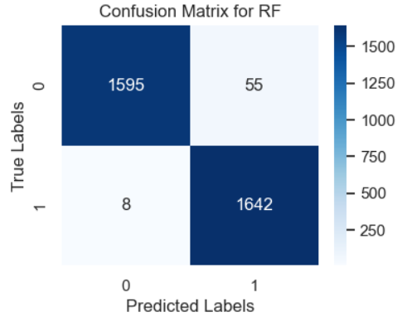

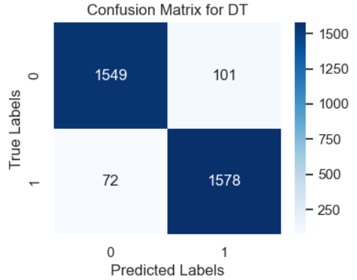
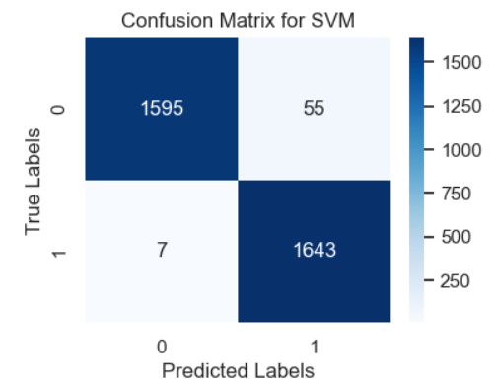
Confussion matrix: we will evaluate the model by using test data and here are the results, By using confussion matrix we can clearly understand that mostly class-1 is predicted correctly.

Slide 29
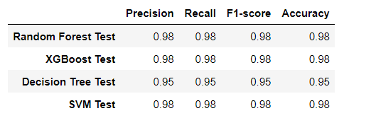
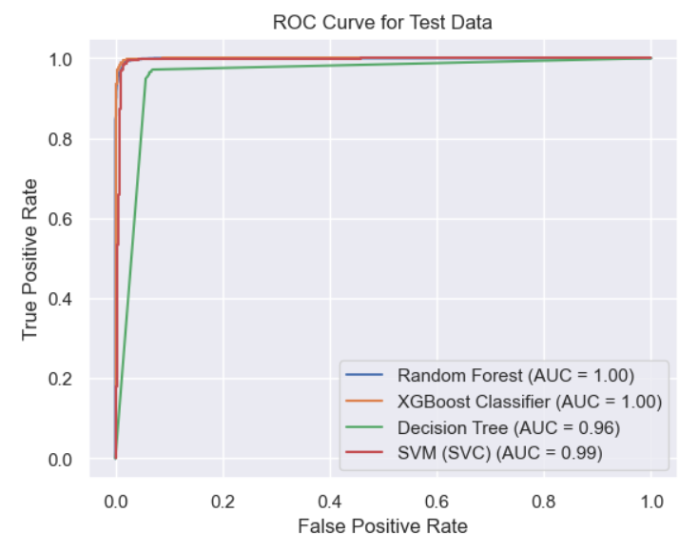
Model Results and ROC:

Slide 30
Approach-4
Deep Learning Method.
If we are not satisified with the ML model results, We can also go for Deep learning method.
Simple neural network using Kera's Sequential for binary classification the first layer (Dense) has 32 neurons and uses the ReLU activation function. And input feature is 59
The second layer (Dense) has 16 neurons with the ReLU activation function, the third layer (Dense) has a single neuron with the sigmoid activation function.
The model is compiled using the Adam optimizer, the loss function is set to binary_crossentropy.
I got the best accuracy using this deep learning model, the training accuracy is 1 and val_accuracy which is test accuracy is 0.98.

Slide 31
Observation from Features:
From Analysis these are the main features that lead to bankrupt:
Interest-bearing debt interest rate:
Interest Bearing Debt means the total amount of outstanding indebtedness of the Companies for borrowed money
When we plot this we can observe that tendency density in class-1 is increasing when the Interest Bearing Debt decreases.
Net Value Per Share(c):
This NAVPS represents the value per share of a mutual fund, ETF, or closed-end fund.
Assets include the total market value of the fund's investments, cash and cash equivalents, receivables, and accrued income. Liabilities equal total short-term and long-term liabilities.
The NAVPS is obtained by dividing the net asset value (total assets less liabilities) of a fund by the number of outstanding shares.
Persistent EPS in the Last Four Seasons:
EPS - Earning per shares
Earning per shares are company net profit divided by total outstanding shares
To found net profit per shares for company
A higher EPS indicates greater value because investors will pay more for a company's shares if they think the company has higher profits relative to its share price

Slide 32
Total debt/Total net worth:
The total debt/net worth ratio is a metric that measures how much of a company's assets are financed by debt. It is the sum of all liabilities divided by net worth.
The ratio of less than 100% is considered a good debt level. A higher percentage goes against common wisdom that suggests corporations should limit their debt below a certain amount, usually 30%.
Borrowing dependency:
This refers to the reliance of an entity (such as a company or individual) on borrowed funds to finance its operations, investments, or other activities. This reliance on borrowing can take various forms, including loans, lines of credit, bonds, or other debt instruments.
Net profit before tax/Paid-in capital:
This is a financial metric used to assess the profitability of a company relative to the amount of capital invested by its shareholders. It is calculated by dividing the net profit before tax (often referred to as pre-tax profit or earnings before tax) by the company's paid-in capital.
This ratio helps investors and analysts understand how efficiently a company is generating profits relative to the capital invested by its shareholders

Slide 33
Accounts Receivable Turnover:
This metric used to assess how efficiently a company is managing its accounts receivable, which represents the amounts owed to the company by its customers for goods or services sold on credit. The ratio measures how many times during a specific period (usually a year) a company collects its average accounts receivable balance.
A higher accounts receivable turnover ratio indicates that the company is collecting its accounts receivable more quickly, which suggests efficient management of credit sales and timely collection of payments from customers.
In this data the tendency of low accounts receivable turnover mostly lead to bankrupt.
Allocation rate per person:
It refer to the distribution of financial resources or expenses across individuals within a company or organization. This allocation could be related to budgeting, cost allocation, or compensation.
In this data we can observe the increasing allocation rate per person leads to mostly bankrupt.

Slide 34
Cash/Total Assets:
This metric used to assess the liquidity and financial health of a company. It measures the proportion of a company's assets that are held in the form of cash or cash equivalents relative to its total assets.
The Cash/Total Assets ratio provides insight into the company's liquidity position and its ability to meet short-term financial obligations. A higher ratio indicates that a larger portion of the company's assets is held in cash or readily convertible assets, which may suggest a stronger liquidity position and greater financial flexibility.
We can observe decreasing this ratio mostly leads to bankrupt
Cash/Current Liability:
This measures a company's ability to cover its short-term obligations with its available cash and cash equivalents. It evaluates the liquidity position of a company by comparing its cash holdings to its current liabilities.
The Cash/Current Liability ratio indicates the proportion of a company's current liabilities that can be covered by its available cash and cash equivalents. A higher ratio suggests that the company has sufficient liquidity to meet its short-term obligations without resorting to additional borrowing or selling assets.
This data has higher rate of this metric lead to bankruptcy because it may have reasons While the ratio may appear high, it might not provide enough coverage to meet the company's actual short-term liabilities. This could be due to aggressive expansion, poor cash flow management, or unexpected expenses that deplete available cash reserves faster than anticipated.

Slide 35
Net Income to Total Assets:
It is used to assess the profitability and efficiency of a company's asset utilization. It measures the company's ability to generate profits relative to the total assets it holds.
A higher ratio suggests that the company is generating more profit per unit of assets, indicating better profitability and asset efficiency.
In this give data when the 'Net Income to Total Asset value is decreasing there is a chance of company will go bankrupt
Net Income to Stockholder's Equity:
It is used to assess the profitability of a company relative to the equity invested by its shareholders. It measures the return on equity (ROE), indicating how effectively the company is generating profits with the capital provided by its shareholders.
A higher ratio suggests that the company is generating more profit per unit of shareholder equity, indicating better profitability and efficiency in utilizing shareholder funds.
In this given dataset, the tendency of decreasing the Net Income to Stockholder's Equity will lead to bankrupt.

Slide 36
Degree of Financial Leverage (DFL):
It is used to measures the sensitivity of a company's earnings per share (EPS) to changes in its earnings before interest and taxes (EBIT), often referred to as operating income.
A higher DFL indicates that a company's EPS is more sensitive to changes in EBIT, meaning that small changes in operating income can have a significant impact on earnings per share. This is because when a company has a higher proportion of debt in its capital structure, it typically has fixed interest payments that must be made regardless of the level of earnings. As a result, changes in operating income can have a magnified effect on net income and EPS, a lower DFL indicates that a company's EPS is less sensitive to changes in EBIT, suggesting lower financial
In this given dataset whenever the DFL values are increasing there is a chance that company will lead to bankrupt.
Interest Coverage Ratio (Interest expense to EBIT):
The Interest Coverage Ratio is a financial metric used to assess a company's ability to meet its interest payments on outstanding debt. It measures the company's ability to cover its interest expense with its earnings before interest and taxes (EBIT).

Slide 37
Summary and Conclusion:
Overall, By using these approach I can observe all are giving best Results, According to this Problem statement the metrics here we need to consider are Recall,precission,F1 score and roc as we don’t need to consider accuracy.
I observed that models based on Decision Trees, Random Forest which were trained on under sampled data performed really well.
Also Approach-1 and Approach-2 are gave best results, But it looks slightly overfitting, But the reason for this is because High imbalance data set so, we used SMOTE in these two Approaches, may be the model is trained over the noise from the smote.
But our main aim is to predict True Positives correctly, I think all the three approach are achieved this.
If a company is not going to get bankrupt but predicted as bankrupt (False Positive) then the company has no harm as such as they can improve their business even more. But if a company, which is having tendency to go bankrupt, is classified as safe then it is a risky situation as company will not take necessary steps. Therefore, it was much important to increase the True Positives even if False Positive is high. This can be seen in confusion matrices.

Slide 38
THANK YOU

