Slide 1
Empowering Financial Security Detecting Fraudulent Transactions using Advanced Machine Learning Techniques and Predictive Analytics
Presentation By -
Indrajith S.

Slide 2
Introduction
In this project, we aim to safeguard financial well-being by leveraging advanced machine learning techniques and predictive analytics to detect fraudulent transactions.
Fraud detection is paramount for financial institutions and businesses to protect assets, maintain trust, and ensure secure financial ecosystems.
It is a critical aspect of the financial industry, particularly in the realm of online transactions. With the increasing threat of fraud in digital payments, the need for robust and effective fraud detection systems has never been more pressing.

Slide 3
Problem Statement
Develop a machine learning model to detect potentially fraudulent transactions based on the provided features. The dataset contains information about various transactions, including account age, payment method, time of transaction, and category. The goal is to build a classification model that can accurately classify transactions as either legitimate or potentially fraudulent.

Slide 4
Table of Content:
1. Understanding the Data
2. Data Pre Processing
3. Handling Imbalance data
4. Model Selection
5. Model Training
6. Model Evaluation

Slide 5
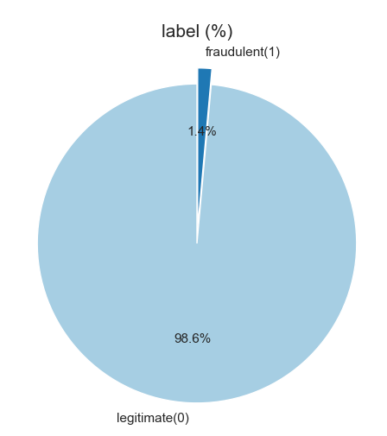
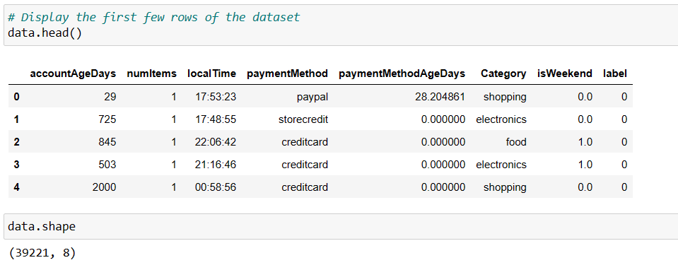
Project Journey
1. Understanding the Data
2. Data Pre Processing
3. Handling Imbalance data
4. Model Selection
5. Model Training
6. Model Evaluation
Key features include account age, payment method, time of transaction, and category.
The 'label' indicates whether a transaction is fraudulent(1) or legitimate(0).

Slide 6
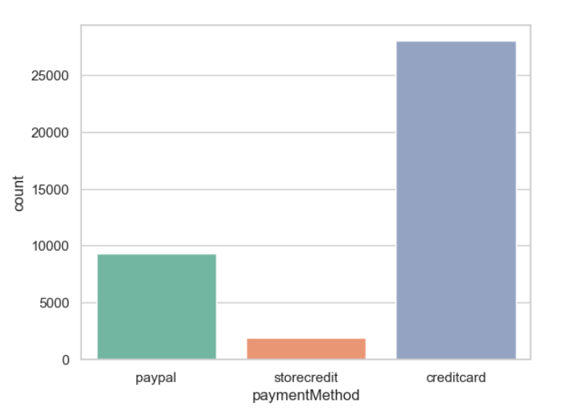
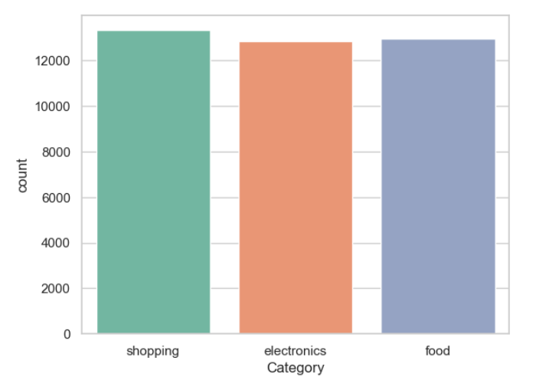
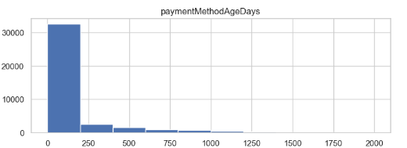
Project Journey
1. Understanding the Data
2. Data Pre Processing
3. Handling Imbalance data
4. Model Selection
5. Model Training
6. Model Evaluation
We can clearly understand that the data is imbalance, Will handle the imbalanced dataset.
Also we will encode the categorical variables for more understanding.

Slide 7
1. Understanding the Data
2. Data Pre Processing
3. Feature Engineering
4. Model Selection
5. Model Training
6. Model Evaluation
We cleaned and prepared the dataset for analysis.
Any missing data points were addressed to ensure data integrity.
Categorical variables were transformed into numerical format for machine learning.
There are missing values in 2 columns Category(95) and isWeekend(560) total 655 values are missing.
The column isWeekend is in float dtype, we will change into int data type and fill with the Mode of that column

Slide 8
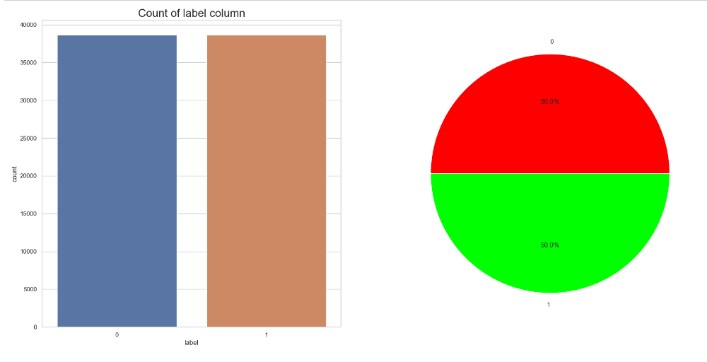
1. Understanding the Data
2. Data Pre Processing
3. Handling Imbalance data
5. Model Training
6. Model Evaluation
4. Model Selection
This data is highly imbalanced as we can see class-0 is 38661- legitimate,where class-1 is 560- Fraudulent.
So we are using upsampling technique to balance the data,After upsampling we can clearly see that both the class-1 and class-0 are in same numbers.

Slide 9
1. Understanding the Data
2. Data Pre Processing
3. Handling Imbalance data
4. Model Selection
5. Model Training
6. Model Evaluation
Created a multiple machine learning model like "Logistic Regression“,"K-Nearest Neighbors“, "Decision Tree“ , "Random Forest“ , "Gradient Boosting“ , "AdaBoost Classifier“ and "XGBoost Classifier“ to see which model is performing well.
Among all these except Logistic Regression and K-Nearest Neighbors models all other are performing well.
But looks like a overfitting model, So I had performed cross-validation method.
I am interested in Random forest model, So performed hyper-parameter tuning, The results are well when compared to all other models, Specific hyperparameters were tuned to optimize model performance.

Slide 10

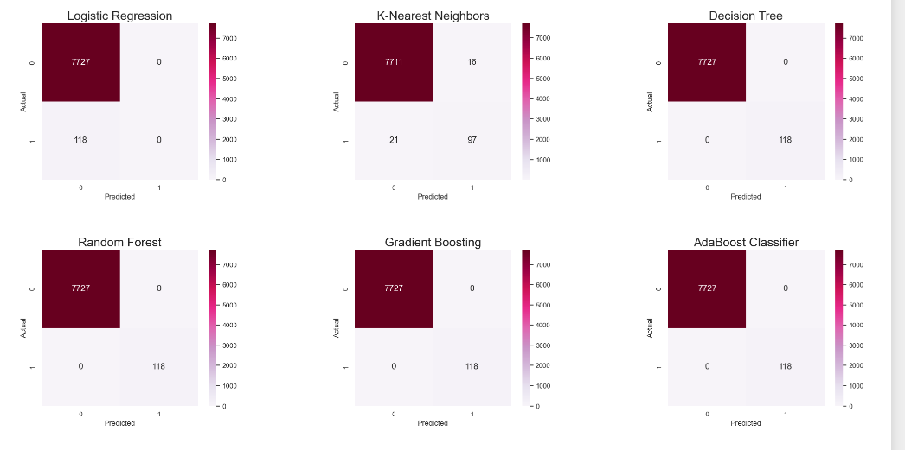
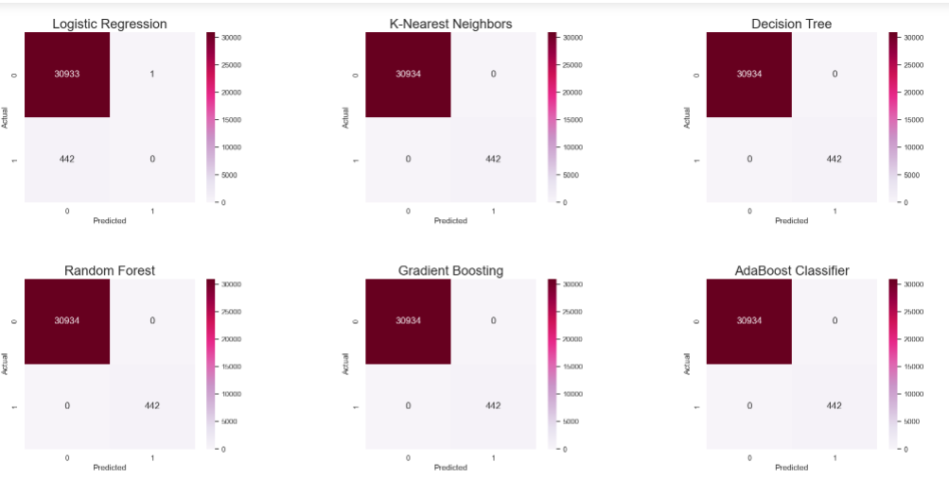
1. Understanding the Data
2. Data Pre Processing
3. Handling Imbalance data
4. Model Selection
5. Model Training
6. Model Evaluation
Test Data
Train Data

Slide 11
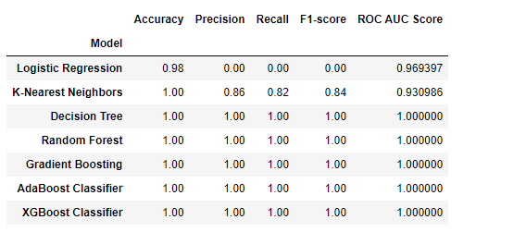
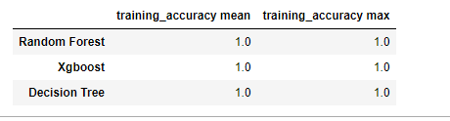
Project Journey
1. Understanding the Data
2. Data Pre Processing
3. Handling Imbalance data
4. Model Selection
5. Confussion matrix
6. Model Evaluation
We evaluated the model using a range of performance metrics, including accuracy, precision, recall, F1-score, and AUC.
Evaluation metrics for all the models For Cross validation

Slide 12
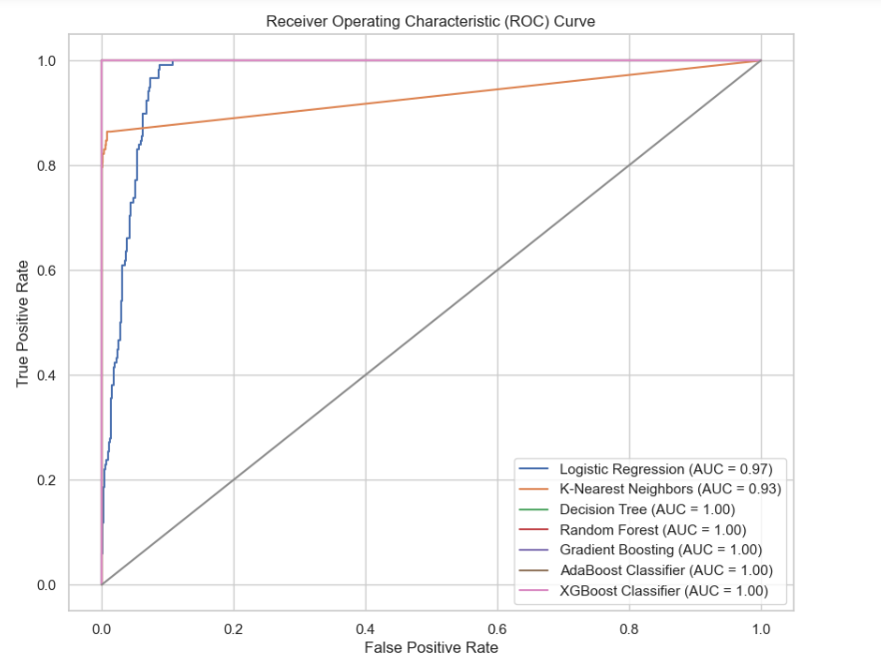
ROC CURVE FOR ALL MODELS

Slide 13
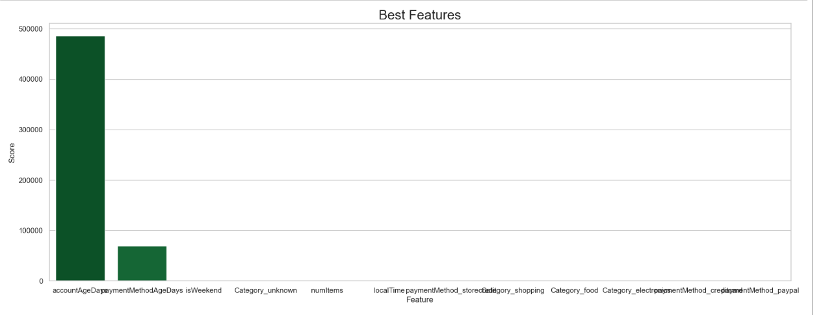
FEATURE IMPORTANCE

Slide 14
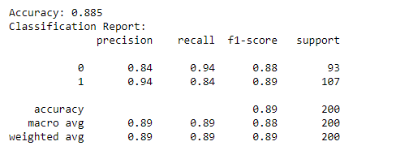
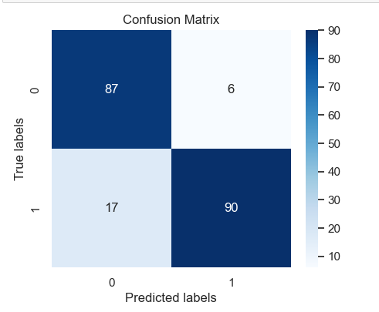
Hyper Parameter Tuning
For more accuracy I tried to build a random forest model with hyper parameter tuning, Which performs well for this dataset.
These confussion matric and classification report shows the performance after hyperparameter tuning.

Slide 15
Key Insights
The main observations or insights derived from the analysis of model performance are, if the column name accountAgeDays paymentMethodAgeDays are 1, Definitely that would be a fraudulent.
From this 39221 rows of this dataset, the above mentioned two columns are main reason that the transaction would be fraud.
The PaymentMethod Creditcard and PayPal having high tendency for the fraud transaction when compared to storecredit.
The storecredit payment method registered are very low to have a fraud transactions.
There is a high tendency that the fraud transactions are mostly happened in Weekend.

Slide 16
Conclusion
In this payment fraud detection project, we followed a structured approach that encompassed understanding the data, preprocessing it,selecting a suitable model, training it, and rigorously evaluating its performance.
The model achieved a 100% accuracy in identifying payment fraud. The model's performance results show a sign of some error, like overfitting; that is, the model learns the characteristics of the training set so specifically that looks like overfitting, But we got a best results after hyper parameter tuning.

Slide 17
T H A N K Y O U

