Slide 1
Application of High-Performance Compute to Singular Value Decomposition
CSI 703
2 May 2022

Slide 2
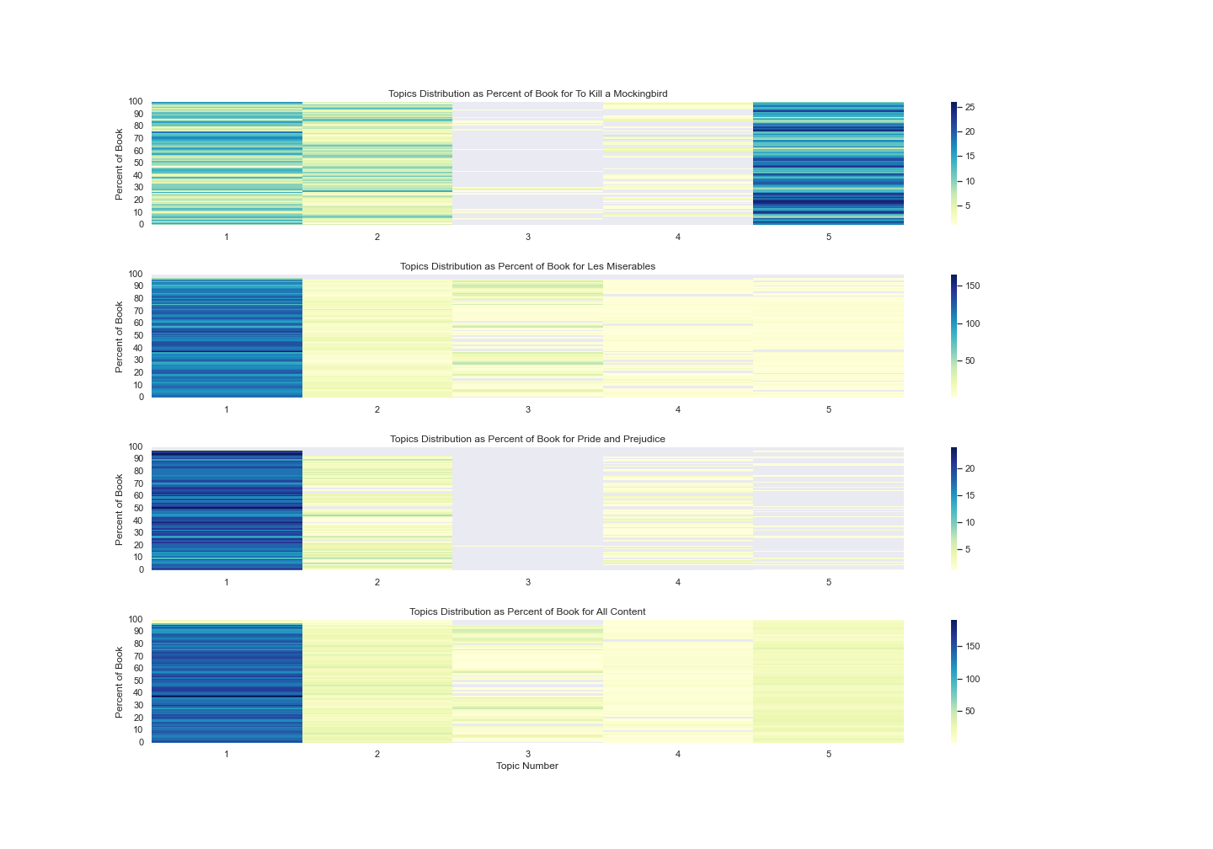

Slide 3
