Slide 1


Smart Home Energy Management System
PRESENTED BY
JIYA JAIN
Notes:
1

Slide 2
System Modules Overview
1
2
Authentication and Role Management
Smart Device Management
This module handles user authentication and authorization, ensuring secure access to the system.
Manages the integration and control of various smart home devices.
UserAuthController
AuthService
UserRepository
Device
DeviceController
DeviceService
DeviceRepository
3
4
Real Time Energy Tracking
Analytics Dashboard
Provides continuous monitoring and logging of energy usage data from connected devices.
Presents energy consumption patterns and system performance through interactive visualizations.
UsageLog
EnergyTrackingController
EnergyTrackingService
UsageRepository
AnalyticsController
AnalyticsService
ChartGenerator
AnalyticsRepository
5
6
Scheduling and Automation
Recommendation System
Enables users to set schedules and create automated rules for device operation to optimize energy use.
Offers personalized suggestions for energy saving based on usage data and learned preferences.
Schedule
SchedulerController
SchedulerService
NotificationService
SchedulerRepository
Recommendation
RecommendationController
RecommendationService
Notes:
2

Slide 3
Module 1: Authentication & Role Management
Ensures secure system access by managing user authentication and roles.
Here are the core classes and their responsibilities:
🧑‍💻 UserAuthController
⚙️ AuthService
🗄️ UserRepository
Handles login and registration requests
Receives user credentials from the frontend
Sends requests to the service layer
Validates user credentials
Handles authentication logic
Manages role-based access control
Communicates with the database
Stores and retrieves user details
Supports authentication operations
Notes:
3

Slide 4
Module 2: Smart Device Management
This module provides the essential framework for managing and controlling various smart home devices, ensuring seamless integration and user control within the system.
Purpose
Main Components
Manage all smart home devices
DeviceController
DeviceService
DeviceRepository
Device (Model)
Key Functions
Allow users to control devices (ON/OFF)
Maintain real-time device status
Add, Update, and Delete devices
Fetch list of devices
Control device operations
Store and update device configurations
Outputs
Real-time device status updates
Comprehensive device list for dashboards
Notes:
4

Slide 5


System Workflow & Process Flow
This diagram illustrates the core interactions within the system, from user actions to automated suggestions.
Step 1: User Login
Step 2: Device Control
Step 3: Usage Recording
User logs in (Module 1 validates access).
User turns ON a device (Module 2 executes action).
Device usage is recorded (Module 3).
Step 4: Data Analysis
Step 5: Automation/Suggestion
Usage data is analyzed (Module 4).
Automation or suggestion is generated (Module 5 & 6).
Supporting System Roles
User Action Hub
Energy Data Source
Automation Enabler
Decision Driver
All device operations start here.
Direct interaction with appliances.
Generates device-level usage data.
Foundation for energy tracking.
Device state enables scheduling.
Supports automatic ON/OFF.
Usage data feeds analytics.
Enables smart recommendations.
Notes:
5

Slide 6
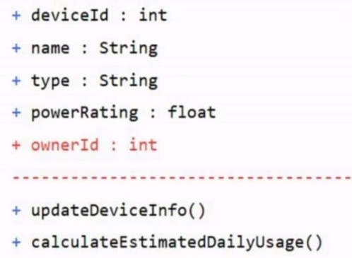
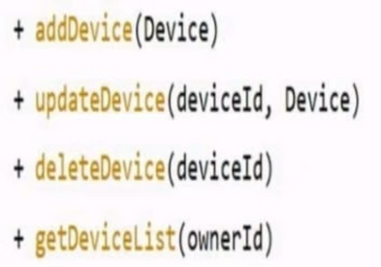
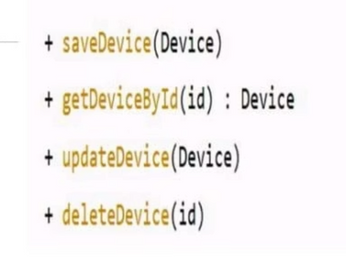
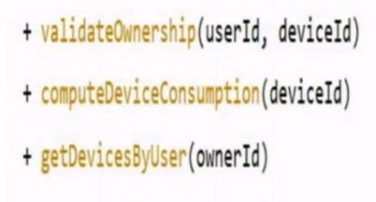
Module 2: Class Diagrams & Architecture
DEVICE
DEVICECONTROLLER
Handles requests to interact with devices, translating user commands into device-specific actions.
Represents the physical or virtual smart home device, encapsulating its state and core functionalities.
DEVICEREPOSITORY
DEVICESERVICE
Manages the storage, retrieval, and persistence of device data within the system's database.
Orchestrates business logic related to devices, coordinating between the controller and repository layers.
Notes:
6

Slide 7
Module 2: Class Activity Flow & Interaction
01
02
03
User Interaction & Controller Layer
Service Layer
Repository Layer & Response
The DeviceService orchestrates business logic:
The DeviceRepository manages data persistence:
The authenticated user selects a smart device and requests an action (ON/OFF or configuration change).
Applies relevant business rules.
Updates the device's operational state.
Calculates the impact on power usage.
Stores the updated device state.
Persists the configuration in the database.
The DeviceController accepts the request.
It validates the user session (from Module 1).
Forwards the request to the service layer.
Finally, the updated device status is sent to the dashboard, providing the user with real-time feedback.
Notes:
7

Slide 8
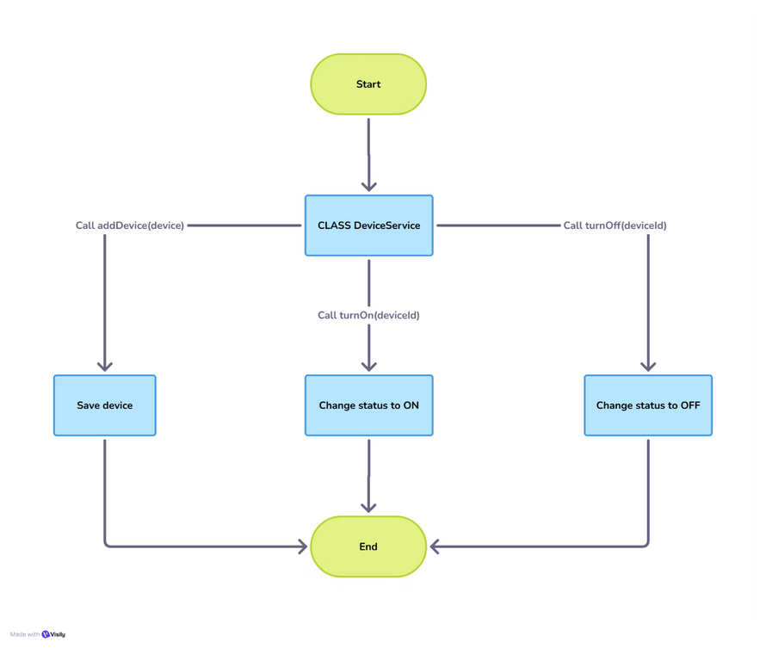
Module 3: Real Time Energy Tracking
This module is designed to provide comprehensive, real-time visibility into energy consumption across all integrated smart devices. It continuously collects data, processes it, and presents it through an intuitive dashboard.
Key functionalities include:
Live Data Feed: Continuous aggregation of energy usage from devices.
Usage Visualization: Interactive charts and graphs to identify consumption patterns.
Anomaly Detection: Alerts for unusual spikes or drops in energy, indicating potential issues or optimizations.
Performance Metrics: Calculation of energy efficiency and cost savings based on device operation.
By offering immediate insights, Module 3 empowers users to make informed decisions for energy optimization and cost reduction.
Notes:
8

Slide 9
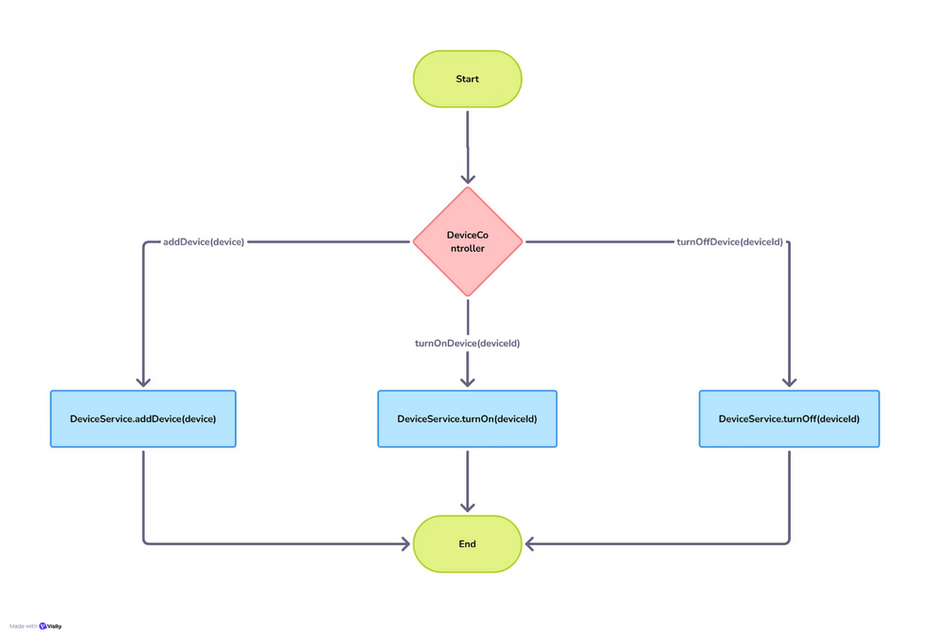
Module 4: Analytics Dashboard
This module provides advanced analytical tools designed to transform raw energy data into actionable insights. It empowers users to dive deeper into consumption patterns, predict future trends, and generate comprehensive reports for strategic decision-making.
Key capabilities include:
Customizable Dashboards: Tailor your view with personalized widgets and data displays for focused analysis.
Predictive Analytics: Utilize sophisticated algorithms to forecast future energy consumption based on historical data and external factors.
Comprehensive Reporting: Generate detailed and customizable reports on energy usage, cost, and efficiency over specified periods.
Performance Benchmarking: Compare your energy performance against industry standards, internal targets, or past operational periods.
By leveraging these powerful analytical features, Module 4 enables proactive energy management, identifies opportunities for optimization, and supports significant operational improvements.
Notes:
9

Slide 10
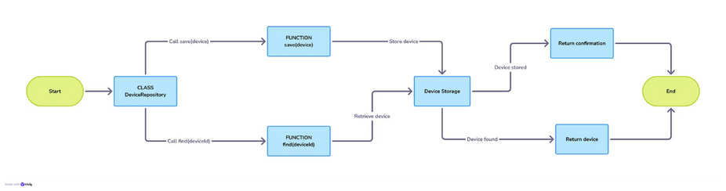
Module 5: Scheduling & Automation
This module focuses on optimizing energy operations through advanced scheduling and automation capabilities. It allows users to create automated tasks, set up intelligent rules, and schedule actions for various energy systems to maximize efficiency and reduce manual intervention.
Key functionalities include:
Automated Task Creation: Define and implement custom automation rules based on real-time data, schedules, or events.
Rule-Based Orchestration: Set up sophisticated "if-then" scenarios to trigger actions across integrated energy devices and systems.
Calendar-Based Scheduling: Plan and execute energy-related operations and routines according to predefined calendars and recurring events.
Notification and Alert System: Configure automated alerts for critical events, anomalies, or performance deviations to ensure prompt response.
This module streamlines energy management workflows, enhances system responsiveness, and drives significant operational savings by minimizing human error and maximizing system uptime.
Notes:
10

Slide 11
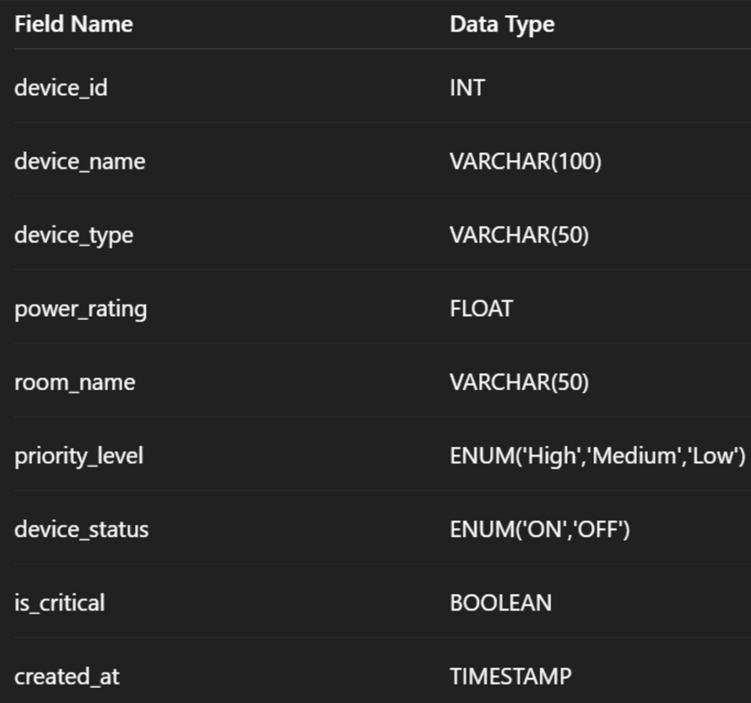
Module 6: Recommendation System
This module introduces an intelligent Recommendation System designed to provide actionable insights for optimizing energy consumption and operational efficiency. By leveraging advanced analytics and machine learning, it helps users make informed decisions to reduce costs and improve sustainability.
Key functionalities include:
Data-Driven Insights: Analyze historical and real-time energy data to identify patterns and predict future usage.
Optimization Suggestions: Offer tailored recommendations for adjusting schedules, device settings, and operational workflows to maximize energy savings.
Predictive Maintenance: Alert users to potential equipment malfunctions before they occur, suggesting timely maintenance to prevent downtime.
Performance Benchmarking: Compare current energy performance against industry best practices and similar facilities to highlight areas for improvement.
Notes:
11

Slide 12
Thank You!
Notes:
12

