Slide 1

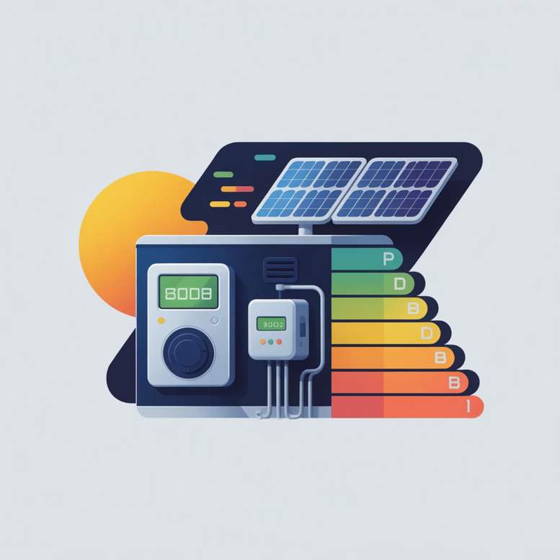
SMART HOME ENERGY MANAGEMENT
Jiya Jain
Notes:
1

Slide 2






modules
what is SHEMS?
The Smart Home Energy Management System (SHEMS) is a Java-powered web platform designed to monitor, analyze, and manage energy usage within a household. It continuously observes electricity consumption, estimates upcoming usage patterns, and provides guidance to lower overall power costs, all accessible through an interactive dashboard.
Authentication & Role Management
Secure user access
Manage user roles and permissions
Smart Device Management
Integrate and control smart devices
Manage device settings and configurations
Real Time Energy Tracking
Monitor live electricity consumption
Track and log usage patterns
Analytics Dashboard
Visualize energy data with charts
Identify peak consumption periods and cost projections
Scheduling & Automation
Automate device actions
Set energy-saving schedules and notifications
Recommendation System
Provide personalized energy-saving tips
Suggest cost reduction strategies
Notes:
2

Slide 3
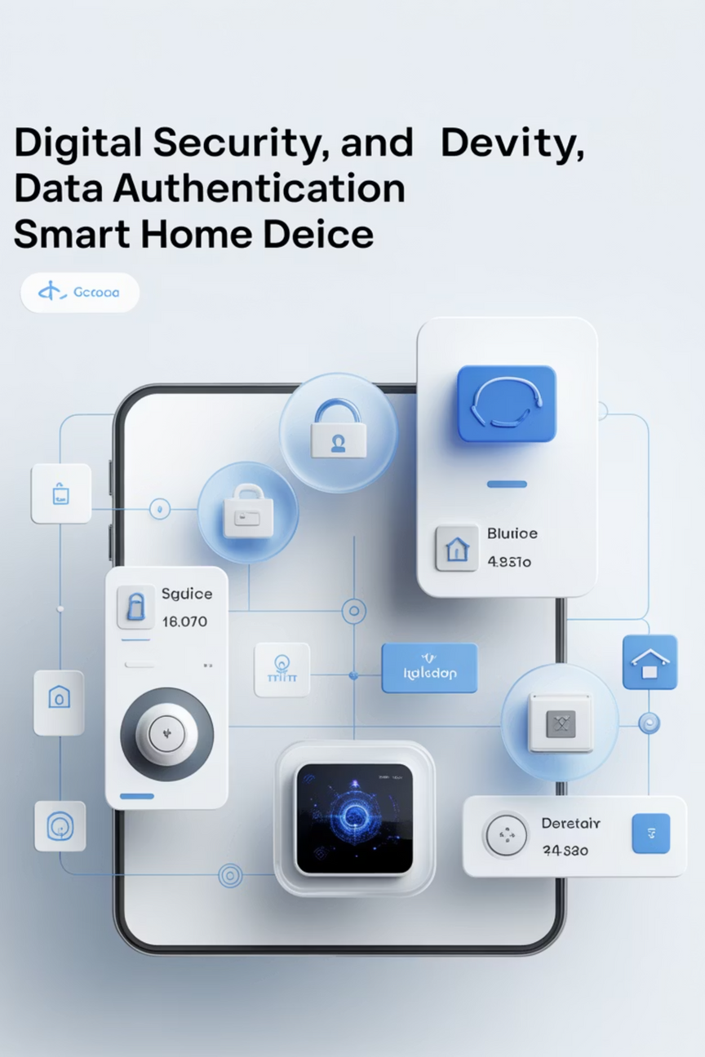

A quick review
MODULE 1: Authentication & Role Management
Handles secure user login and registration.
Validates user credentials and enforces role-based access control.
Ensures only authorized users can access system features.
MODULE 2: Smart Device Management
Manages all smart home devices.
Accepts and processes device control requests.
Maintains real-time device status (ON / OFF).
Integrates with Module 1 for secure device access.
Notes:
3

Slide 4
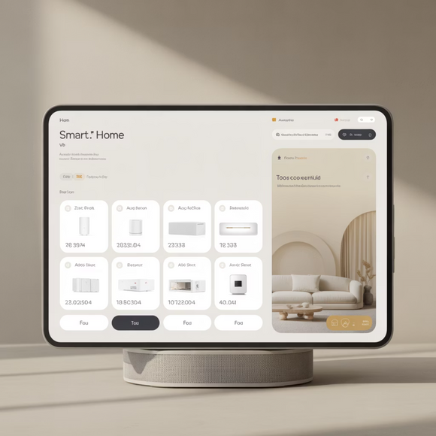
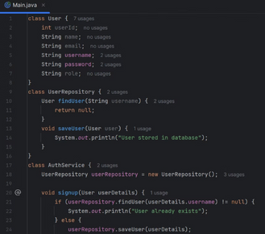
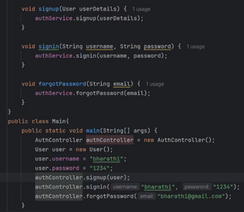
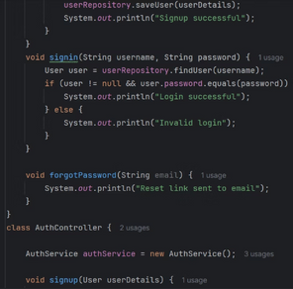

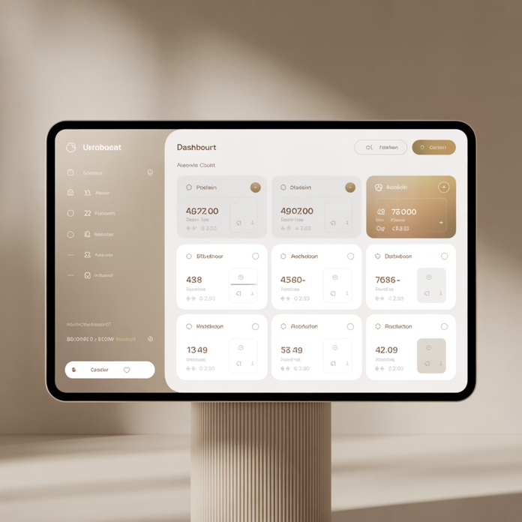
MODULE 1: Authentication & Role Management
MODULE 2: Smart Device Management
Handles secure user login and registration.
Validates user credentials and enforces role-based access control.
Ensures only authorized users can access system features.
Manages all smart home devices.
Accepts and processes device control requests.
Maintains real-time device status (ON / OFF).
Integrates with Module 1 for secure device access.
Notes:
4

Slide 5

Module 3: Classes & Their Responsibilities
UsageLog
UsageRepository
Represents the data model for energy usage.
Stores and retrieves energy usage data from the database.
Stores device ID, timestamp, duration, and power usage.
Maintains consistency of energy records.
EnergyTrackingController
EnergyTrackingService
Receives energy tracking requests from the system.
Calculates energy consumption based on device usage.
Acts as the entry point for energy tracking operations.
Applies business logic and prepares data before saving.
Notes:
5

Slide 6
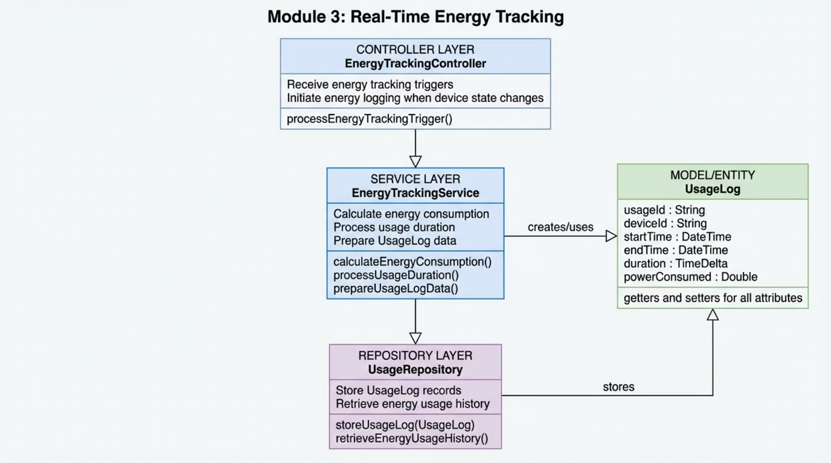
WORK FLOW
Module 3 – Working Flow
Device state changes in Module 2
EnergyTrackingController receives tracking trigger
EnergyTrackingService calculates energy usage
UsageLog object is created
UsageRepository saves data
Data is available for analytics and dashboard
Notes:
6

Slide 7
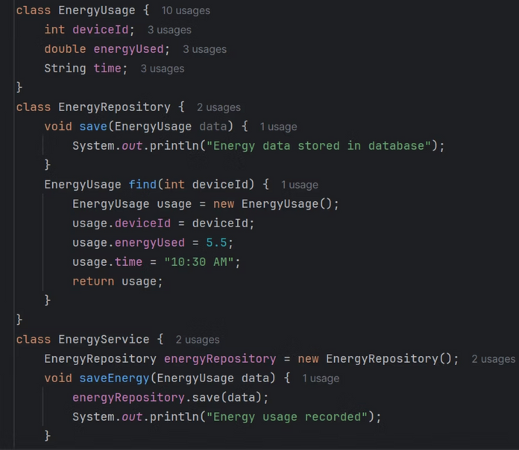
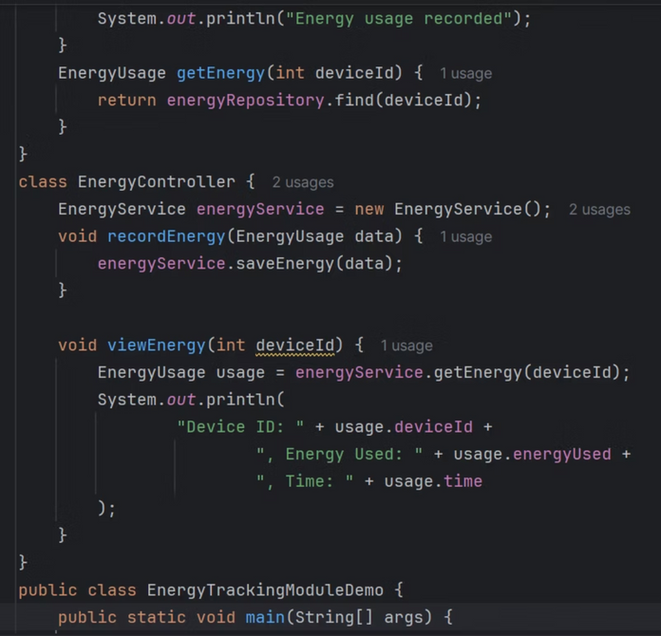
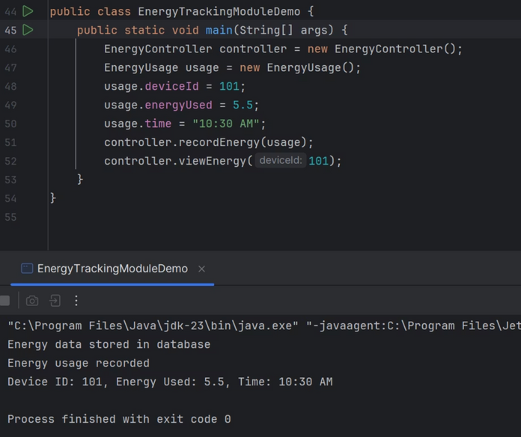
functioning of module 3
Notes:
7

Slide 8
Thankyou
Notes:
8

