Slide 1

SMART HOSTEL ENERGY MANAGEMENT
Jiya Jain
Notes:
1

Slide 2
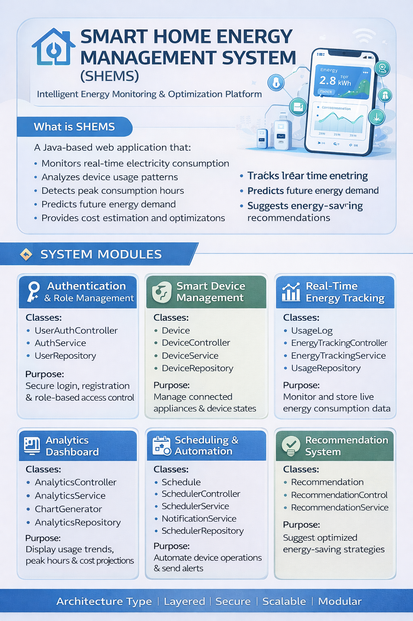

Notes:
2

Slide 3
KEY FEATURES BY MODULE
MODULE 1: AUTHENTICATION & ROLE MANAGEMENT
MODULE 2: SMART DEVICE MANAGEMENT
Handles secure user login and registration.
Validates user credentials.
Enforces role-based access control.
Stores and retrieves user details.
Separates responsibilities using Controller–Service–Repository layers.
Ensures only authorized users can access system features.
Manages all smart home devices.
Accepts device control requests.
Applies business logic for device operations.
Updates and stores device data.
Maintains real-time device status (ON / OFF).
Integrates with Module 1 for secure device access.
Notes:
3

Slide 4
MODULE 3: REAL-TIME ENERGY TRACKING
MODULE 4: ANALYTICS DASHBOARD
📊 USAGELOG
📊 ENERGY USAGE ANALYSIS
Stores device-wise energy usage data
Calculates total, daily, and monthly energy consumption
Maintains timestamp and power consumption details
📈 TREND VISUALIZATION
⚙️ ENERGYTRACKINGSERVICE
Displays usage trends using charts and graphs
Calculates energy usage
💰 COST ESTIMATION
Applies business logic before saving data
Estimates electricity cost based on energy usage
🎮 ENERGYTRACKINGCONTROLLER
🏢 HIGH CONSUMPTION IDENTIFICATION
Handles energy tracking requests
Identifies rooms or devices with high energy usage
Logs usage when device state changes
🔐 SECURE ACCESS
🗄️ USAGEREPOSITORY
Provides analytics access only to authorized admins
Saves and retrieves energy usage records
Ensures data consistency
Notes:
4

Slide 5
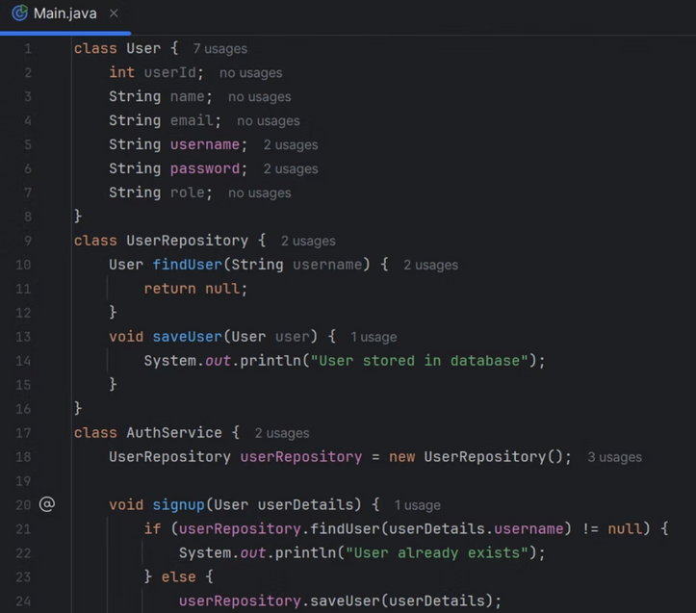
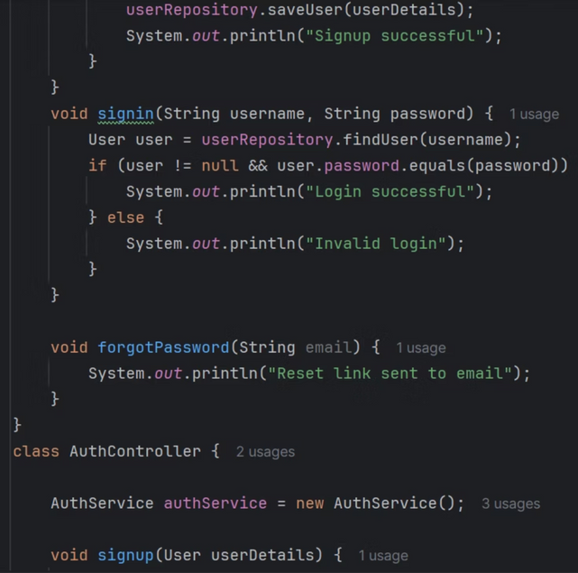
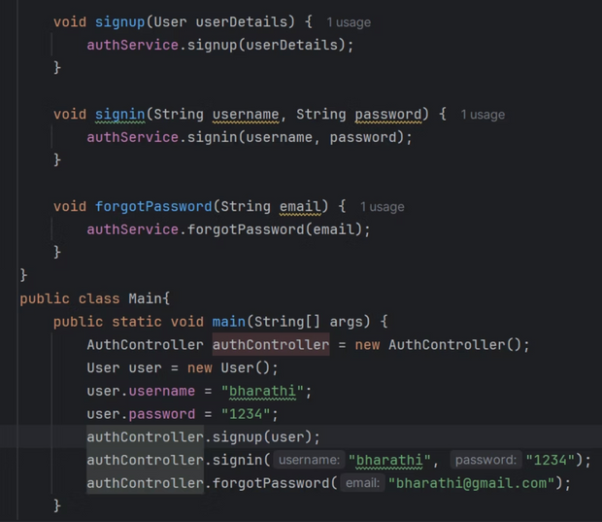
MODULE 1
Notes:
5

Slide 6
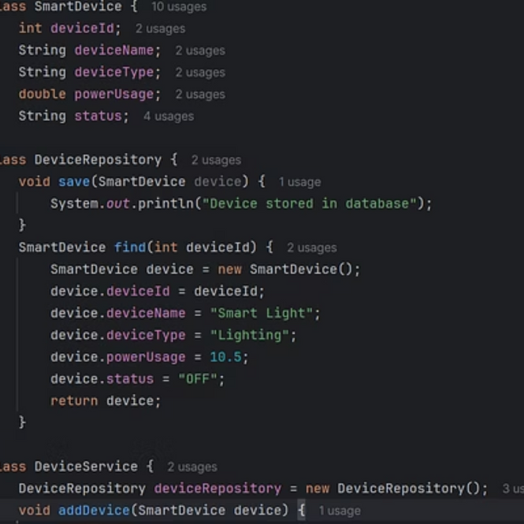
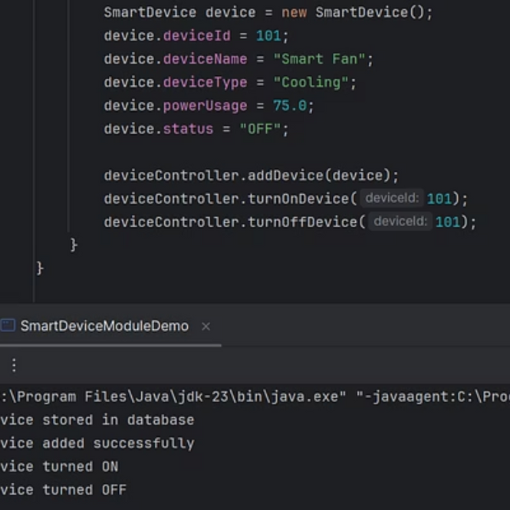
MODULE 2
Notes:
6

Slide 7
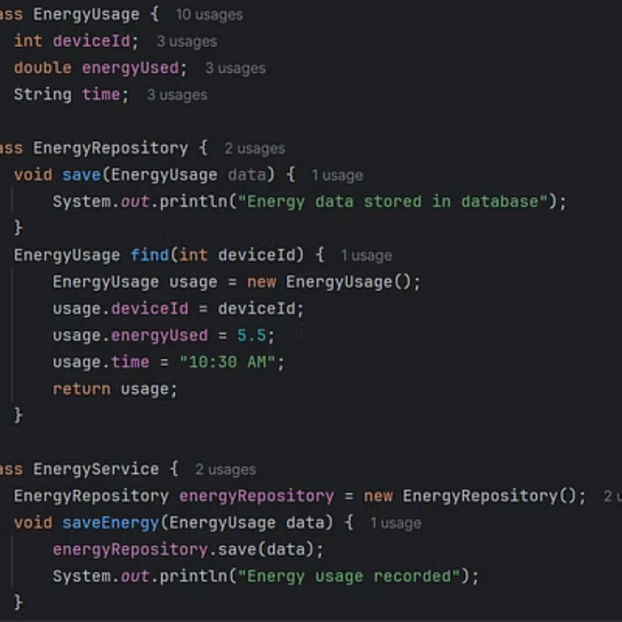
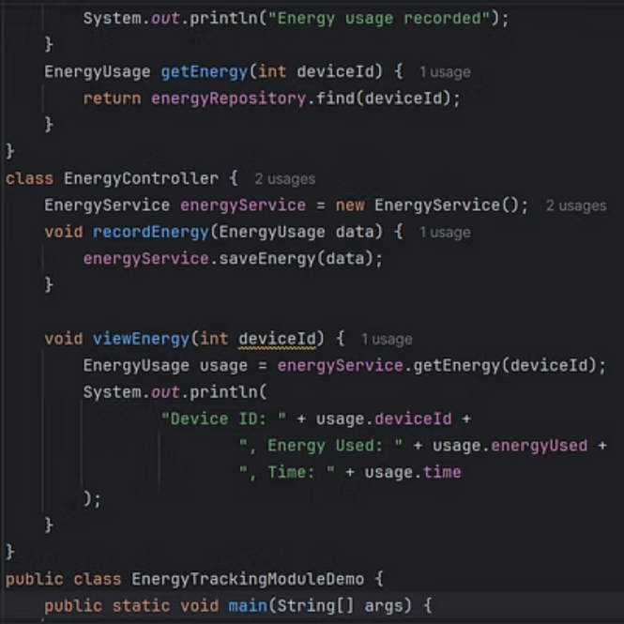
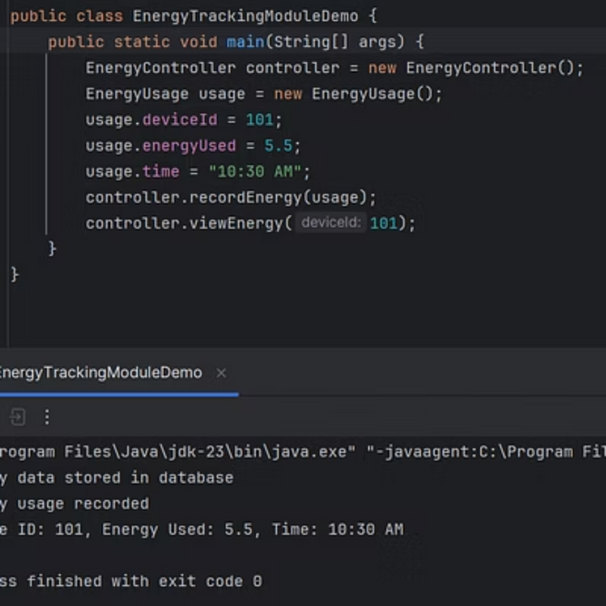
FUNCTIONING OF MODULE 3
Notes:
7

Slide 8
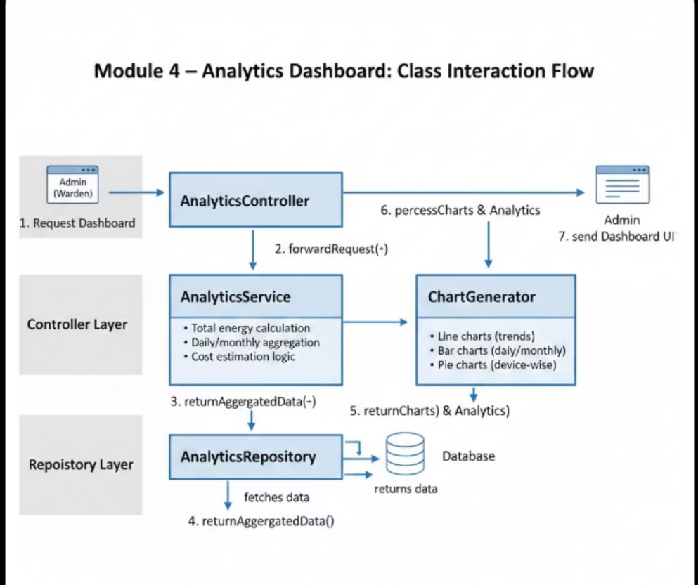
CLASSES & THEIR RESPONSIBILITIES
📊 ANALYTICSCONTROLLER
⚙️ ANALYTICSSERVICE
🗄️ ANALYTICSREPOSITORY
📈 CHARTGENERATOR
Handles analytics dashboard requests
Processes and analyzes energy usage data
Retrieves energy usage data from the database
Converts analytical data into visual charts
Acts as the entry point for analytics operations
Calculates totals, trends, and summaries
Supports filtered and aggregated queries
Generates graphs for better data interpretation
Notes:
8

Slide 9
WHY ANALYTICS DASHBOARD IS NEEDED?
Problem Without Analytics:
Raw energy data is difficult to interpret.
No visibility into high-consumption rooms or blocks.
Decision-making is manual and inaccurate.
Solution with Analytics Dashboard:
Converts usage data into visual insights.
Helps identify wastage patterns.
Enables data-driven energy management.
INPUT TO ANALYTICS DASHBOARD
Data Sources:
Energy usage data from Module 3
Device details from Module 2
User roles from Module 1
Input Type:
Device ID
Timestamp
Power consumption
Usage duration
OUTPUT OF ANALYTICS DASHBOARD
Dashboard Displays:
Total energy consumed (kWh)
Daily energy usage
Monthly consumption trend
Active vs inactive devices
MAIN CLASSES:
AnalyticsController
AnalyticsService
AnalyticsRepository
ChartGenerator
Notes:
9

Slide 10
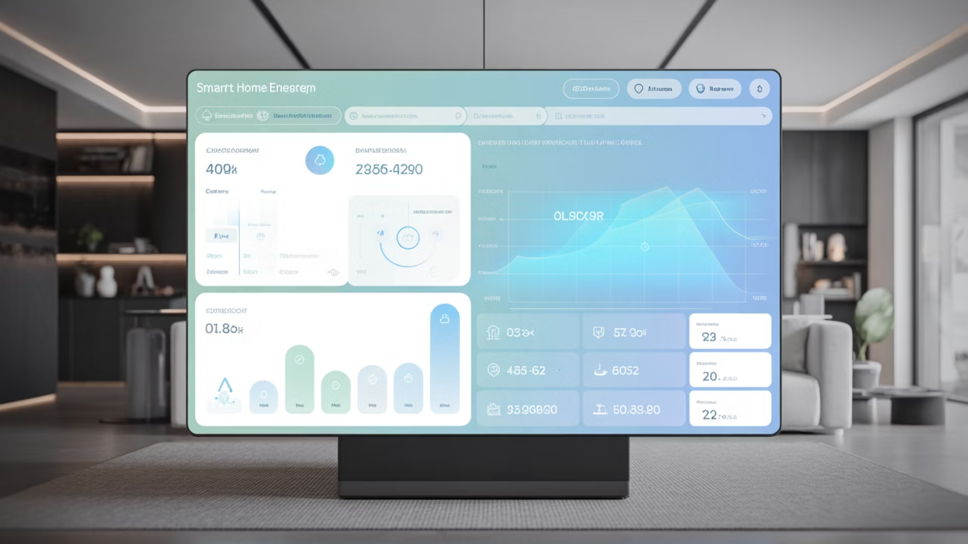

THANK YOU
Notes:
10

